Slide 1
Wine traceability in Chile

Slide 2
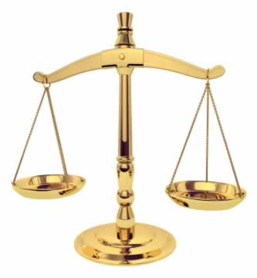
Chilean Wine Regulation
Law N° 18,455 of 1985 lays down rules for production, processing and trade of ethyl alcohol, alcoholics beverages and vinegars.
Decree N° 78 of 1986, which regulates Law N°18.455
The Agriculture Decree N° 464 of 1994 lays down viticultural zoning and provides detailed rules for their use.
The Decree N° 521 of 1999, lays down detailed rules for the designation of origin pisco.
The control and supervision of compliance with laws and regulations, depend on the Agricultural and Livestock Service oficial body of the Ministry of Agriculture.

Slide 3
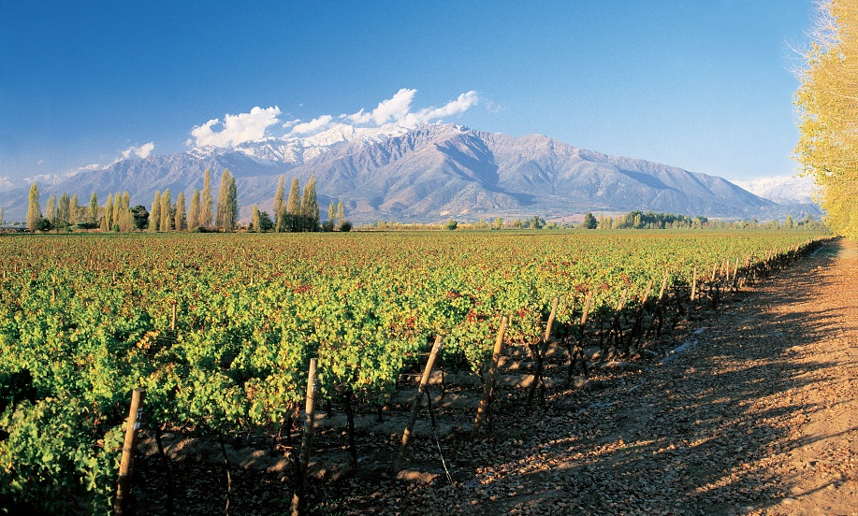
Agricultural & Livestock Service is responsible for ensure the authenticity and safety of wines and alcoholic beverages that are produced, traded exported and imported into the country, through the compliance of the regulatory requirements and controls of these products to prevent fraud or risk health to consumers.
The Agricultural & Livestock Service set out the regulation and controls to the protection of GI for wines, and certifies this condition in export products according to the requirements of the destination markets.

Slide 4
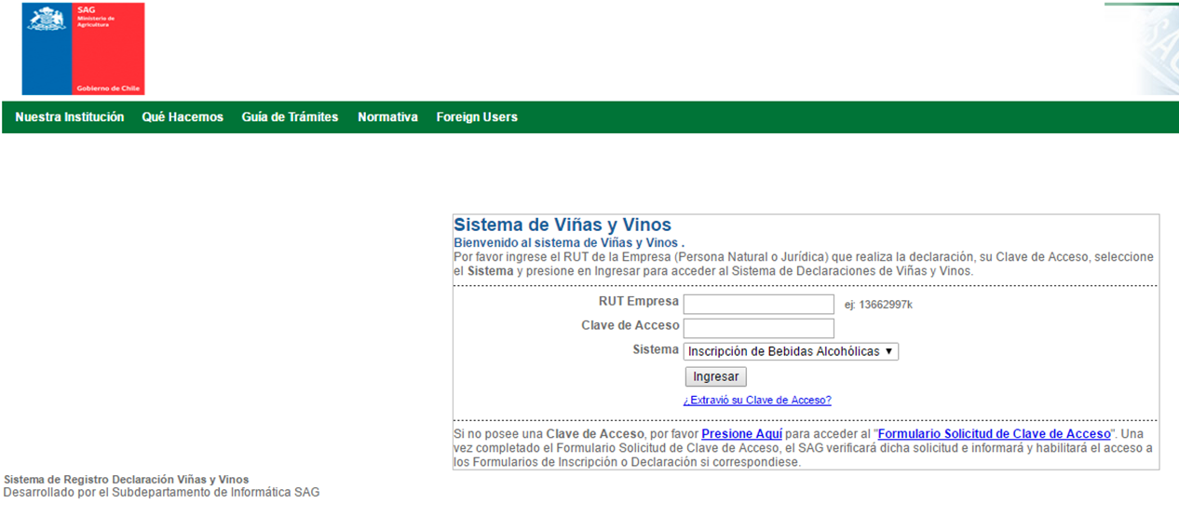
Traceability in alcoholics beverages
Every producer, exporter or importer of alcoholics beverages must to be registered in the Agricultural and Livestock Service records in order to trade his products, therefore every alcoholic beverage to be traded in the Chilean market, must to be registered in this record.
The bottle and or the label of any alcoholic beverage must to contain information related with the lot or batch of the product and the name and address of the producer (importer) to be traded in the Chilean market.
Register of alcoholics beverages is made online by users through the link
http://svyv.sag.gob.cl/insc_dec/Login.aspx

Slide 5
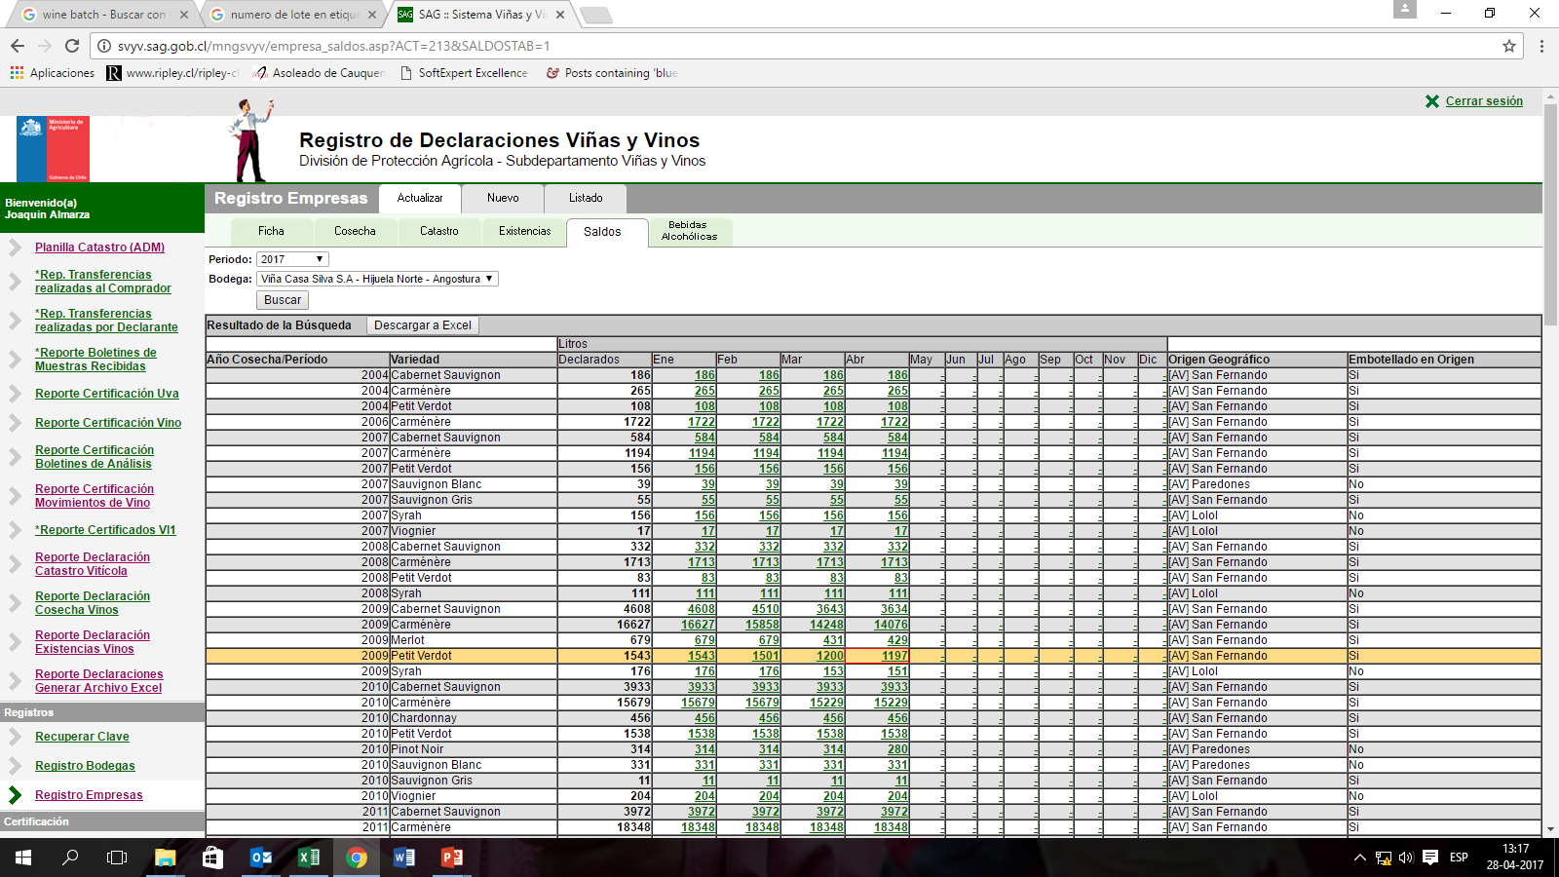
Traceability in alcoholics beverages
Alcoholics beverages must to have an analitical report issue by the oficial or an Acredited Laboratory under the Agricultural & Livestock Service to attesting the condition of the product as apt for human consumption, this analitical report is linked with the number of lot or batch of the product.
In the case of wines with mention of variety of grape, vintage year and geografical indication, this mentions are under the control of the Agricultural & Livestock Service to guarantee to the consumers the proper statement on labells.
All this requierements applies to ensure wine safety, quality and authenticity to consumers.

Slide 6
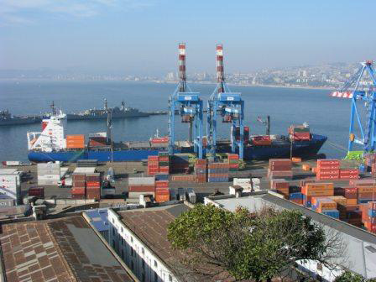
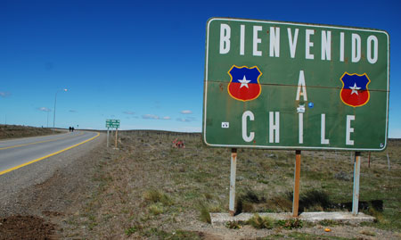
Traceability in imported alcoholics beverages
Imported wines must to be registered in the record of alcoholics beverages of the Agricultural and Livestock Service, which allows the product to be sold in the Chilean market.
Application for import inspection by Customs Destination Certificate. This certificate identifies the lot or batch and the true nature of the product and is linked with the record of alcoholics beverages.
Sampling and analitycal testing. All the imported products are sampling and shall be submitted to analytical testing, to prove that the product tested complies at least, with all the requirements for similar domestic products. From each analytical testing will be issue an analytical report related with the lot or batch of the product linked with the importer.
Items of wines and alcoholics beverages protected under Agreement or FTA subscribe by Chile or wine from member countries of the World Wine Trade Group (WWTG), who signed the MOU on wine certification requirements are exempted of sampling and analytical testing. The recognition of the control made in origen to ensure safety, quality and or authenticity applies in those cases.

Slide 7
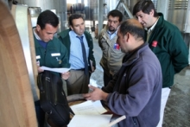
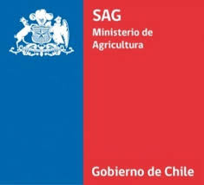
Traceability issues
Due to all the check control made by the agency in charge, in the last 10 years only a beer was recalls from the market by request of the EU, so far none imported wine has been recalled from the market.
Under the record system for alcoholics beverages, and the mandatory labelling requirements, the name and address of the importer and the lot or batch must to be present en each bottle of any alcoholic beverage.
The alcoholics beverages traceability system is under complete control of the Agricultural & Livestock Service, oficial body of the Ministry of Agriculture.

Slide 8
Thank you for your attention

