Slide 1
Russian Federation: traceability of import wines
Session 1: Economy Roundtable – Focus on Traceability
National Convention Center
May11, 2017

Slide 2
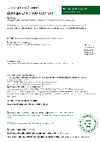
Import of wine and related products:
general procedure for the declaring of compliance
1-Declarant
2-Wine
3-Testing
4-Completion
of Declaration
5-Registration
of Declaration
6-Declaration
Legal person
within the
Russian Federation or Eurasian Economic Union (EAEU/Customs Union)
Import wine
In accordance with the requirements of the Russian Federation/EAEU in Laboratories accredited in the EAEU
Declarant
Certification Body accredited in the EAEU
Wine ready for customs clearance

Slide 3
Import of wine and related products:
general procedure for the receipt of excise tags
2-Application for excise tags
3-Registration
4-Insurance
obligations
5-Receipt of
excise tags
6-Excise tags
1-Contracting
Importer & Foreign wine producer/trader:
contract for wine shipment
Importer: application to the Central Excise Customs (ZAT) of the Russian Federation/Pay-ment of excise tags
Importer & Central Excise Customs (ZAT) of the Russian Federation
Importer: financial ensuring of the use of excise tags
Importer & Central Excise Customs (ZAT)
Applying of excise tags by wine producer/trader (abroad).
Wine ready for delivery & customs clearance

Slide 4
Import of wine and related products:
main acting bodies
Laboratories accredited in the EAEU – testing of wine (listed at the http://www.fsa.gov.ru)
Certification bodies accredited in the EAEU – certification of wine compliance/registration of declarations of compliance (listed at the http://www.fsa.gov.ru).
Federal Service for Customers’ Rights Protection and Human Well-Being Surveillance
(Rospotrebnadzor) – expertise in case of wines from certain countries of origin/expertise of new food
additives including wine additives (http://www.rospotrebnadzor.ru)
Federal Service for Accreditation (RusAccreditation) – accreditation of labs & certification bodies, maintenance of databases of accredited labs, certification bodies, experts & declarations, registration of declarations (http://www.fsa.gov.ru)
Federal Customs Service (FTS) – customs clearance (http://customs.ru)
Central Excise Customs (ZAT) – management of the excise policy for related import goods (http://cat.customs.ru)

Slide 5
Traceability of wines:
elements for tracing
Declaration of compliance (confirmation of the compliance with the requirements from the Technical Regulations of the EAEU/Customs Union – # ТР ТС 021/2011 “Food Safety”, ТР ТС 029/2012 “Food Additives, Flavourings & Processing aids”, ТР ТС 022/2011 “Labelling”; operator - Federal Service for Accreditation RusAccreditation)
Test reports (mainly safety parameters from the Technical Regulations of the EAEU/Customs Union – # ТР ТС 021/2011 “Food Safety”, ТР ТС 029/2012 “Food Additives”, ТР ТС 022/2011 “Labelling”; operator – Federal Service for Accreditation RusAccreditation)
Excise tags (operator - Federal Service for Alcohol Market Regulation Rosalkoholregulirovanye)

Slide 6
Uniform State Automated Information System (EGAIS):
system of traceability for alcoholic products including wines on the basis of excise tags
system of the accounting of excise payments (excise tax tags system)
protective measure against illegal alcoholic products including wine (counterfeit, adulterated products)
operator of the EGAIS system - Federal Service for Alcohol Market Regulation (Rosalcoholregulirovanye)
since January 01, 2016 – all wholesale trading companies, and also companies for transportation and storage of alcoholic products (including wines) must be connected to the EGAIS system
since July 01, 2016 - all retail companies dealing with alcoholic products (including wine) must be connected to the EGAIS system
applying for the connection to the system – http://egais.ru

Slide 7
EGAIS system:
hard & software based three-level tracing
Producer
Importer
Wholesale warehouse
Retail store
tracing possibilities – from import wine producer to Russian consumers and … back
Consumer

Slide 8
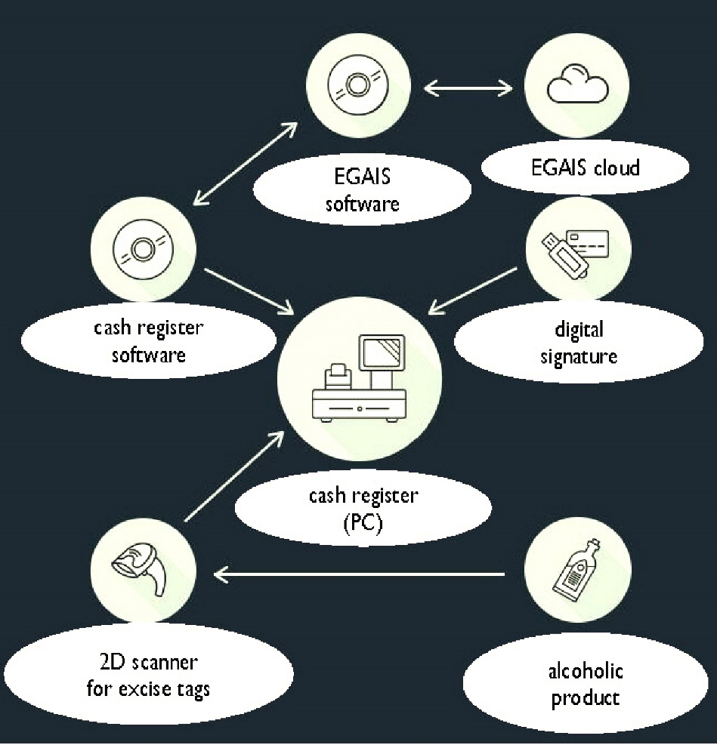
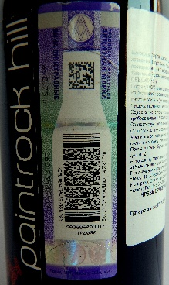
EGAIS system:
retail store level – interactions between tracing elements (excise tags) and hard/software resources

Slide 9
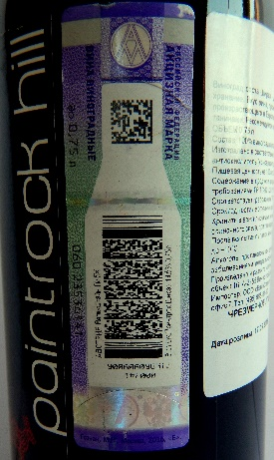
EGAIS system:
practical case - tracing from the retail store level
import wine bottle with the excise tag

Slide 10
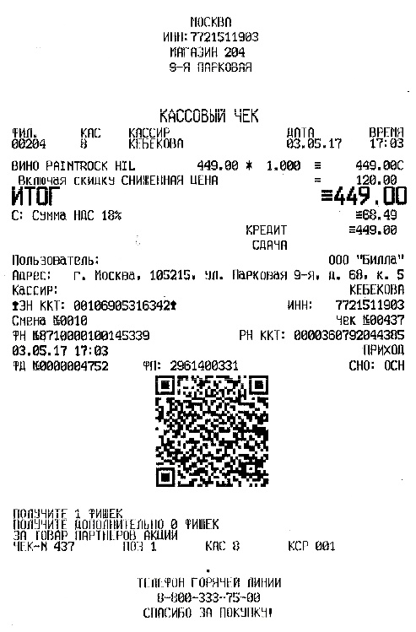
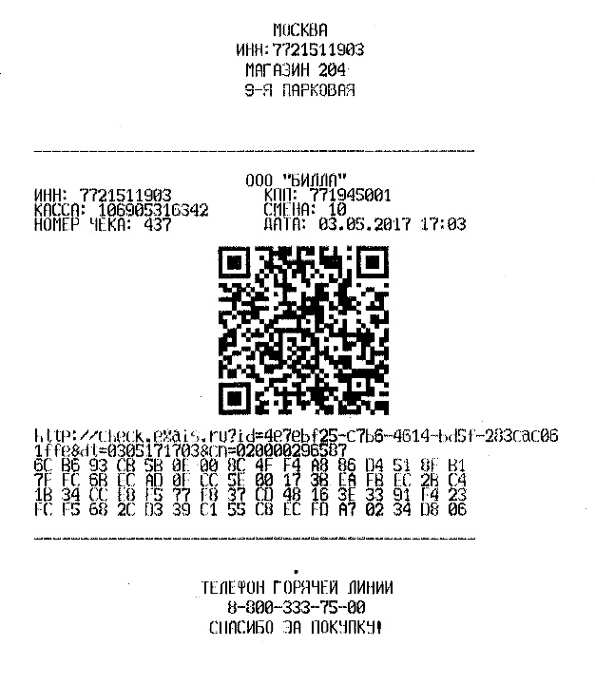
EGAIS system:
practical case - tracing from the retail store level/cash register receipts with the QR code for an import wine
scanning by any QR code reading software for smartphones

Slide 11
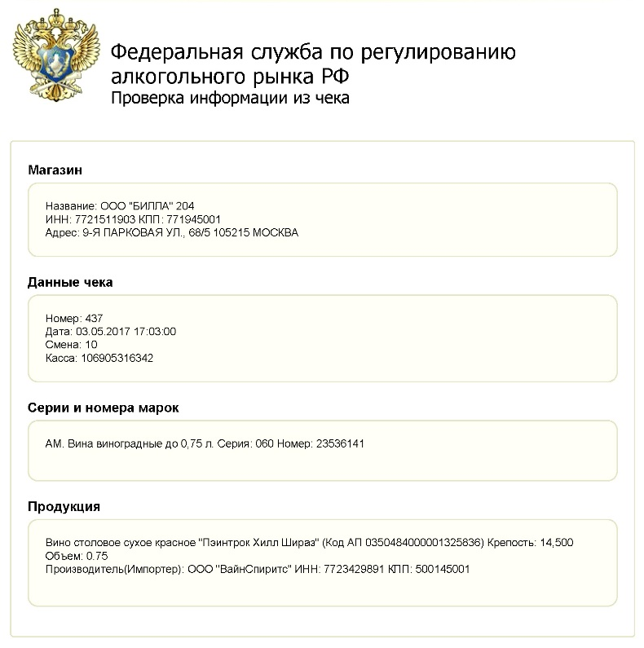
EGAIS system:
practical case - tracing from the retail store level/scan result from the EGAIS cloud (Rosalkoholregulirovanye)
Retail store address
Cash register receipt data
Excise tag data
Type of wine, brand, alcohol content,
volume, data on importer

Slide 12
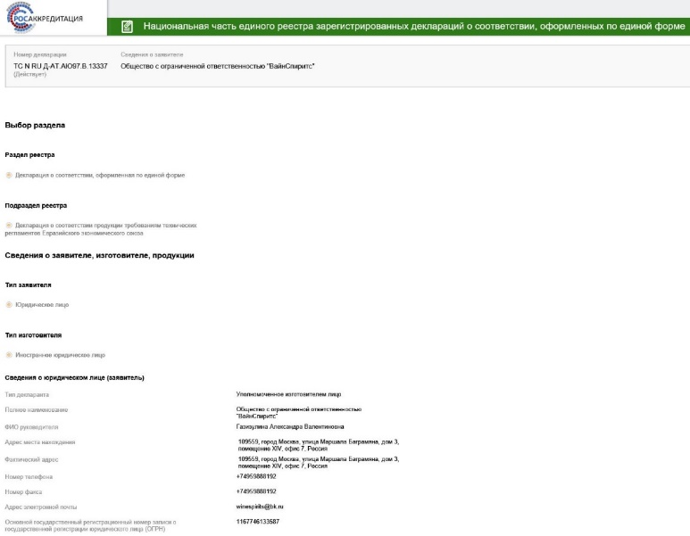
EGAIS system:
practical case - tracing from the retail store level/electronic declaration (certificate) from the database maintained by the RusAccreditation
No. of the declaration of compliance (date of issue, validity)
Data on importer & producer
Documents for certification submitted by the importer (confirmation of the state registration of the importer; contract which confirms the product compliance to requirements of the Technical Regulations and responsibility for non-conformity of the supplied products with the specified requirements; test report)
Type of certification (scheme 3d – serial production)
No. of the test report & data on test lab
Product origin (import)
Product type & brand
Product parameters (alcohol by volume, sugar content)
Product code (22.04 …)
Package (volume), shelf life & storage conditions
Data on Technical Regulations of the EAEU/Customs Union (ТР ТС 021/2011 “Food Safety”, ТР ТС 029/2012 “Food Additives”, ТР ТС 022/2011 “Labelling”)
Data on certification body
http://fsa.gov.ru/index/staticview/id/295/

Slide 13
Wine and related products on the Russian market:
statistics – domestic production
Vine, mil. t
 | 2000 | 2001 | 2002 | 2003 | 2004 | 2005 | 2006 | 2007 | 2008 | 2009 | 2010 | 2011 | 2012 | 2013 | 2014 | 2015 | 2016 | 2017 forecast
Gross vintage | 0.279 | 0.237 | 0.214 | 0.341 | 0.309 | 0.322 | 0.234 | 0.315 | 0.268 | 0.299 | 0.324 | 0.412 | 0.267 | 0.439 | 0.529 | 0.475 | 0.552 | 0.500
Wine, mil. hl
 | 2000 | 2001 | 2002 | 2003 | 2004 | 2005 | 2006 | 2007 | 2008 | 2009 | 2010 | 2011 | 2012 | 2013 | 2014 | 2015 | 2016 | 2017 forecast
Wine | 2.40 | 2.70 | 3.30 | 3.70 | 3.90 | 3.17 | 4.74 | 5.13 | 5.03 | 5.03 | 4.51 | 4.04 | 3.67 | 3.39 | 3.21 | 4.00 | 3.68 | 3.25
Sparkling wine | 0.7 | 0.8 | 0.8 | 0.9 | 1.2 | 1.41 | 1.54 | 2.16 | 2.08 | 1.94 | 2.24 | 2.20 | 2.05 | 1.72 | 1.56 | 1.61 | 1.47 | 1.41
Brandy | 0.17 | 0.2 | 0.27 | 0.35 | 0.39 | 0.45 | 0.6 | 0.8 | 0.99 | 1.27 | 0.9 | 0.81 | 0.98 | 0.74 | 0.69 | 0.77 | 0.76 | 1.00
Bulk wine | 0.51 | 0.64 | 0.78 | 0.95 | 1.21 | 1.37 | 1.62 | 1.72 | 1.59 | 2.25 | 2.65 | 3.22 | 3.42 | 2.75 | 2.70 | 3.63 | 3.06 | 3.00
Ministry of Agriculture of the Russian Federation, 2017

Slide 14
Wine and related products on the Russian market:
statistics – domestic consumption
Consumption (total), mil. hl
 | 2000 | 2001 | 2002 | 2003 | 2004 | 2005 | 2006 | 2007 | 2008 | 2009 | 2010 | 2011 | 2012 | 2013 | 2014 | 2015 | 2016
Wine | 5.23 | 5.61 | 6.26 | 7.22 | 7.86 | 8.10 | 7.80 | 9.10 | 9.80 | 9.80 | 6.10 | 6.60 | 6.20 | 6.00 | 5.80 | 5.40 | 5.20
Sparkling wine | 1.80 | 1.85 | 1.77 | 1.87 | 1.85 | 1.94 | 2.06 | 2.41 | 2.60 | 2.55 | 2.60 | 2.97 | 2.80 | 2.77 | 2.60 | 2.36 | 2.20
Altogether | 7.03 | 7.46 | 8.03 | 9.09 | 9.71 | 10.04 | 9.86 | 11.51 | 12.4 | 12.35 | 8.7 | 9.57 | 9.00 | 8.77 | 8.40 | 7.76 | 7.40
Consumption (per capita), l
 | 2000 | 2001 | 2002 | 2003 | 2004 | 2005 | 2006 | 2007 | 2008 | 2009 | 2010 | 2011 | 2012 | 2013 | 2014 | 2015 | 2016
Wine | 3.56 | 3.82 | 4.30 | 5.01 | 5.47 | 5.66 | 5.43 | 6.36 | 6.85 | 6.88 | 4.25 | 4.63 | 4.35 | 4.18 | 3.99 | 3.70 | 3.55
Sparkling wine | 1.23 | 1.26 | 1.22 | 1.30 | 1.29 | 1.35 | 1.43 | 1.69 | 1.82 | 1.79 | 1.81 | 2.08 | 1.96 | 1.93 | 1.79 | 1.62 | 1.50
Altogether | 4.79 | 5.08 | 5.52 | 6.31 | 6.76 | 7.01 | 6.87 | 8.05 | 8.67 | 8.67 | 6.07 | 6.72 | 6.32 | 6.11 | 5.78 | 5.32 | 5.05
Ministry of Agriculture of the Russian Federation, 2017

Slide 15
Wine and related products on the Russian market:
statistics – export/import
Export, mil. hl
 | 2000 | 2001 | 2002 | 2003 | 2004 | 2005 | 2006 | 2007 | 2008 | 2009 | 2010 | 2011 | 2012 | 2013 | 2014 | 2015 | 2016
Wine | 0.005 | 0.009 | 0.01 | 0.015 | 0.02 | 0.01 | 0.001 | 0.02 | 0.009 | 0.002 | 0.01 | 0.005 | 0.008 | 0.006 | 0.005 | 0.04 | 0.03
Sparkling wine | 0.001 | 0.002 | 0.002 | 0.004 | 0.006 | 0.002 | 0.002 | 0.006 | 0.005 | 0.002 | 0.006 | 0.006 | 0.003 | 0.01 | 0.014 | 0.014 | 0.016
Import, mil. hl
 | 2000 | 2001 | 2002 | 2003 | 2004 | 2005 | 2006 | 2007 | 2008 | 2009 | 2010 | 2011 | 2012 | 2013 | 2014 | 2015 | 2016
Wine | 1.83 | 2.67 | 3.20 | 4.28 | 2.40 | 3.50 | 2.20 | 2.20 | 2.3 | 1.70 | 2.20 | 2.40 | 2.50 | 2.60 | 2.30 | 1.60 | 1.70
Sparkling wine | 0.10 | 0.10 | 0.10 | 0.10 | 0.10 | 0.11 | 0.08 | 0.13 | 0.20 | 0.20 | 0.32 | 0.46 | 0.30 | 0.43 | 0.47 | 0.33 | 0.35
Bulk wine | 1.56 | 1.48 | 1.30 | 1.50 | 1.22 | 1.28 | 3.40 | 3.77 | 3.16 | 2.43 | 2.85 | 2.15 | 2.01 | 1.89 | 1.71 | 2.03 | 1.93
Ministry of Agriculture of the Russian Federation, 2017

Slide 16
Import of wine and related products:
import wine shipments recalls
Recalls of import wine within two control levels: declaring of compliance (depending on region - 1-5 % non-compliant), state control & supervision.
1-2 Recall cases, for example in years:
2017 (phthalates, pesticides),
2015 (phthalates, bifenazate),
2013 (non-compliant to requirements),
2012 (increased SO₂ content, sediments, impurities),
2000 (phthalates).

Slide 17
THANK YOU FOR ATTENTION

