Slide 1
Traceability- The Australian Perspective
Steve Guy, Wine Australia

Slide 2
Definition
The ability to track and trace any food through all stages of production, processing and distribution.

Slide 3
Why is it needed?
Risk management tool
Ensuring food safety
Trace risky food to its source
Enables targeted product withdrawals
Cultural and religious reasons- Halal/ Kosher/ Vegan/ Vegetarian
Organic and Sustainable
Authenticity (particularly important for wine given provenance implies quality and wine is low risk from a safety perspective)

Slide 4
What does it look like?
Supply chain participants must be able to identify where their products come from and where they are going
The recorded details include name and address of supplier/customer, the nature of the product and the date of the transaction.

Slide 5
Food Safety Requirements
Standard 3.2.2 (www.foodstandards.gov.au)
One step back (clause 5(2))- for imported food this requires the business to provide the name and address of the importer
One step forward (clause 12 Food recall)
Production records
Volume produced
Batch or lot identification markings
Where distributed

Slide 6
Specific Commodity Requirements in Australia
Seafood businesses
Dairy production, transport and processing
Poultry processors
Egg producers and processors
Seed sprout processors

Slide 7
Specific requirements for wine
Enforced by Australian Grape and Wine Authority (Wine Australia)
Extends traceability beyond safety to include quality and authenticity

Slide 8
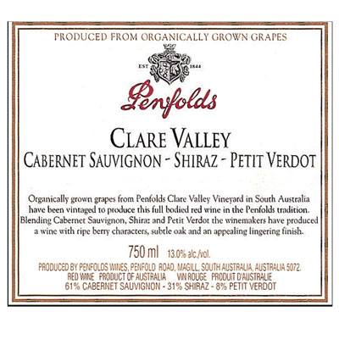
Authenticity

Slide 9
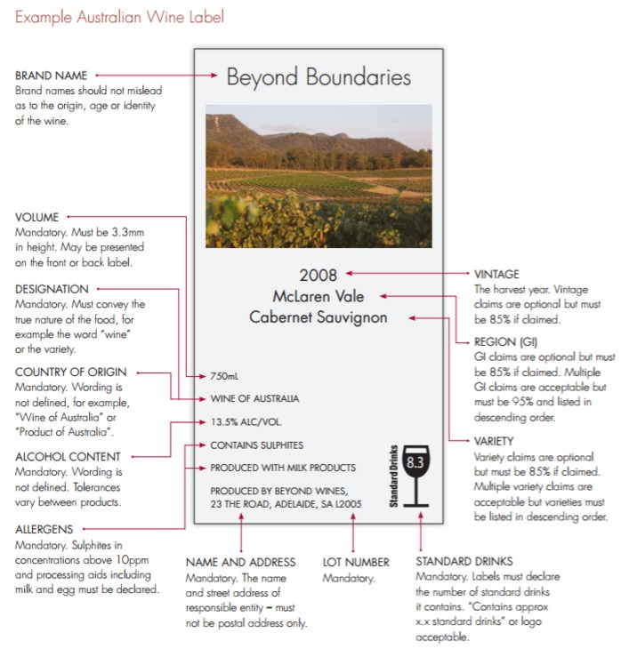
Authenticity

Slide 10
Australian Wine: What records must be kept?

Slide 11
Wine Goods Receival Register

Slide 12
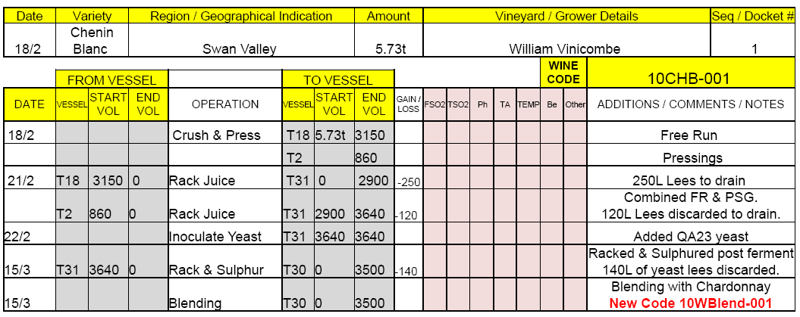
LIP Manual System – Blending Example
In this case a new record and a new WINE CODE is created for the blend.
Details of the operation are recorded in the Wine Processing Record of the component wine.
In the notes section the new WINE CODE of the new blend is clearly
indicated.

Slide 13
LIP Manual System – Blending Example
New record created.
New WINE CODE assigned.
Records exactly the same information.
Notes section contain the WINE CODE of the component.
This is the double entry principle of traceability.

Slide 14
Records must be made within 3 days and retained for 7 years.

Slide 15
Wine Supply Chain

Slide 17
Export Flow Chart
Obtain licence
Register wine
Apply for shipping permit
Apply for import certificate if required

Slide 18
Product recalls (all commodities)

Slide 19
Major reasons for recall (all commodities)

Slide 20
Microbiological issues (none related to wine)

Slide 21
Wine only subject to two recalls
11 May 2012 : Glass fault in a 2 litre fortified wine (6 variants)
18 March 2015 :Choking hazard with the plastic lid

Slide 22
New technologies to assist traceability (source: vinologa.com)

