Slide 1
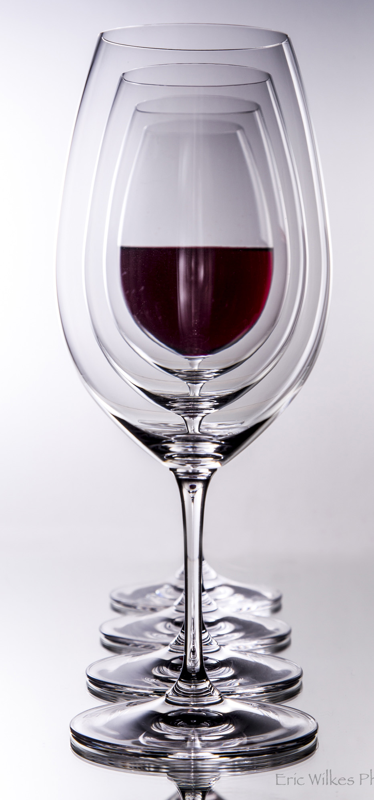
Common Wine Faults and Their Impacts
Dr Eric Wilkes
Australian Wine Research Institute

Slide 2
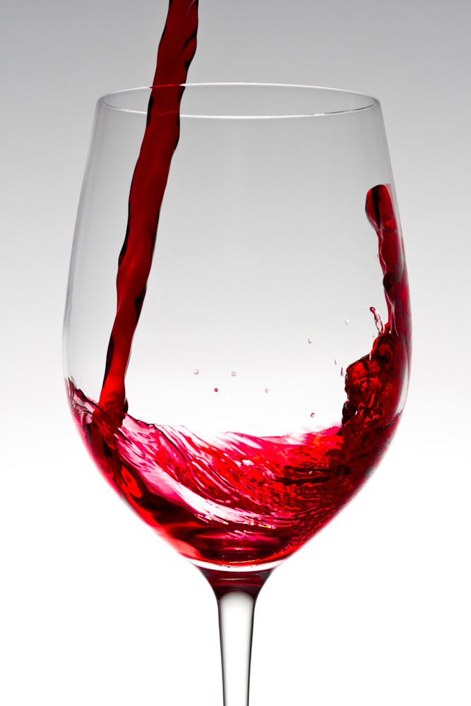
Wine is a manufactured natural product
So by definition, things will go wrong.
One of the roles of the AWRI is to investigate such manufacturing issues.

Slide 3
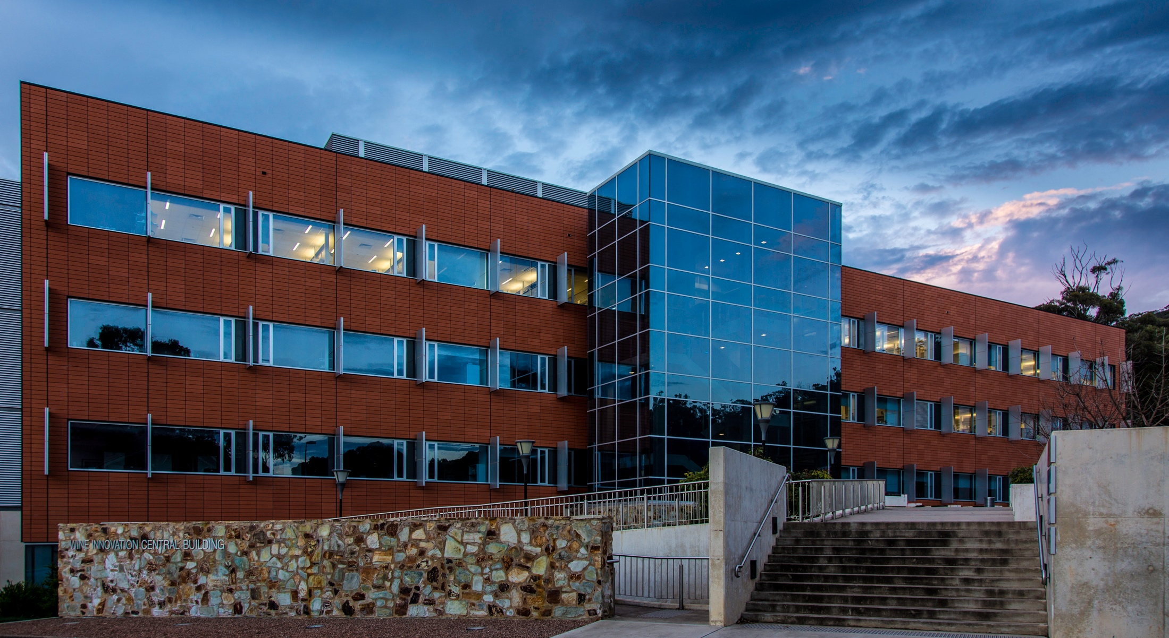
The AWRI

Slide 4
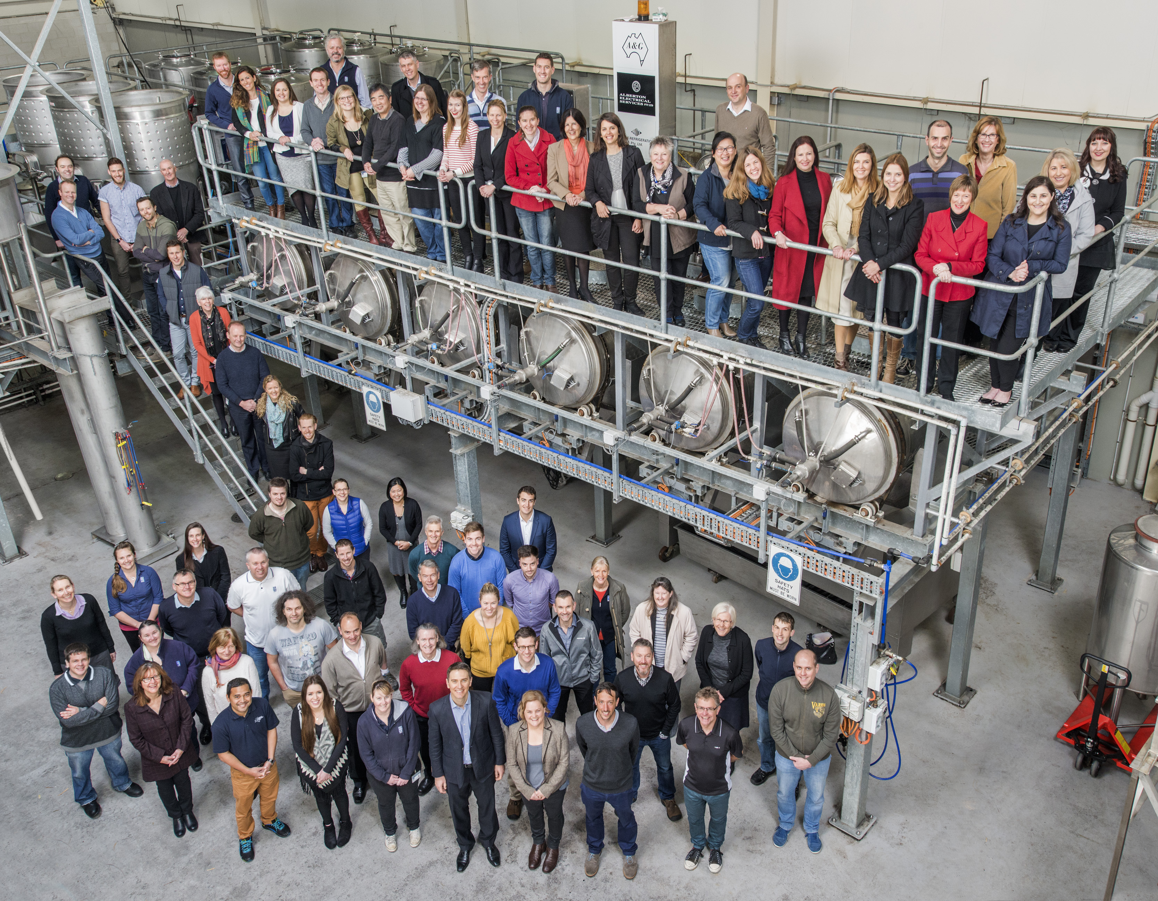
World class people
The gap…

Slide 5
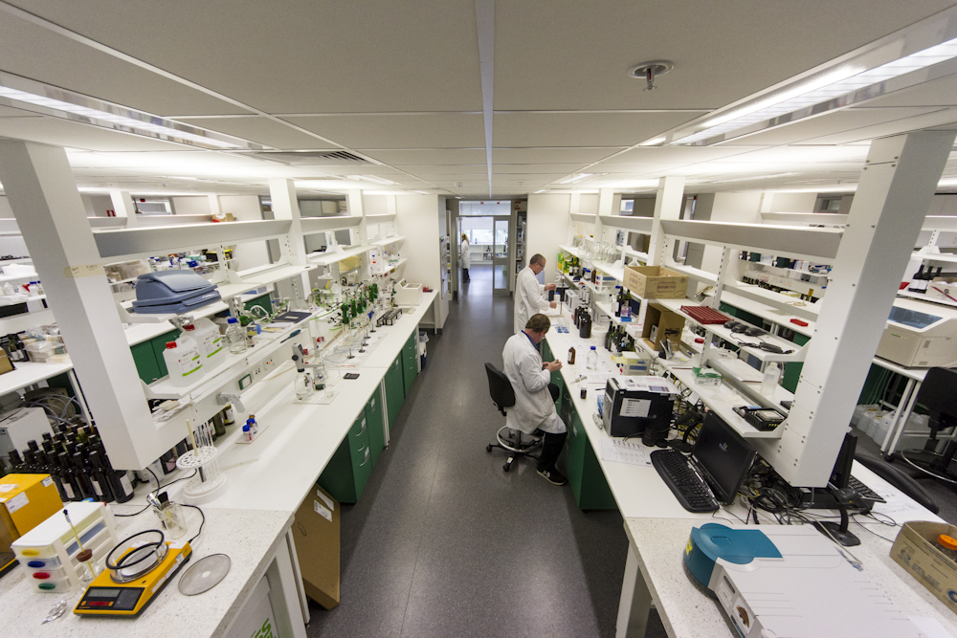
World class facilities
Notes:
Sample numbers continue to rise, and rise and rise

Slide 6
Industry owned business model
Research
Extension
Labs
Development
Industry
Services to Industry
Notes:
CS is a significant part of the AWRI (21 staff) and one of it greatest strengths is being an integrated part of the organisation.

Slide 7
So what do we get asked?
~5,000 requests for technical assistance per annum; ~20 every day
>1,000 problem samples investigated per annum

Slide 8
So what are the major fault investigations?

Slide 9
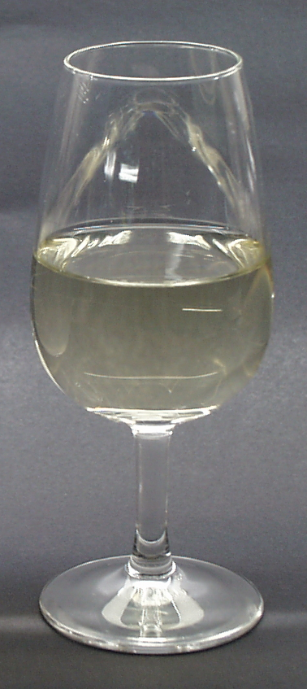
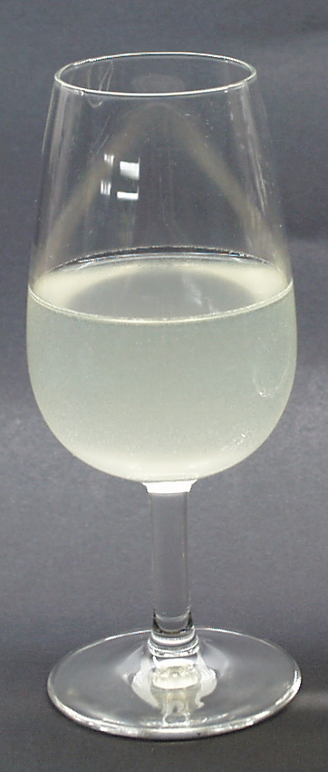
Wine Hazes
~10% all winemaking investigations
are protein/copper-protein related

Slide 10
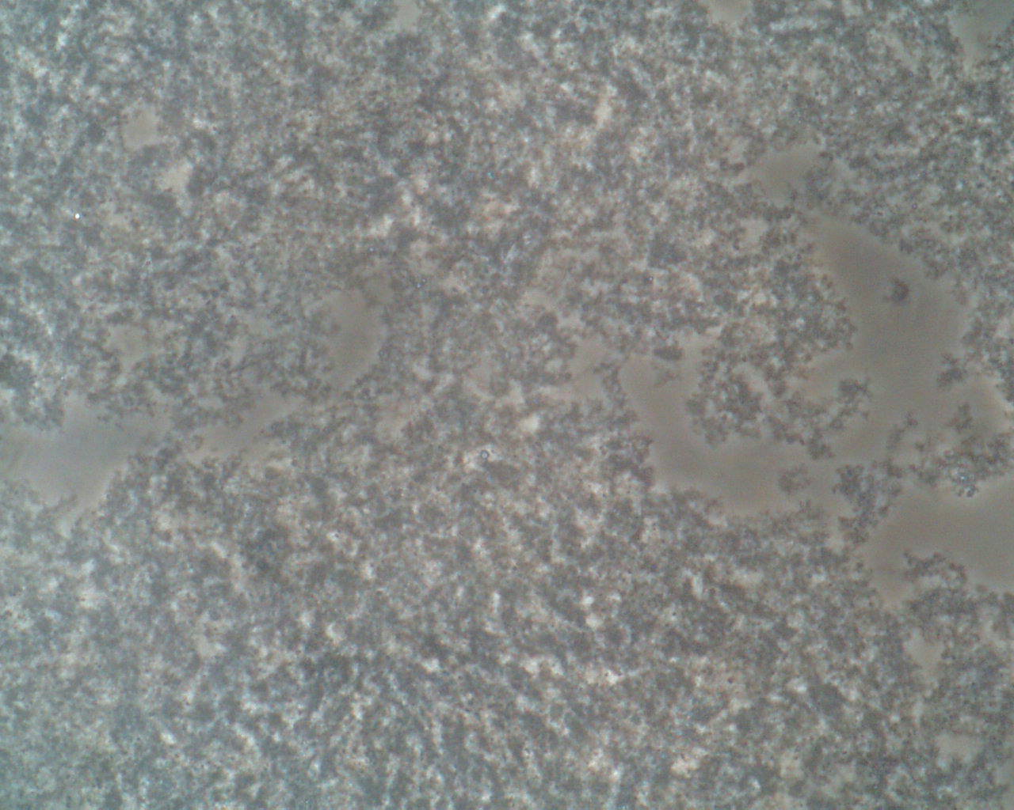
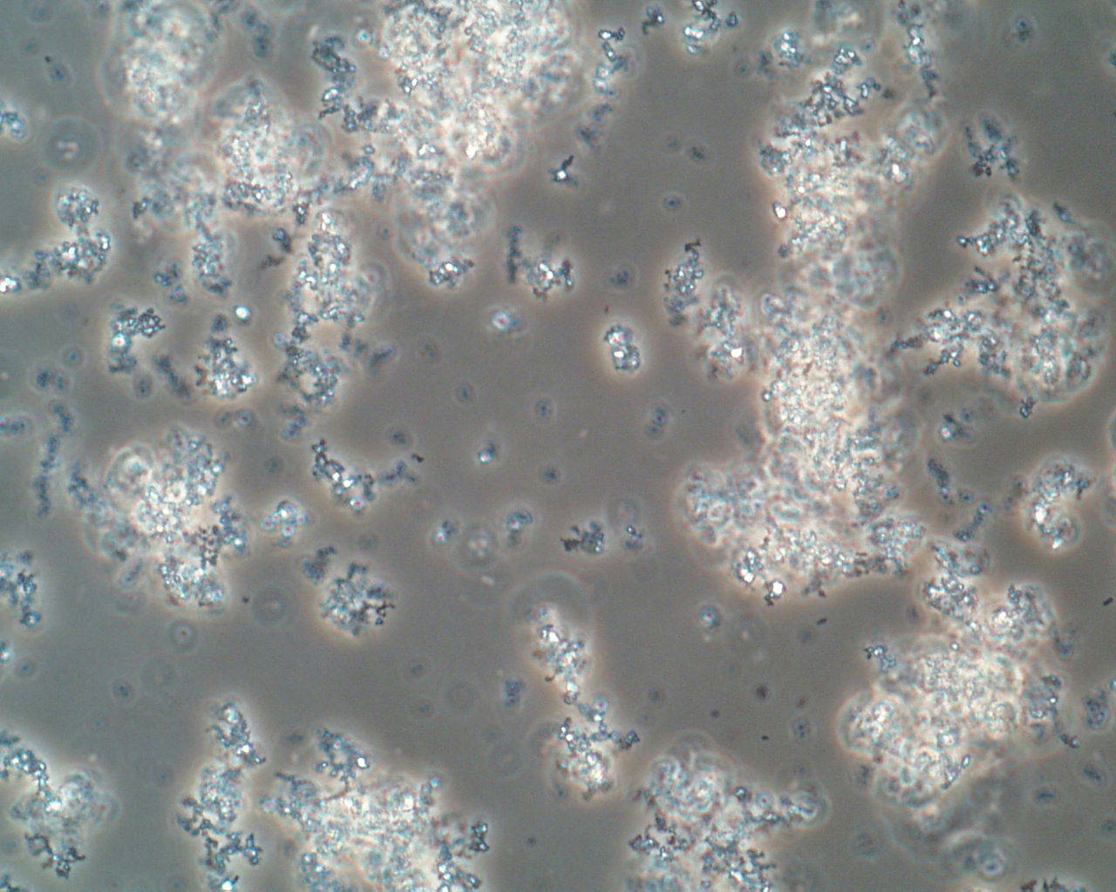
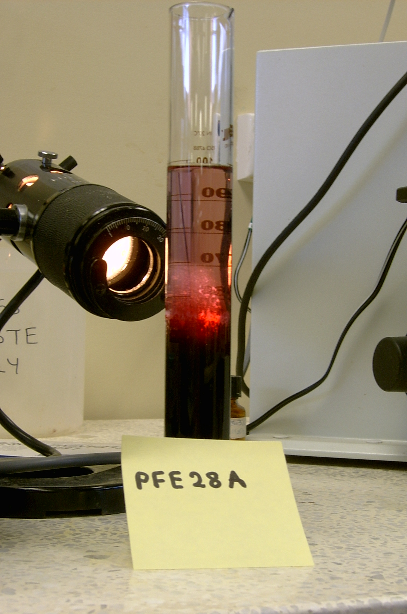
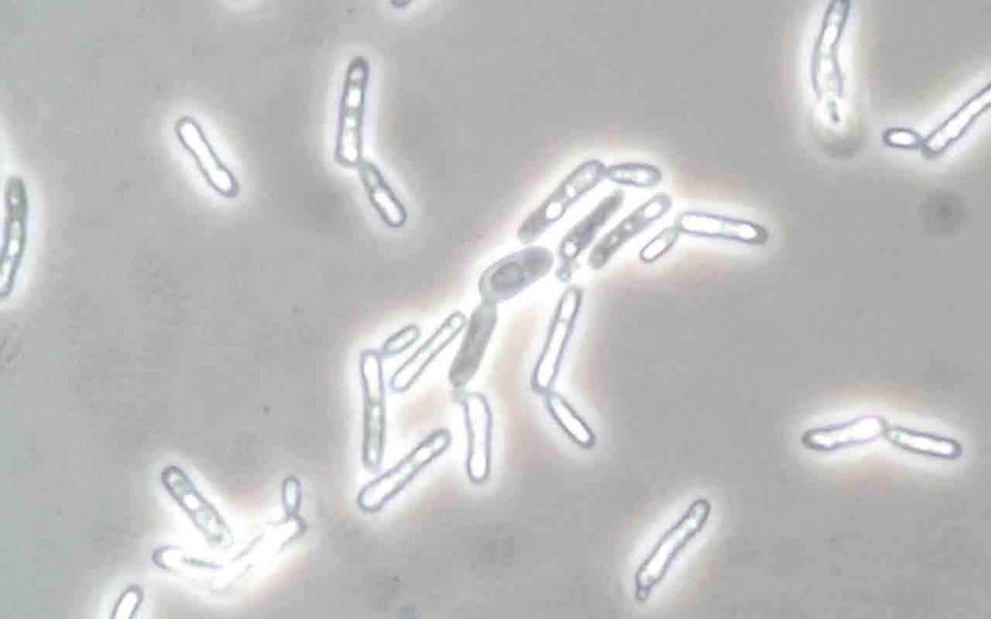
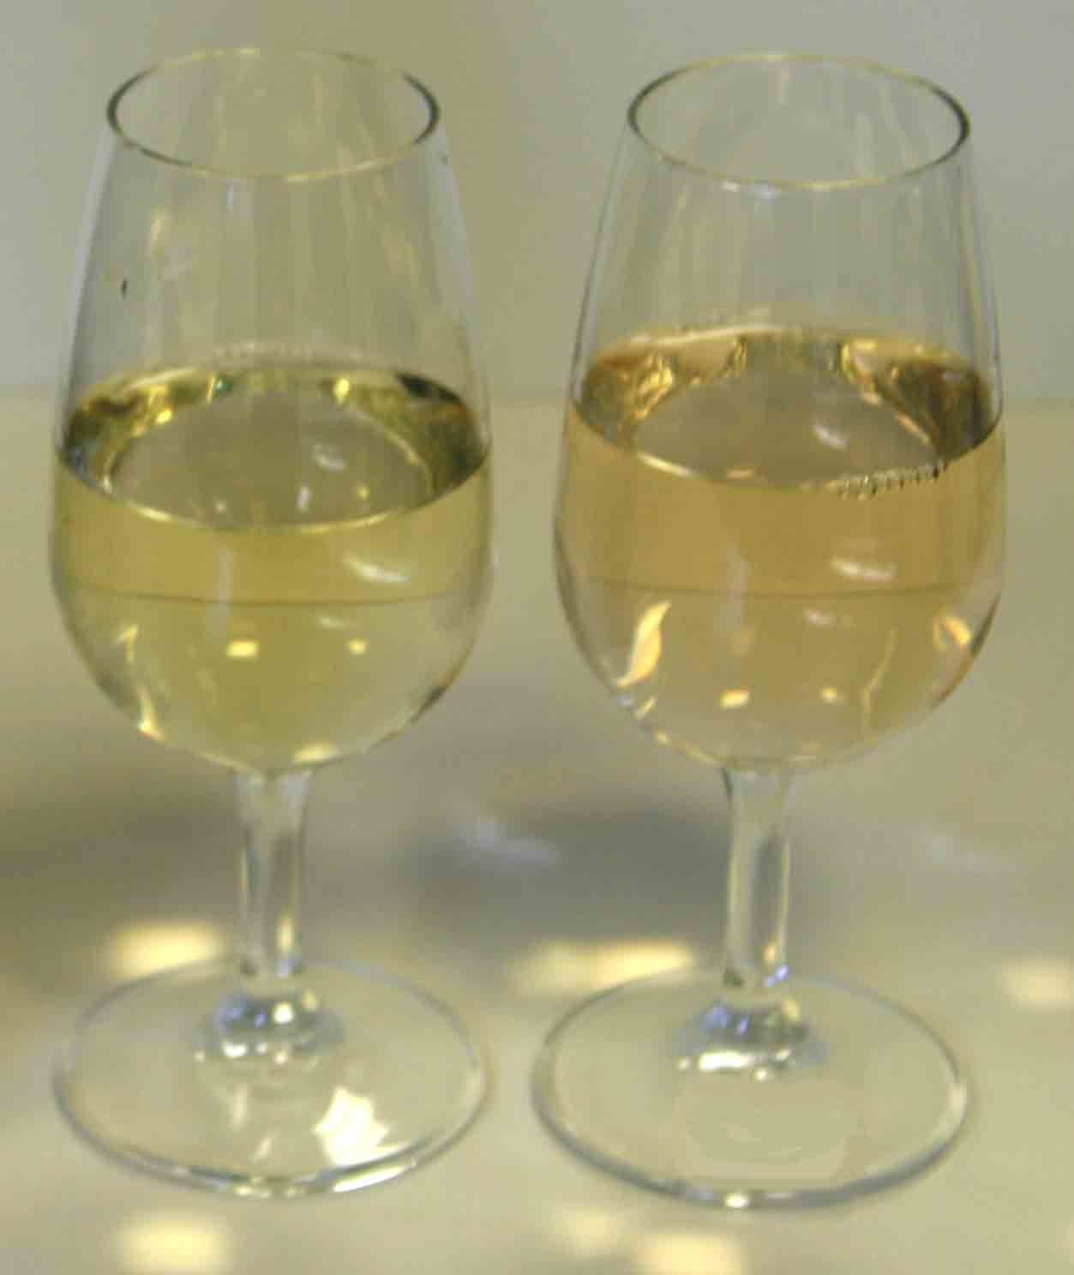
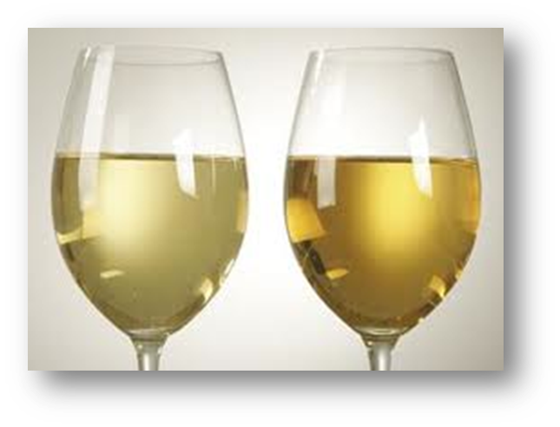
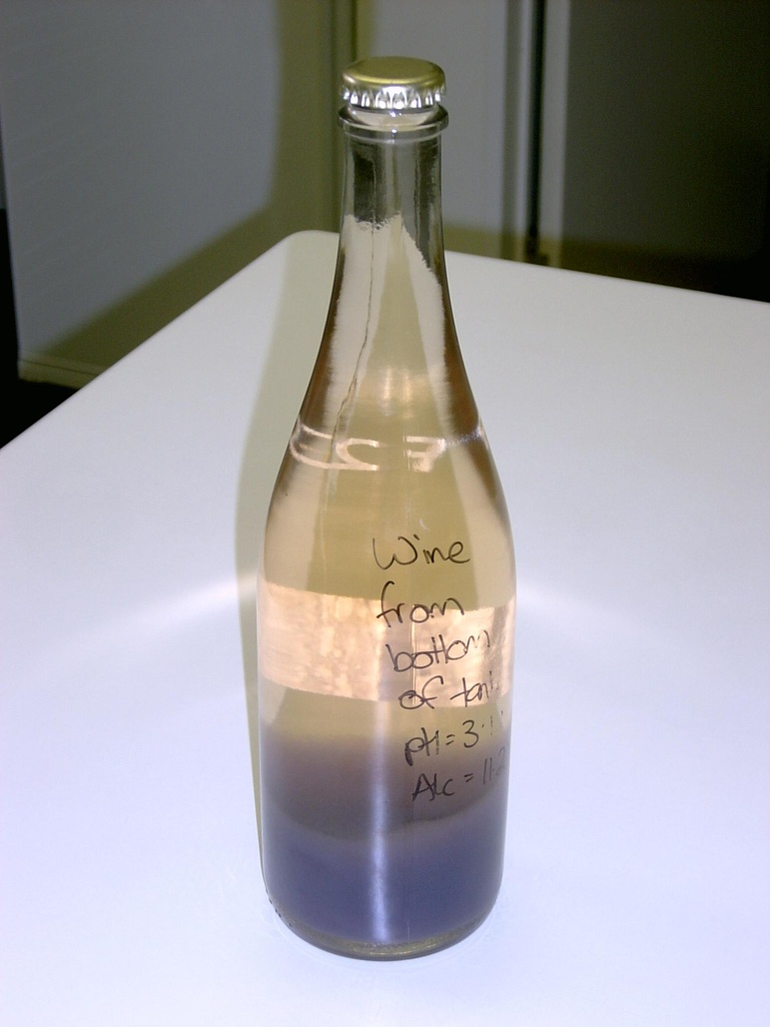
Hazes
Protein
Copper/Protein
Polysaccharides
Yeast
Pinking
Oxidised phenolics
Iron

Slide 11
Wine Hazes are caused by naturally occurring proteins

Slide 12
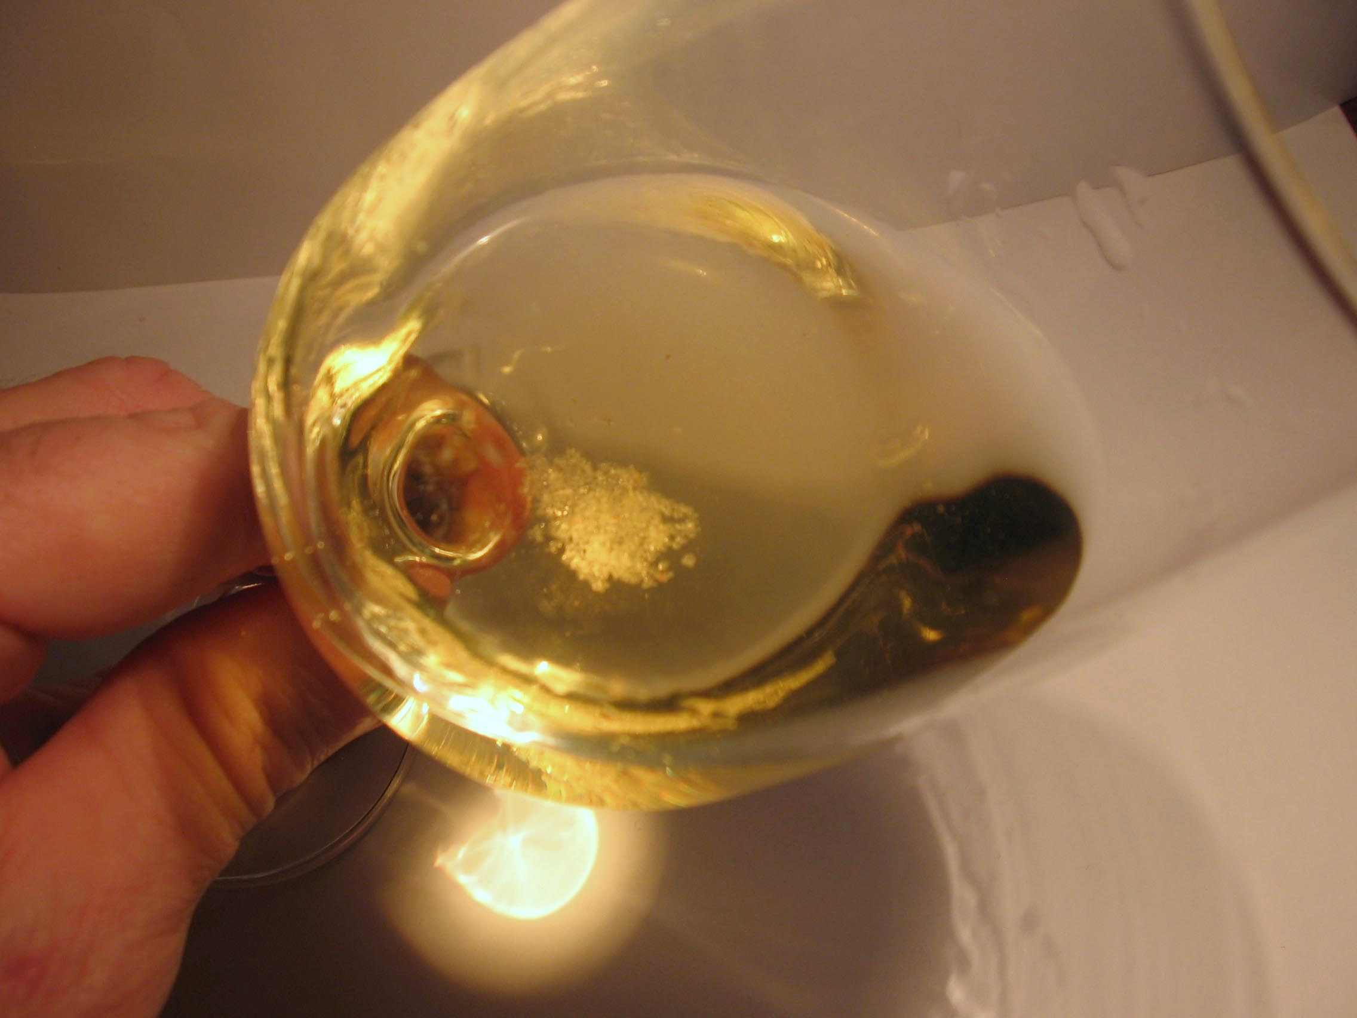
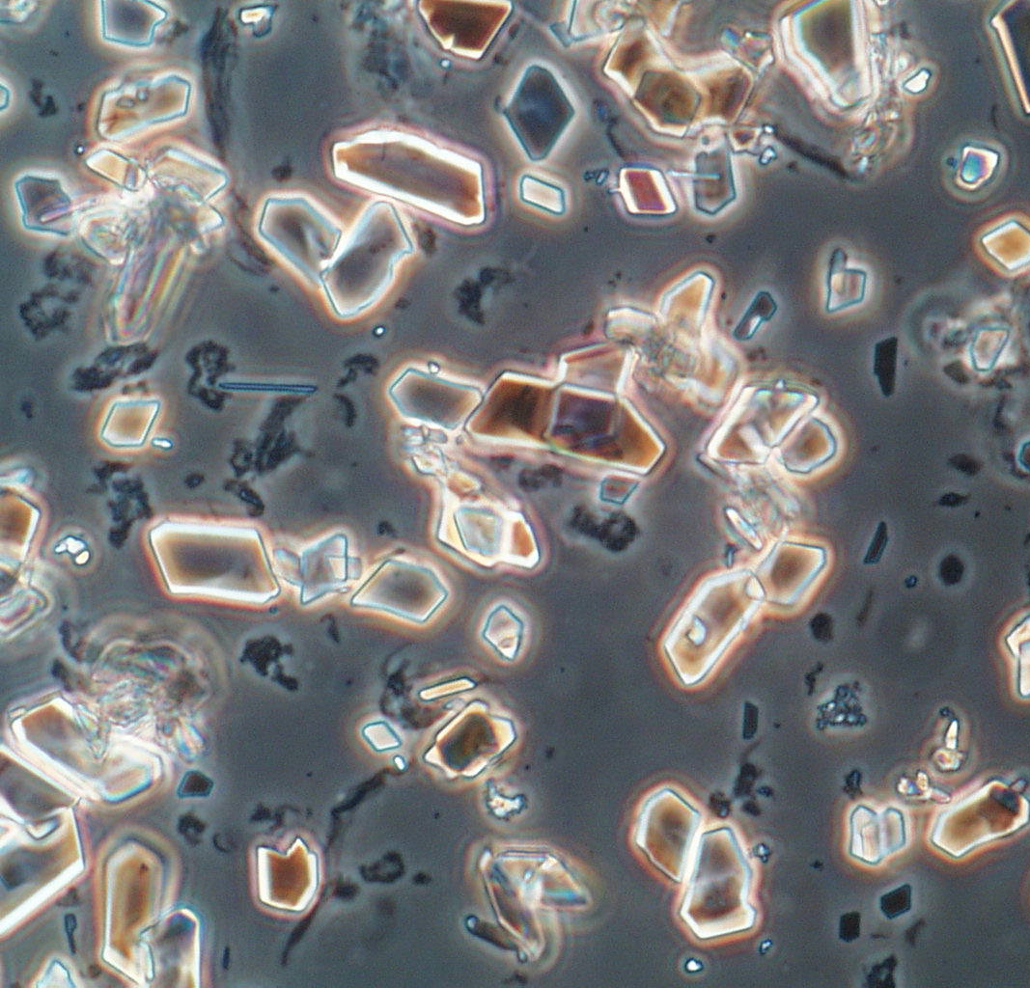
Crystalline deposits

Slide 13
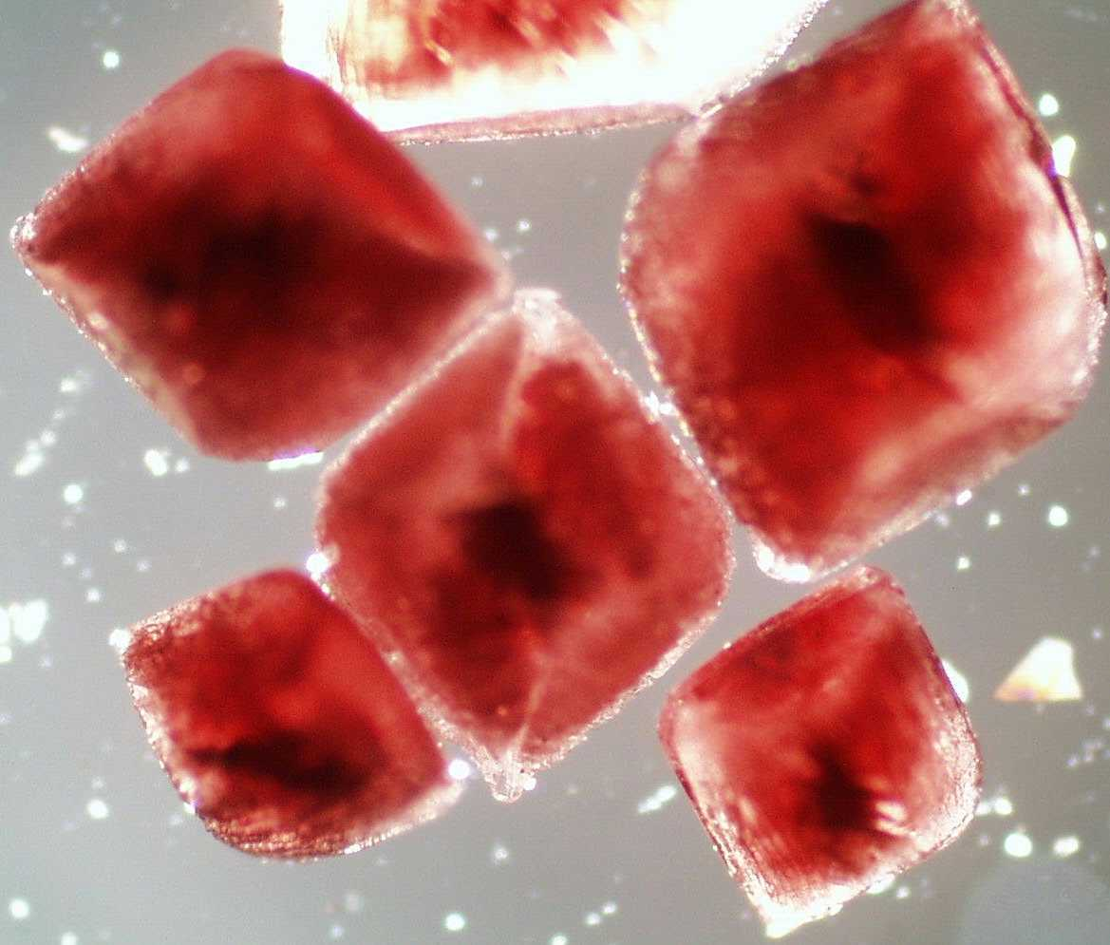
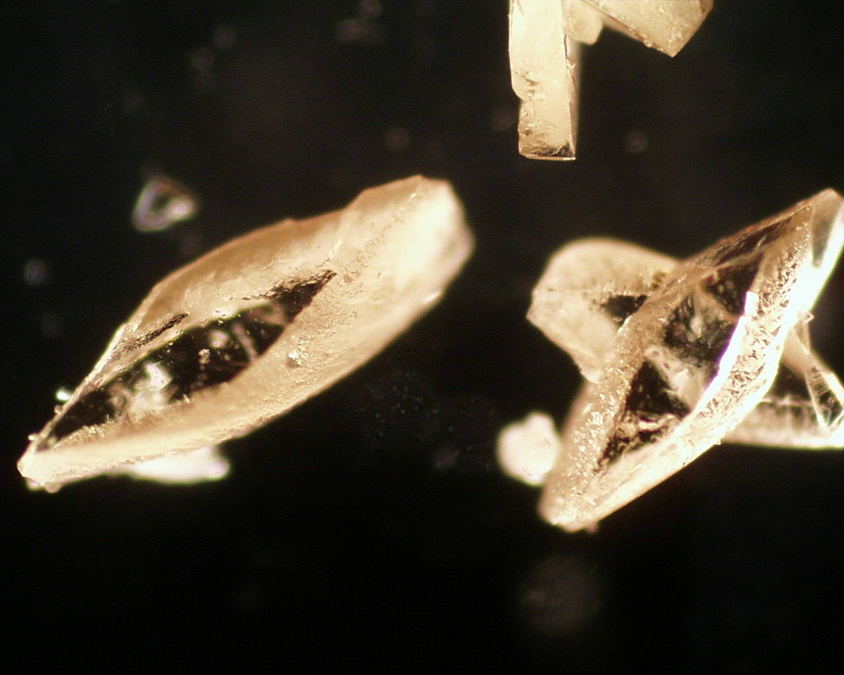
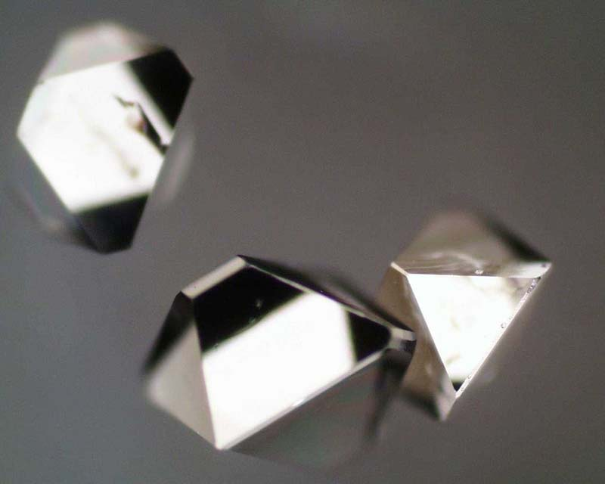
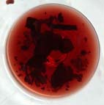
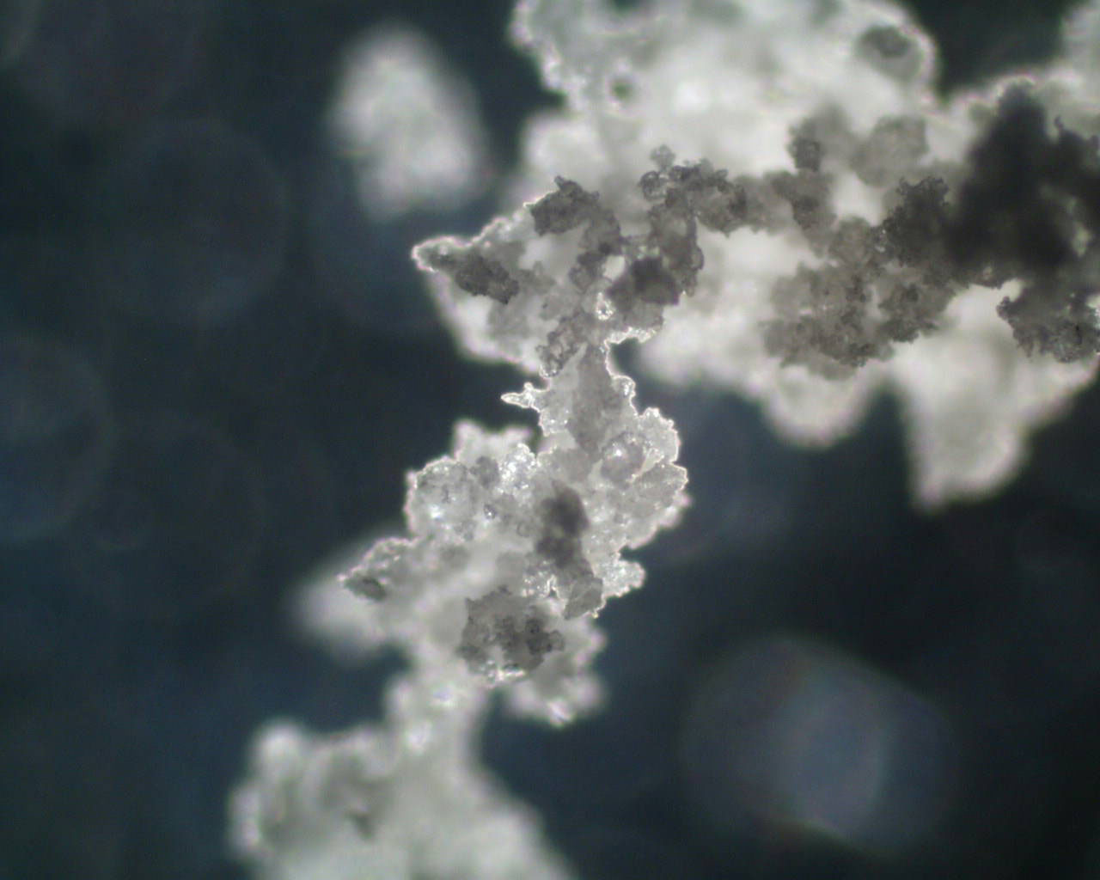
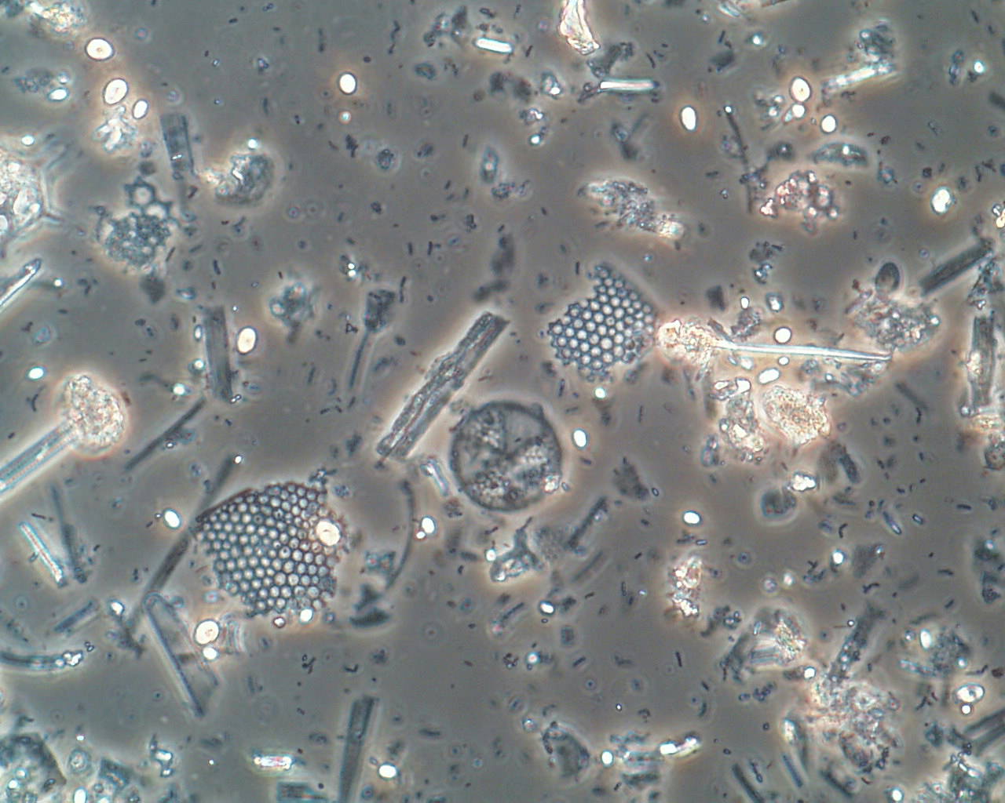
Crystalline type deposits
Potassium L bitartrate (KHT)
Calcium L and DL tartrate
Quercetin
Cork wax
Diatomaceous earth

Slide 14
Taints

Slide 15
Oxidation and Reduction
O₂
Reduction
Oxidation
complexity
blackcurrant
struck flint
complexity
softening
integration
rotten eggs
cabbage
burnt rubber
sewage
browning
bruised apple
cooked
tired
Notes:
Lets call them what they really are, unpleasant stinks!
Research has shown that they are linked to a range of factors.
The amount of copper and iron in the wine
The yeast used and the nature of the ferment
The amount of oxygen seen at various times of the wines life.
Importantly, some research has shown that for a some wine, lower levels of oxygen in bottle (for instance as seen with a saran/tin screwcap) can lead to higher amounts of the compounds responsible for the stinky odours.

Slide 16
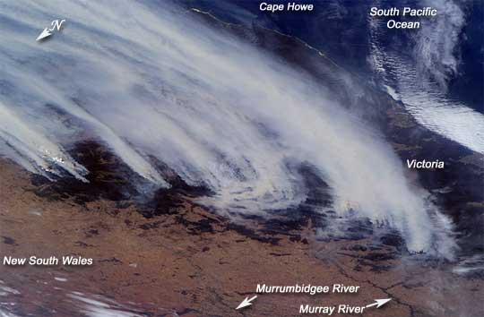
Smoke Taint
Changes in climate are leading to increased fire events.
smoky, phenolic, medicinal
The compounds responsible are generally the same introduced by barrel aging
Notes:
Guaiacol
(threshold: 20 ng/L, described as smoky, phenolic, medicinal)—a component of smoke (eg. Leigh Francis’ samples earlier today). Associated with high toast level in barrels; formed during barrel toasting process, can then be extracted into wine at a typical concentration of 30–40 μg/L. Also possible component of cork taint – the primary off-flavour compound in faulty corkwood affected by a yellow discolouration. It is formed by soil bacteria such as Streptomyces sp. (which grow on lignin in the corkwood) and other microflora including some moulds (Amon et al).
Guaiacol is present in corkwood, but the quantities formed by the degradation of lignin under normal processing conditions for wine corks would be insufficient to cause a taint in cork. Therefore, guaiacol is not a significant cause of cork taint in Australia.
Guaiacol is often below its flavour threshold concentration and influences wine aroma by acting in combination with other components. (Synergism – response to several components is greater than the sum of the individual contributions.

Slide 17
Cork Taint
Notes:
They never stop

Slide 18
Microbiological issues
Wine does not pose a risk as far as pathogens is concerned.
However, some yeast and bacteria can cause issue before, during and immediately after fermentation.
Oenococcus oeni, Pediococcus, Lactobacillus, Brettanomyces
All have the potential to damage the quality of wine
But none produce dangerous metabolites in wine.
The taint compounds are usually present in incredibly low concentrations.

Slide 19
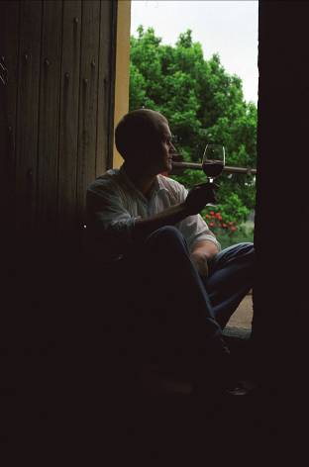
So what are wine faults
In the vast majority of cases they are naturally occurring wine components.
They become an issue when they become out of balance with the normal expectation due to processing or climatic effects.
The major impact is on consumer acceptance .
They do not pose any risk to human health and safety.

