Slide 1
Review of the WRF since 2011
Jeffrey Clarke
General Manager Advocacy & General Counsel
New Zealand Winegrowers

Slide 2
Seminar on Key Issues in Wine Regulation San Francisco 2011
First full WRF meeting
18 APEC Member Economies participating
12 APEC Member Economies presenting
Notes:
I want to start with the 2011 seminar on key issues in wine regulation because this is a watershed moment for the WRF and I think for understanding of wine regulation in our region.
Marks the first occasion when regulators and experts from across the APEC region come together to discuss regulatory issues in the international trade in wine
Recognises grow in the trade in all types of wine – grape, rice, fruit – across APEC in line with economic growth
Establishes a commitment to work together to enhance regulatory coherence across the region in a practical and meaningful way
Gave life to the agreement of the Sub Committee on Standards and Conformance to create the WRF in 2008
Culmination of an idea conceived back in 2002 based on the aim of finding new approaches to facilitate international trade in wine
Importance of meeting recognised by the fact that is was attended by former WTO DG Mike Moore (pictured)
This meeting was both a new beginning and a culmination of many years of work. My task today is to look at what has been achieved since 2011 – but it is useful to understand a little bit of the history to put that into context.

Slide 3
In the beginning…
In 2002 World Wine Trade Group members recognised the importance of APEC in wine production and consumption and synergy of WWTG objectives and APEC’s Bogor goals.
Industry asked governments to consider a pathfinder initiative for wine based on the principles of the Mutual Acceptance Agreement on Oenological Practices.
Notes:
The idea of the WRF began in 2002 with the WWTG. WWTG participants saw the growth in the trade in wine throughout the Asia Pacific region. APEC countries were emerging as increasing important sites of both production and consumption.
Wine is a highly regulated product and consequently can be subject to technical barriers to trade. Very often these are unintended and simply a result of different regulatory histories or approaches. WWTG’s approach is that sharing knowledge and harmonizing technical rules can produce benefits for producer and consumer countries.
At Cape Town and Mendoza meetings in 2002, WWTG industry group encouraged govts to consider a pathfinder initiative within APEC based on the MAA.
From Mendoza statement:
“At the last meeting of the World Wine Trade Group held in Cape Town, the industry section requested that the APEC members of the World Wine Trade Group jointly present a 'pathfinder' initiative that embodies the concepts in the Mutual Acceptance Agreement on Oenological Practices (MAA OP) to the APEC Ministerial and Leaders' Meetings. It is critical that the World Wine Trade Group take a leading role in the development of sound wine policies and regulations in these markets. First, the MAA OP is not a set of winemaking standards but the winemaking regulations approved by each member country could be incorporated into a standard or similar arrangement, which could then be presented to the other APEC members for consideration as the pathfinder initiative. Such a production standard would enhance the international acceptability of wine produced in the Asia-Pacific region, while the adoption of the principles of the MAA OP would advance the free and open trade in wine, both within the region and internationally. This could provide a significant benefit to the emerging wine industries within these countries and provide an essential precursor for countries to sign onto the MAA OP. Second, by adopting the principles in the MAA OP, particularly those in Articles 5 and 6, a trading standard for wine would eventually be established and negotiations on labeling within APEC could be opened up. It would seem to have a mutual benefit for both producer and consumer countries to sign up to the MAA OP. Third, we could use the initiative to establish mutual recognition arrangements between certification and testing bodies for wine to reduce non-tariff barriers and facilitate trade. The industry section of the World Wine Trade Group has formed a working group to establish a basis for mutual cooperation for the governments to present to APEC member governments. The working group will present its initial findings to the industry sector of the World Wine Trade Group at the first meeting in 2003.”

Slide 4
Fast forward to 2008
2008 SCSC approves formation of WRF and terms of reference with the goals of:
examining options to simplify and harmonise wine regulation across the APEC region, reduce technical barriers to trade and protect consumers.
sharing information and building capacity in wine regulation across the APEC region.
SCSC recognised that WRF was a model case study for capacity building with a view to regulatory alignment.
Notes:
Australia (Battaglene, Guy) carried the torch for the WRF during these early years in APEC (2003-2007), familiarizing the membership with the nature and objectives of the WWTG and its synergy with APEC.
In 2007 Australia suggested looking at principles and guidelines based on the MAA and Labelling Agreements. This was not taken up directly but the idea of the WRF emerged:
(From the 2008 proposal to form the WRF)“It was recognised that since APEC activity is based on non-binding principles, there is no need to discuss the adoption of such principles/guidelines by APEC as a whole at this stage. A better approach would be for economies which have an interest in better regulation of wine and facilitating trade in wine to form an expert group to work together, exchange information and examine areas where useful and productive capacity building activities could be undertaken.”

Slide 5
2009 – Strategic Plan
Vision and Goal
With a vision of simpler regulation to improve consumer protection and facilitate trade across the region, the goal of the Implementation Plan for 2009-2012 is to:
Harmonize wine regulatory standards, to the extent possible; and
Encourage wine regulatory systems within economies, including inspection/assurance; oenological practices and certification systems that are consistent with members’ rights and obligations under the Sanitary and Phytosanitary Measures (SPS) and the Technical Barriers to Trade (TBT) Agreements of the World Trade Organisation.
Strategies
In addressing the goal of the Implementation Plan for 2009-2012, strategies will be focused on building capacity in four key areas of the wine regulatory system:
Wine Regulatory Frameworks
Inspection and Certification systems
Technical skills and Human Resources
Information Sharing and Communication Networks
Notes:
In 2009 a 3-year strategic plan was approved and a number of APEC economies had signed on to be members of the WRF
The following year, in 2010, funding was sought from the TILF Special Account fund to host the fist workshop in fulfilment of the aims of the WRF.
That brings us back to where we started: the 2011 San Francisco seminar.
The purpose of this brief history lesson is really to show what the aims have been from the beginning so that we can judge our progress since 2011 against them.

Slide 6
Successes of the 2011 San Francisco seminar
Identified key principles for regulations that could be considered when regulating rice, grape and other fruit wine with a view to promoting regulatory alignment in the region…;
Gained better knowledge and understanding of recommendations issued by relevant International fora…; and
Established stronger linkages with government departments of other APEC economies and relevant non-government entities (such as laboratories) to enable regular consultation and timely exchange of information….
Notes:
So let’s circle back now to the San Francisco seminar and see what came out of it.
These are the formal outcomes of the seminar as reflected in the official report.
In less formal terms, you could summarise this by saying that we shared knowledge with one another, that we began to develop relationships and a network, and we committed to building on this in the future.
In short, we began to develop relationships of mutual respect and trust which I think must at the heart of any effective regulatory coherence initiative.
In terms of practical outcomes, this first meeting initiated the regulatory compendia which have become one of the essential information-sharing tools in the WRF.
It also initiated the quarterly regulator conference calls as an important means of sharing information and building capacity and relationships.
The important thing is that this was not just a one-off. We have able to build on that strong start, to take the goodwill and turn it into practical outcomes over the following 7 years.

Slide 7
Auckland 2012: Public-Private Dialogue: Risk Management and Certification Requirements for Regional Trade In Wine
Built on momentum of San Francisco 2011
Joint session with WWTG
Introduced concept of public-private dialogue to help build mutual understanding
70 participants from 14 APEC economies
Focussed on two key issues:
management of wine as a low food safety risk product
approaches to certification of wine exports/imports
Notes:
Key points discussed at the meeting included:
Furthering the work on regulatory alignment to reduce multiple and overlapping certification requirements.
The importance of focusing on appropriate risk management approaches, given the low risk profile of wine in terms of food safety.
The value of international standards setting bodies in supporting international collaboration and trade efforts.
Ways of supporting collaboration between industries and regulators across the region.

Slide 8
Successes of the 2012 Auckland dialogue
Participants endorsed the outcomes of the SF 2011 seminar and agreed on a number of recommendations, including:
exploring the possibility of developing a common certificate and e-platform as a pilot project;
considering reporting the outcomes of the seminar to the Food Safety Cooperation Forum with a view to establishing a joint work programme towards harmonising MRLs within APEC, using wine as a case study;
continuing to build on the Compendium of Certification requirements and the quarterly regulator conference calls;
re-convening in 2013-14.
Notes:
There were a range of outcomes and recommendations from members – which reflects the enthusiasm of the meeting. These are a few which reflect the pathways taken by the WRF.

Slide 9
2013: Multi-year project approved
APEC approved funding for 5-year project to implement recommendations of 2011 & 2012 meetings.
5-year "Good Regulatory Practices Action Plan“ established.
WRF recognised as working group member in APEC FSCF Regulatory Cooperation Plan: Pesticide MRLs
Notes:
2013 saw another important milestone achieved. APEC approved co-funding for a 5-year project to implement the recommendations of the previous meetings. This was a recognition of the importance of the WRF not only in what it sought to achieve in the wine sector, but also as a model for other regulatory coherence initiatives in other sectors.
This success was consolidated through recognition of WRF as a working group member in the Food Safety Cooperation Forum’s initiative on pesticide MRLs and also in in a 3-day technical workshop held in Washington DC with 14 economies participating.

Slide 10
Washington DC 2013: Technical Workshop
Key topics included:
laboratory capacity building
pesticide MRLs
export certification
good regulatory practices
Notes:
With members coming together under the auspices of a multi-year project, they had the ability to take on issues and initiatives on a longer time scale. This is where initiatives like the Compendium of Pesticide MRLs, the laboratory ring testing project and the model certificate began to take shape.

Slide 11
Successes of the 2013 Washington workshop
Formation of public-private e-working groups on: Export Certificates; Compendia; Enhanced Risk Controls; Pesticide MRLs
Information gathering to determine the viability of the Model Export Certificate
Commitment to explore how the Compendia can be kept up to date and made available to all participants
Agreement to develop a paper on laboratory capacity building
Agreement to participate in further work on MRLs

Slide 12
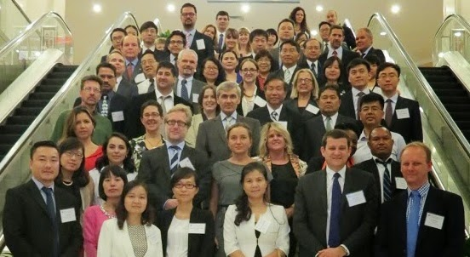
Beijing 2014: Meeting and FSCF Special Session
Beijing meeting held alongside meeting of the Food Safety Cooperation Forum
WRF Working Group Chairs invited to present to FSCF
Notes:
Significant that the WRF met for the first time in an Asian economy and one of the fastest growing wine sectors in the world.
Also significant that the WRF was invited to participate in the FSCF which showed the level of recognition that the WRF was gaining for its innovative and active approach.

Slide 13
Successes of the 2014 Beijing meetings
Outcomes of this meeting included:
Agreement to prepare a draft Model Export Certificate for APEC economies
Establishment of a ring testing programme
Agreement to investigate incorporation of WWTG Tbilisi Principles on Good Regulatory Practice
Issuance of tender to host Compendia
Identification of priority lists of pesticides for which Codex MRLs may be developed
Notes:
This meeting represents the next step in the WRF’s progress because, with the work done within the working groups, it was now able to recommend a number of concrete and practical outcomes

Slide 14
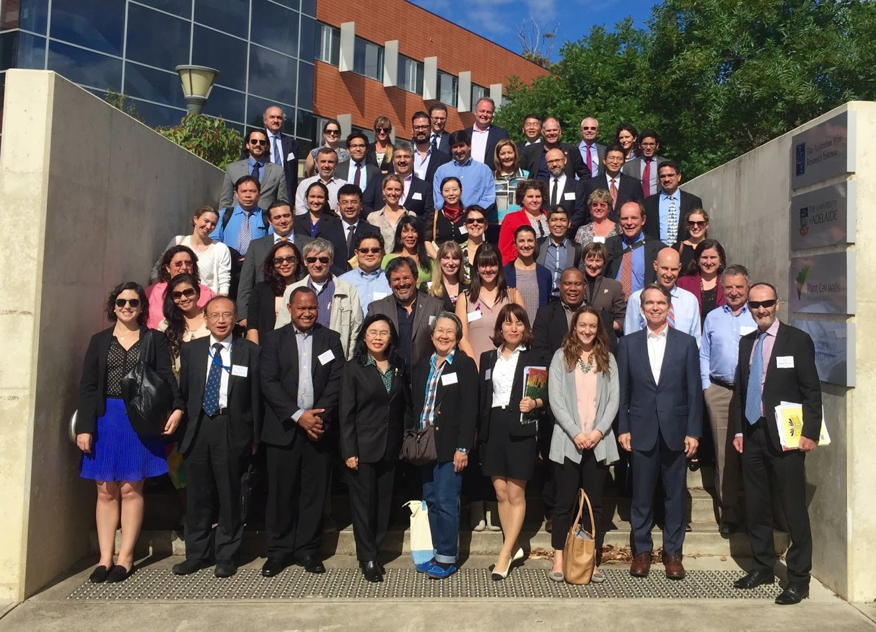
Adelaide 2015: Technical Meeting
Joint session with WWTG
17 APEC economies present
Topics structured around Economy Roundtable and Working Groups

Slide 15
Successes of the 2015 Adelaide meeting
Announcement of the final Model Export Certificate – fulfilling the directions of APEC Trade Ministers
"To increase wine production, to expand trade, and to create jobs in the region, we commit to eliminating unnecessary export certification for wine by 2018 and instruct officials to advance this work." 2014 Joint Ministerial Statement
"We recall the Wine Regulatory Forum’s goal to eliminate unnecessary export certifications by 2018 as a step towards reducing the cost of wine trade in the region and welcome its efforts to develop a consolidated APEC wine certificate.“ 2015 Ministers for Trade Statement
"We note the work of the Wine Regulatory Forum, under the Sub‐Committee on Standards and Conformance (SCSC), on the model wine export certificate as a means to streamline export certificate requirements. We instruct officials to explore other areas where similar trade facilitative initiatives may be applied.“ 2015 Joint Ministerial Statement
Notes:
In this meeting, we see some of the practical results of the previous years’ initiatives as well as some new projects being outlined for the future. The headline result is the announcement of the Model Export Certificate

Slide 16
Successes of the 2015 Adelaide meeting
Other highlights included:
First reporting from the ring-testing programme
Investigation of developing a Compendium of Methods of Analysis
Appointment of FIVS-Abridge as host of Compendia – offering regulators access to a vast range of additional regulatory information from around the world
Creation of a new Working Group on Good Regulatory Practices to look at application of WWTG Tbilisi Principles

Slide 17
Ottawa 2016: Technical Meeting
Joint session with WWTG
14 APEC economies present
Topics structured around Economy Roundtable and Working Groups

Slide 18
Successes of the 2016 Ottawa meeting
Key outcomes included:
Plans to encourage uptake of Model Export Certificate where it could reduce unnecessary requirements
Second reporting from the ring-testing programme and outcomes of workshop held in margins of IWTS
Proposal to develop Compendium of Methods of Analysis
Consideration of draft “Guide to Development of Wine Standards that align with widely accepted International Regulatory Practice”

Slide 19
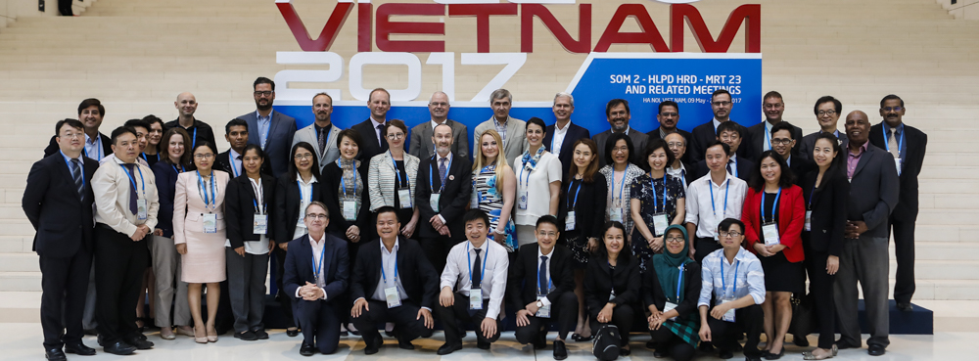
Ha Noi 2017: Building Relationships to Promote Technical Cooperation
Record 19 APEC economies present
Topics included traceability, wine as a low risk product and laboratory accreditation

Slide 20
Successes of the 2017 Ha Noi meeting
Key outcomes included:
Initiation of new project on Certificates of Analysis
Announcement of Chile’s voluntary uptake of Model Export Certificate (followed by impressive updake; also now EU/Mexico negotiations)
Further development of the ring-testing programme
Presentation of a further draft of the Guide to the Development of Wine Standards
Review of Australia’s work on the Guideline for harmonisation of MRLs in light of FSCF project
Notes:
At Ha Noi, we can see that the WRF has used the multi-year project to build several important and useful initiatives that have plenty of scope to evolve even further

Slide 21
Accomplishments 2011-2017
1. Bringing transparency to import requirements for wine exporters
The WRF completed 5 compendia outlining wine-related requirements in APEC economies covering the following topics:
export certificates,
food safety and composition,
pesticide MRLs,
labeling, and
methods of analysis.
Notes:
To summarize, the WRF has accomplished a great deal in the past 5 years. I want to list here the accomplishments noted on the WRF website because I think that they are well stated.

Slide 22
Accomplishments 2011-2017
2. Providing regulators with examples of best practices to consider when revising regulations
The WRF partnered with FIVS-Abridge to provide access to the database for wine regulators so they can compare and contrast their requirements against other economies when considering regulatory changes.
Wine regulators now also have access to FIVS-APACE to assist with good and risk-based regulation of winemaking additives and processing aids.

Slide 23
Accomplishments 2011-2017
3. Reducing the number of required export certificates
Following 2011 WRF dialogue on certification, in 2014 the U.S. and China developed a consolidated wine export certificate that has resulted in a significant reduction of unnecessary certificates issued for trade between those economies.
Based upon this work, in 2016 the WRF created a consolidated APEC Model Wine Export Certificate. Chile was the first economy to implement this certificate (which also has become a model in the dairy sector).

Slide 24
Accomplishments 2011-2017
4. Educating non-producing APEC economies about wine as a unique food product
The WRF brought regulators to wineries and wine testing laboratories in the U.S., New Zealand, Australia and Vietnam. One economy has officially recognized that “wine is a microbiologically low risk food product” and others have become vocal advocates for reduced non-health related testing of wine. [Others recognised?]
5. Increasing the accuracy of testing of wine in regulatory laboratories
The WRF is in the third round of wine ring tests and labs are getting hands-on support to help increase precision and accuracy.

Slide 25
Accomplishments 2011-2017
6. Influencing wine standards in international trade agreements
Two key concepts from the WRF have just found their way into the Distilled Spirits, Wine, and Beer Annex of the USMCA Agreement (NAFTA 2.0).

Slide 26
Final thoughts
These are real, practical achievements that make a difference to regulators and traders
They embody the Bogor goals of reducing non-tariff barriers and improving market access
They have been achieved through a willingness to work together and with other interested groups
There is still plenty more to be done!

