Slide 1
Winemaking –
How humble grapes and tiny microbes create a product we love to make, consume, and regulate.
Paul Huckaba
Analytical Laboratory Manager, Bronco Wine Company
Winemaker, Redwood Vineyards

Slide 2
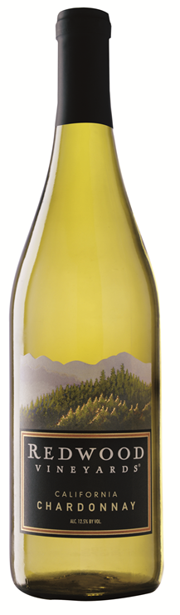
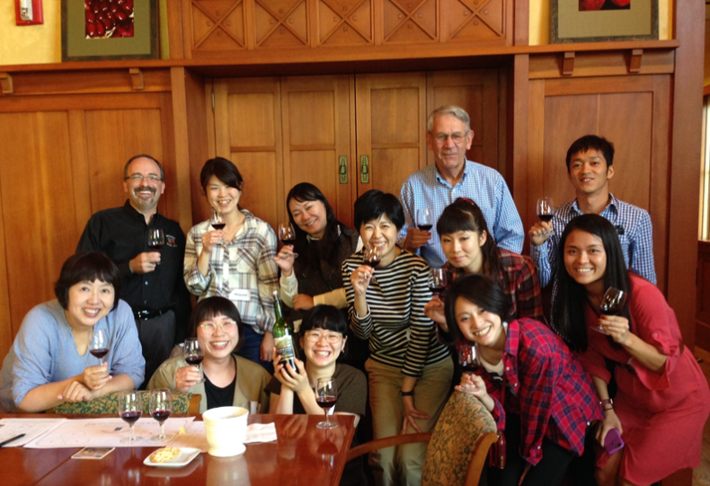
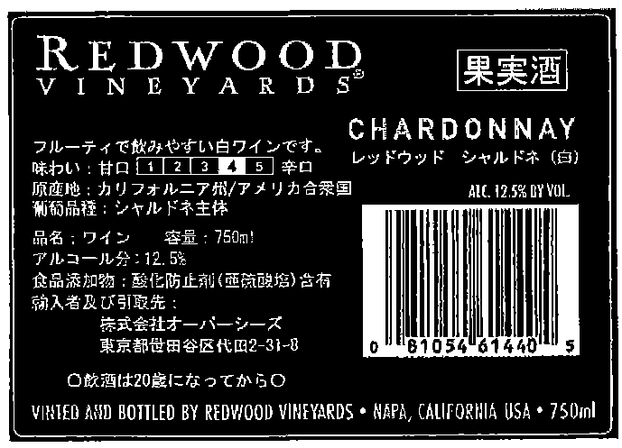
Winemaking – More than just grapes and yeast?
As a winemaker, I have a unique responsibility
  I need to work to make a good product that our customers will enjoy.
  I need to keep in mind that winemaking is affected by Codex Alimentarius, the idea of GMP, 27 CFR §24.246, and other regulations or agreements.

Slide 3
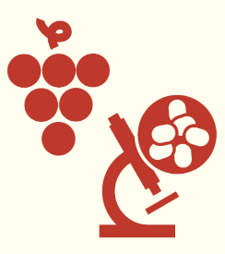
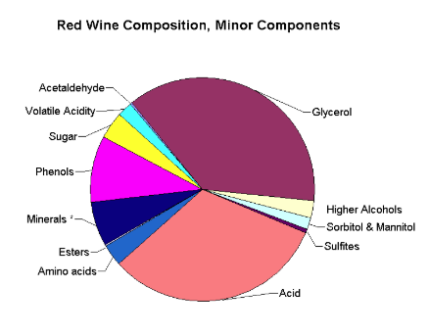
Winemaking – Humble Grapes and Tiny Microbes
Grapes + Yeast = Wine
The wine is made up of
  Water
  Ethanol
  “Minor Components”
These minor components are highly variable due to:
  Region of origin
  Climate conditions
  Grape varieties
  Winemaking practices
  Winemaker style
  Fermentation conditions
  Many other influences
(Copyright 2002, 2004, 2005 Andrew L. Waterhouse, UC Davis)

Slide 4
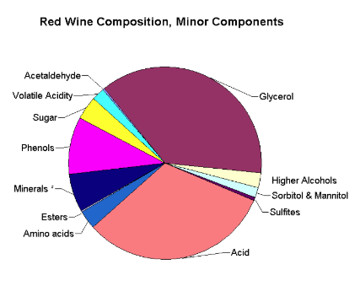
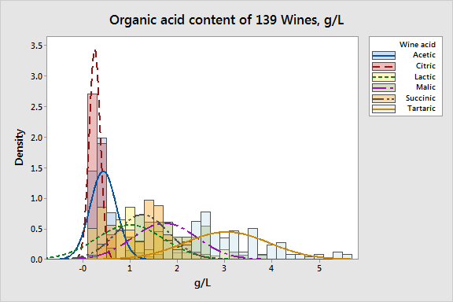
Winemaking – Humble Grapes and Tiny Microbes
“Minor Components” of Wine
Every naturally occurring metal on the Periodic Table has been found in wines, but usually in vanishingly small amounts, and does not pose a health risk.
The variability of something as seemingly simple as acid or metals can be very large.
Manganese in Wine
5
4
Mn concentration (mg/L)
3
2
1
0
Africa
Europe
Oceania
S-America
Region
(Data Courtesy of the Australian Wine Research Institute)

Slide 5
Winemaking – Humble Grapes and Tiny Microbes
“Minor Components” of Wine – Variability
Variability is a natural, unavoidable, and desirable outcome of wine being a product made from a natural raw material such as grapes.
Issues arise when arbitrary limits are enforced on any given component in wine.
Often, the limits imposed on wines do not reflect the natural variation founds between styles and regions, and:
  are not based on science
  are not risk-based
Manganese in Wine
8.0
7.0
6.0
5.0
Mn (mg/L)
4.0
3.0
2.0
1.0
0.0
60
40
20
0
20
40
60
Australian red wines
International red wines
(Data Courtesy of the Australian Wine Research Institute)
Limits such as these can:
Produce serious impediments to trade between economies
Restrict the demonstration of local stylistic characters.

Slide 6
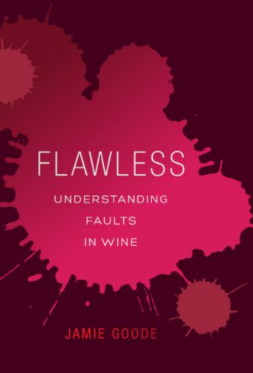
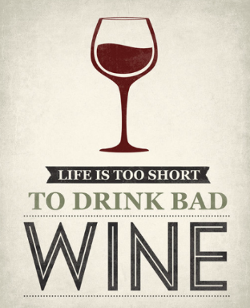
Winemaking – Humble Grapes and Tiny Microbes
When things go wrong…
Despite a winemaker’s best efforts, there can be challenges in the winemaking process.
These often manifest themselves as “Faults”
Wine Faults:
  Are typically due to naturally occurring wine components.
  Become an issue when they are out of balance with the normal expectation due to processing or climatic effects.
  Are primarily driven by consumer acceptance.
They do not pose any risk to human health and safety.

Slide 7
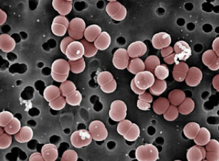
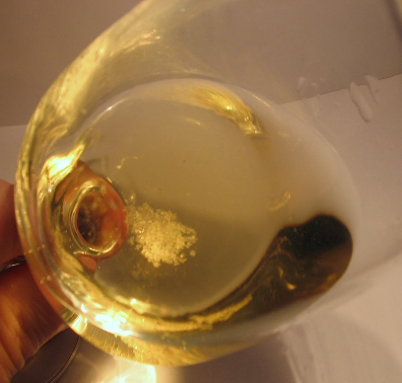
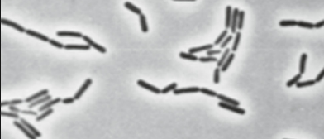
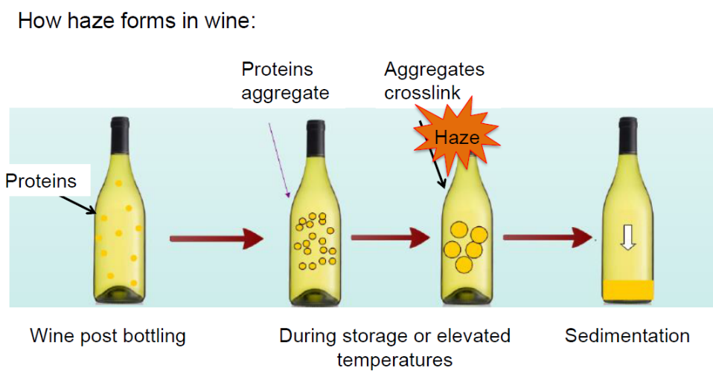
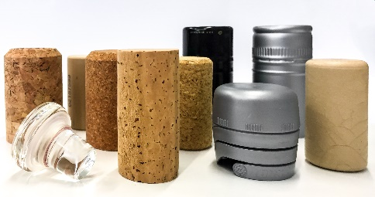
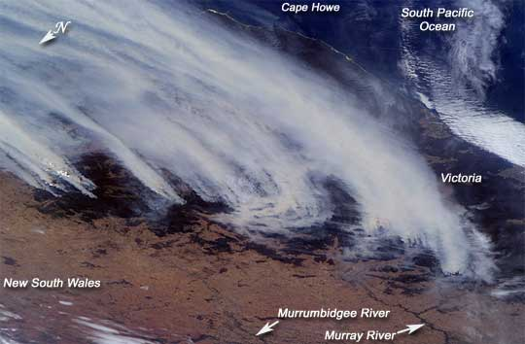
NO Risk to Human Health and Safety
Winemaking – Humble Grapes and Tiny Microbes
Some Examples of Wine Faults
Crystalline Deposits (Tartrates)
Microbiological Issues
Hazes
Cork Taint, Smoke Taint

Slide 8
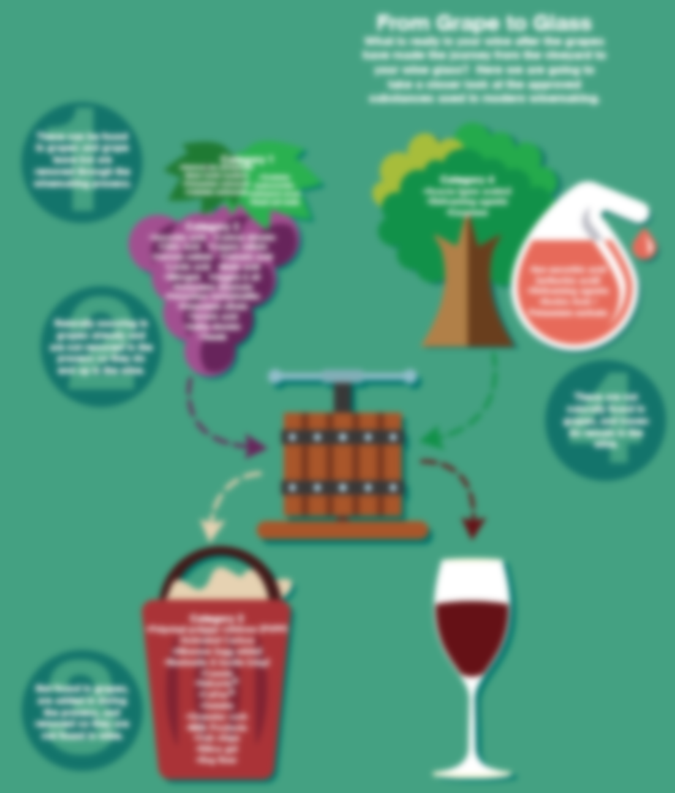
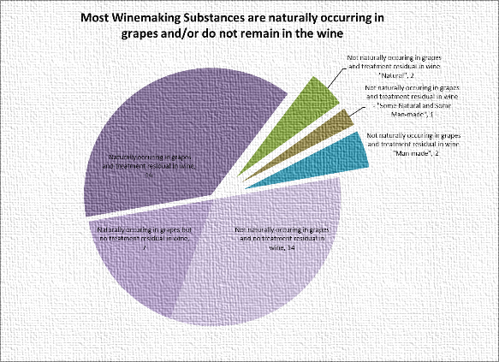
Winemaking – More than just grapes and yeast?
Grapes + Yeast = Wine
Grapes + Yeast + Winemaking Substances = More consistent and reliable fermentations, and better wine.
This is really important to winemaking, but it is one aspect of international trade that can be a source of problems.
  Winemaking Substances can be:
    Naturally Occurring in Grapes and remain
    Naturally Occurring in Grapes and do not remain
    Not Naturally Occurring in Grapes and do not remain
    Not Naturally Occurring in Grapes and remain
      Both from “Natural” and man-made substances
      Winemaking substances are used selectively by winemakers only when needed.

Slide 9
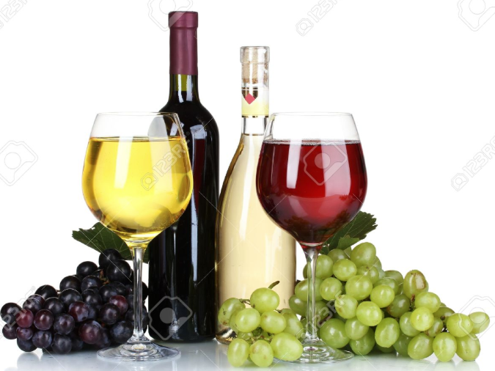
Some interesting facts about
Winemaking Substances
Most of the substances used are naturally occurring
Many of them are found in grapes and wine.
Some examples include:
Very few substances do not occur naturally and also remain in the wine to any extent.
Malic Acid | Albumen/Egg White
Lactic Acid | Casein/Milk Products
Citric Acid | Enzymes
Potassium Bitartrate | Granular Cork
Tartaric Acid | Oak Chips
Tannin | Bentonite
Yeast | Isinglass
Sulfur Dioxide | Gelatin

Slide 10
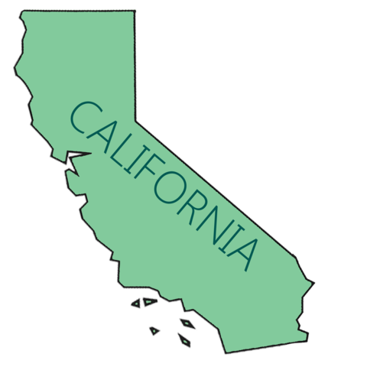
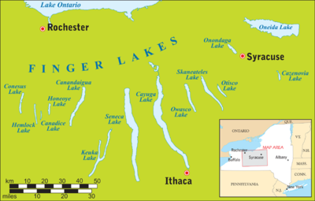
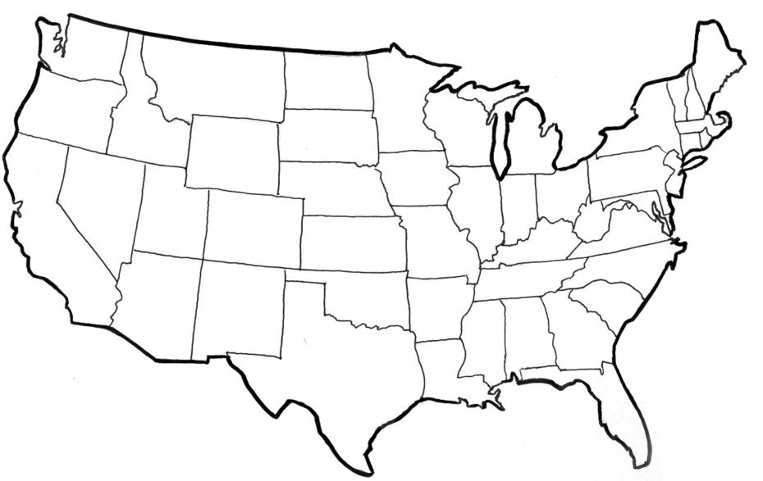
Some interesting facts about
Winemaking Substances
The substances that naturally occur in grapes and wine and that are introduced simply to adjust the level of the same substance already present may be a special class of additives and not need labeling. To do so could confuse or mislead consumers.
Citric acid – If I add it, this doesn’t mean that my wine is always more “acidic” than a wine from a cooler growing area.

Slide 11
Additives and Processing Aids
Food Additive means any substance not normally consumed as a food by itself and not normally used as a typical ingredient of the food, whether or not it has nutritive value, the intentional addition of which to food for a technological (including organoleptic) purpose in the manufacture, processing, preparation, treatment, packing, packaging, transport or holding of such food results, or may be reasonably expected to result, (directly or indirectly) in it or its by-products becoming a component of or otherwise affecting the characteristics of such foods. The term does not include “contaminants” or substances added to food for maintaining or improving nutritional qualities.
Processing Aid means any substance or material, not including apparatus or utensils, and not consumed as a food ingredient by itself, intentionally used in the processing of raw materials, foods or its ingredients, to fulfil a certain technological purpose during treatment or processing and which may result in the non-intentional but unavoidable presence of residues or derivatives in the final product.
(Source: http://www.fao.org/docrep/005/y2200e/y2200e07.htm )
Examples:
Lactic Acid
Malic Acid
Oak
Sulfur Dioxide
Tannins
Tartaric Acid
Examples:
Bentonite
Carbon Dioxide
Casein
Egg Albumin
Nitrogen

Slide 12
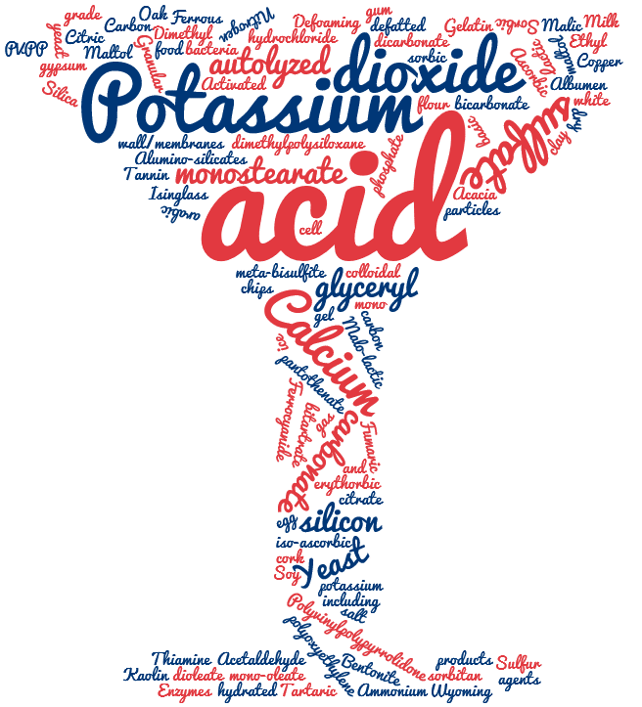
Additives and Processing Aids
To distinguish between these two can be difficult
  Does it remain?
  Is it removed, or is it intended that most of it is removed?
Citric Acid?
Activated Carbon?
Tartaric Acid?
Diammonium Phosphate?

Slide 13
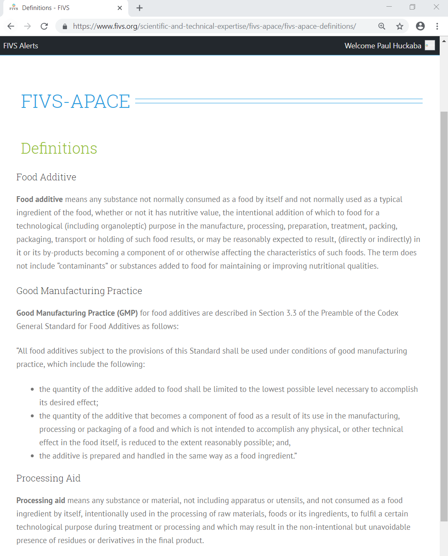
Additives and Processing Aids
A helpful resource:
  FIVS – APACE
  Additives and
    Processing
    Aids
    Codex for
  Enology

Slide 14
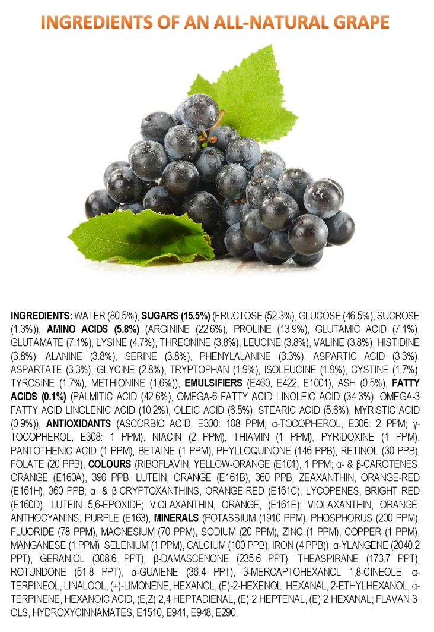
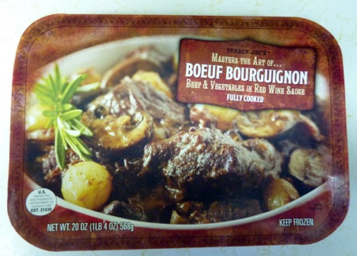
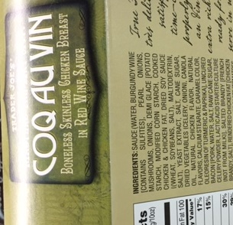
Wine is a single ingredient food
It is a historical beverage (8,000⁺ years)
The customer understands what it is
There is precedent
European Community (2009) AGRICULTURAL PRODUCT QUALITY POLICY: IMPACT ASSESSMENT
  “…single-ingredient processed product (wine, olive oil, etc.)…”
  “-Single-ingredient pressed or processed products (wine, dairy products including cheese, olive oil, coffee, tea, fats and oils, sugar, tobacco)”
http://ec.europa.eu/agriculture/quality/policy/com2009_234/ia_annex_a1_en.pdf
(https://jameskennedymonash.wordpress.com/)

Slide 15
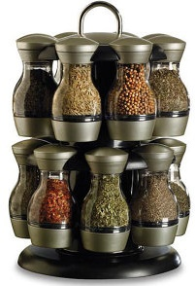
Wine is not a recipe product
Not all the substances are used for every wine
  Grape Color / Grape Variety
  Winemaking Style
  Grape Region / Vineyard / Part of each vineyard
Winemakers don’t use everything on the list
  Quality considerations
  Cost considerations
I don’t even use the same things each year, or each time I bottle.
Vintage | Year 1 | Year 1 | Year 2 | Year 2 | Year 3 | Year 4
Blend Month | March | June | August | January | August | September
Total Acidity | 6.16 g/L | 5.28 g/L | 4.85 g/L | 4.77 g/L | 5.91 g/L | ?
Add Citric Acid? | No | 5 units | 8 units | 7 units | No | ?

Slide 16
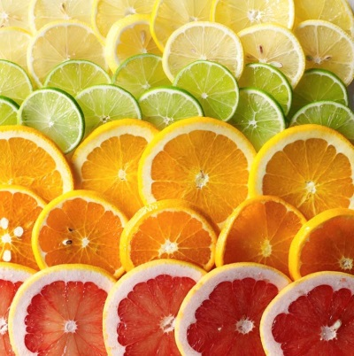
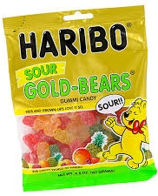
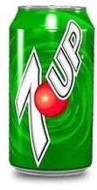
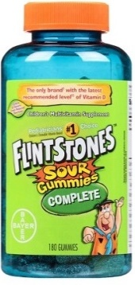
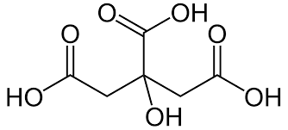
Winemaking substances are safe
The substances permitted in wine are safe to the consumer. The vast majority are either foodstuffs themselves, occur naturally in grapes / wine, or else have been evaluated by JECFA and given an “ADI not specified” designation.
  JECFA – Codex Alimentarius Joint Expert Committee on Food Additives
  ADI – Acceptable Daily Intake – “the amount of the additive, expressed on a body weight basis, that can be ingested daily over a lifetime without appreciable health risk (notionally ‘zero’ risk).”
    ADI not specified – “the total daily intake of the substance…does not …represent a hazard to health” (http://www.fao.org/docrep/008/ae922e/ae922e05.htm)
Citric Acid

Slide 17
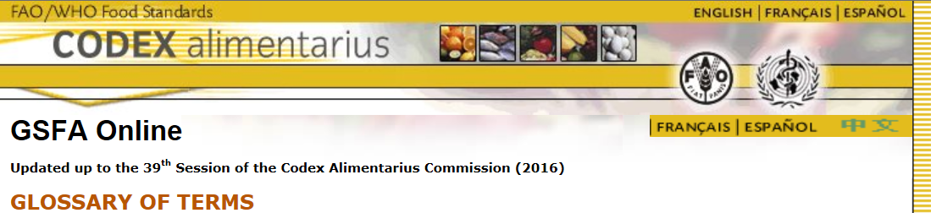
Numerical Limits vs. GMP
What does GMP mean?
The Codex Alimentarius General Standard for Food Additives (GFSA) states:
  "All food additives subject to the provisions of this Standard shall be used under conditions of good manufacturing practice, which include the following:
    the quantity of the additive added to food shall be limited to the lowest possible level necessary to accomplish its desired effect;
    the quantity of the additive that becomes a component of food as a result of its use in the manufacturing, processing or packaging of a food and which is not intended to accomplish any physical, or other technical effect in the food itself, is reduced to the extent reasonably possible; and,
    the additive is prepared and handled in the same way as a food ingredient."
http://www.fao.org/gsfaonline/reference/glossary.html

Slide 18
Numerical Limits vs. GMP
By convention, Codex sets usage levels for an additive at GMP where there is no numerical ADI (“ADI Not specified”).
Numerical Limits can cause trade issues due to:
  Differences in markets
  Confusion due to different scientific units used to express those limits
    examples: g/L, g/kg, mg/mL, mg/cm³, mg/L, mg/dm³, mg/kg, ppm, meq/L
How might Numerical Limits affect Citric Acid use in the blend I’m making?
  What if I wanted to export this to another country?
  What if they had a numerical limit, especially if it wasn’t based on health concerns?
  What if they had GMP as a usage guide?
  Numerical Limits – sometimes based on usage?
    Citric Acid – a Sequestrant? an Acidifier? a Stabilizer?

Slide 19

What about Codex Alimentarius Substances?
Codex allows only the following five compounds for grape wines (14.2.3):
  Dimethyl Dicarbonate (DMDC)
  Sulfites
  Carbon Dioxide (CO₂)
  Sorbates/Sorbic Acid
  Lysozyme
    (http://www.fao.org/gsfaonline/docs/CXS_192e.pdf)
What happens when an economy just allows these five?
What is missing from this list that a winemaker might want to use?
  Acidifying agents, Fining agents, Yeast Nutrients, other?

Slide 20
Trade Issues…
There is potential for complications arising from the use of synonyms to describe the substances permitted for use in winemaking
  Synonyms Confusion
Tartaric Acid CAS #526-83-0
(D,L)-Tartaric Acid
2,3-Dihydroxysuccinic Acid
Threaric Acid
Racemic Acid
Uvic Acid
Paratartaric Acid
L(+) Tartaric Acid CAS #87-69-4
Synthetic L(+) Tartaric Acid
  Confusing names
DAP - Diammonium Phosphate, CAS #7783-28-0
DAP is also known as Diammonium hydrogen phosphate, Ammonium monohydrogen phosphate, and Ammonium phosphate, dibasic. DAP is a fermentation promoter, serving as a source of nutrition for yeast.
Molecular formula = (NH₄)₂ HPO₄
Ammonium Phosphate, CAS #10361-65-6
Ammonium phosphate is also known as Triammonium phosphate. Ammonium phosphate is a highly unstable compound and not used in winemaking.
Molecular formula = (NH₄)₃ PO₄
Ammonium Dihydrogen Phosphate, CAS #7722-76-1
Ammonium dihydrogen phosphate (ADP) is also known as Monoammonium phosphate. Ammonium dihydrogen phosphate forms large crystals and widely used in the field of optics. It is also used in some fire extinguishers.
Molecular formula = NH₄ H₂PO₄
  C hemical
  A bstracts
  S ervice

Slide 21
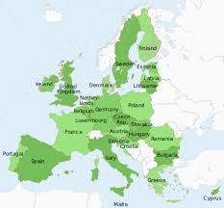
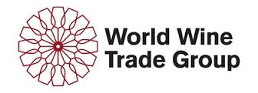
More Trade Issues
Trade issues can occur where different (but safe) winemaking practices are permitted in different markets.
Approaches to resolve these trade issues:
    Harmonization – This is potentially difficult in scenarios where there is no existing movement to create a single market. An example that does work is in the European Union where there is a , harmonized set of regulations for the 28 member states. (Commission Regulation EC 606/2009)
    Mutual Acceptance approach – The World Wine Trade Group (WWTG) uses this approach. Simply put, if the substance is safe, an importing economy will accept wines made with the substance, even if it is not allowed in their economy.

Slide 22
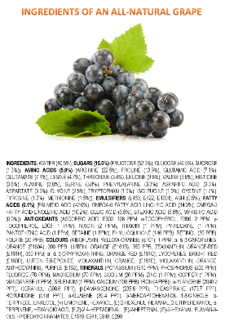
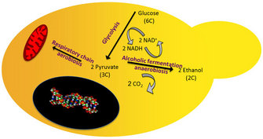
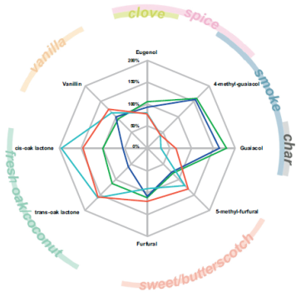
More Trade Issues
Trade issues can develop around “adventitious substances” in wine
  Sources can include:
    Grapes
    Yeast or Bacteria Fermentation products
    Oak-related compounds
      Eugenol
      Isoeugenol
      Furfural
      5-Methylfurfural
      Guaiacol
      4-Methylguaiacol
      Oak Lactones (cis- and trans-)
      (http://winefolly.com/review/oaking-wine)
Just because a compound is present in wine, that isn’t a guarantee that it was directly added.
(www.bouchardcooperages.com)

Slide 23


Conclusions
Grapes and Wine are highly variable.
Winemaking Substances are safe.
  Most are naturally occurring.
  Most supplement what is already present.
Because grapes vary, the substances (and amounts) used will vary.
A GMP approach, particularly when the ADI is “not specified”, can remove many barriers to trade.
Using the 5 Winemaking Substances in Codex is not enough.
Where possible, can we identify unnecessary barriers to trade and…
  Eliminate sources of confusion?
  Promote an understanding of the compounds found in wine?
  Remove these barriers?

Slide 24
Discussion Questions
Where in your regulations is the list of allowed winemaking materials for your economy?
How are materials added to or removed from the list?
On what criteria, or on which standards, do you base your list of winemaking materials?
  (for example, OIV, Codex list, JECFA–“ADI not specified”, etc.)

