Slide 1
Good practice norms in wine regulation
A Guide to the Development of Wine Standards

Slide 2
Guide to Development of Wine Standards
Progress so far…
Initial Draft
Initial WG draft & first rounds of comments
Oct 16
Presented. Comments received
March draft
Revised & WG review
Comments
Still to come…
APEC WRF
Today
Present and discuss May draft
Review
Final review & comment
Note as reference document

Slide 3
Why a Guide to Developing Wine Standards?
All grape wine is fundamentally the same: a single ingredient product
All wine regulation has same goals:
Safety, traceability [consumer protection]
Truthful description [consumer choice]
Facilitate trade [economic growth]
But there is no single approach to wine regulation around the world

Slide 4
Many differences in wine regulation…
Differing:
definitions for common terms
permitted additives / processing aids
use limits for those
labelling requirements
permitted winemaking practices
approaches to substances occurring in wine
This can be challenging for both regulators and winemakers

Slide 5
There are accepted wine regulatory norms
Despite differences, there are commonly accepted international good practice norms. Embodied in:
WWTG Labelling Agreement
Bilateral agreements: eg - ANZ Food Standards Code - Australia-EU Wine Agreement
Annex to the TPP Agreement
Wealth of experience within APEC WRF of addressing technical trade barriers for wine

Slide 6
What will the guide be?
A reference source for our economies to consult when creating or reviewing wine standards
Not intended to be adopted as a standard
Body of good practice wine standards; a reference of norms that:
Are appropriate to protect consumers
Protect product integrity
Minimise impediments to international trade

Slide 7
Ultimate outcome?
It is hoped the Guide…
Will facilitate economies’ comparison of standards
Will facilitate cooperation between regulators
May eliminate unnecessary analyses
May encourage alignment between economies, and so facilitate trade

Slide 8
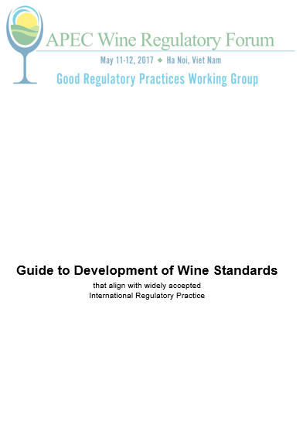
What’s in the guide?

Slide 9
What’s in the guide?
Main sections cover:
Clear definitions of common concepts
Labelling conventions
Winemaking practices, including reference to commonly accepted:
wine additives and processing aids
discussion of limits that are applied to certain practices
Common wine composition considerations

Slide 10
Content examples - definitions
alcohol content means the concentration of alcohol, by volume of ethanol at a temperature of 20˚C, typically expressed as percentage of ethanol: eg “12% alcohol by volume”
label means any brand, mark, pictorial or other descriptive matter that is written, printed, stencilled, marked, embossed or impressed on, or firmly affixed to the container of wine;

Slide 11
Content examples - labelling
“Single Field of Vision” labelling:
“wine”
country of origin (place where grapes grown)
% alc; and
volume of contents
all visible without turning container
Any other information may appear anywhere on the container

Slide 12
Content examples – labelling
Other common labelling concepts:
use-by dates / sell-by date not required,
lot numbers / identifiers
alcohol tolerance (label accuracy)
Allergens to be labelled
Permitted additives and processing aids not labelled
country of origin

Slide 13
Content examples - labelling
Other information noted as typically not required (but can be given), eg:
sweetness indications
harvest dates
winemaking practices
vineyard management practices
Use of robust “overstickering” (esp useful for imported product)

Slide 14
Content examples – good winemaking practices
Recognition of diverse winemaking practices:
Climate, soil, varieties, styles and winemaking history varies around the world
Materials, processes, treatments and physical techniques also vary
Legitimate and diverse practices are used around the world eg to achieve stability, longevity
All should be used to the minimum extent necessary to achieve the desired effect

Slide 15
Content examples – additives and aids
Generally permitted wine additives and processing aids
Notes commonly used ones
Reliable sources of guidance on typical safe limits:
JECFA,
APEC Wine Regulatory Forum Food Safety Compendium
Other wine composition matters
Minerals and naturally occurring substances
Alcohol content, Carbon Dioxide, acidity

Slide 16
Guide to Development of Wine Standards
Progress so far…
Initial Draft
Initial WG draft & first rounds of comments
Oct 16
Presented. Comments received
March draft
Revised & WG review
Comments
Still to come…
APEC WRF
Today
Present and discuss May draft
Review
Final review & comment
Note as reference document

Slide 17
What now?
Encourage economies to review the revision that will follow this meeting
Provide any remaining comments through GRP WG
WG will finalise and bring revised draft to next APEC WRF meeting for noting as a APEC WRF reference document.

