Slide 1
Risk-Based Regulatory Intervention & Evidence-Based Review
Jonathan Breach – Head of Quality & Regulatory Affairs, Accolade Wines Australia

Slide 2
Acknowledgements – contributing content co-authors
Paul Huckaba – Bronco Wine Company
Anne Kraus – E&J Gallo Winery
John Thorngate – Constellation Wines

Slide 3
In 1538, the alchemist and physician Philippus Aureolus Theophrastus Bombastus von Hohenheim, also known as Paracelsus wrote
“All things are poison, and nothing is without poison, the dosage alone makes it so a thing is not a poison.”
It also marks, perhaps for the first time, the clear articulation of an overt concern about the principles of product safety and consumer protection.

Slide 4
Legislative Control and Limits
Primary function is consumer protection:
Hazardous Product (Health & Safety)
Unfit Product (Non-safety related Quality)
Fraudulent Product (Consumer protection & Brand reputation)
Misuse of Product (Health & Social Licence)

Slide 5
Legislative Control and Limits
Risk-based Regulatory Intervention is applicable to a breadth of issues involving wine:
Maximum Residue Limits of Agrochemicals from Viticulture
Addition/Use Limits for Winemaking Additives & Processing Aids
Residual Heavy Metal & Natural Toxicant limits
Limits to unintended by-product contaminants arising from lack of GMP
Minimum font/logo height on labels for awareness & comprehension
Specifications on food contact materials
Compositional requirements on minimum blending to prevent consumer deception / meet consumer expectations
Restrictions of times, locations and manner by which we advertise

Slide 6
Legislative Control and Limits
Risk-based Regulatory Intervention is applicable to a breadth of issues involving wine:
Maximum Residue Limits of Agrochemicals from Viticulture
Addition/Use Limits for Winemaking Additives & Processing Aids
Residual Heavy Metal & Natural Toxicant limits
Limits to unintended by-product contaminants arising from lack of GMP
Minimum font/logo height on labels for awareness & comprehension
Specifications on food contact materials
Compositional requirements on blending to prevent consumer deception
Restrictions of times, locations and manner by which we advertise

Slide 7
The Issue With Technology Developing Faster Than Regulation
Problem:
Analytical chemistry is identifying new substances and detecting them at lower and lower concentrations.
In today’s regulatory framework, detection of any amount of a substance that does not have an agreed regulatory limit could lead to trade barriers.

Slide 8
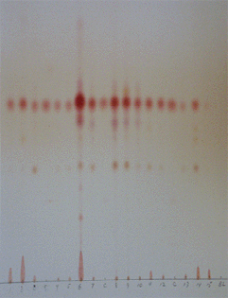
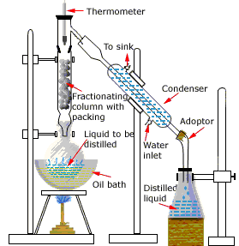
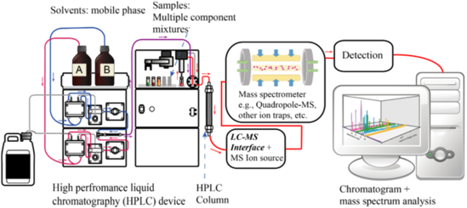
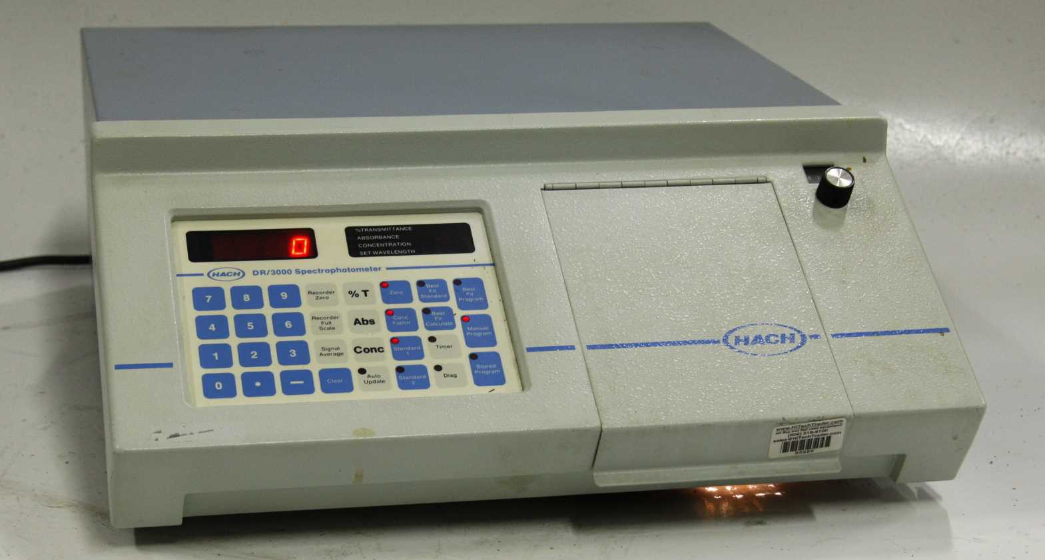
The Issue With Technology Developing Faster Than Regulation
Many of these compounds are being detected at trace amounts where often there is little or no toxicological data available
Past
Present

Slide 9
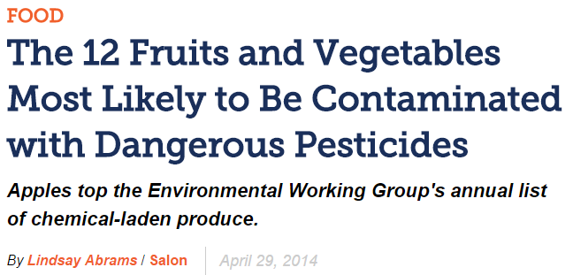
The Issue With Technology Developing Faster Than Regulation
Additional problem: The ability to detect a much larger range of chemicals with increasing levels of sensitivity is frequently being presented in the media as a latent risk to public health in the absence of evidence.

Slide 10
Codex Alimentarius
An organization run by the FAO and the WHO with the objective of supporting food safety and international trade.
The Codex Committee on Contaminants in Foods (CCCF) has developed criteria to guide development of chemical limits:
Limits should be set to protect public health.
Limits should be set based on GMP or GAP to establish a level as low as reasonably achievable.
Limits should not be set lower than it can be analyzed for using a readily available validated method.

Slide 11
Hazard identification
Hazard assessment
Exposure assessment
Risk assessment
Risk management
Identification of a chemical in a food
Calculate a safe level – threshold
Estimate exposure
Compare threshold to exposure to define risk
Define risk management plan
Analytical Science
Identifies chemical
Generates data to support exposure estimate
Use of validated methods to verify risk management measures
Toxicology
Defines the safe level or threshold
Calculates exposure
Determines if there is a safety concern

Slide 12
The Issue With Technology Developing Faster Than Regulation
To measure a chemical’s toxicity, risk assessors carry out animal dose/response studies to determine “how much is too much?”
The study’s outcome, incorporating a multiplicative safety factor, will be some measure of recommended exposure to mitigate the hazard;
e.g., Safe human dose (SHD), Acceptable Daily Intake (ADI), Tolerable daily Intake (TDI) or the Joint FAO/WHO Expert Committee on Food Additives’ (JECFA) Provisional Tolerable Weekly Intake (PTWI).

Slide 13
Cast Study 1
IMPACTED
83 wines
31 brands
23 companies
Claimed certain wines contain unsafe levels of arsenic based on the limit set by the US Environmental Protection Agency (EPA) for drinking water and Food and Drug Administration (FDA) for bottled water – 10 parts per billion (ppb).
13.5 glasses
3 bottles
The 10 ppb limit is based on typical US consumption of water (2 L/ day).
Moderate US wine consumption (1-2 glasses/day = 0.15-0.3 L/day).
A 10 ppb limit for wine is therefore, overly conservative.
2 L/day
The lawsuit on arsenic has been dismissed in two successive sets of court proceedings.
Thresholds are often times not a “one size fits all” and
consideration of exposure is necessary when utilizing thresholds.

Slide 14
Case Study 2
A recent survey found that white wines averaged 36 mg/L and Red wines averaged 29 mg/L of lead, levels above drinking water standards (The U.S. EPA drinking water action level for lead is 15 mg/L and the EU standard is now 10 mg/L). Does this imply wine needs to be regulated for lead?
A “technological” approach based solely upon ability to detect and quantify would note that the concentrations are measurable and thus, de facto, represent a hazard.
A “toxicological” approach would assess the risk based upon the dose.
(Towle et al., International journal of food contamination 4:7, 2017)

Slide 15
Case Study 2
Based upon wine consumption data from the NHANES database, and an average exposure scenario, an adult would have to drink 9 glasses of white wine/day or 11 glasses of red wine/day to raise their blood lead level to the U.S. Centers of Disease control and prevention (CDC) guidance level of 5 mg/dL. This assumes a 150mL pour, meaning that a consumer would have to drink roughly 2 bottles of wine a day to reach the guidance level.
Towle et al. concluded that “Overall, findings suggest that Pb content in wine does not pose a health risk to adult wine consumers.”

Slide 16
TbIlisi principle #1
The World Wine Trade Group (WWTG) formally adopted a set of principles in Tbilisi, Georgia in 2014, the purpose being to remove unnecessary obstacles to international trade.
This set of 11 principles, the Tbilisi statement on analytical methodology and regulatory limits, derived from a set of 12 principles previously adopted by the international alcohol beverage industry organization, FIVS.
Principle #1, avoiding unnecessary analyses, states:
Governments should establish regulatory limits that are based on risk, thereby avoiding unnecessary analyses.

Slide 17
Risk Management Continuum
The tools for the management of Risk is a continuum.
If there is no significant quantum of risk – there may be no justification for regulation.
If there is a quantifiable risk – is the strategy always the legislative approach?

Slide 18
Does a characteristic about wine need regulation?
Rationale
Health
Quality
Authenticity
Market failure
Relevance
Environmental
Production-related
Post-market
Acknowledged by another market or authority
Risk
What is the least interventionist step that can be taken to eliminate/minimise risk to an acceptable level?

Slide 19
Critical Features For Regulatory Limit/Requirement
Proportional – costs & administration
Accountability – clarity on ownership & authority
Consistency – predictable and aligned with international best practice
Transparency – clarity on targets/expectations & process
Targeted – specific to addressing risk without unintended consequences

Slide 20
Critical Features For Regulatory Limit/Requirement
Self-Regulation
Industry Codes of Practice or Technical Standards
Quasi-Regulation
Codes of Practice or Technical Standards by “Arms-Length” Body
Co-Regulation
Codes of Practice or Technical Standards administered by Industry/Arms Length but underpinned by legislation
Regulation by the State
Statutory Agency or Government Dept acting under authority of legislation

Slide 21
Critical Reasons For Regulatory Review
Risk Drivers
Original causes of identified risk removed or changed
Technology & Production Methods
Change in industry practices removes or changes risk
Changed Trading Conditions
Changes in consumer behaviour, market demand or global regulation

Slide 22
Regulatory responses to benchmarked risk but changing technology
FIVS’s “12 Principles” (otherwise synonymous with WWTG 11 Principles)
Better regulatory certainty:
Consider the establishment of analytical “de minimis” values for substances or classes of substances in wine - values below which they will be deemed to all intents and purposes not to be present in the wine.

Slide 23
Not just an issue of safety, but identity
Many wines use grape derived additives and processing aids (tartaric acid, tannins, etc) which has in some jurisdictions caused concern over “Country of Origin” labelling claims.
i.e. if you have a Chilean wine but used French-made Tannins, is it still a “Product of Chile”
Solution in Australia is use of a “de minimis” clause for approved additives/processing aids.
Entirely consistent with common Free Trade Agreement clauses setting “non-originating material” thresholds for tariff reduction.

Slide 24
Jurisdictions with Regulatory Impact & Effective Regulation Frameworks
United Kingdom – Better Regulation Framework (August 2018)
https://www.gov.uk/government/publications/better-regulation-framework
Australian Government Guide to Regulation (2014)
https://www.pmc.gov.au/resource-centre/regulation/australian-government-guide-regulation
New Zealand – Regulatory Institutions & Practices (2014)
https://www.productivity.govt.nz/sites/default/files/regulatory-institutions-and-practices-final-report.pdf
OECD - Recommendation of the Council on Regulatory Policy and Governance (2012)
http://www.oecd.org/gov/regulatory-policy/2012-recommendation.htm

Slide 25
Evidence Based Consensus Building
Applicable to both the evaluation of regulatory need, and the review of ongoing regulatory relevance.
Clear advantages for a government agency able to work with industry to articulate risks, identify a range of solutions and consult on commitment.
Such an approach is also more likely to achieve the right regulatory intervention, commensurate to risk, through consensus.

Slide 26
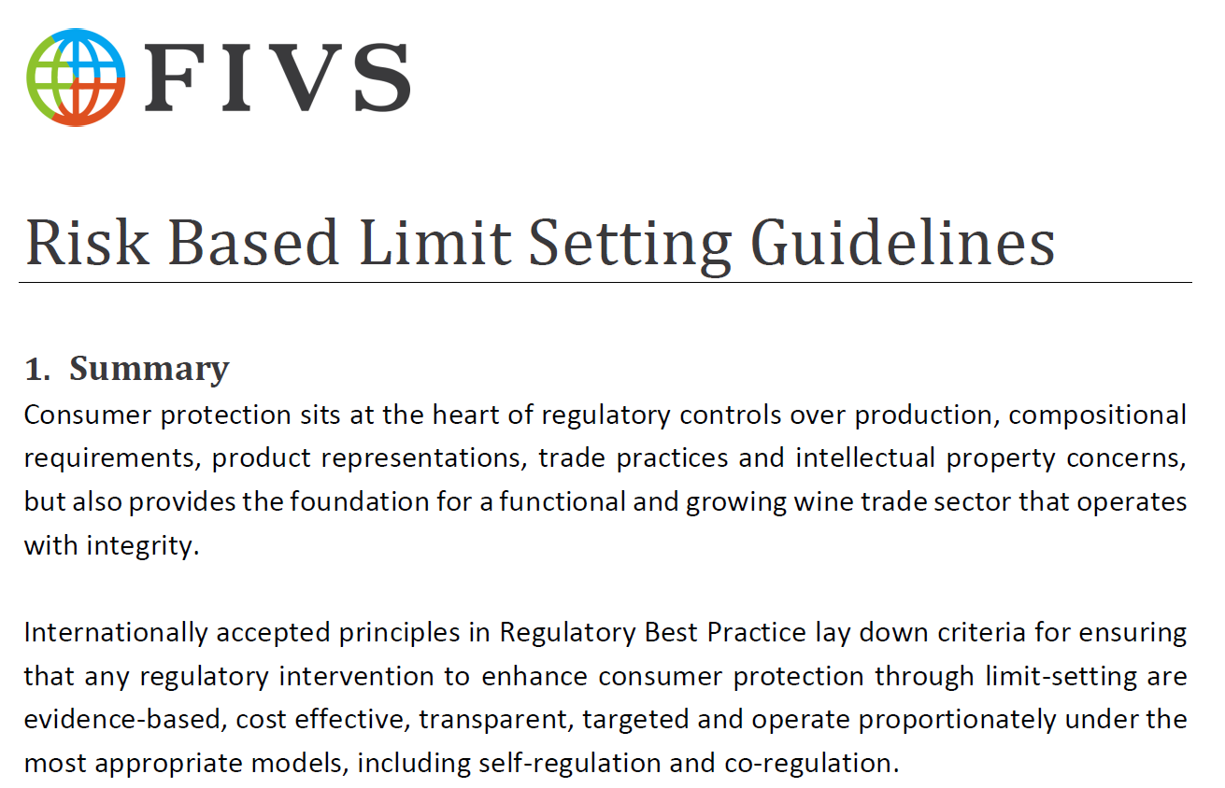

Slide 27
Opportunities for sharing of best practice regulation amongst APEC economies
How many economies have a clear policy or procedure on the systemic criteria for justifying new regulation?
How many economies have a dedicated agency or government department charged with oversight of potential regulatory impact on economy, trade & bureaucracy?
How many economies have dedicated review procedures for regulatory reform, “red tape” reduction and evaluation of the effectiveness of regulation?
Thank you.

