Slide 1
Certificates of Analysis What They Can Tell Us and What They Cannot
Paul Huckaba
Analytical Laboratory Manager, Bronco Wine Company

Slide 2
Certificates of Analysis
Overview:
Background
FIVS Papers on Certificates of Analysis for Safety and Authenticity
Is Wine an Inherently Safe product?
Can Basic Testing Show Authenticity?
Can Basic Testing Show “Quality”
Are Certificates of Analysis Necessary?
Summary, and a Question to Consider

Slide 3
Certificates of Analysis
“The Tbilisi Statement”
“The ‘Statement on Analytical Methodology and Regulatory Limits’ was adopted to remove unnecessary obstacles to international wine exports. The principles, finalized at the trade group's annual meeting in Tbilisi, Georgia on Aug. 25-26, 2014, were proposed to address a continuing pattern of wine trade barriers. Many countries establish unnecessary rules which delay and add to winery costs, resulting in restricted market access and trade.”
(https://www.wineinstitute.org/resources/pressroom/09022014)
Tbilisi Statement, Principle #01 - AVOID UNNECESSARY ANALYSIS
“GOVERNMENTS SHOULD ESTABLISH REGULATORY LIMITS THAT ARE BASED ON RISK, THEREBY AVOIDING UNNECESSARY ANALYSIS.”

Slide 4
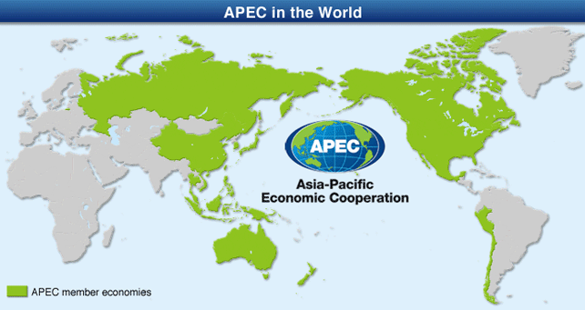
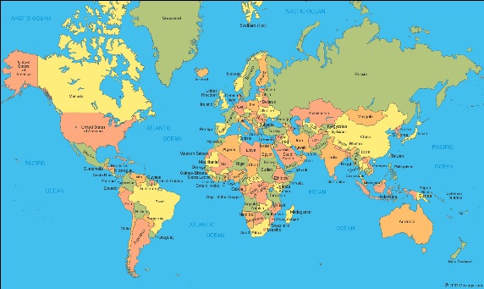
Certificates of Analysis
In the APEC region, “…the costs of unnecessary testing and certification in the region (were) estimated at 1 billion USD per annum.”
$1,000,000,000 USD
$?,???,???,??? USD

Slide 5
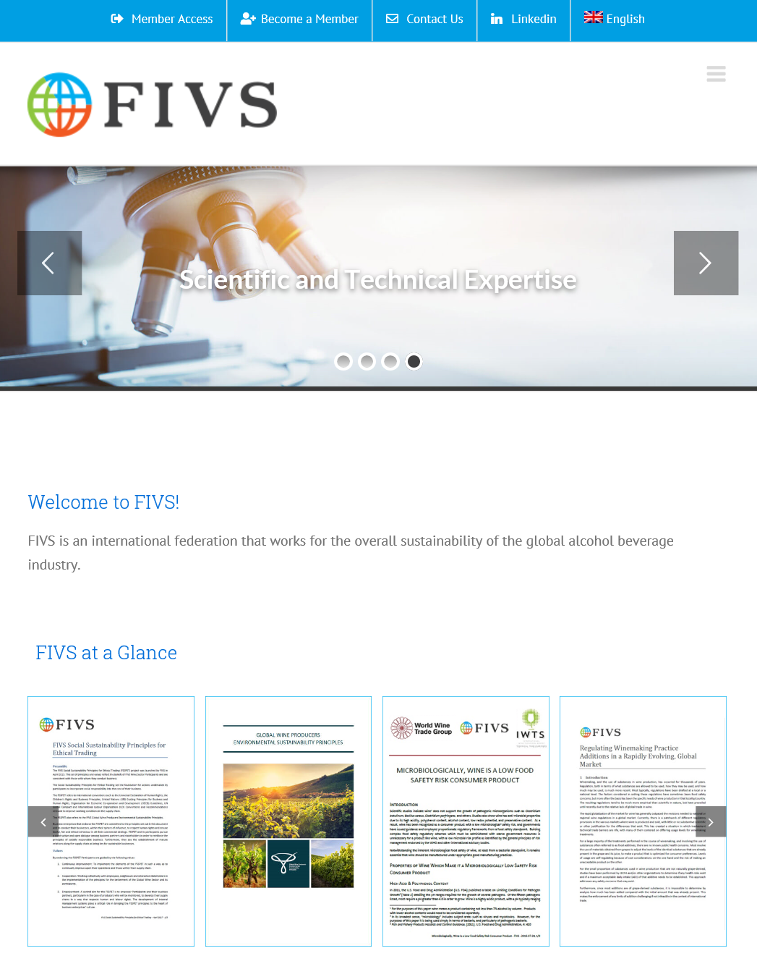
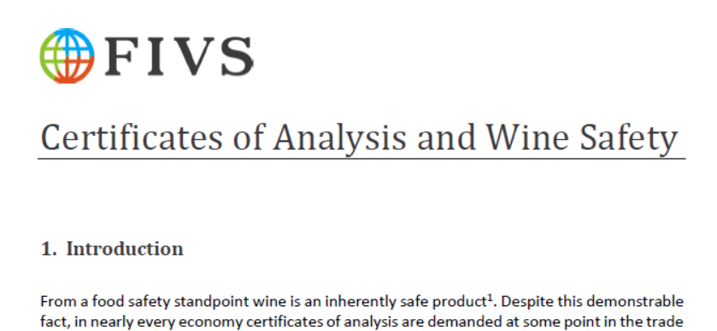
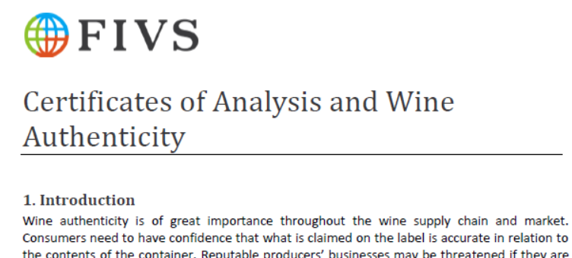
Certificates of Analysis
FIVS Papers on Certificates of Analysis
Wine Safety
Wine Authenticity
www.fivs.org

Slide 6
Certificates of Analysis – Safety
Is Wine an Inherently Safe Product?
A Collection of “Requested” Tests for COAs
Appearance | Hybrids | Stability at -5°C
Bacteria, cultured | Iron | Sucrose
Calories | Lead | Sugar Free Extract
Citric Acid | Limpidity | Titratable Acidity (TA)
Color (sensory evaluation) | Methanol | Total Alcoholic Strength
Copper | Molecular Sulphur Dioxide (SO2) | Total Dry Extract
Density | pH | Total Sugar (Reducing Sugar - Inverted)
Ethanol | Reducing Sugar | Total Sugar
Free Sulphur Dioxide (SO2) | Remaining Extract | Total Sulphur Dioxide (SO2)
Fungus, cultured | Sorbic Acid | Volatile Acidity (VA)
Gas Pressure at 20°C | Specific Gravity | Volume per Bottle
Glucose + Fructose (sugars) | Stability at 55°C | Yeast, cultured
(ETS Labs (2017), Analysis for Exports. St. Helena, California, USA.)

Slide 7
Certificates of Analysis – Safety
Is Wine an Inherently Safe Product?
We can group tests into 6 main categories
Health and Safety – (e.g., Total SO₂)
Wine Quality and Legality – (e.g., Ethanol, Methanol, VA)
Additive Levels – (e.g., Sorbic Acid, Citric Acid)
Microbiological – (e.g., Yeast, Bacteria, Mold, “Fungus”)
Physical Characteristics – (e.g., Stability, Color, Limpidity)
Typical Wine Parameters – (e.g., pH, Sugars)

Slide 8
Certificates of Analysis – Safety
Is Wine an Inherently Safe Product?
“Health and Safety”
Sulfur Dioxide (SO₂)
Methanol
Heavy Metals
CONCENTRATIONS ARE TOO LOW FOR CONCERN

Slide 9
Certificates of Analysis – Safety
Is Wine an Inherently Safe Product?
“Wine Quality and Legality”
Ethanol
Gas Pressure
Methanol
Volatile Acidity
Quality and legality don’t affect safety

Slide 10
Certificates of Analysis – Safety
Is Wine an Inherently Safe Product?
“Additive Levels”
Mostly Grape-Derived
Difficult to determine added amount
Good Manufacturing Practice (GMP) usage
Minimal usage
No risk, Based on JECFA evaluations
Concentrations are too low for concern

Slide 11
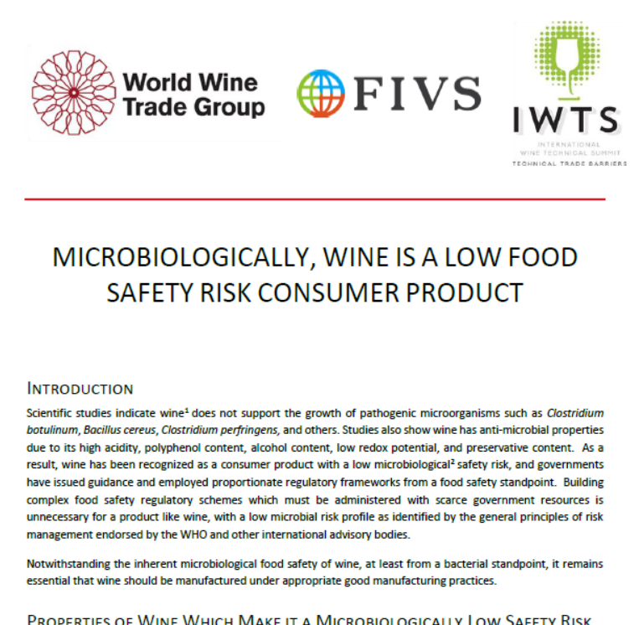
Certificates of Analysis – Safety
Is Wine an Inherently Safe Product?
“Microbiological”
Yeast/fungus, Bacteria
Pathogens (E. Coli, Salmonella)
“Microbiologically, Wine is a Low Food Safety Risk Consumer Product”
(https://www.bio-conferences.org/articles/bioconf/pdf/2016/02/bioconf-oiv2016_04003.pdf)
Pathogens don’t survive in wine

Slide 12
Certificates of Analysis – Safety
Is Wine an Inherently Safe Product?
“Physical Characteristics”
Color, limpidity (clarity), Stability
Subjective descriptors
Can vary based on tradition, culture, fashion, or style.
Characteristics of wine don’t affect safety

Slide 13
Certificates of Analysis – Safety
Is Wine an Inherently Safe Product?
“Typical Wine Parameters”
pH, Acidity, sugars, density, etc.
Grape-based, so a narrow range of values
Additions – more of the same?
Safe in the Grape? Safe in the wine!

Slide 14
Certificates of Analysis – Safety
Are Certificates of Analysis for Safety Necessary?
Certificate of analysis tests are either:
Not related to health and safety
Declared on the bottle
Unlikely to reach harmful levels in wines made using Good Enological Practice
Certificates of Analysis Don’t Ensure Safety
So…are they necessary?
“What about Authenticity?”

Slide 15
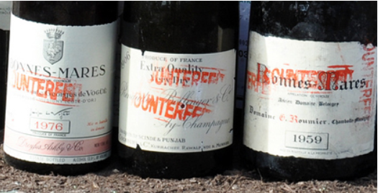
Certificates of Analysis – Authenticity
What is Authenticity?
“The Product is what it claims to be”
Accurate label claims in relation to content
Vintage
Variety
Geographic Origin
Certificates of Analysis may not be necessary

Slide 16
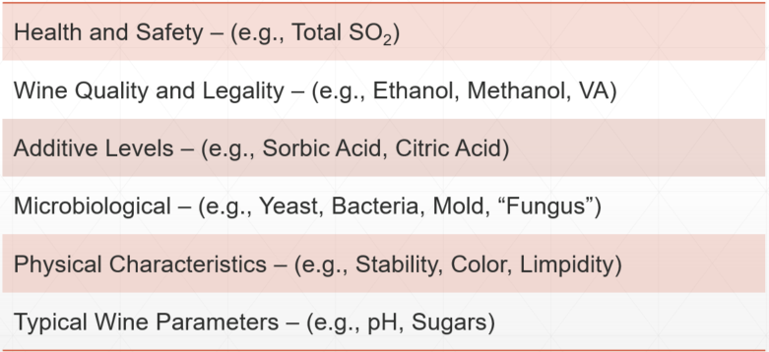
Certificates of Analysis – Authenticity
Can Basic Testing show Authenticity?
Health and Safety
Sulfur Dioxide (SO₂)
Methanol
Heavy Metals
Not indicators of authenticity
Concentrations found typically overlap, and no substantial variations for vintage, geographic area, or variety.

Slide 17
Certificates of Analysis – Authenticity
Can Basic Testing Show Authenticity?
Wine Quality and Legality
Ethanol, Volatile Acidity (VA)
Methanol
Gas Pressure
Fall in a narrow range of values (Ethanol, VA)
Methanol – If high, then above allowable levels
Gas Pressure – Wine Classification, not Authenticity

Slide 18
Certificates of Analysis – Authenticity
Can Basic Testing Show Authenticity?
Additive Levels
Allowed in wine
Mostly Grape-Derived
Difficult to determine added amount
Presence does not indicate lack of authenticity

Slide 19
Certificates of Analysis – Authenticity
Can Basic Testing Show Authenticity?
Microbiological
Yeast/fungus, Bacteria
Global winemaking microbes, so presence is possible
Pathogens (E. Coli, Salmonella)
Do not survive in wine, so results will be “None Detected”
“Microbiologically, Wine is a Low Food Safety Risk Consumer Product”
(https://www.bio-conferences.org/articles/bioconf/pdf/2016/02/bioconf-oiv2016_04003.pdf)
Presence would not indicate lack of authenticity

Slide 20
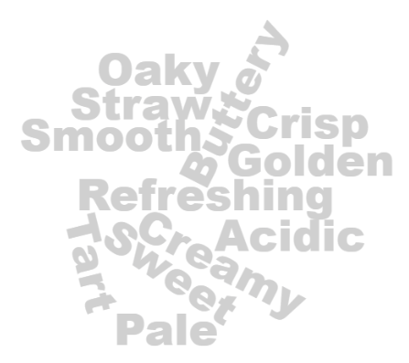
Certificates of Analysis – Authenticity
Can Basic Testing Show Authenticity?
Physical Characteristics
Color, limpidity (clarity), Stability
Subjective – opportunity for mischaracterization
Can vary based on tradition, culture, fashion, or style.
“What Does a California Chardonnay look/taste like?”

Slide 21
Certificates of Analysis – Authenticity
Can Basic Testing Show Authenticity?
Typical Wine Parameters
pH, Acidity, sugars, density, etc.
Mostly grape-based, so a narrow range of values which are variable, not fixed.
The ranges are well known
Variation within a small range
Well-characterized range, and easy to “replicate”

Slide 22
Certificates of Analysis – Authenticity
Overall Rationale
Basic tests don’t show authenticity
Sophisticated tests have limits
Wine Variability – Seasonal, winemaking
Blending – Variety, Vintage, Region
Cost, Time, scarcity – Not practical for testing for international trade
Certificates of analysis don’t ENSURE authenticity.
So…are they necessary?
“What about Quality?”

Slide 23
Certificates of Analysis – “Quality”
(Note: FIVS paper is in progress, and moving towards consensus agreement)
What is “Quality”?
A very difficult term to define, and even more difficult to quantify
Individual Taste Preference
Historical Wine Style
Price Point
Is it…
Absence of Faults?
“Locally Made”?
Small-Lot or Artisanal?
Part of a legal definition?
?

Slide 24
Certificates of Analysis – Quality
Can Basic Testing Show “Quality”?
Health and Safety
Sulfur Dioxide (SO₂)
Methanol
Heavy Metals
Concentrations found typically overlap, and are in a fairly narrow range.
Higher levels may be usual for the wine type.

Slide 25
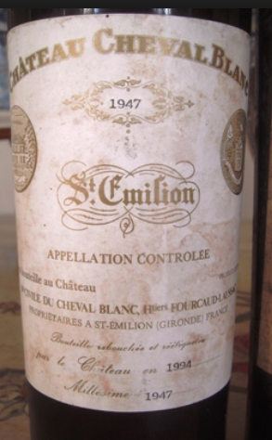
Certificates of Analysis – Quality
Can Basic Testing Show “Quality”?
Wine Quality and Legality
Ethanol
Volatile acidity (VA)
Methanol
Gas Pressure
Fall in a narrow range of values (Ethanol, Methanol)
VA – Higher levels can be typical, and add complexity.
Gas Pressure – CO₂ Level, not “Quality”

Slide 26
Certificates of Analysis – Quality
Can Basic Testing Show “Quality”?
Additive Levels
Added in very small amounts
Added only when needed, often to increase “Quality”
Taste profile improvement
Removal of undesirable aromas
Maintaining microbiological stability
Mostly grape-derived, so difficult to determine added amount
Neither Presence nor absence would indicate lack of “quality” in a wine.

Slide 27
Certificates of Analysis – Quality
Can Basic Testing Show “Quality”?
Microbiological
Yeast/fungus, Bacteria
If wine is unfiltered, their presence would not be surprising
Unfiltered wine is seen by some consumers as being of higher quality
Brettanomyces (yeast) influence is seen as positive by some, negative by others
Pathogens (E. Coli, Salmonella)
Result will always be “None Detected”
“Microbiologically, Wine is a Low Food Safety Risk Consumer Product”
(https://www.bio-conferences.org/articles/bioconf/pdf/2016/02/bioconf-oiv2016_04003.pdf)
Presence would not indicate lack of “Quality”

Slide 28
Certificates of Analysis – Quality
Can Basic Testing Show “Quality”?
Physical Characteristics
Color, limpidity (clarity), Stability
Related to consumer preferences, age of the wine, or winemaking style
Very subjective, and may not allow for consumer preference.
Are often based on traditional styles for the area of origin for the wine.
“Quality“ based on physical characteristics can deny the customer the right to choose and may impair the production of traditional wines.

Slide 29
Certificates of Analysis – Quality
Can Basic Testing Show “Quality”?
Typical Wine Parameters
pH, Acidity, sugars, density, etc.
Mostly grape-driven, so a narrow range of values, but vary due to differences in grape growing or necessary adjustments in winemaking
Wines from the same region, grower, or vineyards can vary widely
Consumers often dictate a style that affects these parameters
Grapes exert a huge influence on these values
Variation is too large to use as a measure of “Quality”

Slide 30
Certificates of Analysis – Quality
Overall Rationale
“Quality” is very difficult to define, and may actually defy definition
“Quality” is often in the mind of the consumer
Analytical values by themselves cannot give an indication of quality, and due to regional, climatological, or stylistic differences, the limits would either be too restrictive, or so wide as to be meaningless.
CERTIFICATES OF ANALYSIS DON’T ENSURE “QUALITY”
So…are they necessary?

Slide 31
Certificates of Analysis
Summary:
Certificates of Analysis Don’t Ensure Safety
Certificates of Analysis Don’t Ensure Authenticity
Certificates of Analysis Don’t Ensure “Quality”
In the APEC region, “…the costs of unnecessary testing and certification in the region (were) estimated at 1 billion USD per annum.”
Can we justify this expense?
$1,000,000,000 USD
$?,???,???,??? USD

Slide 32
Certificates of Analysis – What They Can Tell Us and What They Cannot
Questions?
Thank you

