Slide 1
A closer look at some analytes
Dr Eric Wilkes
The Australian Wine Research Institute

Slide 2
Background
Tbilisi Statement
Avoiding Unnecessary Analysis. Governments should establish regulatory limits that are based on risk, thereby avoiding unnecessary analysis.
There are a wide range of analytes requested on certificates and in most cases the justification for these requirements are either;
Wine Quality
Product Provenance/Authenticity
Consumer safety
Here we will review the validity of a number of common analytes used to address these concerns.

Slide 3
Quality

Slide 4
Titratable Acidity or Total Acid
Generally defined as the sum of all the acids in wine as determined by a titration to a given pH endpoint (7.0 in the EU and 8.2 almost everywhere else) and expressed in terms of tartaric acid equivalents.
Realistically only looking at food acids as they are what naturally occur in wine and the approved methods do not differentiate for mineral acids if they were present.
So not a case of consumer safety!
All wines contain some level of titratable acidity and the values are not unique to a given region or economy.
So not a case of identifying authenticity!
So does it give an indication of quality?

Slide 5
Organic acids in wine
The main organic acids found in wine are:
  Tartaric
  Malic
  Lactic
  Succinic
  Acetic
  Citric
  All are naturally occurring food acids found in many foods and beverages.
The proportion of each are largely driven by environmental factors.

Slide 6
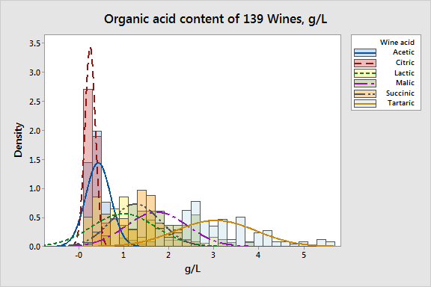
A complex story
The organic acids found in wine have a direct and significant role in the taste, balance, colour and stability of a wine, and represent an integral aspect of the wine style.

Slide 7
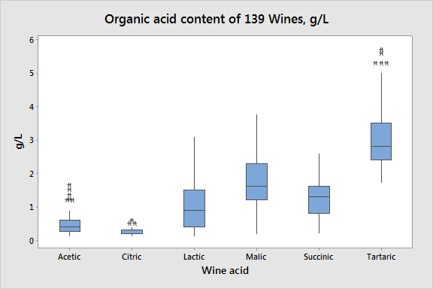
No simple relationship
The variation in organic acid content between wines is significant and represents a complex interplay between environmental and stylistic issues.
Importantly, all these naturally occurring species pose no health related issues at quantities found in wine.

Slide 8
Driven by style, Not quality
Climate, vineyard and variety are the main drivers of the naturally high variation in acid content.
Warmer climates can lead to significantly less acid available in grapes.
Acid adjustments are a traditional and widely accepted tool used to meet sensory, stylistic and stability goals.
Acid additions are made to meet a sensory profile (GMP) rather than to meet arbitrary limits.
Introduction of arbitrary limits on such naturally variable components would impose a significant impost on the ability of some economies to make wines that meet their traditional and consumer expectations.
A given level of titratable acidity does not correlate with any indicator of quality, rather it is simply a reflection of individual style the winemaker is trying to achieve.

Slide 9
Authenticity

Slide 10
Sugar Free extract
Sugar free extract (SFE) and the closely related measure total dry extract (TDE) are historical measures for wine.
By Definition TDE is :
“ The total dry extract or the total dry matter includes all matter that is non-volatile under specified physical conditions” (OIV 2015).
Essentially it is what is left if you dried out a sample of wine.
This is made up mostly of organic acids, glycerol and sugars (Boulton 1996*), but can include significant contributions from other components such as tannins phenolics and proteins, depending on the wine type.
SFE is simply the TDE with the wines sugar content subtracted.
Most commonly the justification for its use is as an indicator that a wine has been adulterated,
i.e. as an indicator of provenance.
*Boulton, R.B., Singleton, V.L., Bisson, L.F. and Kunkee, R.E., 1996. Principles and practices of winemaking. Springer Science & Business Media.

Slide 11
Typical values for SFE
This graph shows the SFE extract results for 179 Australian wines measured over 12 months.

Slide 12
The Problem
The belief that low SFE is a reasonable indicator of wine adulteration has resulted in some regulatory bodies setting minimum limits such as;
16 g/L for whites, 17 g/L for rosés and 18 g/L for reds.
Unfortunately the data underpinning these levels appear to be from a very limited data set in Europe in the early 1900’s.
Studies have shown values as low as 7 g/L for low alcohol German wines* and the recent AWRI survey showed 15 % of results for white wines below the limit.
They also do not take into account accepted modern winemaking practices such as use of different yeast strains, heat treatment of juices, hydrolytic enzymes and the removal of tartrates during cold stabilization.
*Ough, Cornelius Steven, and Maynard Andrew Amerine. Methods for analysis of musts and wines. J. Wiley, 1988.

Slide 13
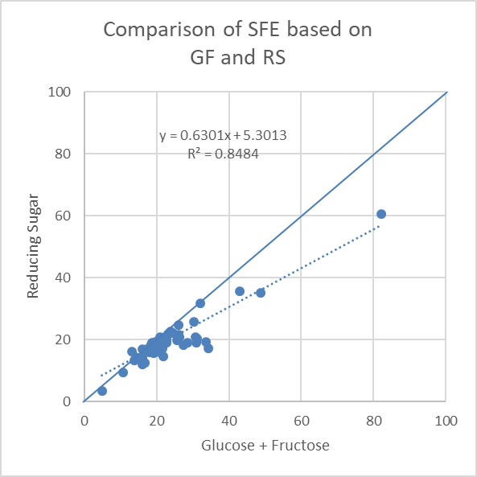
The Impact of Sugar
Another confounding factor is that calculation of SFE requires the analysis of the wines' sugar content.
The choice of sugar analysis methodology (glucose + fructose + sucrose or reducing sugar methods) can lead to differences in analysis results between 0.5 and 3 g/L.
These differences, which are driven to a large extent by non-sugar interferences in the reducing sugar method, can have a significant impact on the determination as to whether a wine meets an arbitrary SFE limit.
Glucose + Fructose
Reducing Sugar

Slide 14
A practical example
5 wines fall below the 16g/L limit when tested using glucose + fructose + sucrose
12 wines fall below the limit when tested using the reducing sugar method
None of the wines had been adulterated by water addition

Slide 15
So does it work?
Sugar Free Extract (SFE) is not a good indicator as to the possible adulteration of wine or authenticity.
Arbitrary lower limits on SFE’s do not take into account variations in vintage, wine style and a range of modern legal winemaking practices.
It also has gives no indication of quality or food safety

Slide 16
Consumer Safety

Slide 17
Methanol
Methanol is a substance which has been associated with a number of serious injuries and deaths around the world.
It is a substance which naturally occurs in wine through the enzymatic hydrolysis of pectins.
It can also be formed in wine through the use of dimethyl dicarbonate (DMDC) as antimicrobial.
It is also found naturally occurring in the human body.

Slide 18
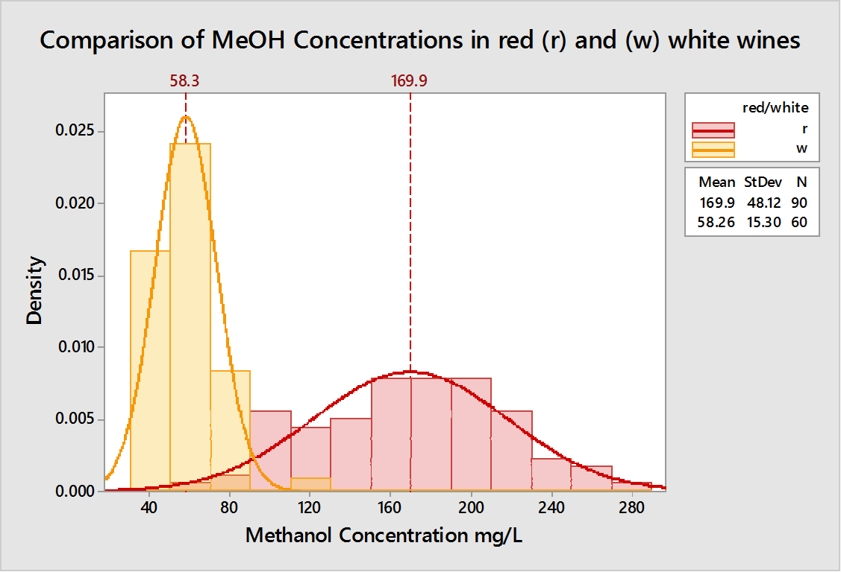
Typical Levels of Methanol in Wine
Typical levels are found in table wines are between 40 and 250 mg/L.
Some botrytized sweet wines can have levels as high as 364 mg/L.
In general red wines have more than whites.
To place this in perspective non-alcoholic fruit juices can have levels as high as 640 mg/L.
The OIV limit for red wine is 400 mg/L.
Grape based wine made using approved practices are highly unlikely to exceed this level.
Hodson, G. et al., 2017. Methanol in wine J.-M. Aurand, ed. BIO Web of Conferences, 9(5), pp.02028–5.

Slide 19
But the dose makes the poison!
A healthy individual can metabolize 1500 mg per hour of methanol without showing any ill effects. European Commission Scientific Committee on Food. Opinion of the Scientific Committee on Food on the use of dimethyl dicarbonate (DMDC) in wines, (2001).
1500mg of methanol is approximately the amount of methanol that would be contained in 3.75 litres (5 standard bottles) of a wine with a methanol content at the OIV maximum of 400mg/L.
This volume of wine would have to be consumed in one hour to ingest more methanol than a healthy individual could metabolise with no ill effects.
Interestingly the standard treatment for methanol poisoning is to inject ethanol!

Slide 20
Methanol in wine
In wine made from grapes using approved winemaking practices it is essentially impossible to produce enough methanol for it to be deleterious to human health.
In cases where methanol poisoning has occurred in relation to wine it is associated with fake or adulterated products.
Such products are unlikely to go through the official processes involving import certificates (at least real ones).
Methanol content also is not an indicator of quality or provenance.

Slide 21
In Summary
The 3 examples discussed; titratable acidity, sugar free extract and methanol, can be clearly seen not to meet justifications for inclusion on certificate of analysis.
As analytical parameters they exist either as an aid to production or for purely historical reasons.
They do not help governments of the public manage risks associated with quality, authenticity or safety.
Hence their inclusion in certificates of analysis is wasteful and unnecessary.
And not in keeping with the very first of the Tbilisi Statements Principles.

