Slide 1
2017 Ring Test Results
Dr Eric Wilkes
Australian Wine Research Institute

Slide 2
Ring Test Program
The program is an opportunity for laboratories from different economies to compare the results for typical wine analysis between different laboratories.
As part of a larger wine proficiency testing program it also allows economies to compare their laboratories results to those typically achieved for the wine tested.
This year there are 23 nominated laboratories from 14 different economies.
There are still significant difficulties being encountered shipping wine samples to a number of economies which will need resolution going forward.

Slide 3
Participants
Economy | Labs | Samples delivered | Results Submitted
Australia | x2 | yes | yes
New Zealand | x2 | yes | yes
Russia | x2 | no | -
Hong Kong | x1 | yes | no
Indonesia | x2 | 1 of 2 | yes
Vietnam | x2 | yes | yes
PNG | x2 | yes | no
Chile | x1 | no | -
USA | x2 | yes | yes
Japan | x1 | yes | yes
China | x2 | yes | no
Peru | x2 | no | -
Mexico | x1 | yes | Next round
Argentina (SF) | x1 | no | -

Slide 4
This years program
For 2017 the APEC ring test program was fully integrated into the Interwinery Analysis Group Proficiency program.
This is a large wine specific program with over 200 participating laboratories.
It consists of 6 separate rounds of testing, 2 red wines, 2 white wine and 2 rose wine rounds.
Laboratories can submit analytical results for any of the common wine analysis that is done.
All data is entered online and collated anonymously.
Within 2 weeks of the closure of each testing window an online report is available.
Currently only the first 2 rounds of testing have been completed.

Slide 5
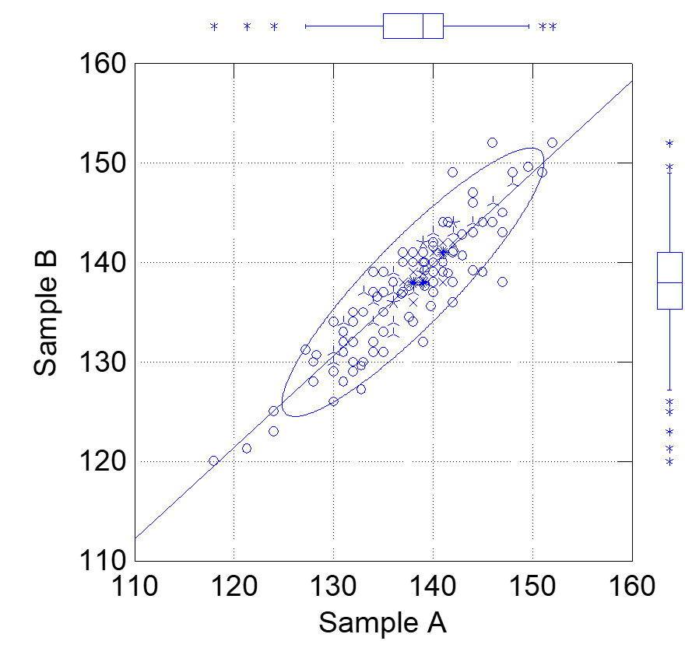
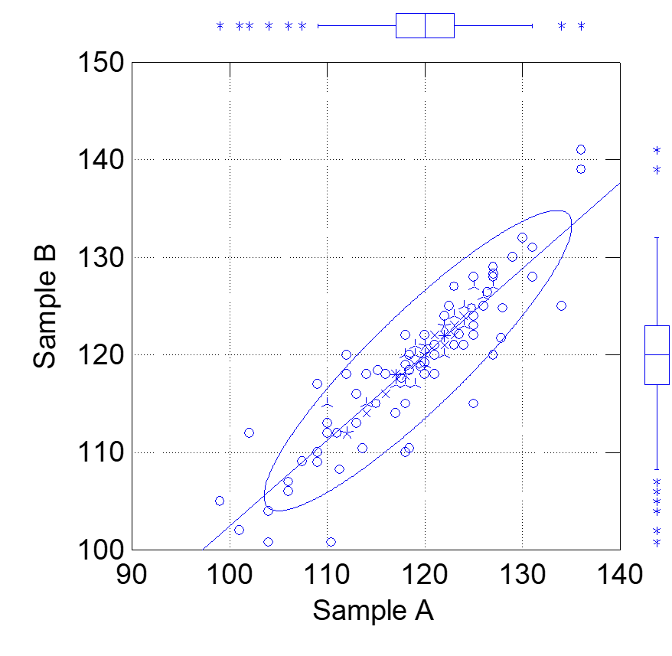
Total Sulfur Dixoide

Slide 6
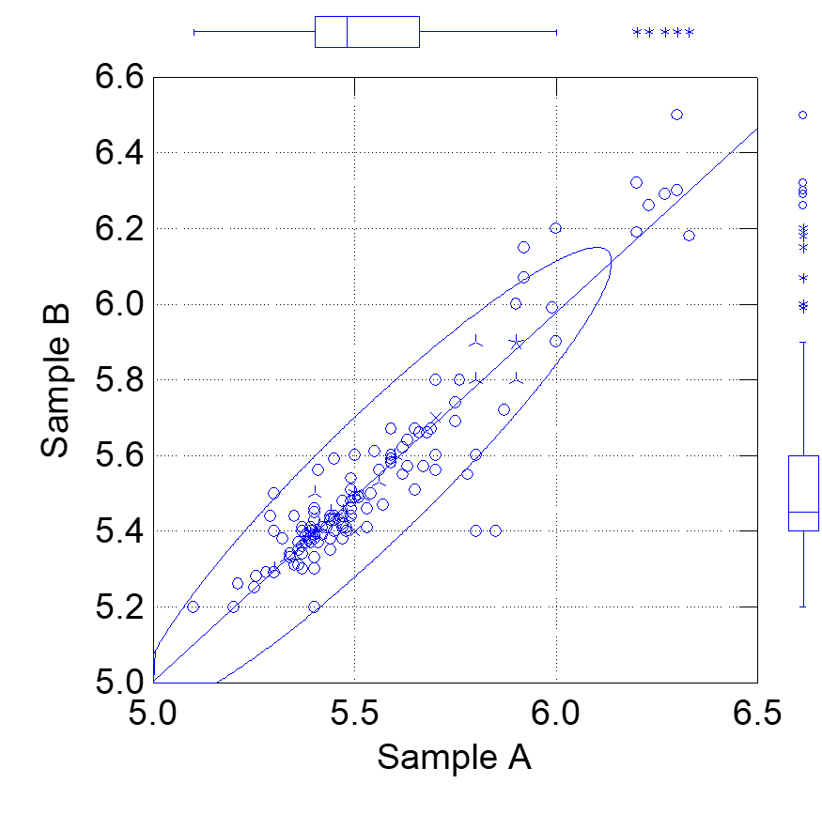
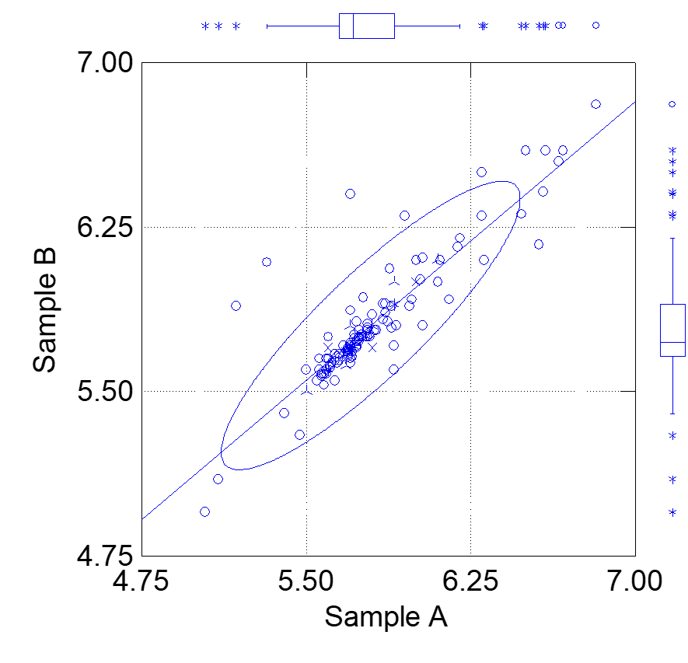
Titratable Acidity pH 8.2

Slide 7
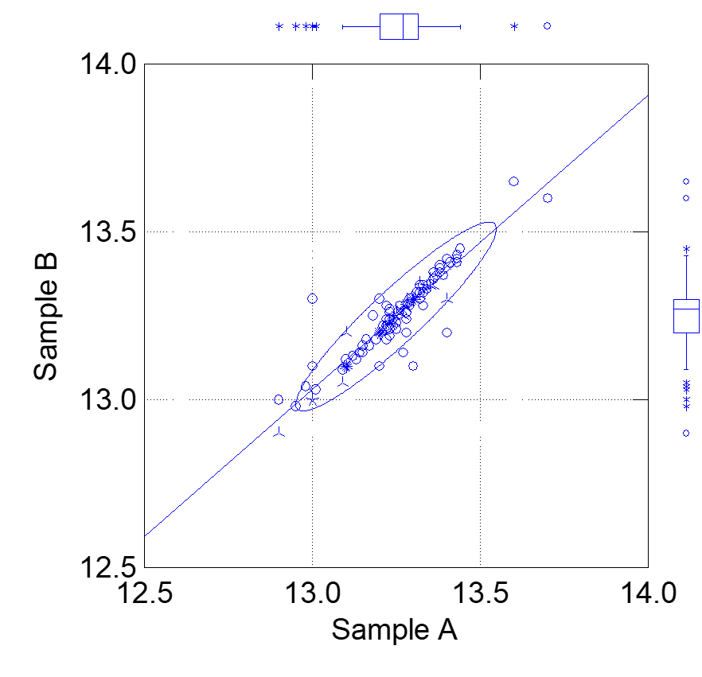
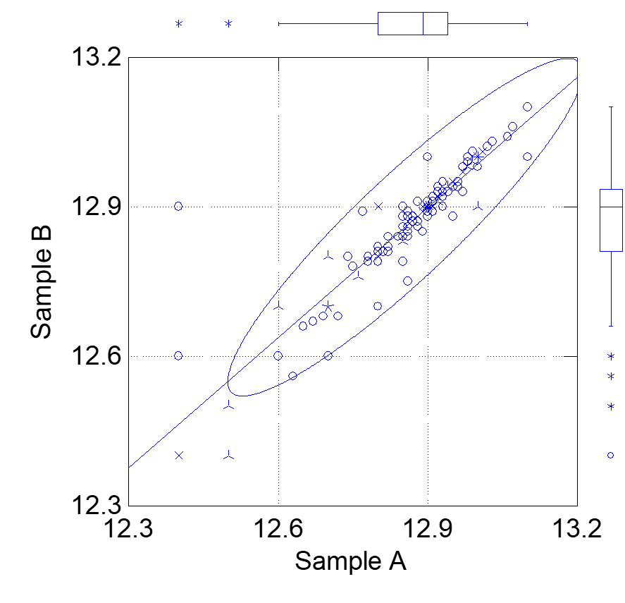
Alcohol

Slide 8
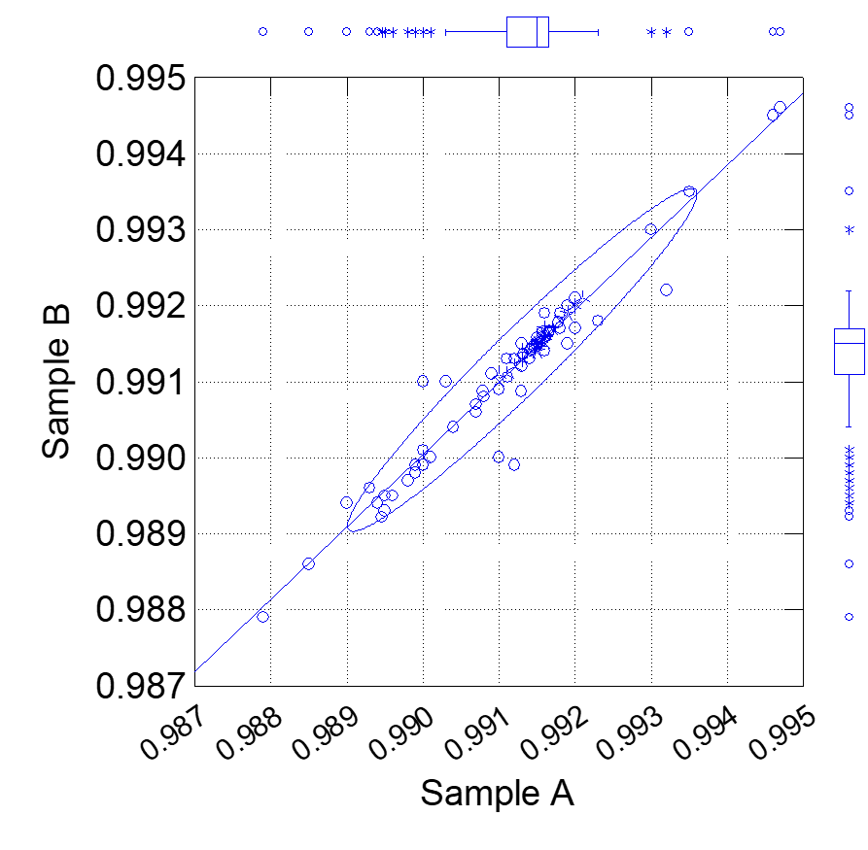
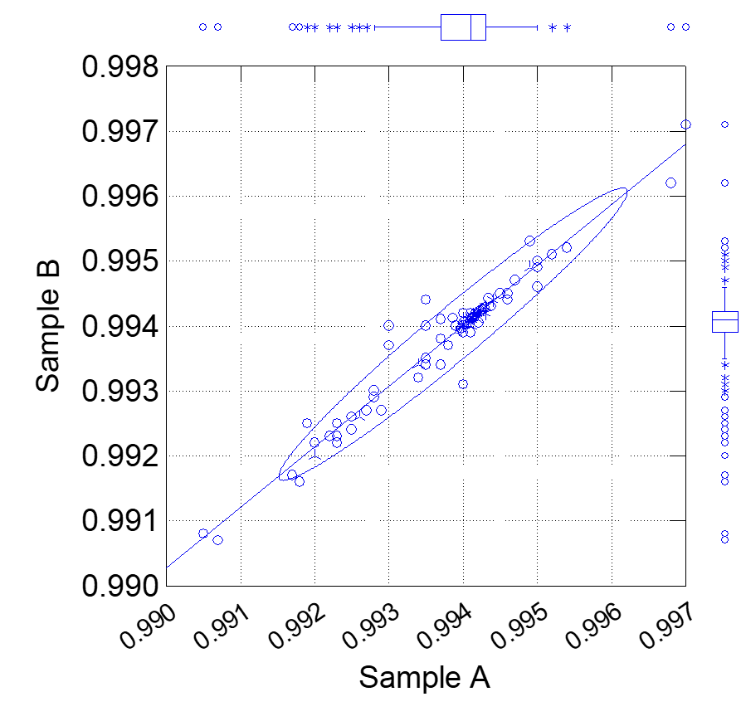
Specific Gravity

Slide 9
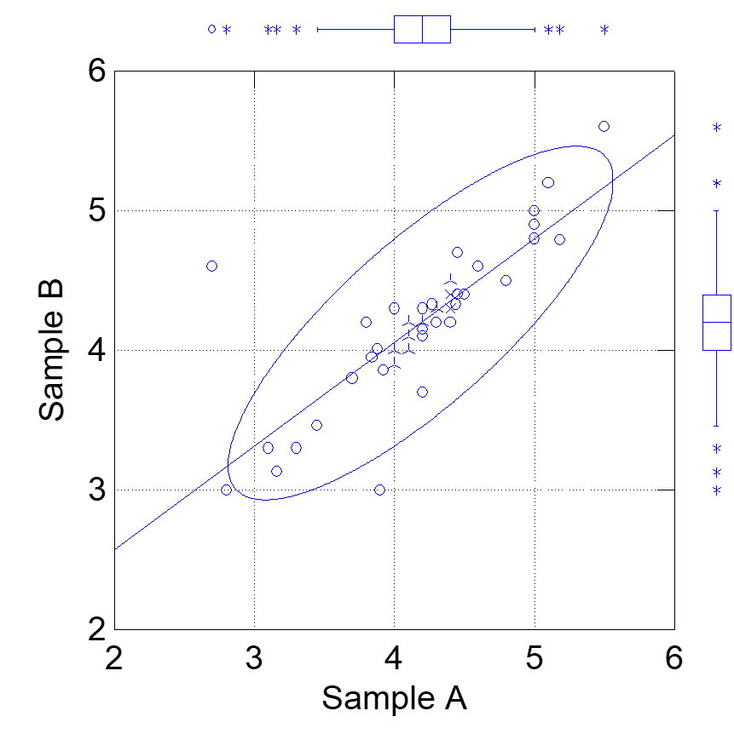
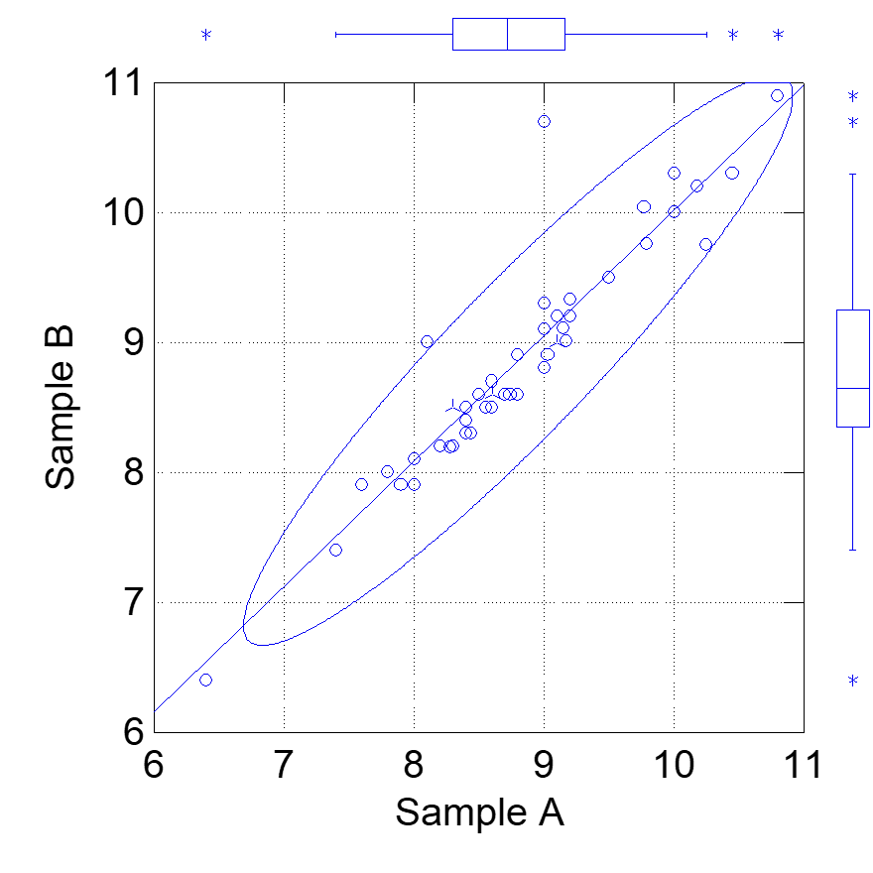
Reducing Sugar

Slide 10
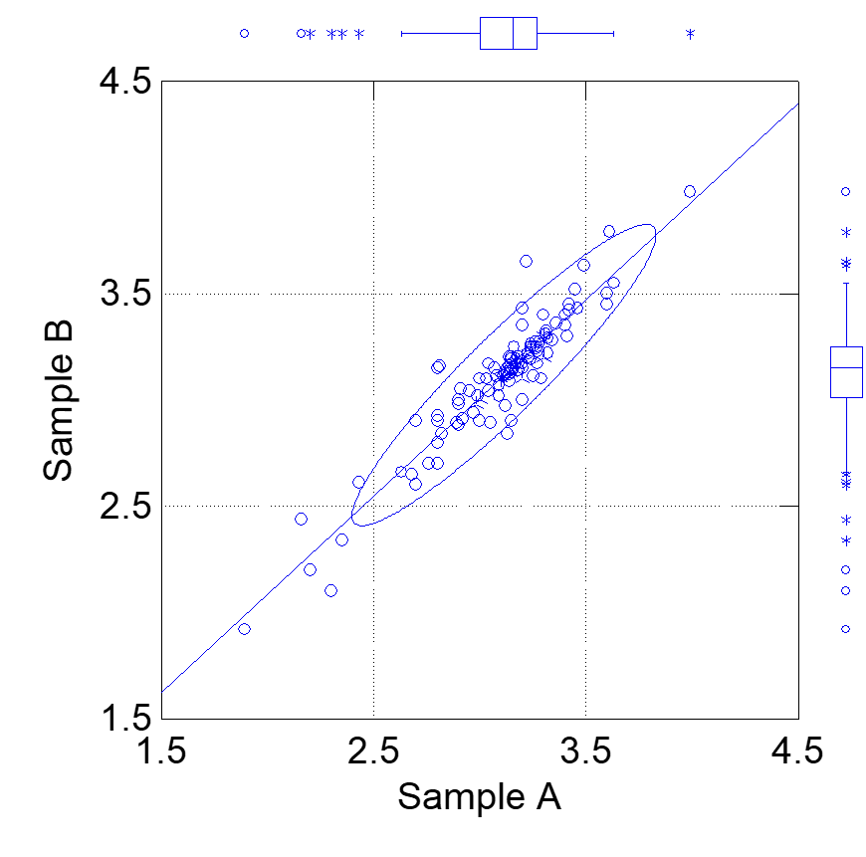
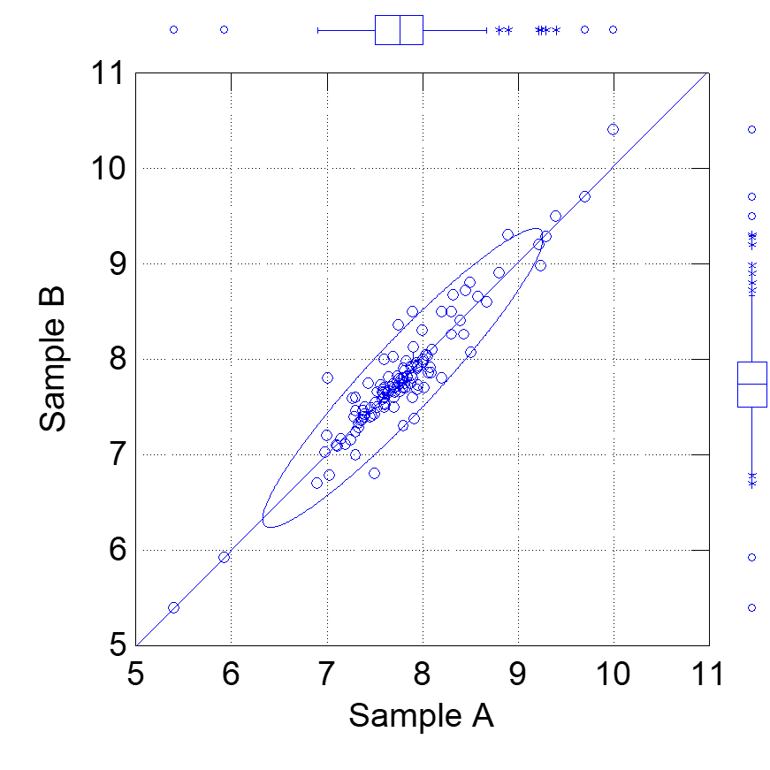
Glucose + Fructose

Slide 11
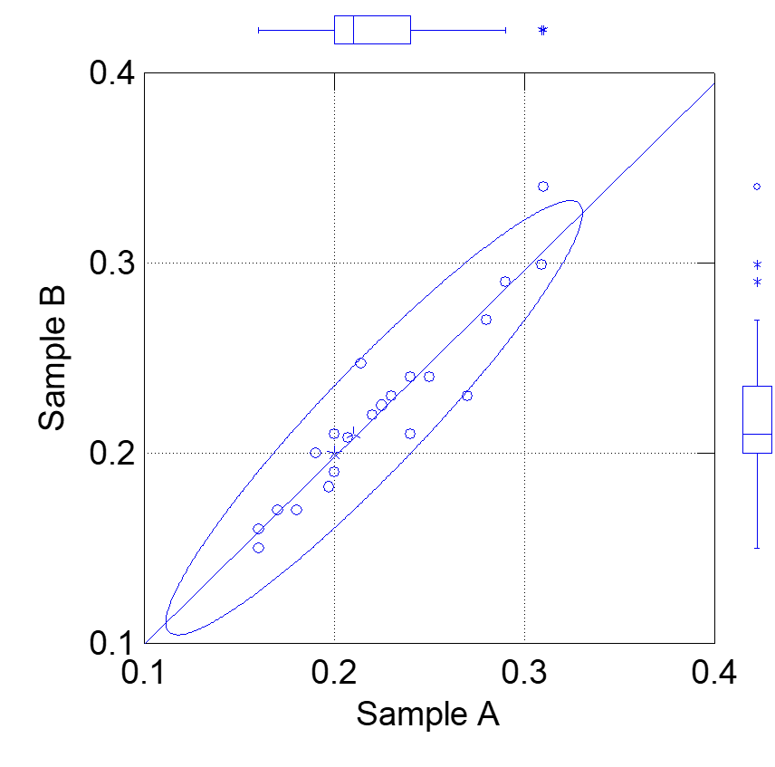
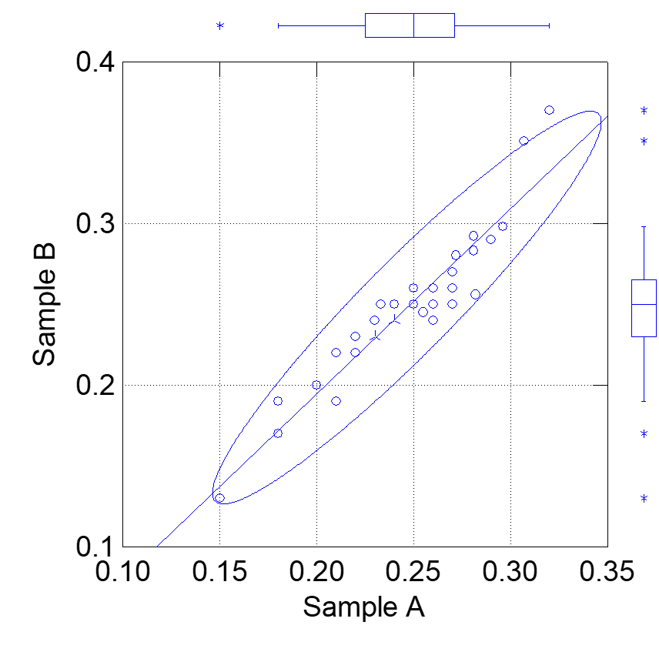
Copper

Slide 12
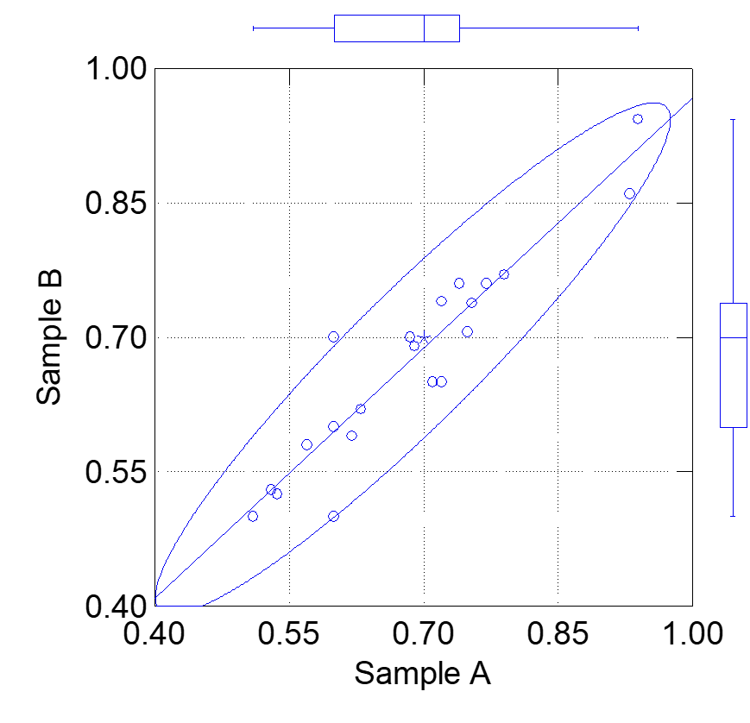
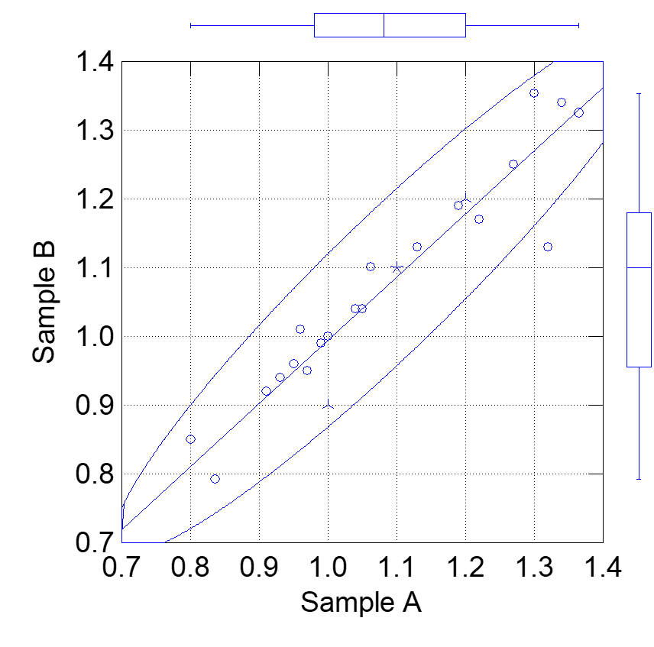
Iron

Slide 13
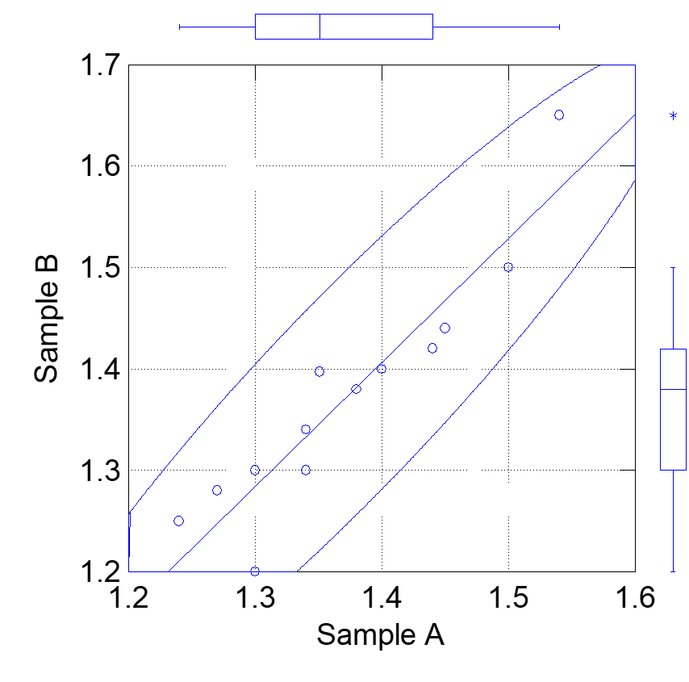
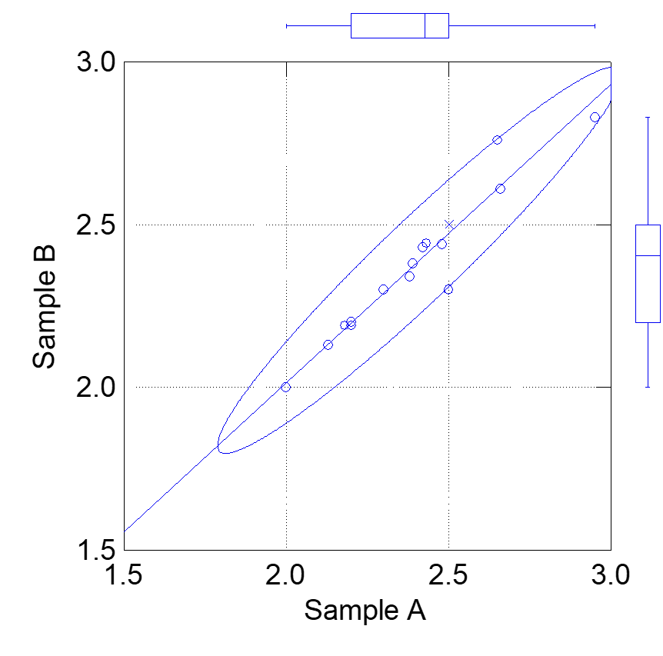
Manganese

Slide 14
Results to date
There have been significant improvements in laboratories performance compared to previous rounds.
Still however significant outliers demonstrating the need to continue the program.
It is significant that laboratories which have participated in the wine program long term are performing more consistently than those new to wine ring testing.
The impact of different analytical methods being used is apparent and leads to varied results between laboratories.
Also need to increase the participation rate going forward.

Slide 15
Program going forward
Completion of the next 4 rounds of testing.
The provision of a consolidated report for participants and WRF members.
A series of 3 virtual workshops to allow participants to discuss results and ways to improve laboratory performance.
A discussion on the value of the program and means to continue it forward post 2018.

