Slide 1
APEC Model Wine Export Certificate, the success of the exchange of information reflected into a certificate which can facilitate wine trade.
Joaquin Almarza S.
Ministry of Agriculture.
Chile

Slide 2
APEC Model Wine Export Certificate Background
Initiative was born under the frame of the Wine Regulatory Forum year 2013.
In the frame of the APEC Sub-Committee on Standards and Conformance (SCSC), the Wine Regulatory Forum (Good Regulatory Practices Action Plan) through the Working Group on export certificates, after 3 years work, developed an APEC Model Wine Export Certificate for the economies that require this type of certification. (2013-2015)
Outcome: to develop a Model Wine Export Certificate in order to reduce and simplify the export certificates to facilitate wine trade among APEC economies.
The APEC Model Wine Export Certificate was approved by regulatory and trade officials from APEC economies, during the APEC Peru in 2016.
The consolidated APEC wine certificate aims to reduce the number of required export certificates for wine trade and to facilitate wine trade in the APEC region.
Chile was the first APEC economy implementing the use of the certificate for wine trade.(2017)

Slide 3
APEC Model Wine Export Certificate Timeline
Washington DC
Beijing
Adelaide
Ottawa
Hanoi
2013
Working Group on Export Certificate
2014
Estudy on Export Certificate
2015
Developement of the APEC Model Wine Certificate
2016
Approve and Adoption of the APEC Model Wine Certificate
2017
Implementationby Chile of the APEC Model Certificate

Slide 4
APEC Model Wine Export Certificate Implementation by Chile
During the WRF technical meeting held in Hanoi-Vietnam, Chile committed the implementation of the APEC Model Wine Export Certificate for the second semester of 2017.
In August of 2017, through the Administrative Resolution N° 4.941, Chile made official the use of the certificate for the economies that require this type of export certificate.

Slide 5
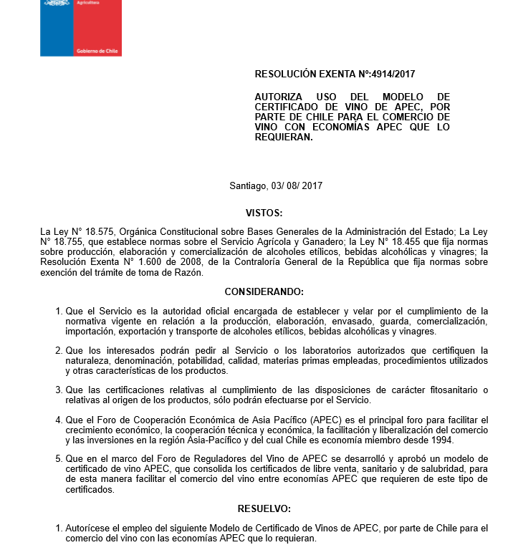
APEC Model Wine Export Certificate Implementation by Chile
Agricultural & Livestock Service (SAG)
Ministry of Agriculture
Administrative Resolution N° 4.941/2017

Slide 6
APEC Model Wine Export Certificate Implementation by Chile
The use of APEC Model Wine Export Certificate was enter into force on August 11 of 2017, by publishing the resolution in the Chilean Official Journal, to be issued as of September of 2017

Slide 7
APEC Model Wine Export Certificate Implementation Key point
Government coordination and action plan
August-September 2017
Agricultural Attache
Economic Attache
Chile APEC economies embassies
Chile APEC economies embassies
Contact with APEC Economies. Government Ministries and Agencies ad-hoc

Slide 8
APEC Model Wine Export Certificate Implementation Key point
APEC Economies | APEC certificate
Australia | NO
Brunei Darussalam | NO
Canadá | NO
China | YES
Hong Kong- China | YES
Indonesia | YES
Japón | NO
Corea | YES
Malasia | NO
México | YES
Nueva Zelanda | NO
Papua Nueva Guinea | NO
Perú | YES
Filipinas | YES
Rusia | YES
Singapur | YES
Taipéi Chino | YES
Tailandia | YES
Estados Unidos | NO
Vietnam | YES
Communication from Chilean government agencies to APEC economies government agencies related with wine trade issues to inform the change of the export certificate usually submitted by the consolidated APEC model Wine Export Certificate.

Slide 9
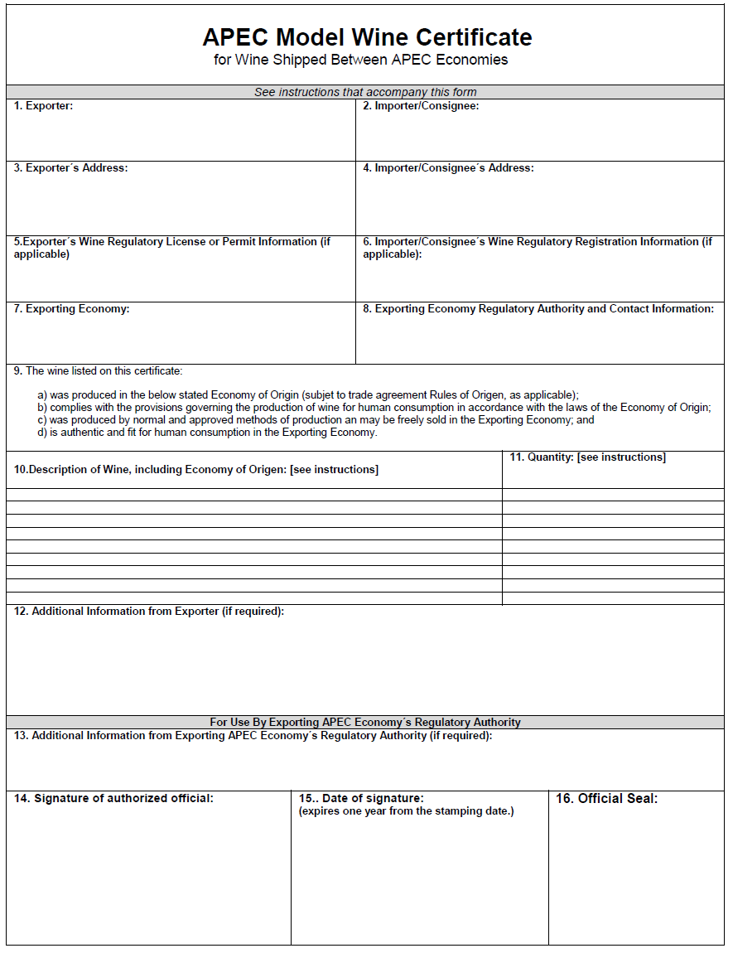
APEC Model Wine Export Certificate
Template use to APEC economies

Slide 10
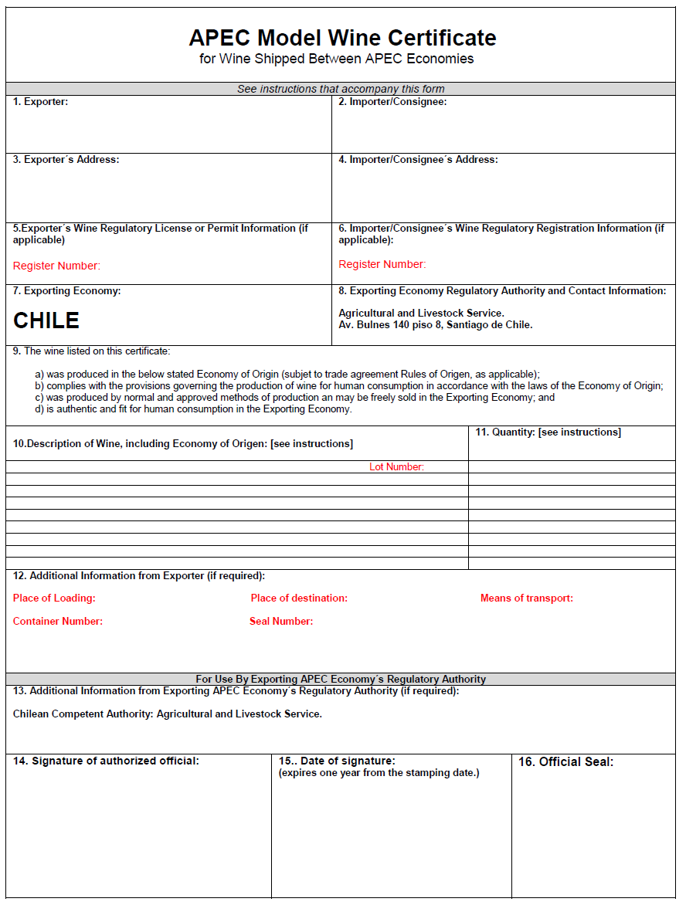
APEC Model Wine Export Certificate
Template for China
Template use to China, considering specific requirement that must to be indicated in the certificate:
Importer/Exporter Register Number.
Product Lot Number
Place of Loading
Place of destination
Means of transport
Container Number
Seal Number

Slide 11
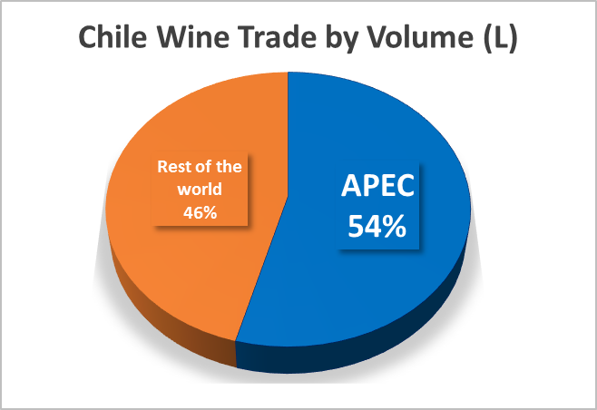
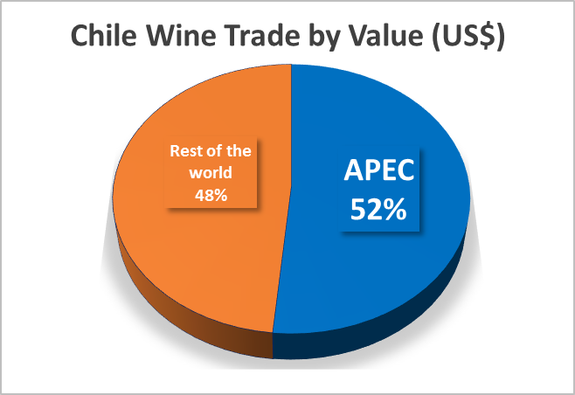
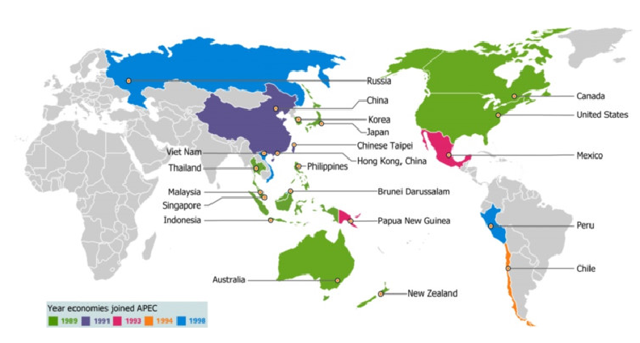
APEC Model Wine Export Certificate
Chile-APEC region Wine Trade

Slide 12
APEC Model Wine Export Certificate
APEC economies to which Model Wine Export Certificate are issued since their implementation by Chile.

Slide 13
APEC Model Wine Export Certificate
Implementation Facs
 | 2016 / 2017 (A) | 2017 / 2018 (B)
October | 875 | 163
November | 894 | 224
December | 938 | 231
January | 783 | 191
February | 569 | 125
March | 846 | 222
April | 687 | 153
May | 903 | 203
June | 822 | 183
July | 803 | 197
August | 845 | 209
September | 883 | 213
Total | 9.848 | 2.314
A remarkable reduction of 7.534 export certificates respecting to those issued before the implementation of the the APEC wine export certificate can be observed comparing the same period of time.
Total amount of free sale, conformity, sanitary and health certificate issued.
APEC wine export certificate issued.

Slide 14
APEC Model Wine Export Certificate
Implementation Facs
N° certificates | Time involved | Time reduction
7.534 | 20 min/certificate | 150.680 min | 2.511 hours | 105 days/year
N° certificates | Cost involved | Cost reduction
7.534 | 10 US$/certificate | 75.340 US$
This reduction in the export certification process means an approximate reduction to ¼ of the export certificates issues to APEC economies before the implementation of the APEC certificate, which represent a reduction in matter of time, cost and administrative burden for both public and private parties, allowing to facilitate significantly the wine trade between Chile and the APEC market.
The application of the APEC Model Wine Export Certificates has implied:
Simplify the administrative burden.
Reduce costs and processing times..
Allow significantly facilitating the wine trade between Chile and the APEC economies that required this type of export certificates.

Slide 15
Thanks for your attention

