Slide 1
Control Chart Internal Quality Control of Laboratory Data (at NIFC)
Tran Cao Son, PhD.
National Institute for Food Control, Vietnam Ministry of Health

Slide 2
National Institute for Food Control
GOVERMENT
MARD
MOH
MOIT
VFA (Vietnam food Administration)
NIFC
4 regional labs under MOH (Nha Trang, HCM, Tay Nguyen, Hanoi)
63 provincial centers
NIFC - national reference food safety laboratory!

Slide 3
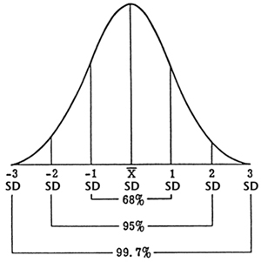
Control chart
Control chart was first developed by Walter Shewhart since 1930
Control chart: a record of the results of periodic inspections over time.
Control chart can be classified into two types: X-chart and R-chart

Slide 4
X-chart

Slide 5
R-chart

Slide 6
Data for control chart
CRM, RM
The assigned value is available with uncertainty: X ± U
IQC, spiked
The target value is average from 30 data
Blank
Control the signal of the blank = control the reagent quality
Duplicate
The bias of two duplicate, from 30 data

Slide 7
X-chart
IQC samples
UWL = +2s
UAL = +3s
LWL = -2s
LAL = -3s

Slide 8
R-chart
Duplicates
UWL = 2,83s LWL = 3,67s

Slide 9
Example – X-chart

Slide 10
Example – R-chart

Slide 11
Out of control situations
Out of control
1 point beyond action limits
2 out of 3 points in a row beyond warning limits
Out of statistical control
7 points in a row on the same side of the central line
7 points in a row steadily increasing or decreasing
10 out of 11 points in a row on the same side of the central line (X-chart)

Slide 12
Choices of control chart
The more frequent a specific analysis is done the more sense a control chart makes
If the analyses are always done with the same sample matrix, the sample preparation should be included. If the sample matrix varies, the control chart can be limited to the measurement only.
Some methods include obligatory measurement of control samples or multiple measurements.
In some cases the daily calibration gives values (slope and/or intercept), internal standard signals can be useful.

Slide 13
References
Internal quality control – Handbook for chemical laborarories
NORDTEST TR569

Slide 14
THANK YOU FOR YOUR ATTENTION!

