Slide 1
Methods of Analysis Compendia
Dr Eric Wilkes & Dr Patricia Nedialkova

Slide 2
Methods of analysis do make a difference
While efforts continue to reduce the reliance amongst APEC economies on analytically based regulatory limits of wine components.
They continue to exist in different economies for a range of analytes.
It would be nice to think that given a known limit for a given wine component that the results between different Testing laboratories would be the same.
However this rarely the case!!!!
One of the major factors influencing the differences seen in analysis in laboratories is the impact of different defined methods of analysis.
This can lead to major impediments to trade as the assessment of the compliance in a laboratory in the originating market may be different to the result obtained once the wine is in its final market

Slide 3
Sugar in wine, a case study of the impact of methods
Depending on the economy sugar can be defined as;
the the amount of reducing substances
The combine glucose and fructose
The difference can be as high as ~3g/L

Slide 4
The methods of analysis compendia
To address this a compilation of the regulated methods used indifferent APEC economies for common wine anaytes has been compiled.
Currently it covers the analysis of alcohol, SO2, TA (7.0 & 8.2), reducing sugars, glucose + fructose, metals and methanol.
It has input from 11 different economies who regulate wine components.
It provides a quick reference to
The method description
If it is a regulated method
The method reference
A link to the detail of the method

Slide 5
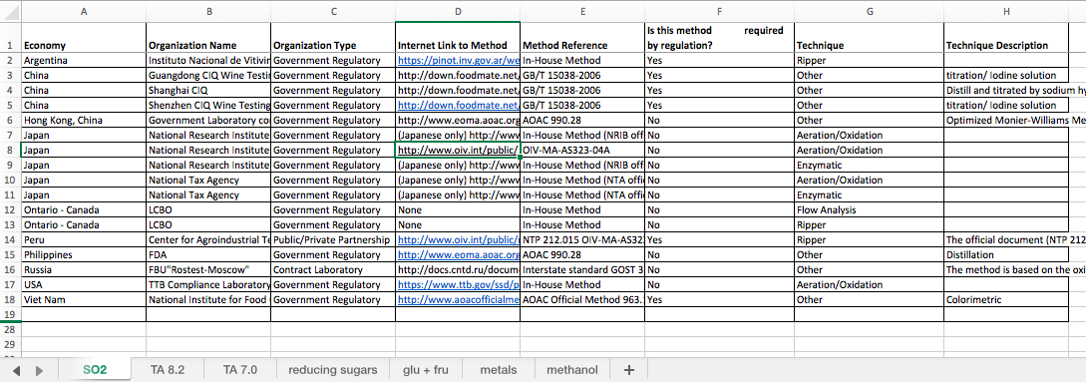
The compendium

Slide 6
The compendia
It I important to note that the compendia does not endorse or imply the suitability of any method for a given analyte.
Nor does it attempt to indicate the suitability of one method over another.
Rather
It simply gives a reference to the method used in a given economy
Allowing wine producers and exporters to take appropriate measure to ensure a wine is suitable for a given market.
Going forward we will add more economies and analytes as they become available.

