Slide 1
Naturally occuring substances in wine
Dr Eric Wilkes
Australian Wine Research Institute

Slide 2
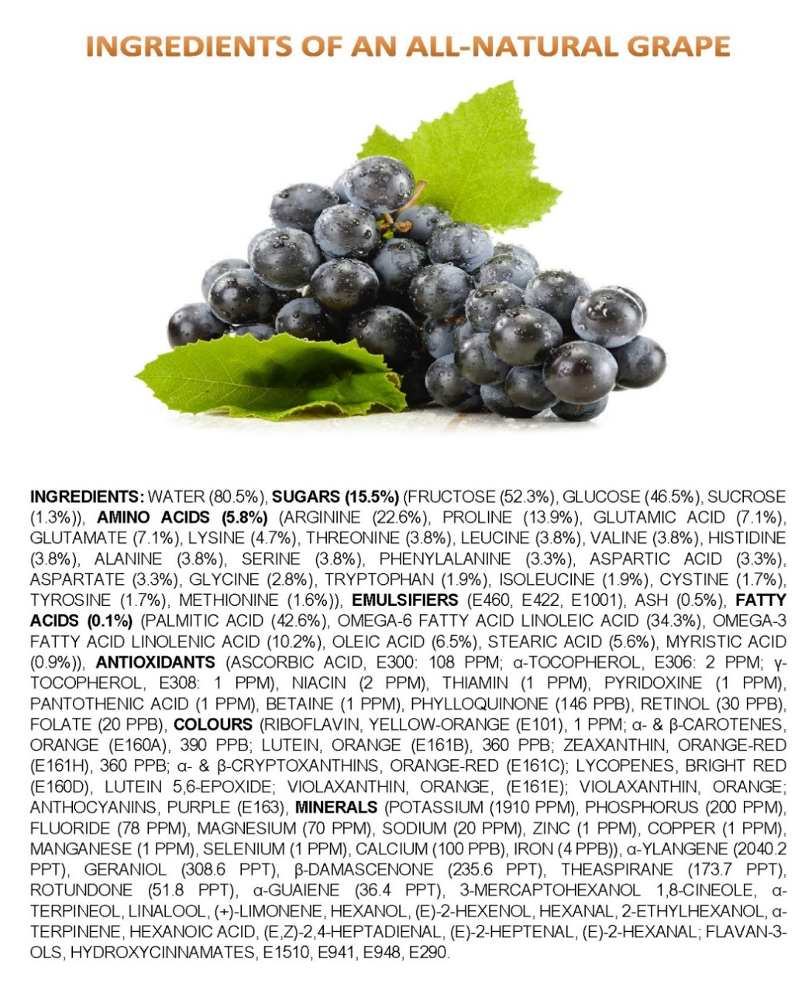
Grapes, a complex mixture
Once harvested the fermentation and maturation process then massively increase the complexity of compounds found in wine.
This is not a bad thing as it is this complexity is an important part of what make wine unique and interesting.
James Kennedy, Melbourne

Slide 3
It is probably better to ask what is not found in wine!
Every one of the naturally occurring metals has been found in wine!

Slide 4
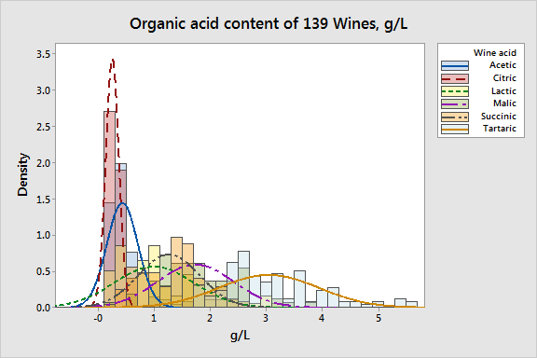
Variability is also huge!
The levels of the different organic acids in wine very significantly.
They have a direct and significant role in the taste, balance, colour and stability of a wine, and represent an integral aspect of the wine style.

Slide 5
Metals as well
8.0
5
7.0
4
6.0
5.0
Mn concentration (mg/L)
3
Mn (mg/L)
4.0
2
3.0
2.0
1
1.0
0.0
0
60
40
20
0
20
40
60
Africa
Europe
Oceania
S-America
Region
Australian red wines
International red wines
The range of Mn levels found in wines around the world is significant.
However, the differences between regions is not statistically significant with distributions being similar.
Notes:
This first study reviewed levels over 600 wines from around the world.
The second study focused on 200 wines from Australia in comparison to 200 international wines.

Slide 6
Issues with regulations
While this variability is a natural, unavoidable and desirable outcome of wine being a product derived from natural raw material.
Issues arise when arbitrary limits are enforced on any given component in wine.
Often the limits imposed on wines do not reflect the natural variation founds between styles and regions.
Not based on science
Based on specific local exemplars
This can
Produce serious impediments to the trade between economies
Restrict the demonstration local stylistic characters.

Slide 7
Typical Levels Compendia

Slide 8
Going forward
The compendia will be developed as a toll to help economies to assess the suitability of regulatory limits when applied to naturally occurring wine components.
The Enhanced Risk Controls and Good Regulatory Practice working group member will work to significantly extend the range of wine components and references.
The compendia itself will be centrally curated to ensure references are valid and of significant rigour.
Longer term the aim will be for the compendia to be converted to a true online database for access of APEC economies

