Slide 1
Export Certificates An Industry Perspective
Sara M. Azevedo, E. & J. Gallo Winery

Slide 2
This Presentation
E. & J. Gallo Winery: Who We Are
Export Certificates: A Business Case Study
Wine is a Microbiologically Safe Product
APEC Wine Regulatory Form
Industry Request

Slide 3
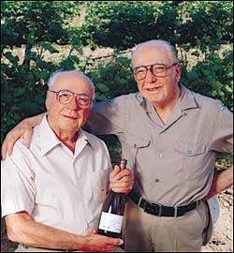
1. E. & J. Gallo Winery: Who We Are
Founded in 1933 in Modesto, CA by brothers Ernest & Julio Gallo
Today we are the largest winery in the world with over 100 brands!

Slide 4
California
Headquartered in Modesto, CA
12 Wineries
49 Vineyards
Presence in Central Valley, North Coast and Central Coast
Recent expansion into Washington!

Slide 5
Worldwide
Active in over 100 countries
International is 20% of business
Largest exporter of California wine

Slide 6
2. APEC Export Certificates: A Business Case Study
In 2016 Gallo spent 4,542 hours producing 6,030 export certificates for 17 APEC economies
Within one country, pending on port of import and distributor, different documents are required!

Slide 7
2. APEC Export Certificates: A Business Case Study
Most common certificate requests:
Certificate of Analysis
Certificate of Free Sale
Certificate of Manufacture
Sanitary Certificate
Certificate of Purity
Certificate of Weights and Sizes
Certificate of Sanitation
Factory Certificate
Good Manufacturing Practice (GMP) Certificate

Slide 8
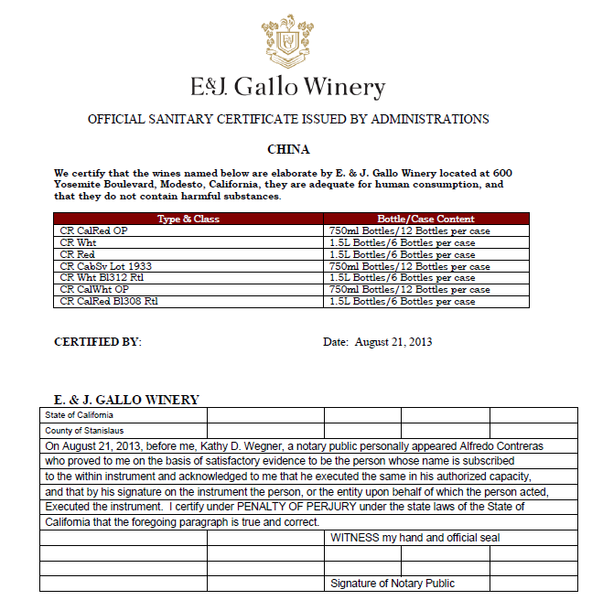
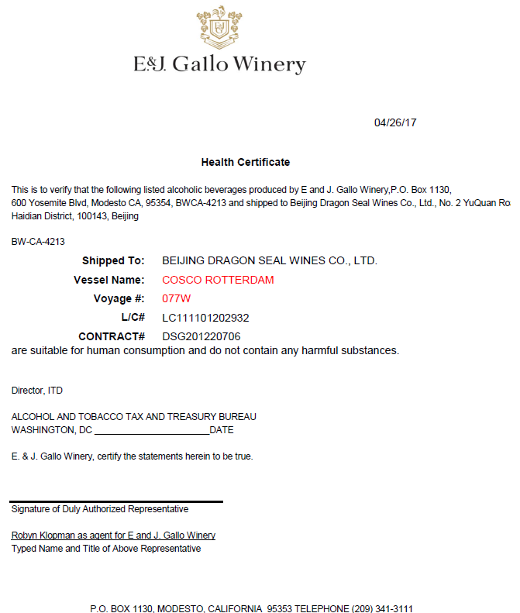
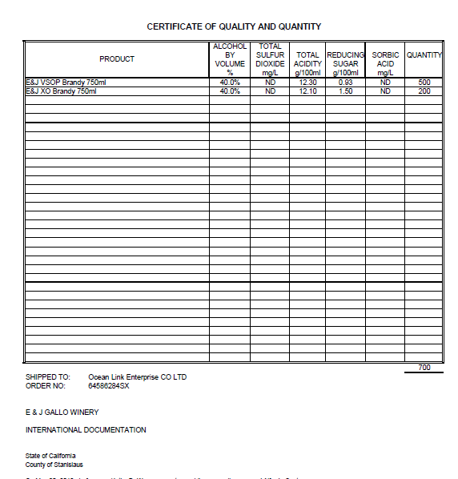
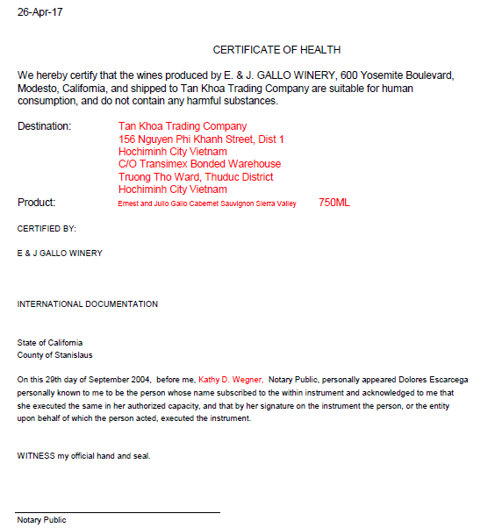
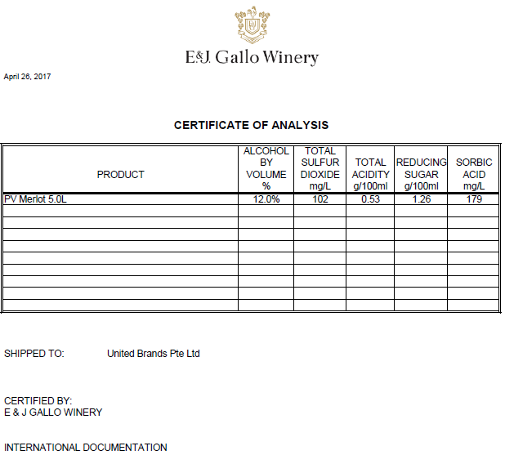

Slide 9
3. Wine is a Microbiologically Low Safety Risk Product
Studies¹ have shown wine is a microbiologically low safety risk product due:
High acid and polyphenolic content;
Alcohol content; and
The use of winemaking additions such as sulphur dioxide (INS 220-228) and sometimes potassium sorbate (INS 202).
Hurdle technology
¹ Microbiologically, Wine is a Low Food Safety Risk Consumer Product, FIVS. Presented at the 39th World Congress of Vine and Wine (2016) https://doi.org/10.1051/bioconf/20160704003

Slide 10
4.
GOAL: being transparency, consistency, reduced paperwork burdens for companies and governments.
Current work acknowledging wine’s unique product characteristics:
Proposed single consolidated, streamlined export certificate
Exploring specific requirements for certificates of analysis

Slide 11
5. Industry Request
Industry would like to encourage economies requiring export certifications to consider implementing the APEC Model Wine Certificate and to streamline documentation requirements amongst ports.

Slide 12
Thank you.

