Slide 1
Session 7
2017-2018
Working group Items
Working Group on Export Certificates

Slide 2
2017-2018 working group items
In the frame of the APEC Sub-Committee on Standards and Conformance (SCSC), the Wine Regulatory Forum (Good Regulatory Practices Action Plan) through the Working Group on export certificates, after 3 years work, developed an APEC Model Wine Export Certificate for the economies that require this type of certification.
This certificate will make it simpler and more efficient to trade wine between APEC economies by consolidating the different certificates into a single one usable across the region.

Slide 3
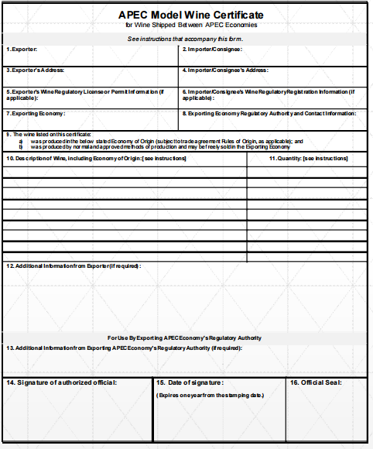
2017-2018 working group items

Slide 4
2017-2018 working group items
The APEC Model Wine Export Certificate was approved by regulatory and trade officials from APEC economies, during the last APEC Peru in 2016.
The last step is the implementation of the certificate for their use among APEC economies that require this type of certification.

Slide 5
2017-2018 working group items
Chile would like for itself iniciate the implementation of the APEC Model Wine Export Certificate for their use among APEC economies that require this type of certification.
The commitment from the economies that requires export certificates is fundamental to implement the model certificate during the 2017.

Slide 6
Text proposal for MRT statement
“We endorse the conclusion of the APEC Model Wine Certificate of the SCSC Wine Regulatory Forum (WRF) and we are committed to widely use the certificate, which will facilitate wine trade in the APEC region. The implementation will enhance the reduction and elimination of technical barriers for wine trade and demonstrate that good regulatory practices could benefit MSMEs.”

Slide 7
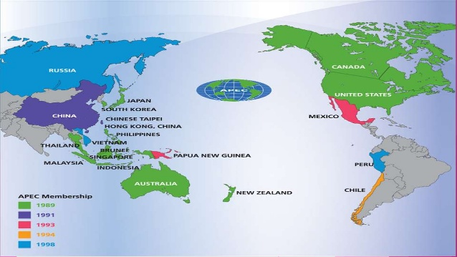
Thank you for your attention

