Slide 1
Ring Test Program
2017 Results
Dr Eric Wilkes
Australian Wine Research Institute

Slide 2
Background
In 2015 the APEC Wine Regulatory forum commissioned a ring test program to evaluate the degree of variability between laboratories in APEC economies who were involved in the testing of common wine components.
The results were far from ideal.

Slide 3
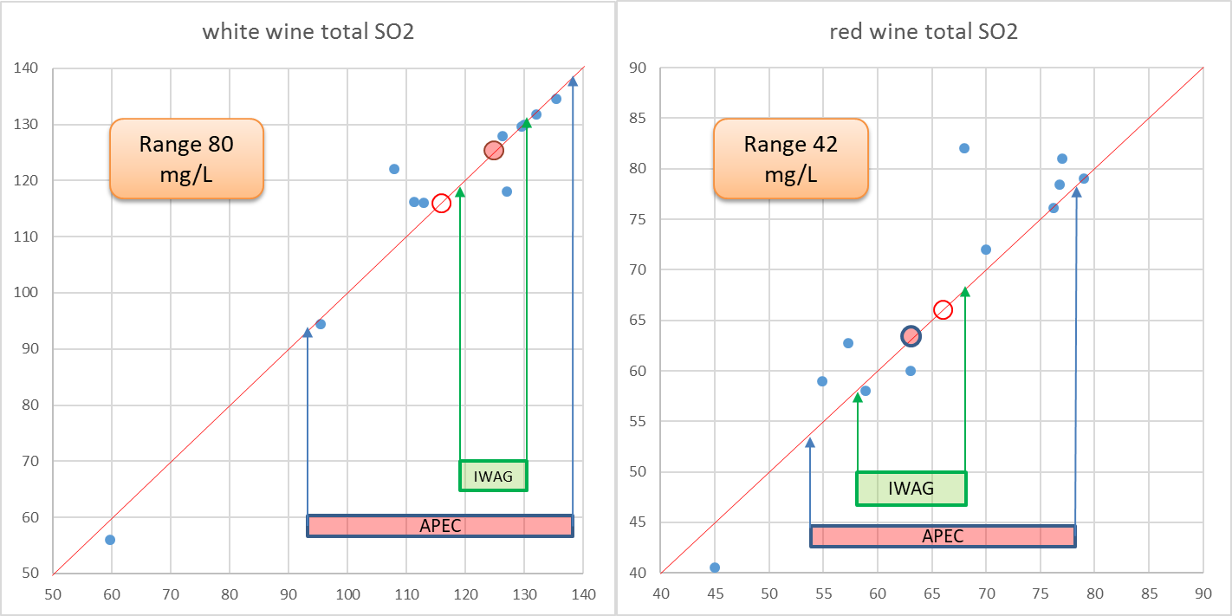
2016 Ring Test Results
Total Sulfur Dioxide
 | White |  | Red
 | APEC | IWAG | APEC | IWAG
Mean | 115.66 | 125 | 67.03 | 63
Standard Deviation | 21.99 | 6 | 11.87 | 5

Slide 4
Background
In 2015 the APEC Wine Regulatory forum commissioned a ring test program to evaluate the degree of variability between laboratories in APEC economies who were involved in the testing of common wine components.
The results were far from ideal.
Based on the these results it was decided to continue the ring test program and run a series of workshops on the best practice in wine laboratory testing.

Slide 5
Laboratory Method Workshops
A workshop/tutorial covering the best practice for methodology for 4 common wine analytes was held prior to the International Wine Technical Summit( IWTs) in San Luis Obispo 2016 and was attended by 55 wine regulators, laboratory scientists and wine industry representatives from six WWTG economies and 11 APEC economies.
In 2017 in at the Hanoi APEC WRF a work shop on “The core elements of a strong laboratory management system” was presented highlighting the base requirements for laboratory analysis.
In 2018 at the Lodi IWTS meeting a further workshop was held for attendees looking at “Fit for Purpose Analysis” and highlighted the importance of robust method validation.

Slide 6
The ring test program
The program is an opportunity for laboratories from different economies to compare the results for typical wine analysis between different laboratories.
As part of a larger wine proficiency testing program it also allows economies to compare their laboratories results to those typically achieved for the wine tested.
In 2018, 22 nominated laboratories from 14 different economies.
There are still significant difficulties being encountered shipping wine samples to a number of economies which will need resolution going forward.

Slide 7
2018 Program
For 2018 the APEC ring test program was fully integrated into the Interwinery Analysis Group Proficiency program.
This is a large wine specific program with over 200 participating laboratories.
It consists of 6 separate rounds of testing, 2 red wines, 2 white wine and 2 rose wine rounds.
Laboratories can submit analytical results for any of the common wine analysis that is done.
All data is entered online and collated anonymously.
Within 2 weeks of the closure of each testing window an online report is available.
Currently only the first 5 rounds of testing have been completed.

Slide 8
Participants 2018
Economy | Labs | Samples delivered | Results Submitted
Australia | x2 | yes | yes
New Zealand | x2 | yes | yes
Canada | x2 | yes | yes
Philippines | x1 | yes
Indonesia | x2 | yes | yes
Vietnam | x2 | yes | yes
PNG | x2 | yes | yes
Chile | x1 | no | -
USA | x2 | yes | yes
Japan | x2 | yes | yes
China | x2 | yes | no
Peru | x1 | no | -
Mexico | x1 | yes | yes
Thailand | x1 | yes | yes

Slide 9
Alcohol
wine | Analyte | APEC mean | APEC stdev | APEC count | APEC CV | IWAG mean | IWAG stdev | IWAG count | IWAG CV
red | Alcohol | 13.25 | 0.67 | 20 | 5.07% | 13.72 | 0.52 | 362 | 3.82%
white | Alcohol | 12.18 | 0.33 | 24 | 2.67% | 12.34 | 0.19 | 342 | 1.57%
rose | Alcohol | 11.58 | 0.25 | 26 | 2.18% | 11.70 | 0.19 | 344 | 1.62%
 |  |  |  | Average | 3.31% |  |  |  | 2.34%

Slide 10
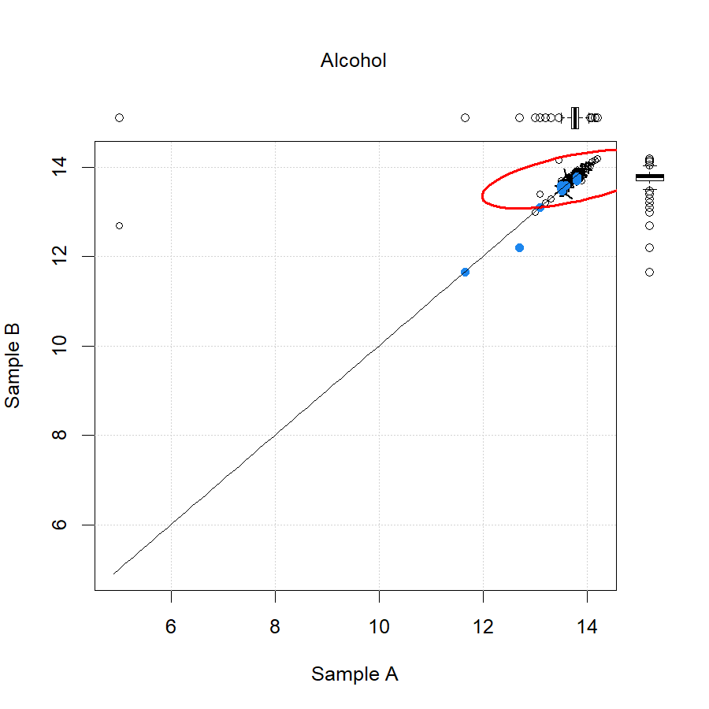
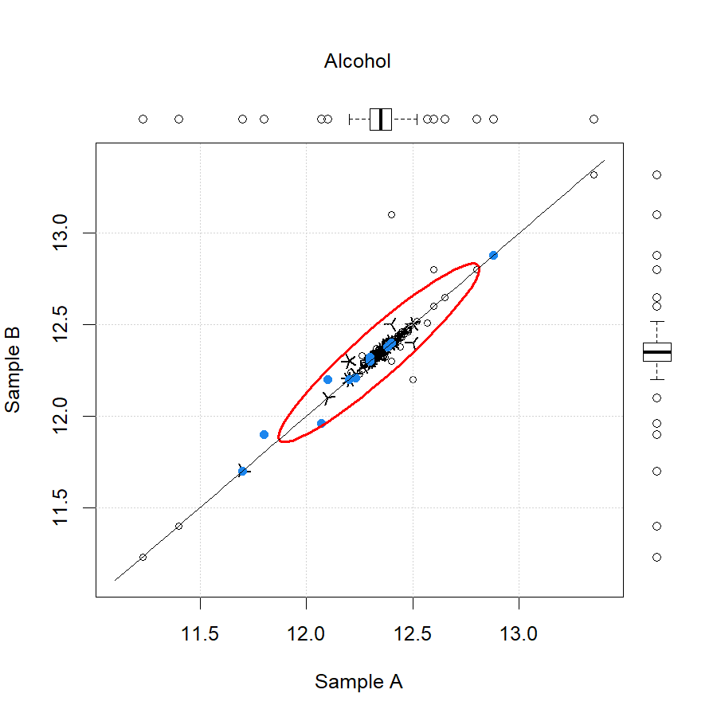
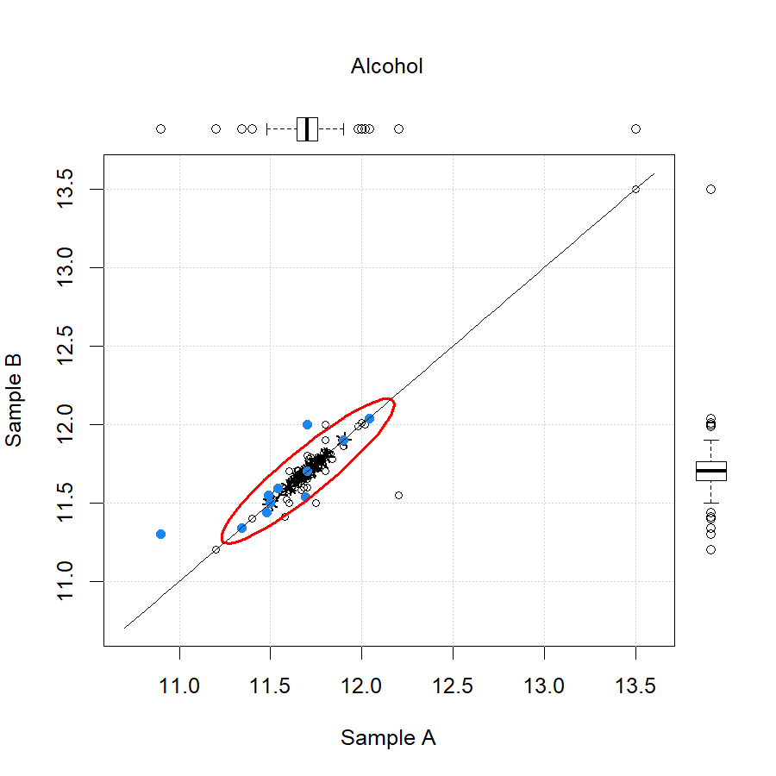
Alcohol

Slide 11
Total Sulfur Dioxide
wine | Analyte | APEC mean | APEC stdev | APEC count | APEC CV | IWAG mean | IWAG stdev | IWAG count | IWAG CV
red | TSO2 | 64.1 | 15.9 | 14 | 24.77% | 56.2 | 7.2 | 370 | 12.89%
white | TSO3 | 92.1 | 12.8 | 16 | 13.94% | 87.9 | 6.4 | 350 | 7.23%
rose | TSO4 | 116.4 | 37.0 | 18 | 31.78% | 127.4 | 11.0 | 346 | 8.65%
 |  |  |  | Average | 23.50% |  |  |  | 9.59%

Slide 12
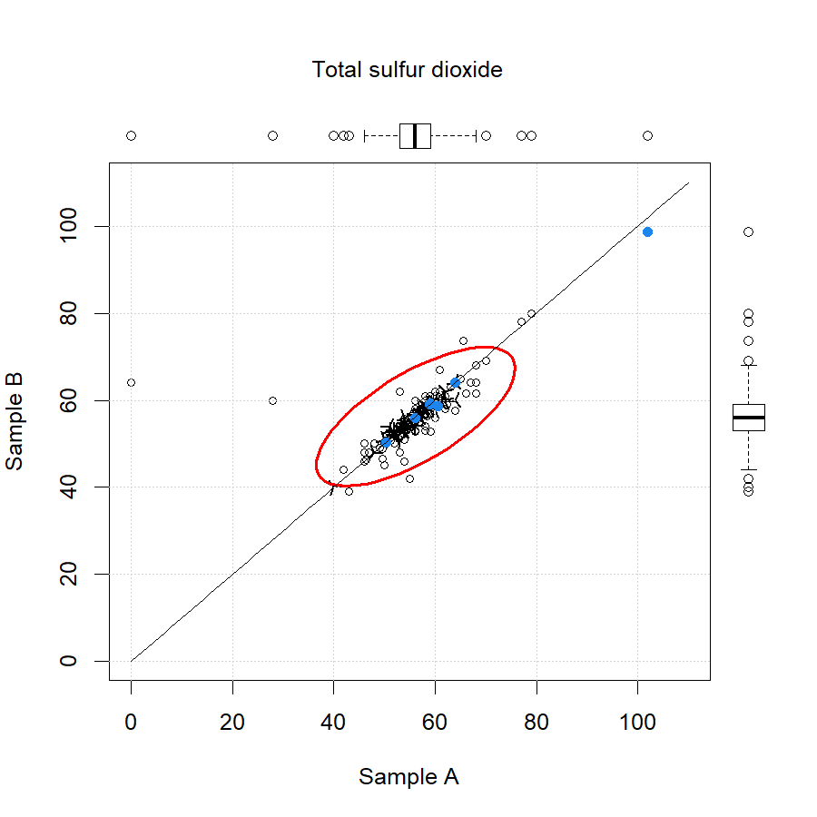
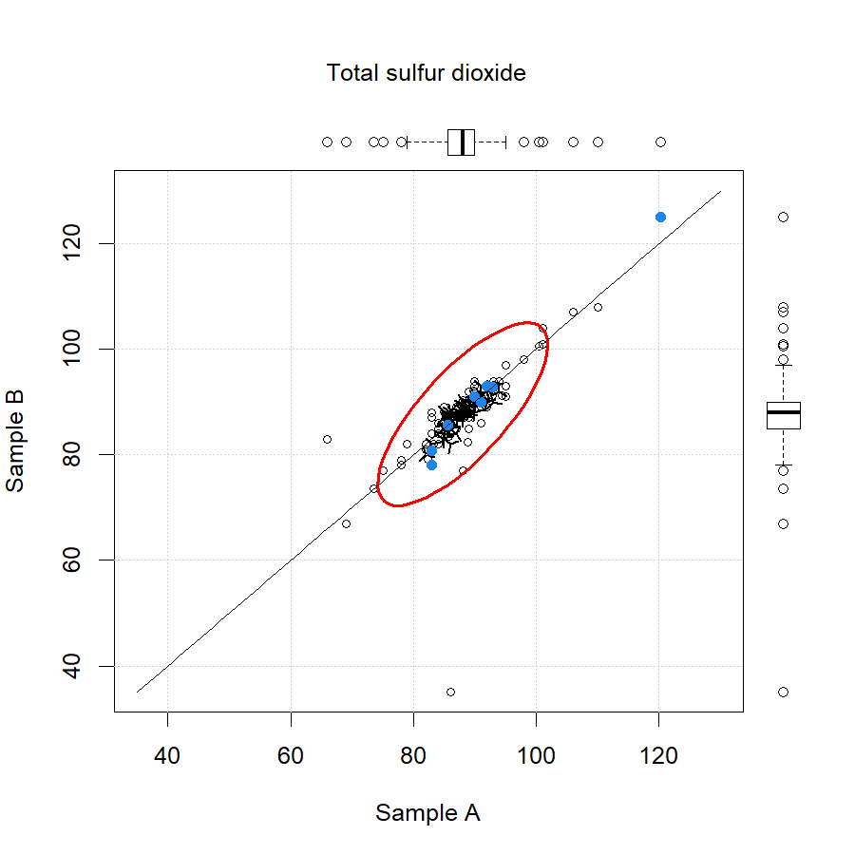
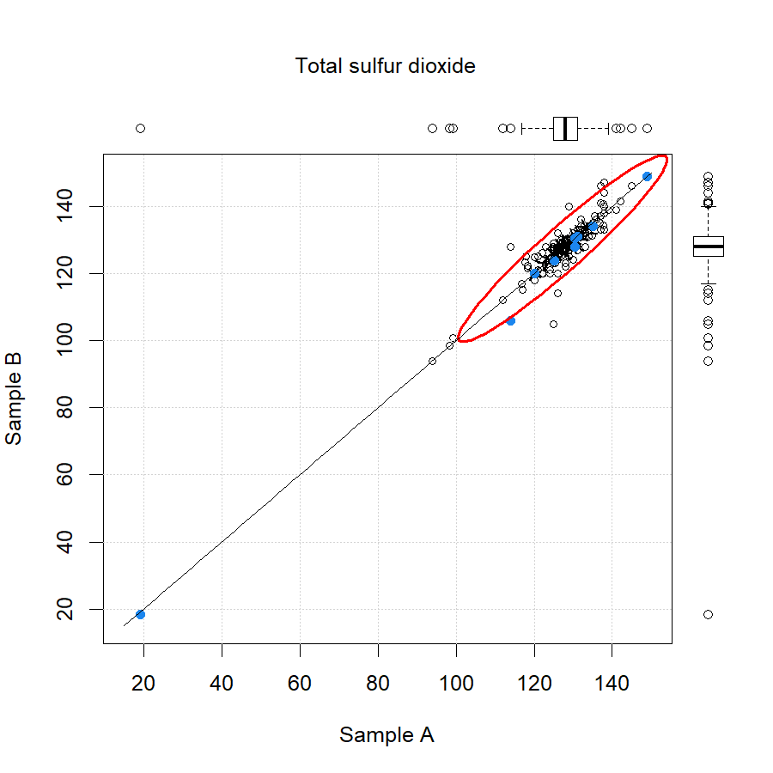
Total Sulfur Dioxide

Slide 13
Titratable Acidity
wine | Analyte | APEC mean | APEC stdev | APEC count | APEC CV | IWAG mean | IWAG stdev | IWAG count | IWAG CV
red | TA | 5.47 | 0.13 | 10 | 2.35% | 5.41 | 0.33 | 350 | 6.18%
white | TA | 5.49 | 0.45 | 10 | 8.23% | 5.20 | 0.30 | 324 | 5.81%
rose | TA | 5.95 | 0.28 | 10 | 4.78% | 5.79 | 0.27 | 322 | 4.64%
 |  |  |  | Average | 5.12% |  |  |  | 5.54%

Slide 14
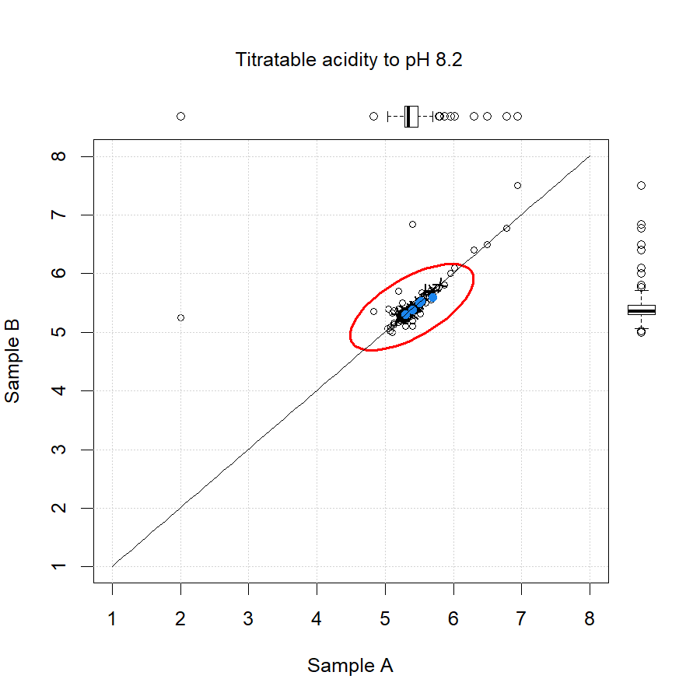
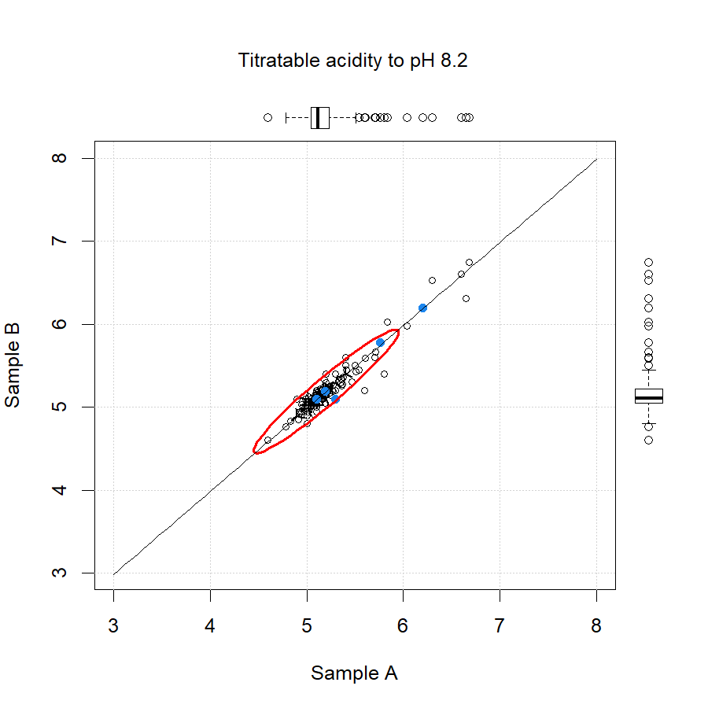
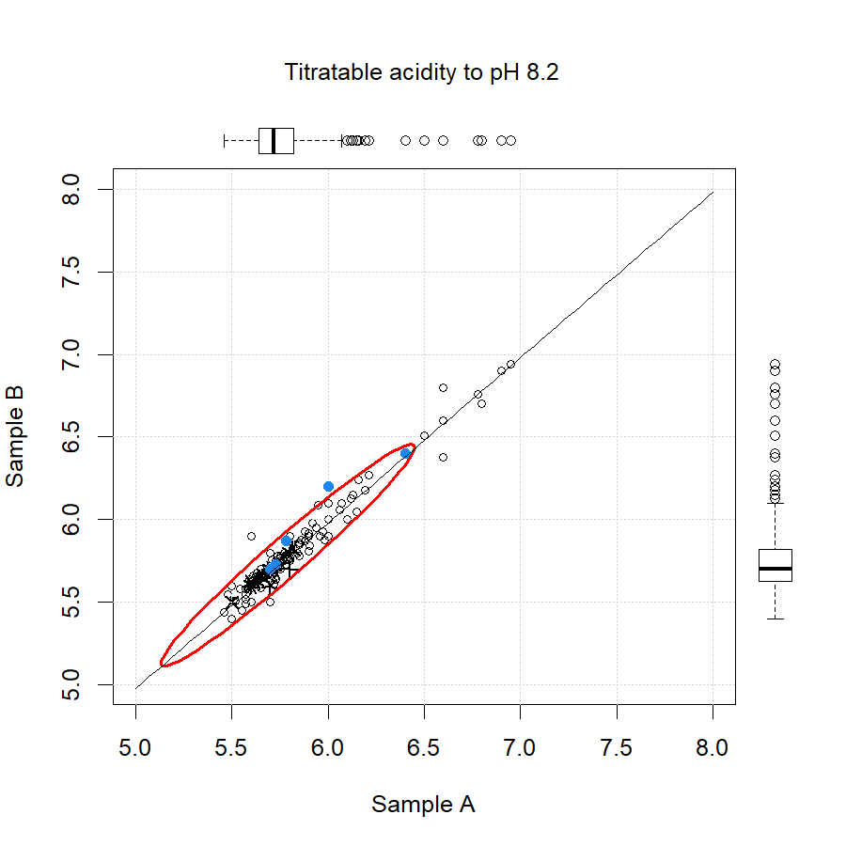
Titratable Acidity

Slide 15
Reducing Sugar
wine | Analyte | APEC mean | APEC stdev | APEC count | APEC CV | IWAG mean | IWAG stdev | IWAG count | IWAG CV
red | Reducing sugars | 3.45 | 1.08 | 8 | 31.28% | 2.91 | 0.77 | 110 | 26.37%
white | Reducing sugars | 3.99 | 0.62 | 12 | 15.62% | 4.09 | 0.50 | 116 | 12.27%
rose | Reducing sugars | 20.28 | 0.94 | 14 | 4.64% | 20.15 | 1.42 | 114 | 7.07%
 |  |  |  | Average | 17.18% |  |  |  | 15.23%

Slide 16
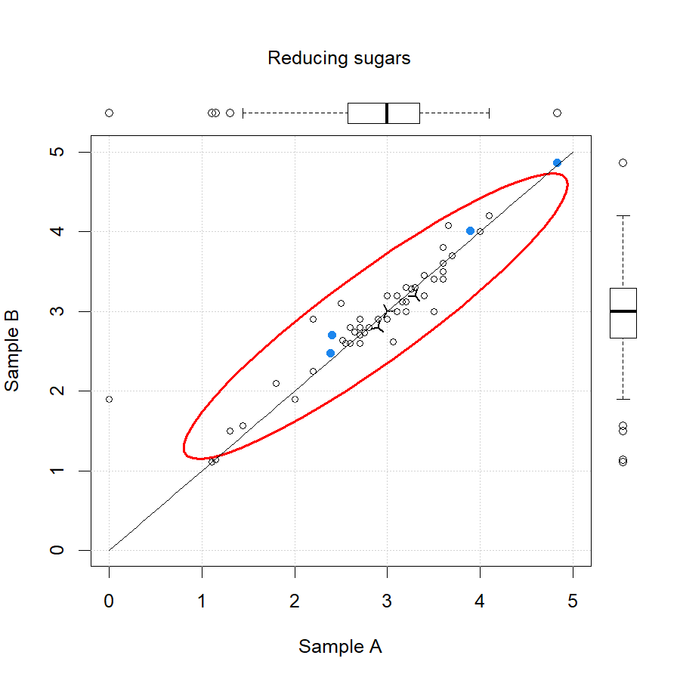
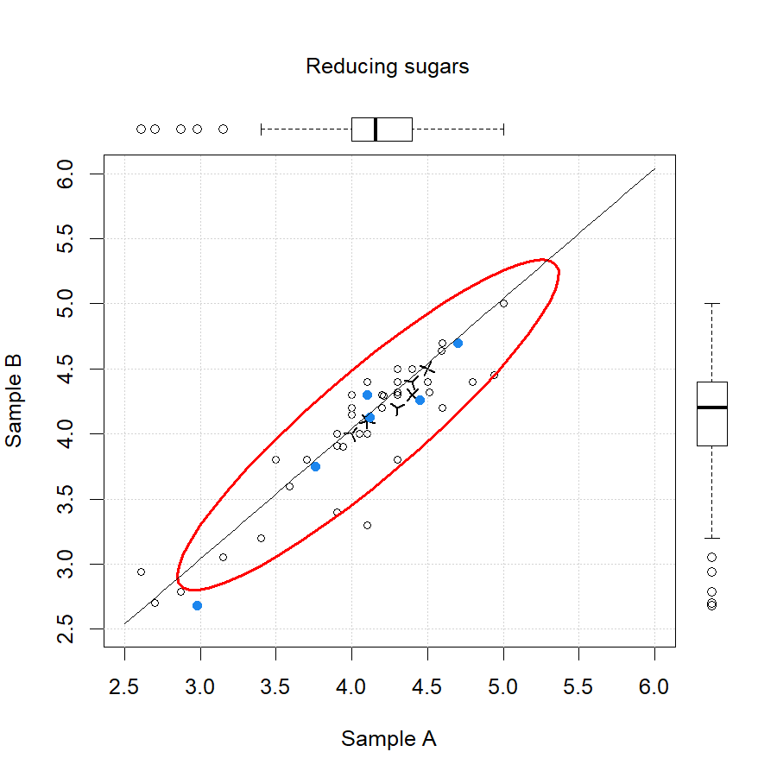
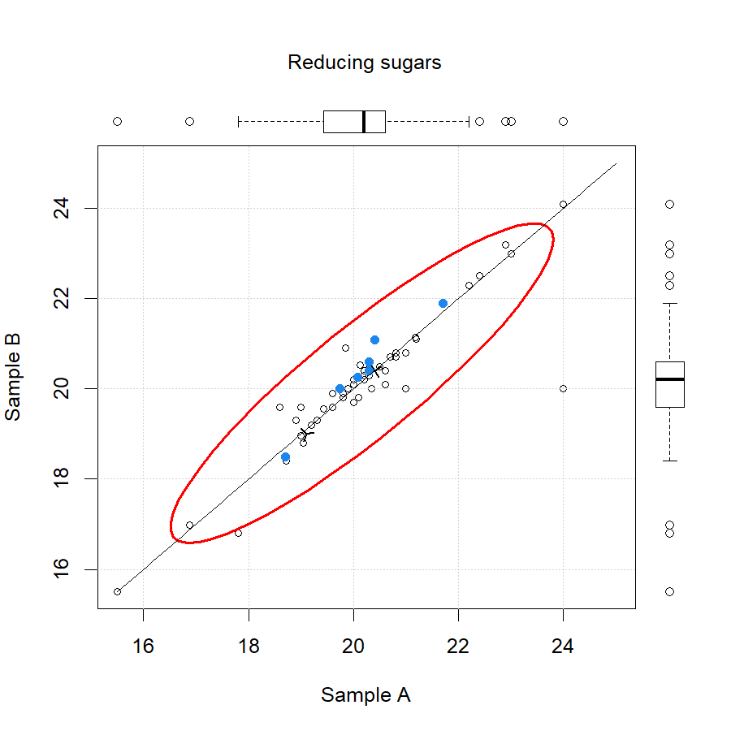
Reducing Sugar

Slide 17
Glucose + Fructose
wine | Analyte | APEC mean | APEC stdev | APEC count | APEC CV | IWAG mean | IWAG stdev | IWAG count | IWAG CV
red | G+F | 1.44 | 0.24 | 6 | 16.29% | 1.29 | 0.32 | 300 | 25.12%
white | G+F | 3.43 | 0.65 | 6 | 19.08% | 2.90 | 0.46 | 272 | 15.82%
rose | G+F | 20.79 | 2.80 | 8 | 13.46% | 19.00 | 2.93 | 266 | 15.41%
 |  |  |  | Average | 16.28% |  |  |  | 18.78%

Slide 18
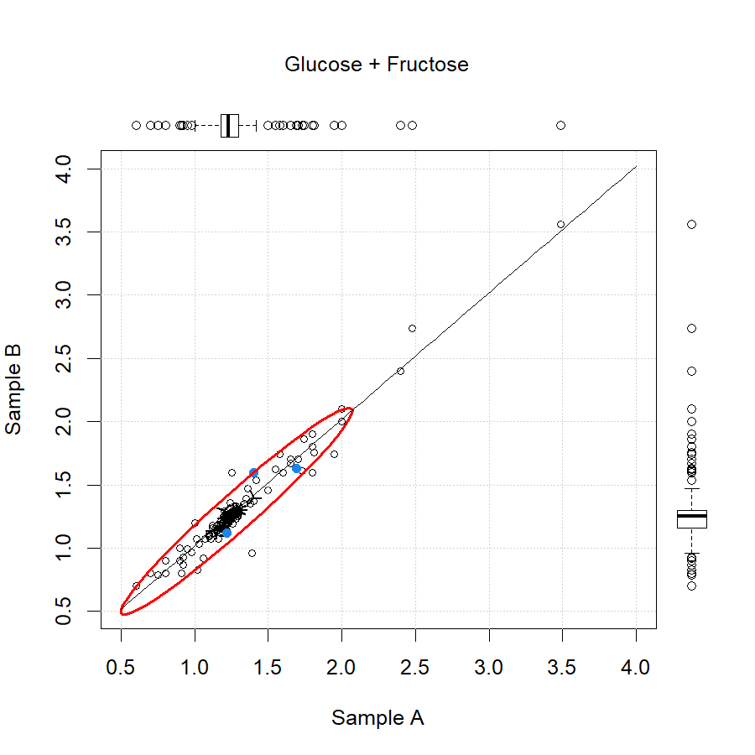
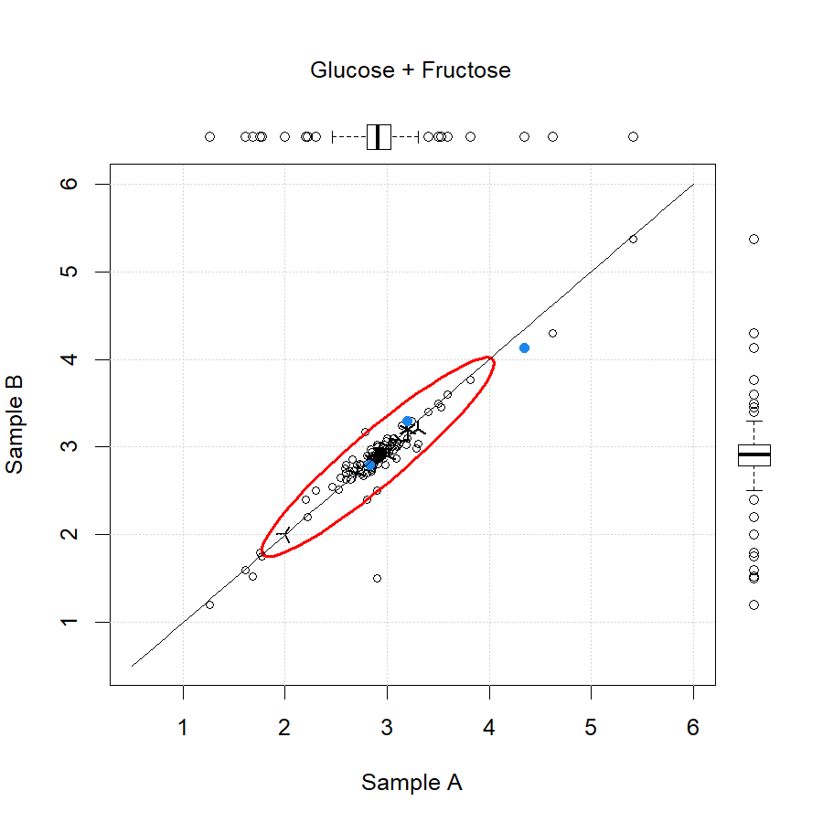
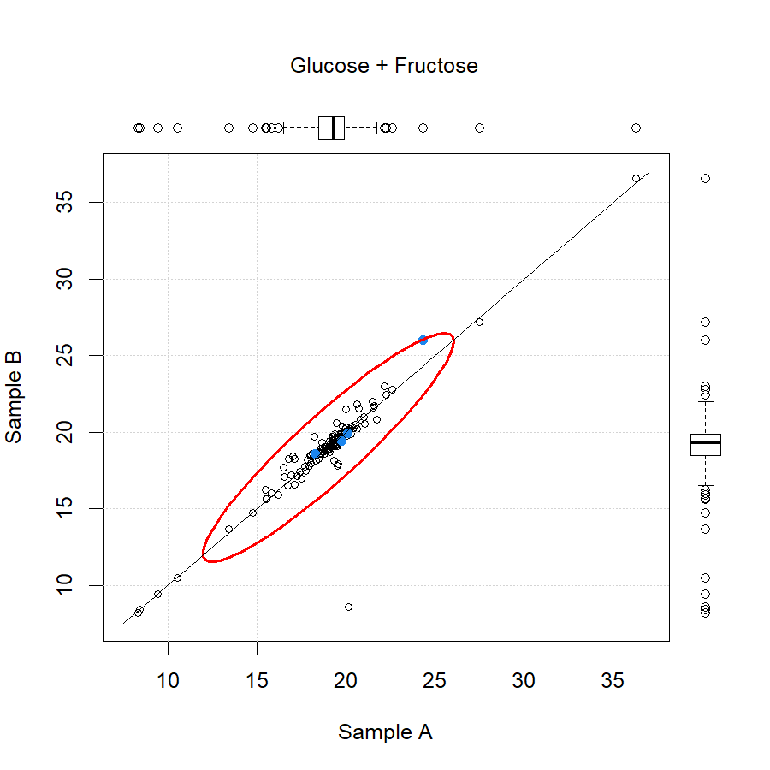
Glucose + Fructose

Slide 19
Specific Gravity
wine | Analyte | APEC mean | APEC stdev | APEC count | APEC CV | IWAG mean | IWAG stdev | IWAG count | IWAG CV
red | S.G. | 0.9940 | 0.0022 | 12 | 0.22% | 0.9926 | 0.0038 | 274 | 0.38%
white | S.G. | 0.9923 | 0.0003 | 20 | 0.03% | 0.9920 | 0.0020 | 268 | 0.20%
rose | S.G. | 0.9999 | 0.0003 | 20 | 0.03% | 0.9999 | 0.0021 | 280 | 0.21%
 |  |  |  | Average | 0.09% |  |  |  | 0.27%

Slide 20
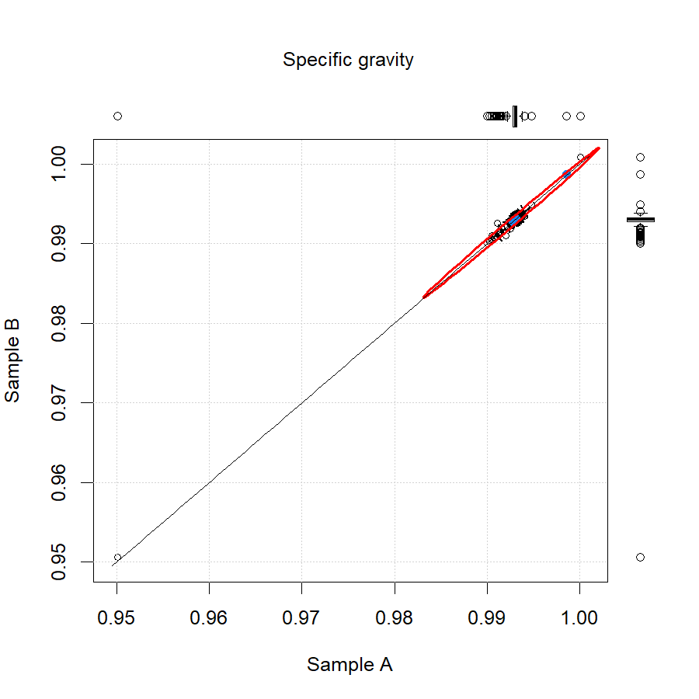
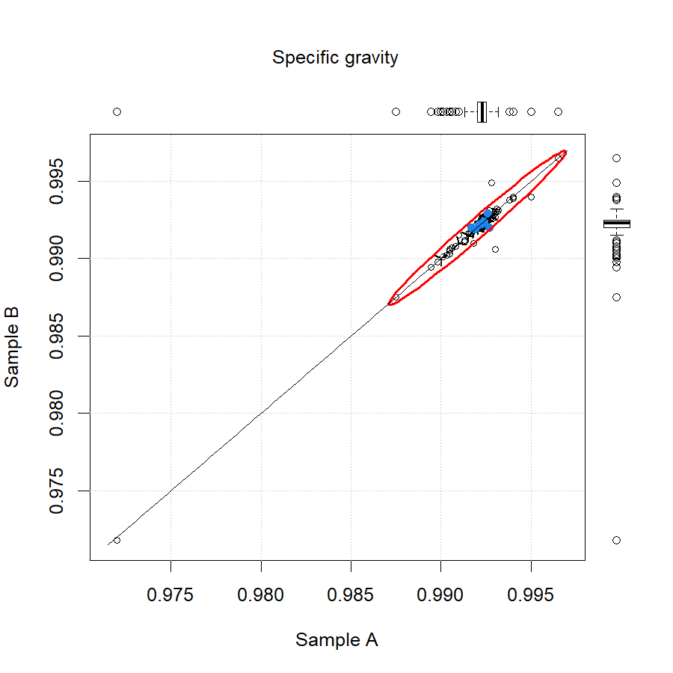
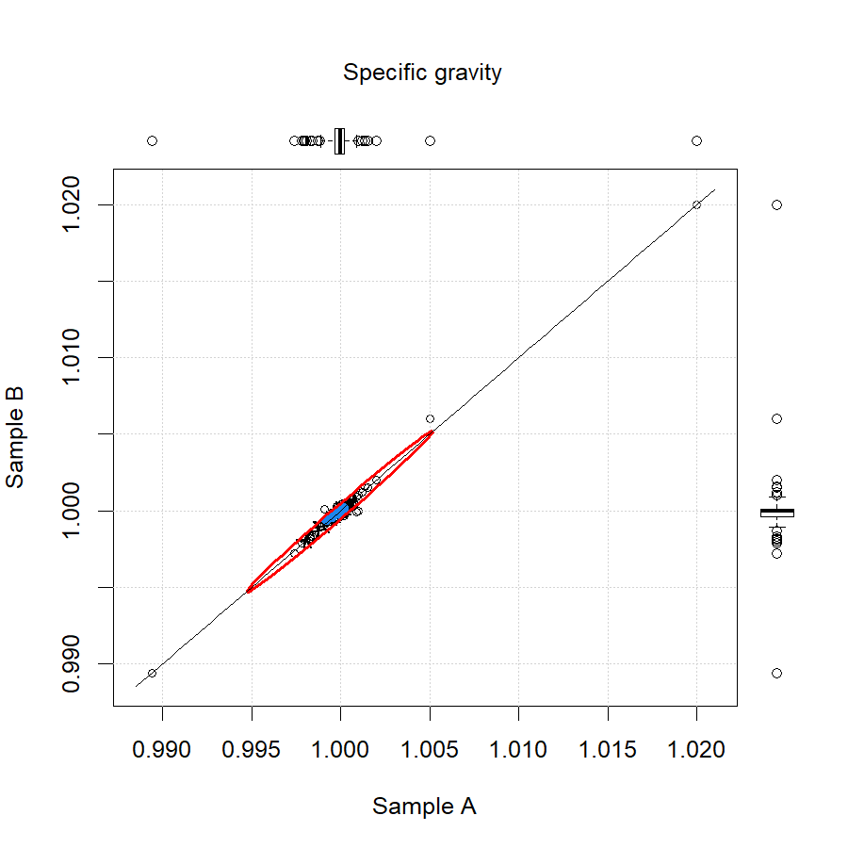
Specific Gravity

Slide 21
Copper
wine | Analyte | APEC mean | APEC stdev | APEC count | APEC CV | IWAG mean | IWAG stdev | IWAG count | IWAG CV
red | Copper | 64.9 | 6.6 | 6 | 10.15% | 62.4 | 22.2 | 52 | 35.58%
white | Copper | 75.2 | 4.3 | 6 | 5.72% | 68.3 | 11.2 | 54 | 16.33%
rose | Copper | 116.1 | 32.6 | 8 | 28.12% | 100.3 | 21.4 | 54 | 21.35%
 |  |  |  | Average | 14.67% |  |  |  | 24.42%

Slide 22
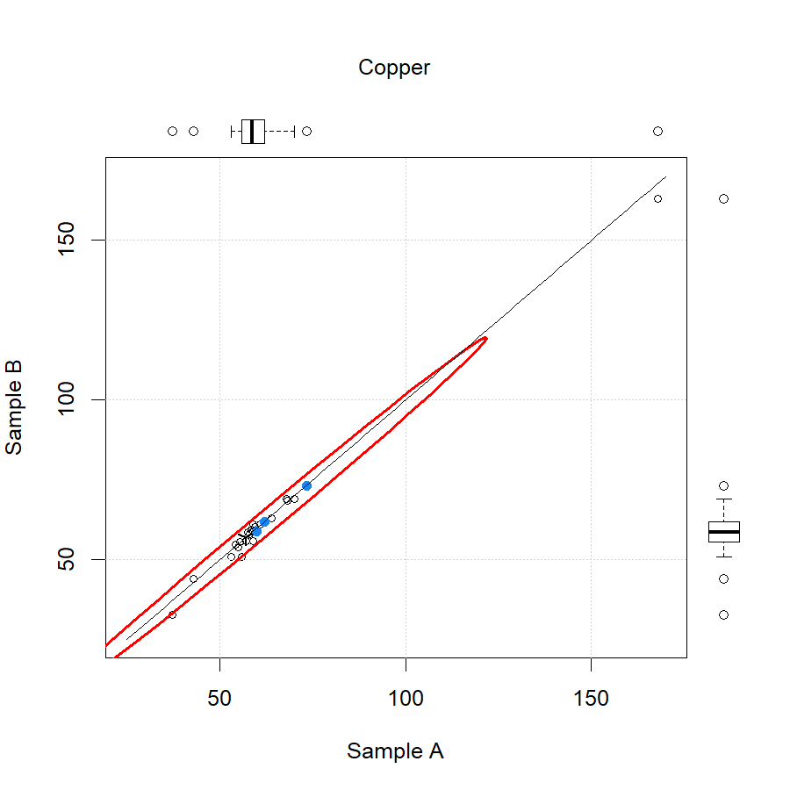
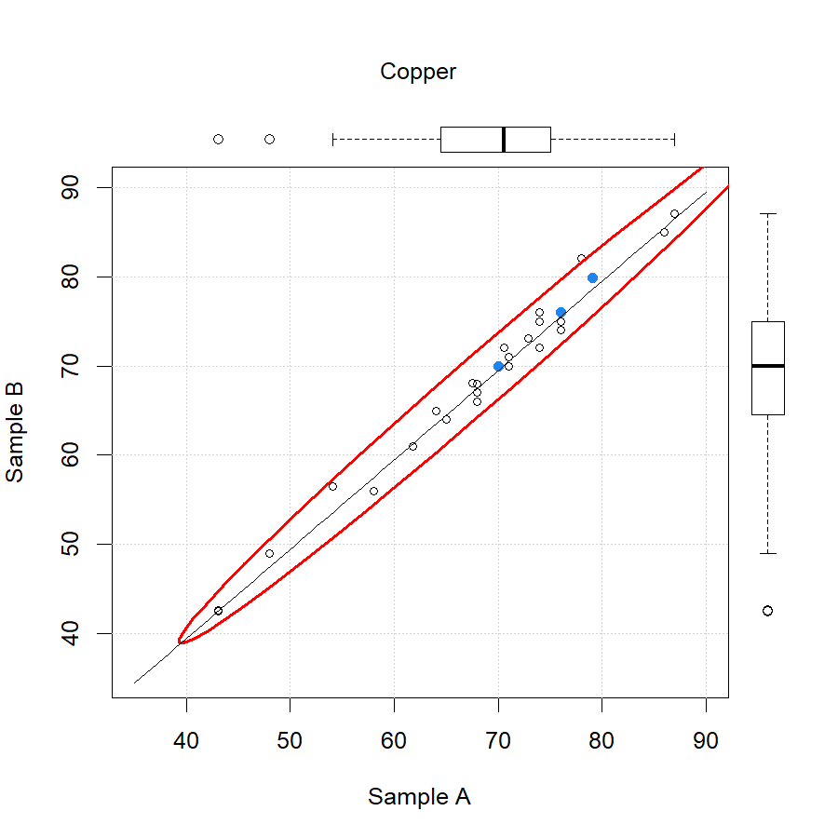
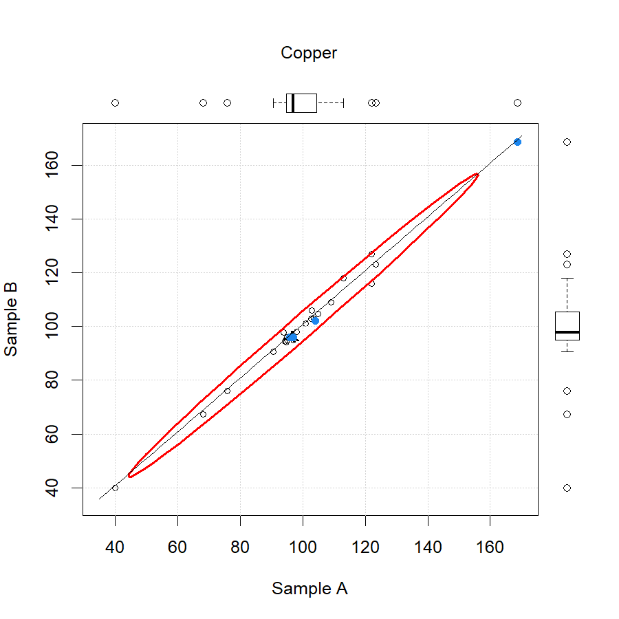
Copper

Slide 23
Iron
wine | Analyte | APEC mean | APEC stdev | APEC count | APEC CV | IWAG mean | IWAG stdev | IWAG count | IWAG CV
red | Iron | 2.50 | 0.55 | 8 | 21.81% | 2.12 | 0.31 | 54 | 14.62%
white | Iron | 1.30 | 0.31 | 10 | 23.71% | 1.03 | 0.20 | 54 | 19.59%
rose | Iron | 1.26 | 0.29 | 10 | 23.16% | 1.42 | 0.20 | 54 | 14.25%
 |  |  |  | Average | 22.89% |  |  |  | 16.15%

Slide 24
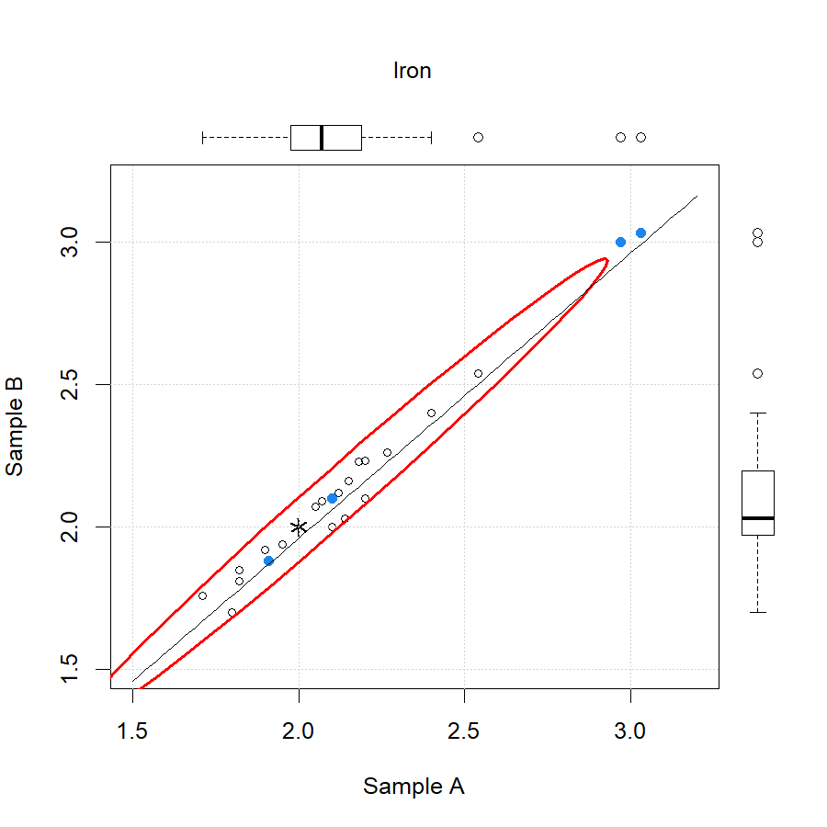
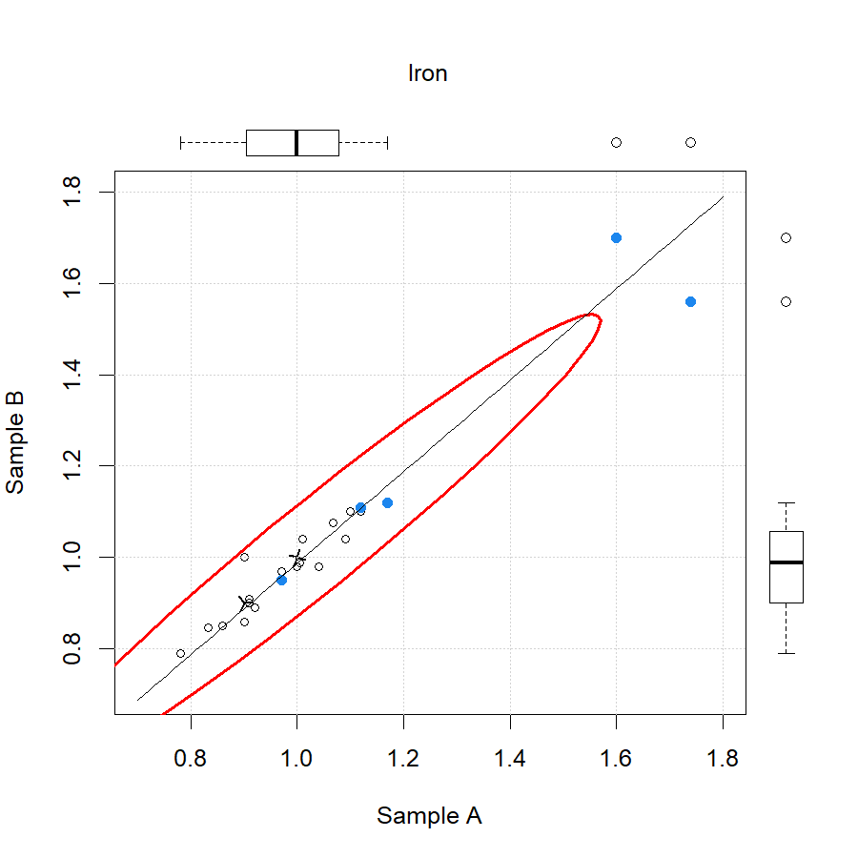
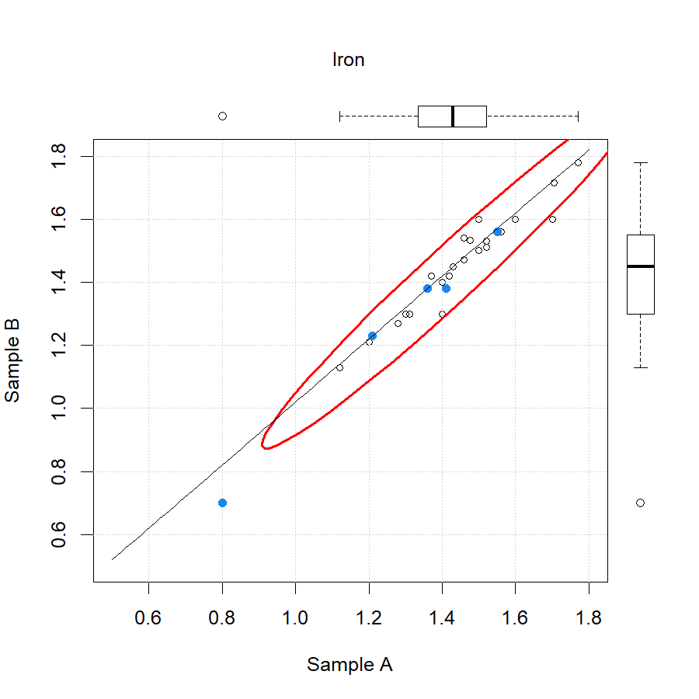
Iron

Slide 25
Manganese
wine | Analyte | APEC mean | APEC stdev | APEC count | APEC CV | IWAG mean | IWAG stdev | IWAG count | IWAG CV
red | Manganese | 2.28 | 0.18 | 6 | 8.11% | 2.16 | 0.27 | 38 | 12.34%
white | Manganese | 1.60 | 0.54 | 8 | 34.13% | 1.38 | 0.28 | 38 | 20.06%
rose | Manganese | 1.13 | 0.53 | 8 | 46.51% | 1.33 | 0.27 | 36 | 20.71%
 |  |  |  | Average | 29.59% |  |  |  | 17.70%

Slide 26
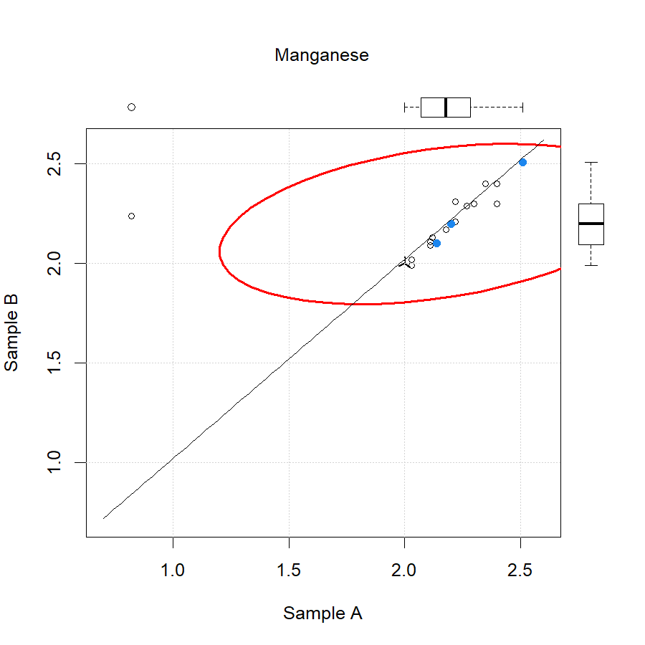
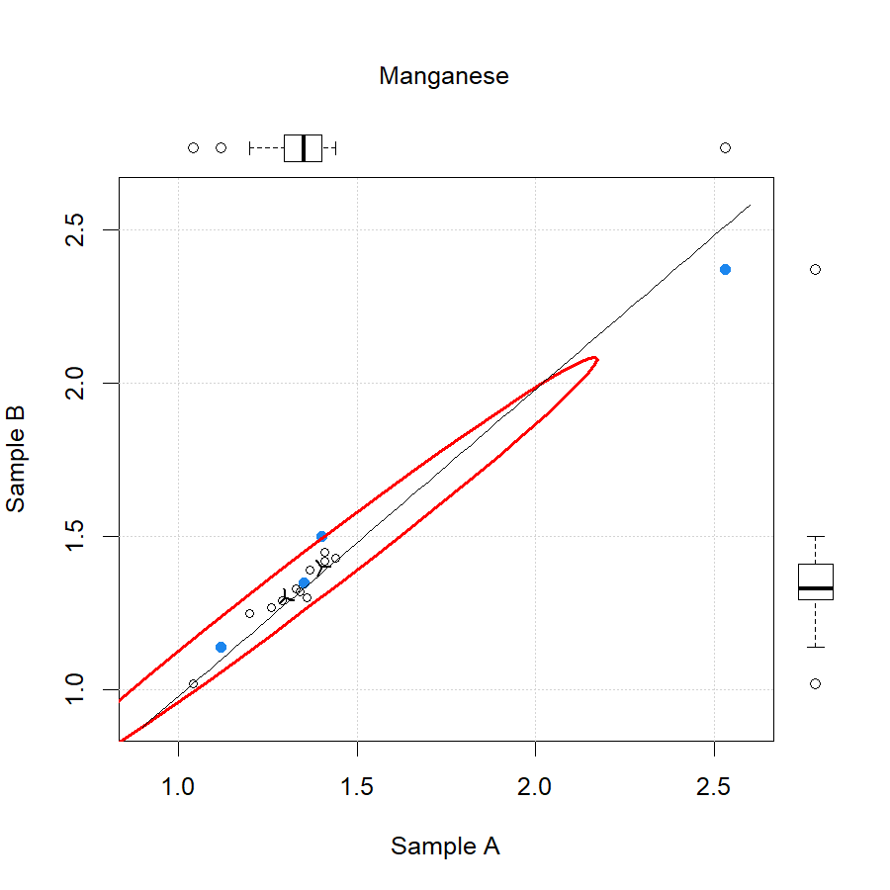
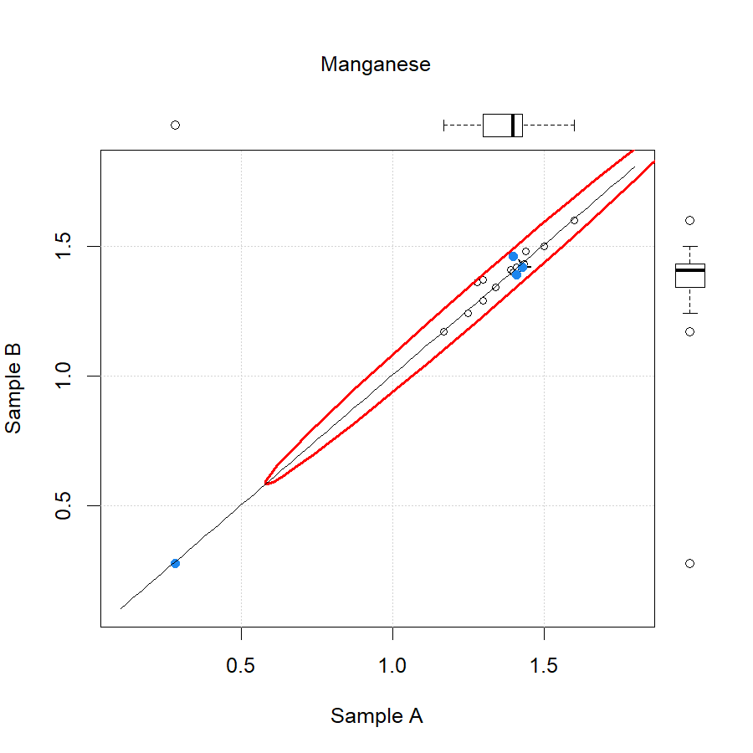
Manganese

Slide 27
Methanol
wine | Analyte | APEC mean | APEC stdev | APEC count | APEC CV | IWAG mean | IWAG stdev | IWAG count | IWAG CV
red | Methanol | 160.3 | 41.5 | 12 | 25.92% | 161.7 | 31.2 | 22 | 19.30%
white | Methanol | 54.8 | 11.6 | 10 | 21.13% | 56.4 | 10.7 | 22 | 18.96%
rose | Methanol | 54.1 | 31.5 | 14 | 58.15% | 51.2 | 24.1 | 24 | 46.98%
 |  |  |  | Average | 35.07% |  |  |  | 28.41%

Slide 28
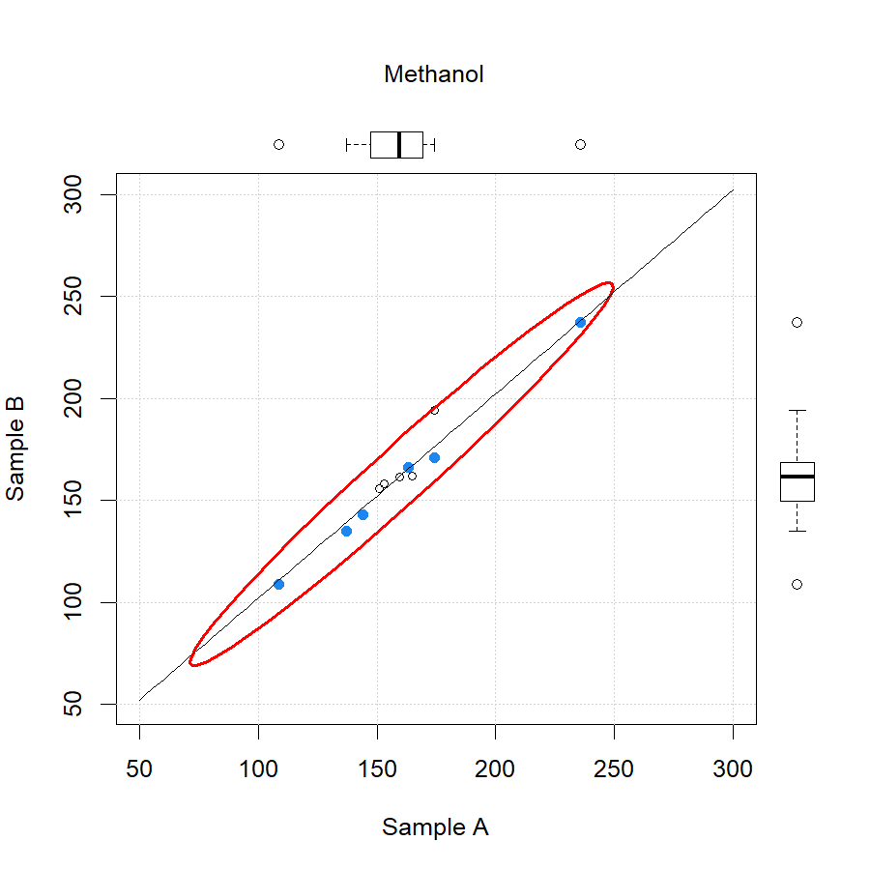
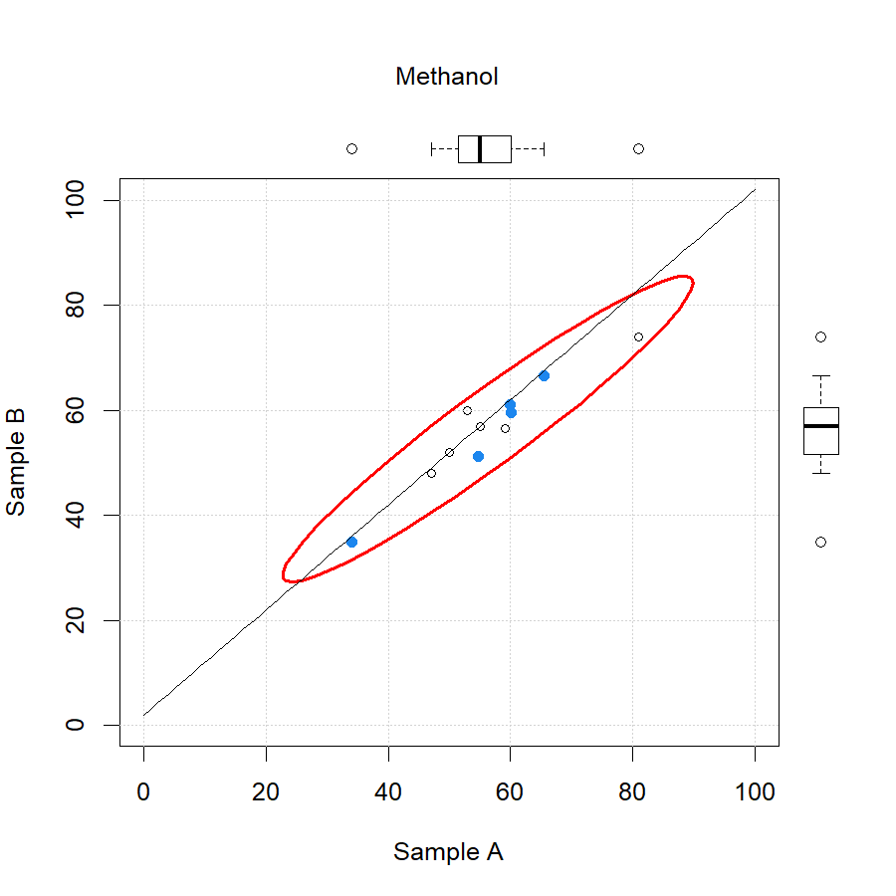
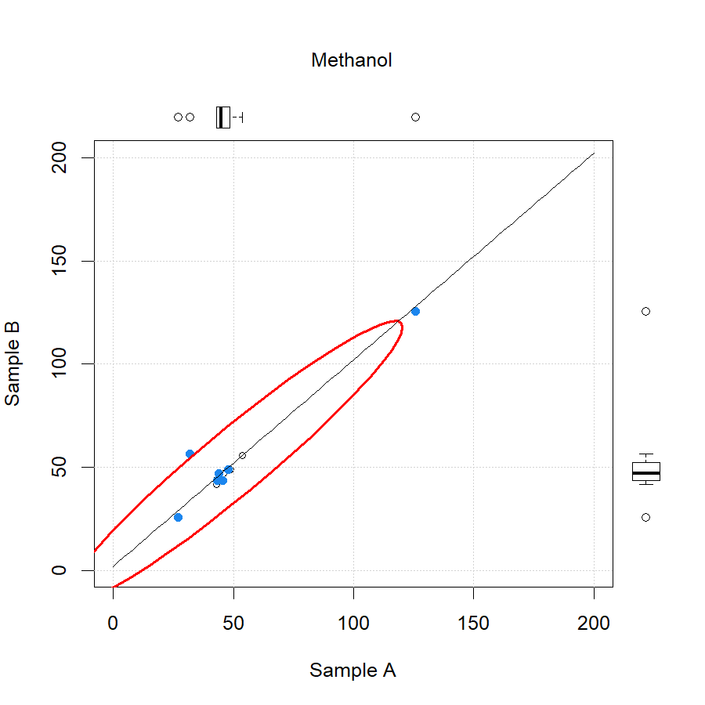
Methanol

Slide 29
Are we Improving?

Slide 30
Results to Date
There have been significant improvements in laboratories performance compared to previous rounds.
Still however significant outliers demonstrating the need to continue the program.
It is significant that laboratories which have participated in the wine program long term are performing more consistently than those new to wine ring testing.
The impact of different analytical methods being used is apparent and leads to varied results between laboratories.
Also need to increase the participation rate going forward.
Need to look for alternative sample delivery options
Funding the program in the future must be addressed as APEC WRF funding ends

Slide 31
Thank You

