Slide 1
Food Safety Cooperation Forum: Export Certificate Workshop
Anna Gore Foreign Agricultural Service U.S. Department of Agriculture

Slide 2
Why Export Certificates?
In 2011, APEC leaders called for the reduction of unnecessary requirements in official export certificates for agricultural products and the elimination of requirements that are not based on science.
53% of those surveyed in a report conducted by the APEC Business Advisory Council (ABAC) view certification as the most burdensome sanitary and phytosanitary (SPS) measure.

Slide 3
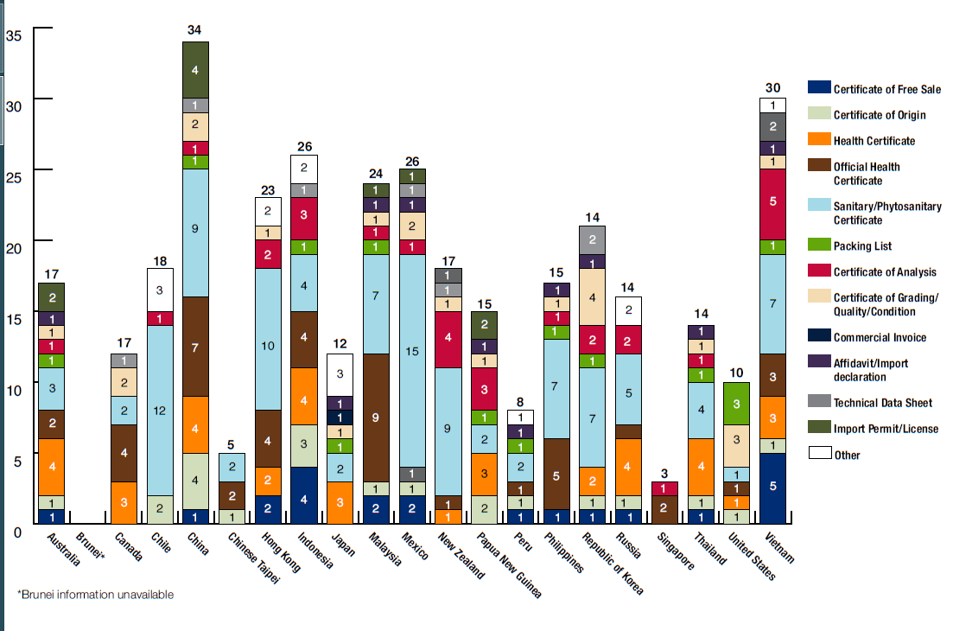
2009 APEC Export Certificate Requirements
Notes:
In 2009, the APEC FSCF PTIN conducted a survey to see what kinds and now many certificates were required by economy and this is a snapshot of that status in 2009. This shows you the breadth of different certificates that are required with more than 80 different official certificates being used in the APEC region.
Note that this information is laid out in the export certificate brochure “Streamlining Export Certificate Requirements for Food Products in the APEC region”

Slide 4
2017 Export Certificate Workshop
19 of 21 APEC economies participated
Speakers from 6 countries
Key issues:
Good regulatory practices in setting certificate requirements
Trust and Confidence
Assessing risk
Science basis
Other assurances
Commodity case studies (including wine!)
Operationalizing Codex model certificates
½ day workshop on possible dairy sector work in 2018

Slide 5
Outcomes and Next steps
2018/9 workshop:
Implementing a risk-based approach to export certificates
Operationalizing model Codex certificates
Other assurances and commercial documents
Non-food safety export certificates (organic, halal, etc…)
Electronic or paperless certification
Dairy Pilot
Update of:
APEC Export Certificate Roadmap
Principles Document
Key documents:
Brochure: Streamlining Export Certificate Requirements for Food products in the APEC Region
Dictionary of Export Certificate Terms
Compendium of Export Certificate Requirements by APEC Economies

Slide 6
THANK YOU
Anna Gore Foreign Agricultural Service
U.S. Department of Agriculture

