Slide 1
Pesticides and Applicable MRLs in Wine
Development of a Information Tool for Implementing Phytosanitary Programs.

Slide 2
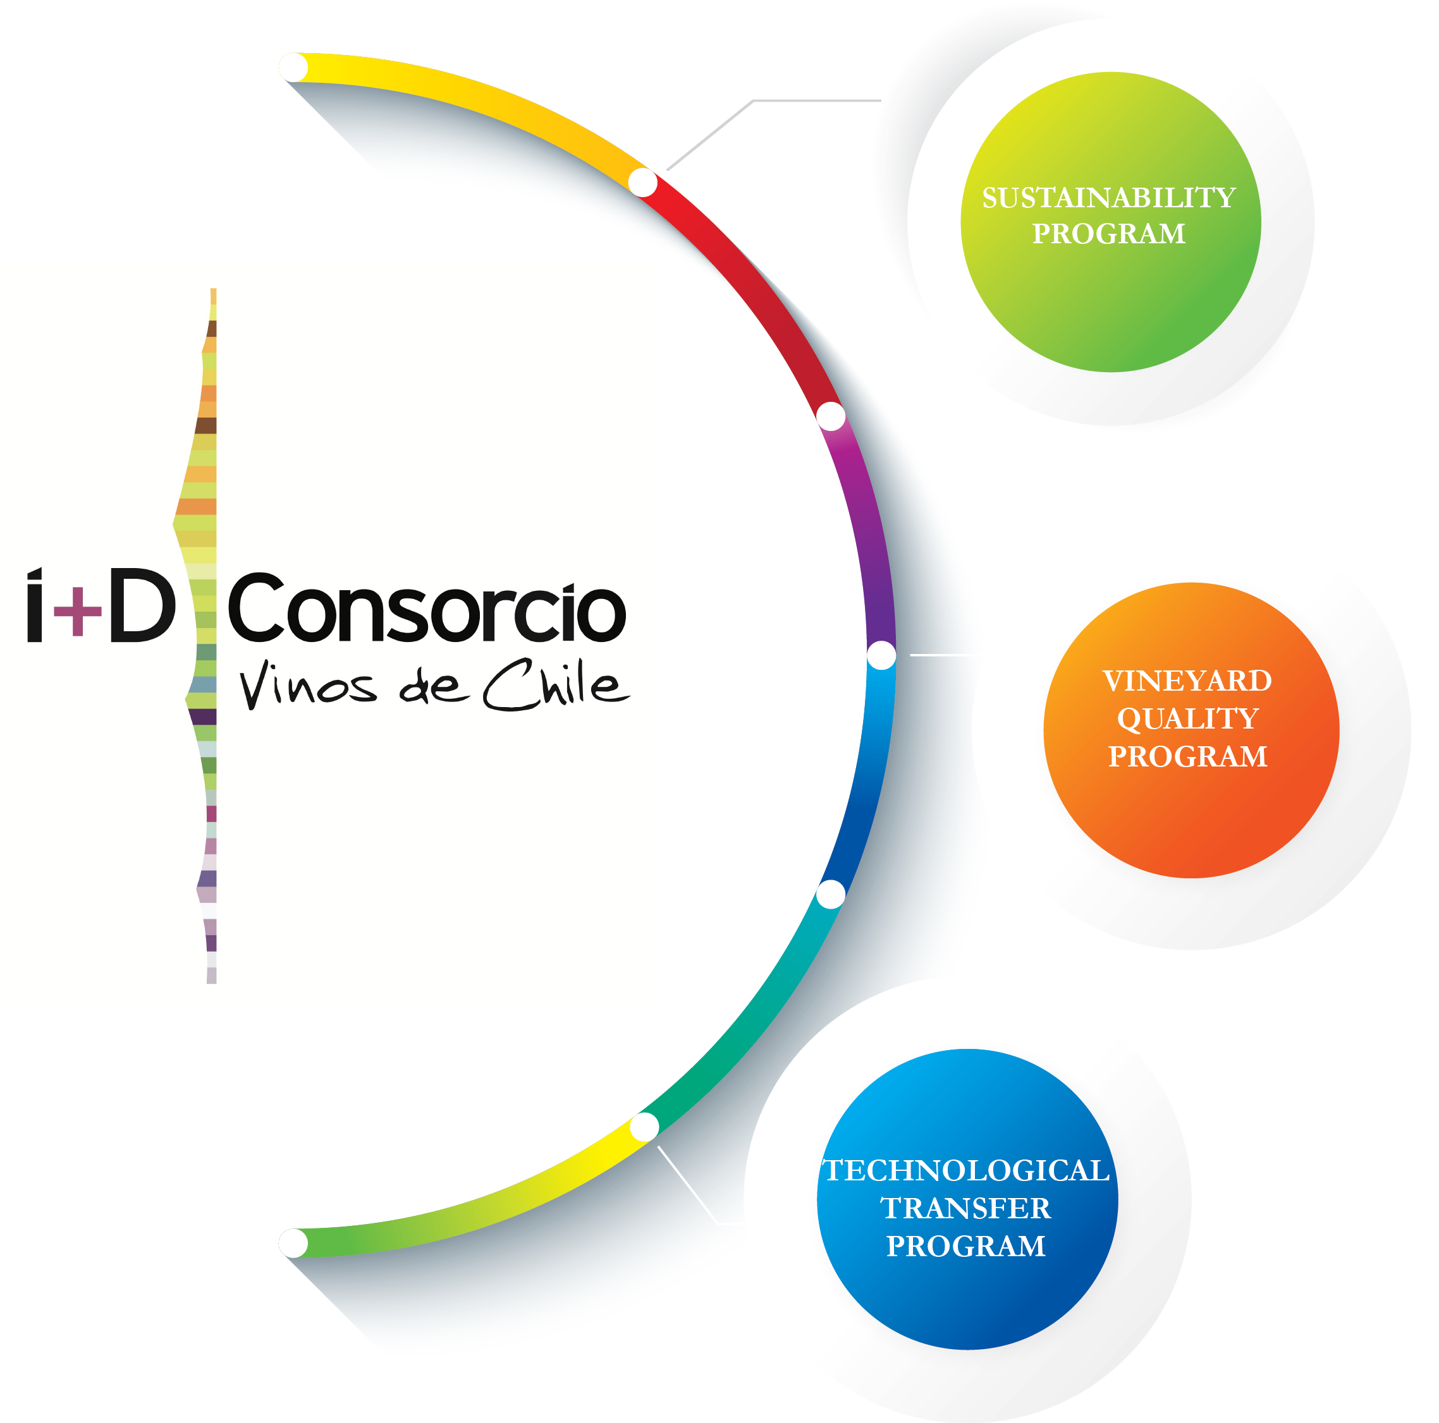
R&D Consortium
Public-Private Collaboration

Slide 3





Projects
Vineyard Quality Program
Sustainability Program
P1 Sanitary quality and traceability
P2 Wine preservation
P3 Geology and wine-growing zones
P4 Climate change and wine-growining zones
P5 Pesticides
P6 Biodiversity
P7 Water management
P8 Energy and GHG reduction
P9 Social responsibility
P10 Sustainability Code
P11 Code and suppliers
Technological Transfer Program

Slide 4

Project results:
Degradation Curves, Transfer Rates and Monitoring System for grape and wine pesticide residues in the viticulture industry

Slide 5
General Objective
Creating a technical – scientific information base through the development of degradation curves studies and the determinant factors in the transfer of pesticide residues in the vinification process. This system shall allow creating an information system dedicated to support productive decision making to prepare safe wines.

Slide 6
Based on field studies, during the first years of the project, Dissipation Curves have been developed for 20 pesticides used in the production of wine grapes. They have also been studied in the industrial process, determining the critical steps in which the biggest effects of pesticide residues are produced (losses), through works developed at the Micro-vinification cellar of SIDAL Limited Company.

Slide 7
Pesticide degradation curve
Pesticide degradation curve in a fruit or plant tissue

Slide 8
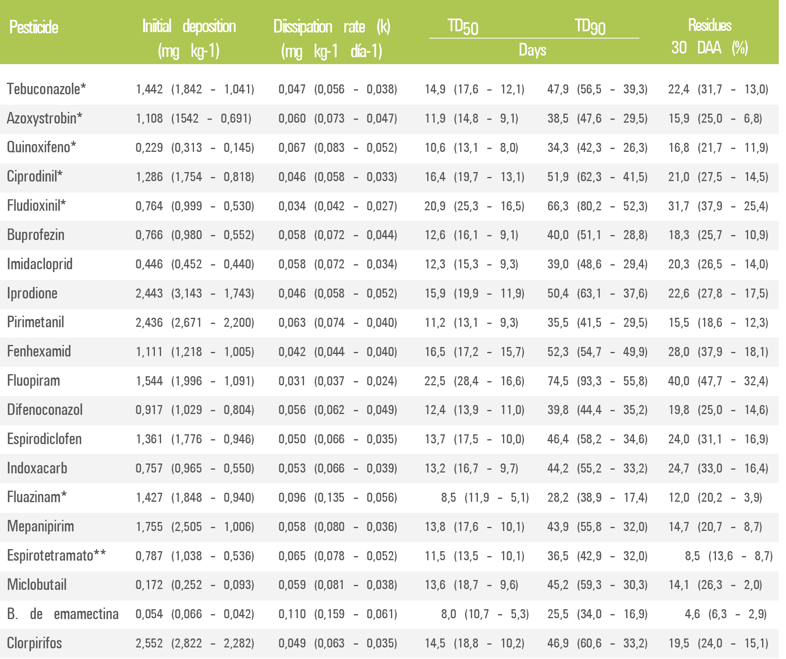
Initial deposition values, dissipation rate (k), TD50, TD90 and percentage of initial deposition at 30 days after the treatment for the 20 pesticides studied up to date.

Slide 9
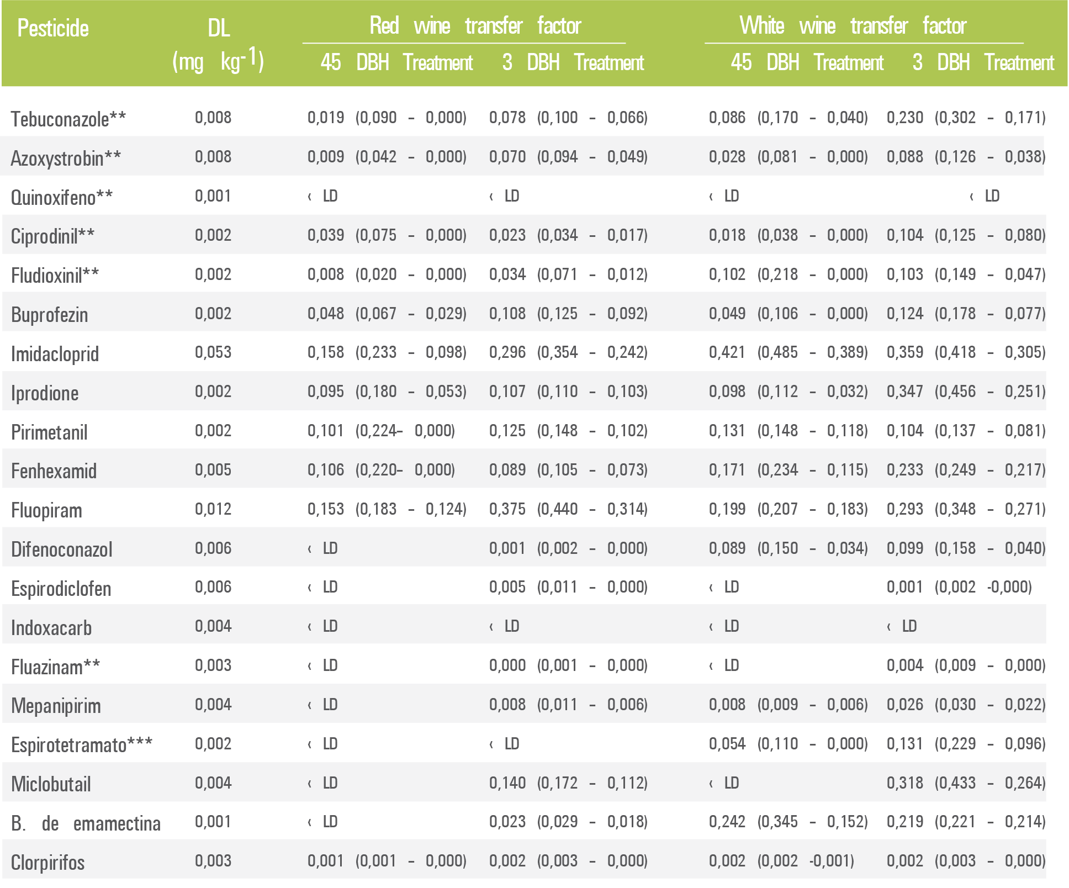
C
Transfer factor for the 20 pesticides studied up to date. These values correspond to the average values obtained from two replicates with the maximum and minimum values determined shown between parentheses

Slide 10
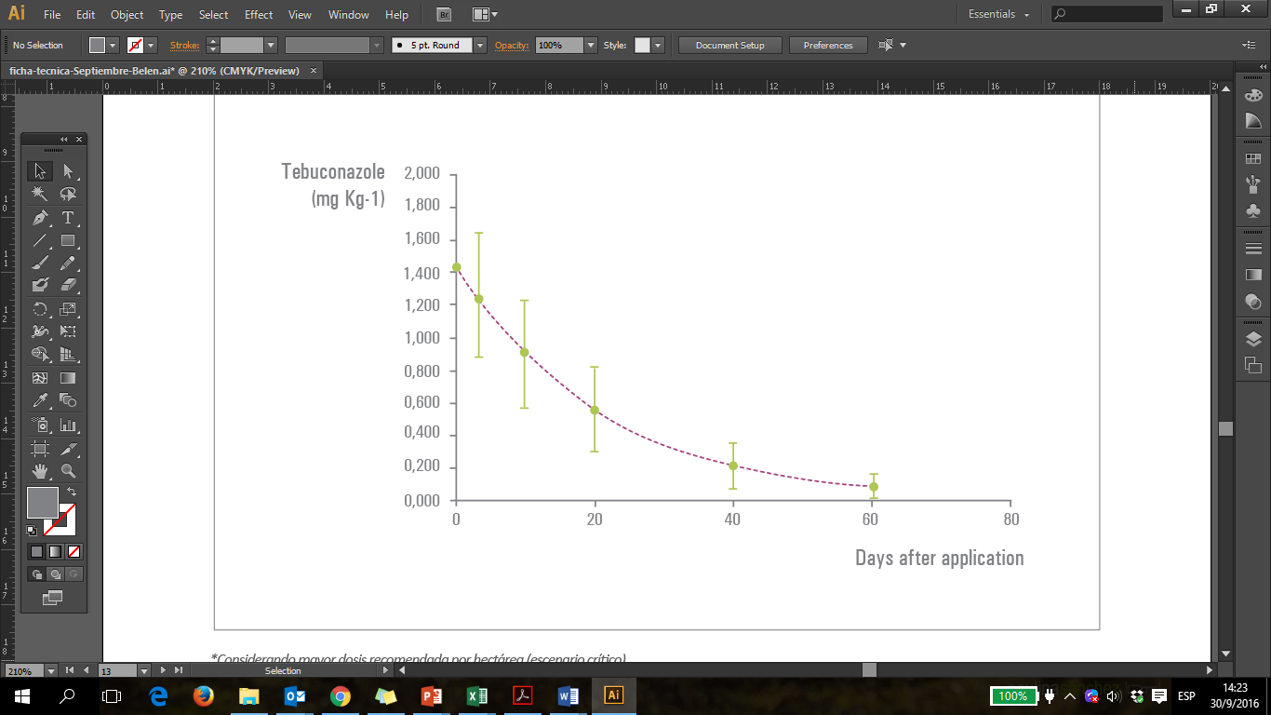
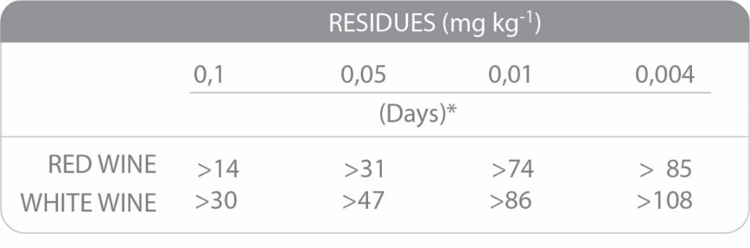
Tebuconazole
Pesticide (Active ingredient):
Formulated product:
Dose used (ml 100 L-1)*:
Average application volume (L ha-1):
Tebuconazole
Custodia 320 SC
258,0 (1,974 L ha-1)
51,6 g i.a 100 L-1 (394,8 g i.a ha-1)
765
Curve estimated based on the first order dissipation model, adjusted using 9 dissipation curves developed in four zones and during two seasons.
ESTE PRODUCTO ESTÁ EN LA LISTA DE DISRUPTORES

Slide 11
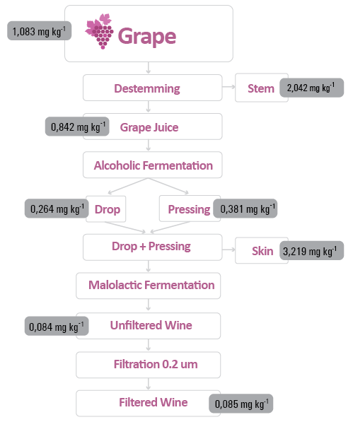
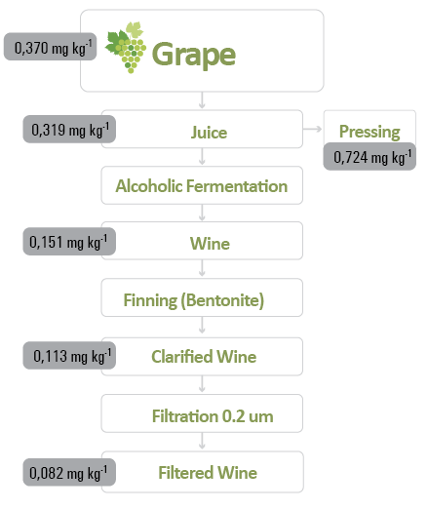
Average residue concentration in the red and white grape vinification process, applied 72 h before harvest. Detection limit (DL) = 0,008 mg kg-1

Slide 12
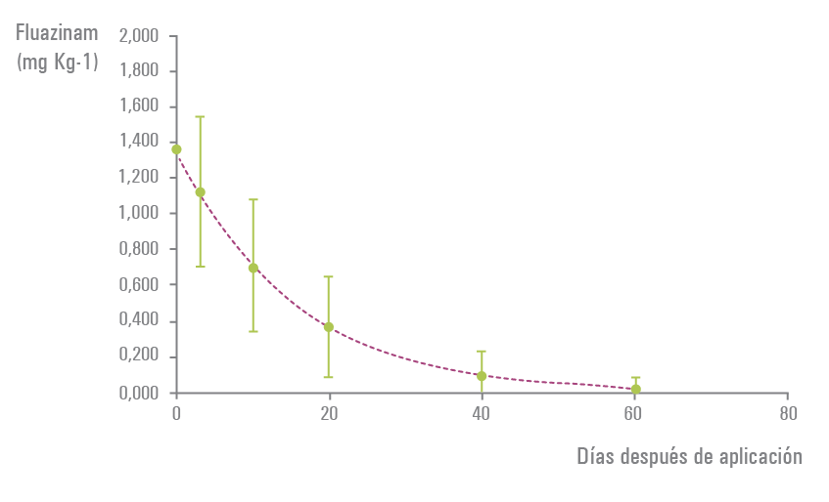
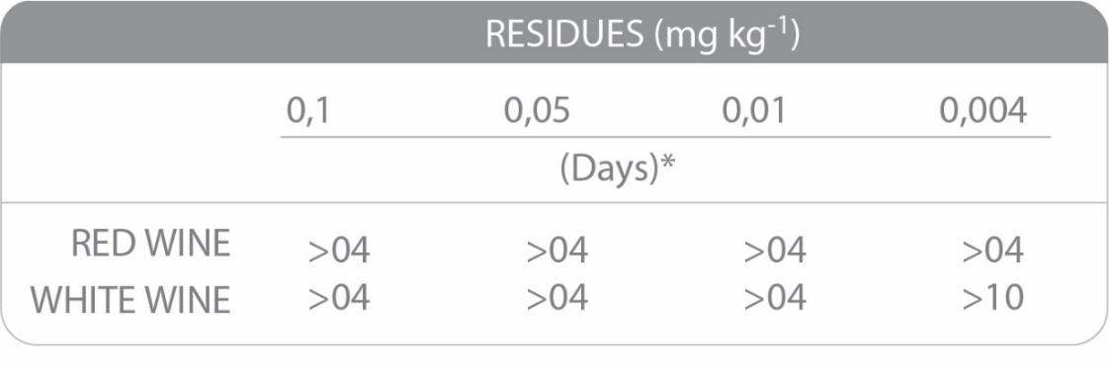
Fluazinam
Pesticide (Active ingredient):
Formulated product:
Dose used (ml 100 L-1)*:
Average application volume (L ha-1):
Fluazinam
Shirlan 500 SC
190 (1,444 L ha-1)
95,0 g i.a 100 L-1 (722,0 g i.a ha-1)
760
Curve estimated based on the first order dissipation model, adjusted using 9 dissipation curves developed in four zones and during two seasons.
ESTE PRODUCTO ESTÁ EN LA LISTA DE DISRUPTORES Y NO SE TRASPASA AL VINO

Slide 13
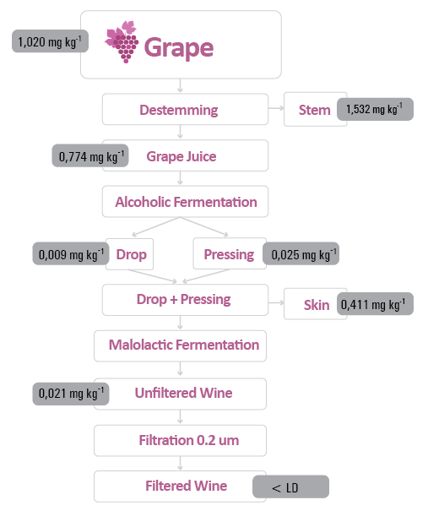
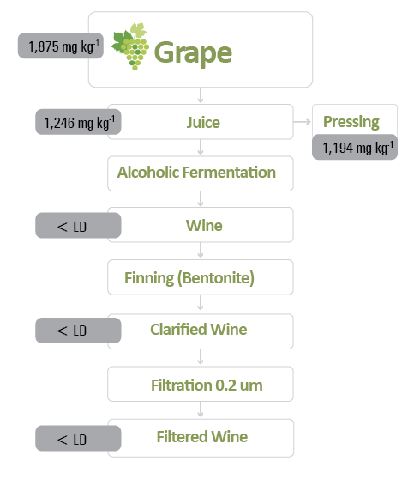
Average residue concentration in the red and white grape vinification process, applied 72 h before harvest. Detection limit (DL) = 0,004 mg kg-1

Slide 14
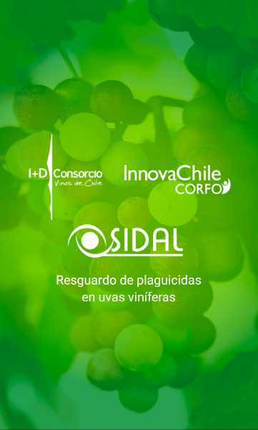
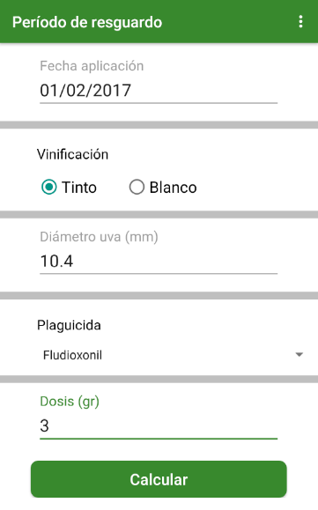
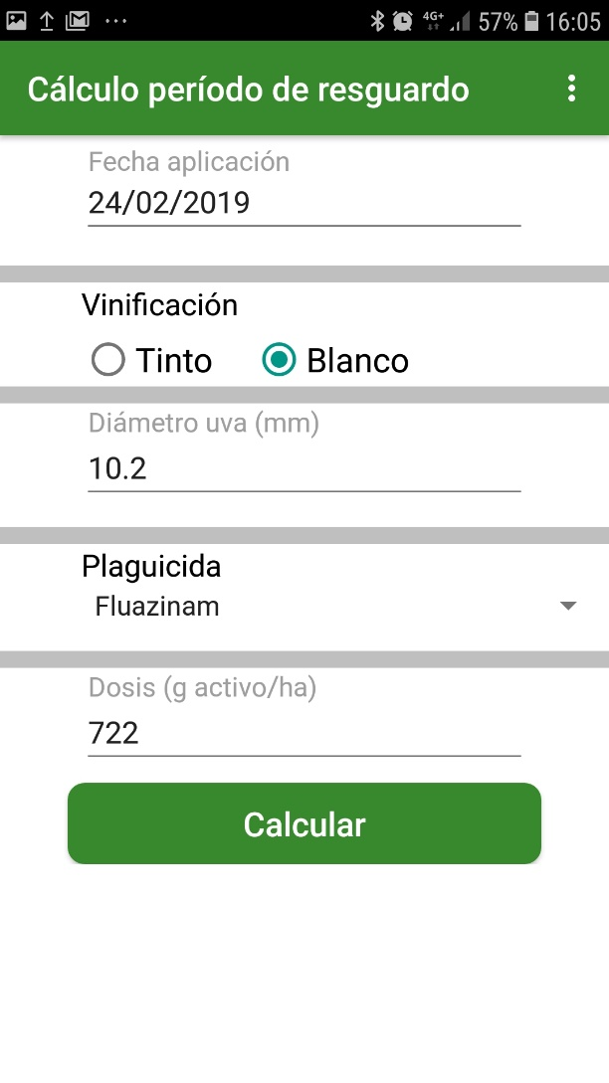
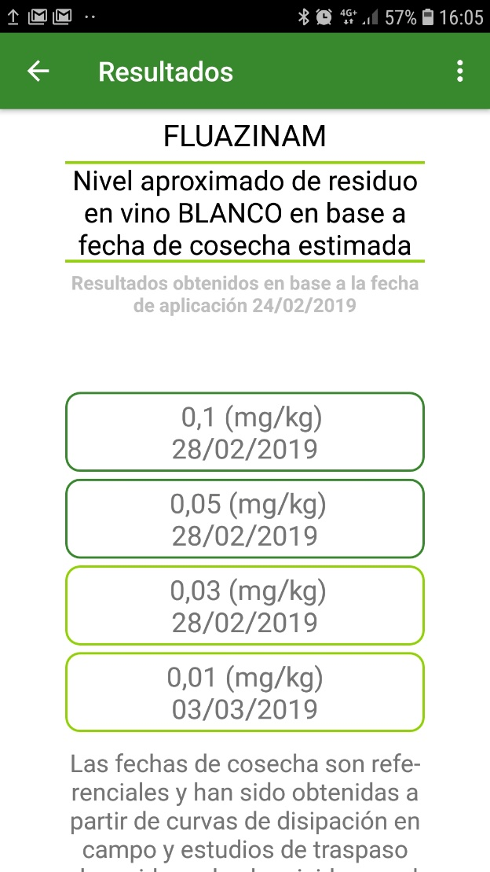
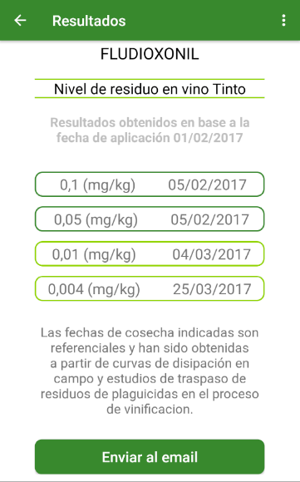
APP

Slide 15

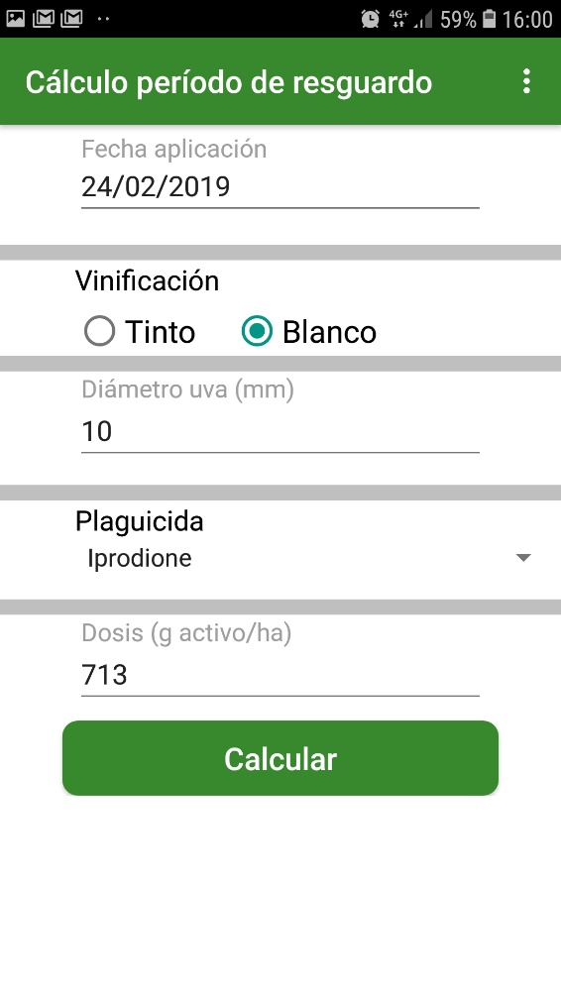
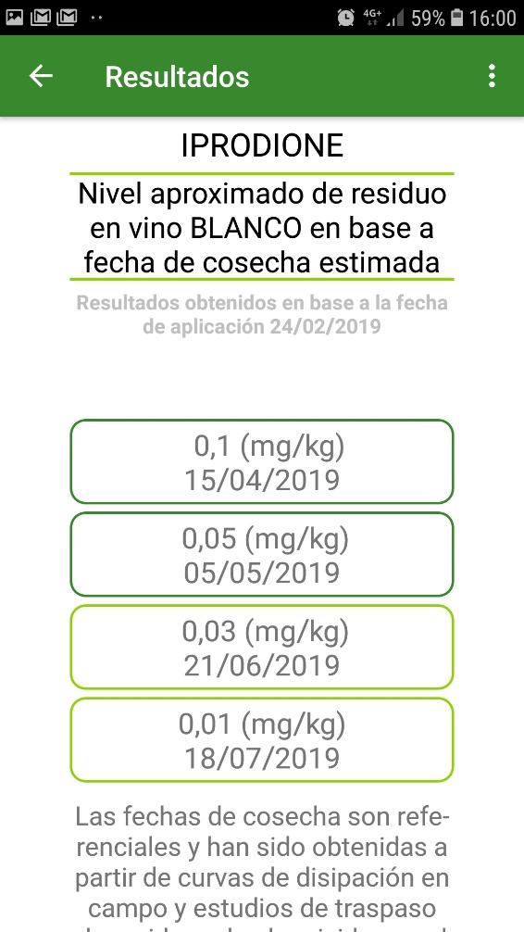
IPRODIONE

Slide 16
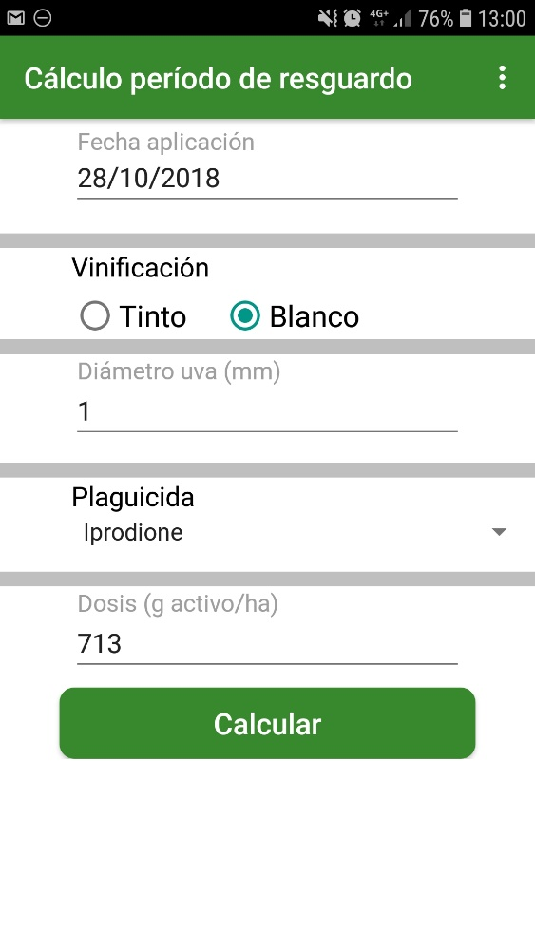
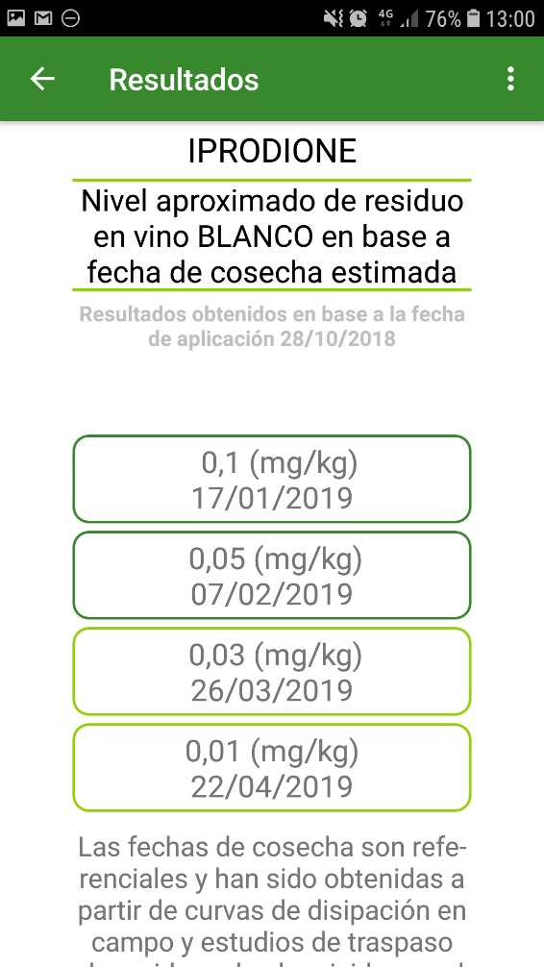
IPRODIONE

Slide 17
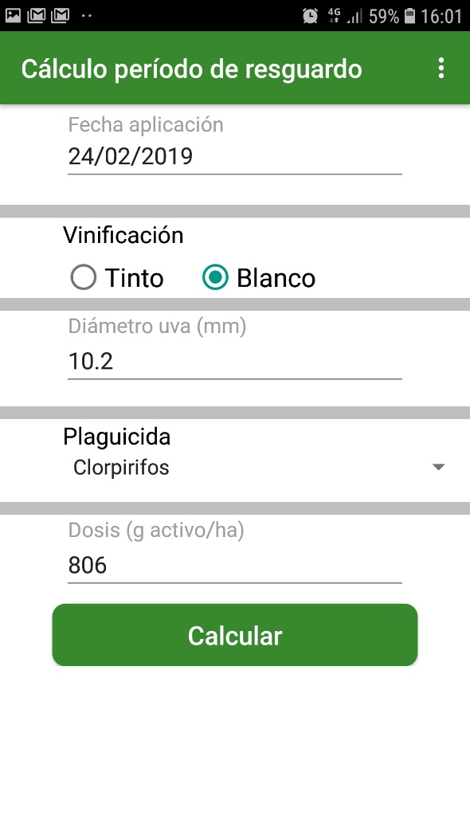
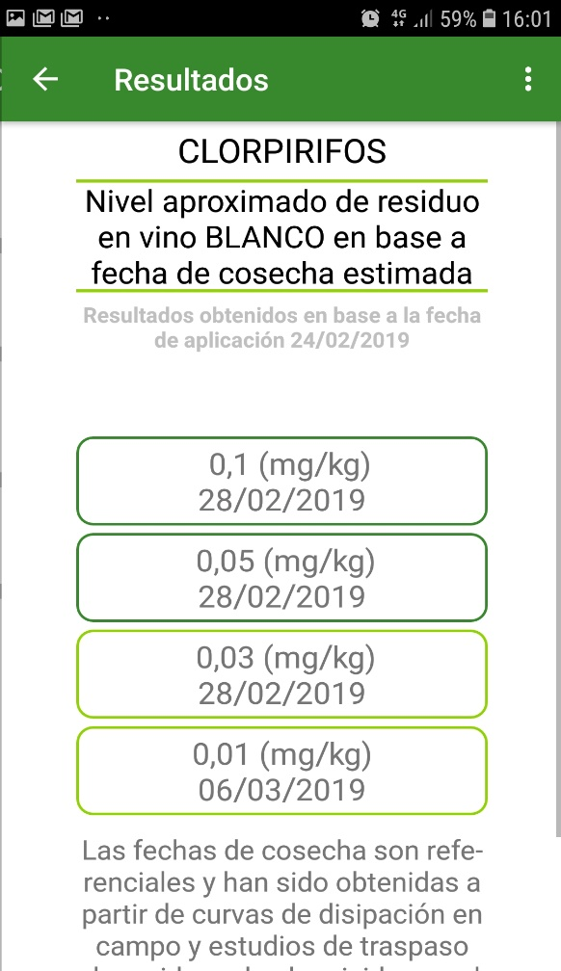
CHLORPYRIFOS

