Slide 1
Wine Low Risk or No Risk?
Steve Guy and Rachel Triggs, Wine Australia

Slide 2
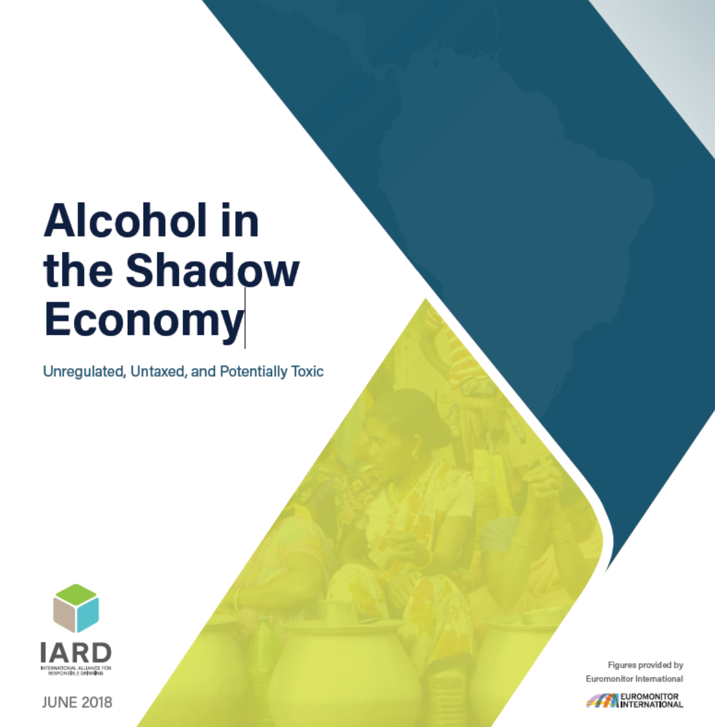

Slide 3
Typical example and recent cases in APEC economies
“Kill me quick”
The Economist April 29,2010
Over 60 dead in Indonesia from drinking bootleg alcohol
Straits Times April 9, 2018
Mexico police shut down second black market tequila operation, investigate if tainted alcohol headed to resorts
Milwaukee Journal Sentinel February 23, 2018
Vladimir Putin orders clampdown on 'surrogate' alcohol as deaths rise-over 60 people have died after drinking fake batch of bath tincture in Siberian city of Irkutsk
The Guardian December 22, 2016

Slide 4
What drives illegal alcohol production?
High price of commercial products.
Often due to high level of regulation.
Cultural factors.
Tradition of home production
Vital source of income in poor communities
Economic factors
Poverty and unemployment
Availability

Slide 5
Why is it a problem?
Unregulated, therefore potentially adulterated and generally higher in strength than commercial product.
Untaxed, therefore fiscal loss to government
Hits the poorest and most vulnerable the hardest.
Empowers and enriches organised criminal activity.

Slide 6
“Unregulated, untaxed and potentially toxic”
Illicit alcohol is the most likely source of health problems
Why?
Non-compliant with production standards
Non-compliant with labelling requirements
Non-compliant with availability restrictions
Non-compliant with consumption age restrictions (drinking by minors)
More dangerous patterns of drinking than with regulated products.

Slide 7
From IARD report…
Governments, communities and legitimate producers should work together to reduce harmful drinking.
“Objectives can only be achieved where there is an enabling regulatory framework that allows legitimate businesses to thrive and does not encourage a shadow economy”

Slide 8
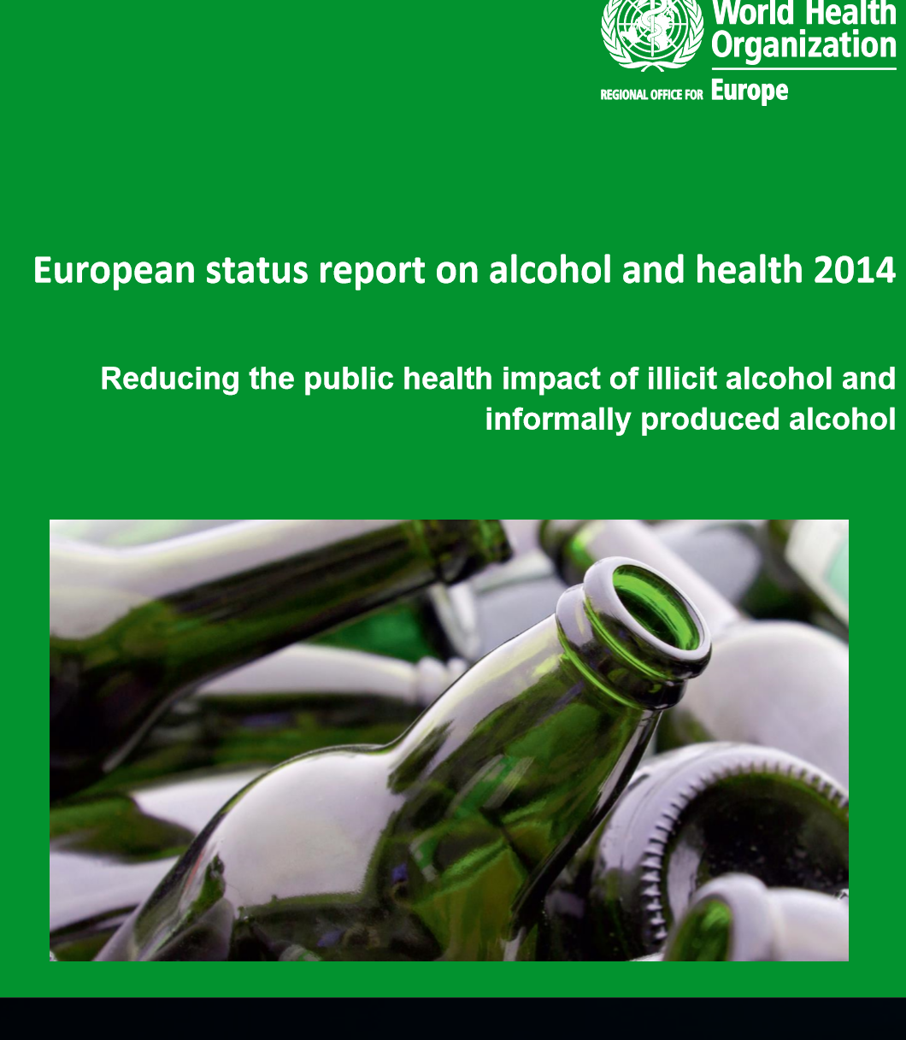

Slide 9
Recommendations from WHO report
Attempt to bring illicit alcohol into the recorded and managed system
Assess extent of potential harm from illicit alcohol
Extensive chemical testing of illicit alcohol to identify riskiest products
Instruct producers of illicit alcohol on how to avoid health risks
Tax stamps

Slide 10
How identify illicit alcohol?
Unfamiliar brand name
Price significantly lower than expected
Unusual taste or smell (e.g. nail varnish remover)
Poor quality labelling and packaging, e.g. labels not straight
Spelling errors on label
Bottles of the same product look different and have different fill levels
No manufacturer details

Slide 11
Chile’s Traceability System

Slide 13
Vietnam’s Traceability System

Slide 15
Thailand’s Traceability System

Slide 17
Russia’s Traceability System

Slide 20
China’s Traceability System

Slide 22
Malaysia’s Traceability System

Slide 24
Korea’s Traceability System

Slide 25
Australia’s Traceability System

Slide 32
How regulators can control risk of illicit alcohol
Use non-toxic substances to de-nature ethanol
Track de-natured ethanol
Pricing policies that avoid extreme differentials
Incentivise the production of legitimate, affordable, alternatives.
Proportionate regulation of availability and access
Monetary incentive to return empty containers
Limit the size of bottles of cologne and other tinctures
Educate the community on the potential dangers of consuming illicit alcohol
Establish a platform for anonymous reporting of illegal production and sale

Slide 33
And how can industry help?
Cooperate with enforcement and share intelligence
Innovate with “markers” (spirits, rather than wine)
Innovate with labels and closures
track and trace by individual package, not only by lot or batch

Slide 34
Digital Traceability
Blockchain technology provides food security and provenance guarantees
Carrefour announced first food blockchain in March 2018 (covering nine high risk products including eggs, cheese, milk, salmon and ground beef)
Australian sugar industry commenced a 4 year project this year to guarantee origin and sustainability credentials of each batch of exported sugar.

Slide 35
Key “take-home” message
Heavy regulation of the commercial alcohol market may have the unintended consequence of driving consumption even further into the illicit sphere.
(see “Unrecorded alcohol in Vietnam” IARD February 2018)

Slide 36
Thank You

