Slide 1
Session 3: Certification
Andreas Clark - Moderator
Acting Chief Executive
November 2013
Notes:
1

Slide 2
Certification around the Globe
Certificate of Conformity
Sanitary Certificate
Chemical Analysis
Certificate of Origin
VI1 Certificate
Certificate of Free Sale
Certificate of Origin
Chemical Analysis
Certificate of Free Sale
Certificate of Origin
Certificate of Origin
Certificate of Origin
Certificate of Origin
Health Certificate
Certificate of Free Sale
Health Certificate
Chemical Analysis
Hygiene Certificate
Certificate of Origin
Certificate of Origin
Hygiene Certificate
Certificate of Free Sale
Certificate of Origin
Certificate of Free Sale
Certificate of Free Sale
Certificate of Free Sale
Chemical Analysis
Certificate of Origin
Chemical Analysis
Certificate of Origin
Certificate of Free Sale
Certificate of Free Sale
Certificate of Origin
Certificate of Origin
Certificate of Free Sale
Chemical Analysis
Certificate of Free Sale
Cultivar Certificate
Certificate of Origin
Certificate of Free Sale
Certificate of Free Sale
Notes:
An illustration of the plethora of certification requirements amongst Australia’s wine trading destinations around the world (by no means exhaustive).

Slide 3
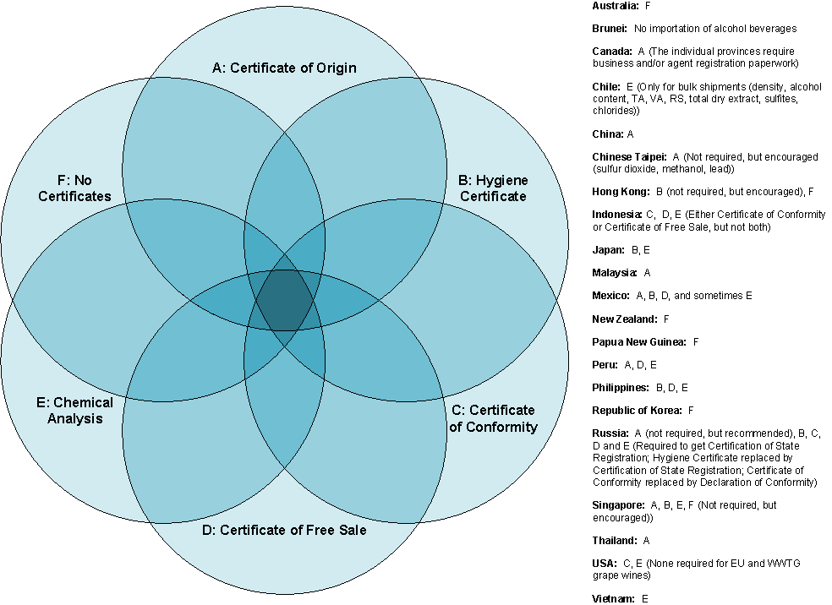
APEC Summary
Source: TTB

Slide 4
Complex Certification
Wine presents a low risk
Microbiological: None
Physical: Incorrect labelling, contamination
Chemical: Preservatives, allergens, contaminants
Notes:
Wine is a low risk product. There are no known pathogens that are able to survive in wine so the microbiological risk is zero. Physical risks can occur through incorrect labelling for the destination market or physical contamination with foreign items (snails, broken glass). This type of risk is best managed by filtration at bottling, internal quality management systems, hazard analysis, record keeping and inspection. Chemical risks are best managed by good manufacturing processes in the vineyard and winery and controlled using HACCP principles.

Slide 5
Risk-based Assessment
Low risk product assessment
Risk-based assessment would focus on labelling (ie, lack of allergens warning) and chemical contaminants.
Instead, the focus is increasingly on formatting and analysis of export documentation.
Notes:
Too much focus is placed on document inspection with certificates rejected for incorrect formatting (ie, font, spelling, location of terms and colour of signatures and stamps) rather than employing a risk-based assessment of the actual product. Labelling problems and contaminants will not be identified by reviewing export documentation alone.

Slide 6
Where to?
Are there any parameters that need to be routinely tested and certified?
Sulphur dioxide, Methanol, Heavy metals?
If so, why? Is there evidence that wine poses a threat?
For each identified parameter, determine a commonly accepted test methodology and competent laboratories.
Our experience suggests that a standardised document decreases the likelihood of scrutiny and enhances efficiency for exporters and the Customs border. Exporters know what is required and Customs officials know what to look for.

Slide 7
E-Certification?
Benefits of e-certificates
Increased efficiencies in time and cost
Environmental impact in elimination of paper documents and postage/shipping costs
Increased security through possible direct communication with issuing authorities
EU is currently considering a new system to accept electronic VI1 certificates
Notes:
E-certs would increase efficiencies in streamlining administration of trade between trading partners allowing direct and prompt communication between exporters and agents. Importers would have immediate access to all required import documentation prior to the arrival of the shipment through a standardised receipt of e-docs. Currently, paper certificates are issued by Wine Australia to the Australian exporter and will usually pass from the exporter to the shipping agent, to the shipper and finally to the importer before being presented to the Customs officials of the importing country. Amendments or corrections could be easily fixed without major disruption or delays. Lost certificates would not result in additional warehousing fees while cost of production and distribution would be significantly reduced and postage fees eliminated.

Slide 8
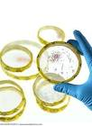
Wine Safety
“Wine is the most healthful and hygienic of beverages”..
(Louis Pasteur)
“No human pathogens can flourish in wine environment”
Sugita-Konishi et al,
Japanese Society for Bioscience, Biotechnology and Biochemistry, 65(4) 954-957 2001
Notes:
And don’t forget … any discussion around certification should remain within the context of health risk and where wine sits in that context.

Slide 9
Notes:
9

