Slide 1
Social Sustainability
What’s industry up to??
Jeffrey Clarke
October2018

Slide 2
Social Sustainability – Health Aspects
Today
Overview of some key FIVS resources to support global industry in social sustainability re health & moderation
FIVS’ Social Sustainability Partnership with Wine in Moderation (WiM)
Normalising sociable drinking: Measurable behaviour change in New Zealand through Cheers!
Discussion: what should industry be doing?

Slide 3
FIVS: Resources for Social Sustainability
What is Social Sustainability
Moderate consumption, and responsible marketing and advertising of alcohol beverages
Incorporation of broader concepts of social responsibility into industry business models to ensure:
fair working conditions,
respect for workers’ rights, and
ethical behaviour in all operations.

Slide 4
FIVS: Resources for Social Sustainability
FIVS resources include:
Working Group on Social Sustainability
Alerts – regular updates on developments of interest
FIVS-Assure…
Advertising and Marketing Guidelines…

Slide 5
An online database gathering resources on social aspects programs in the alcohol beverage industry.
Draws on best practices by companies, trade associations, and other entities from around the world.
Presented under four topics:
young people & alcohol,
drinking & driving,
responsible drinking, and
marketing & advertising

Slide 6
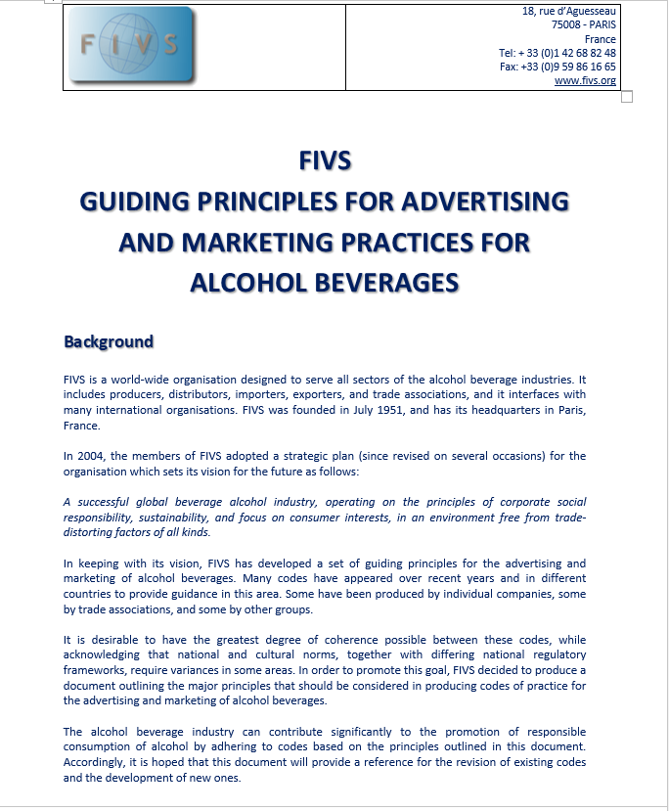
FIVS: Advertising and Marketing Guidelines
Coherence in Codes of advertising principles. Includes…
Consumption should only be represented at an appropriate age.
Only responsible and moderate consumption should be represented
Not linked with therapeutic benefits or personal success
Vetting system
Promotion at events; education

Slide 7
FIVS: Loads more…
Contact FIVS Secretariat for more on all this…
… including the newly re-envigorated Social Sustainability WG

Slide 8
2. FIVS Partnership - Wine in Moderation

Slide 9
3. Normalising Sociable Drinking

Slide 10
4. DISCUSSION
Your turn…
We’ve been at this a while. How are we doing?
What areas are we doing well in?
What could we do better to show that we are a responsible industry?
What are examples of industry and governments working well together in this space?
What are the biggest challenges?

