Slide 1




Cheers! / UBER
Sober-self Bot campaign
(a brief summary)

Slide 2

Social change initiative of NZ beverage alcohol industries
GOAL: Create a healthier, safer and more responsible drinking culture in New Zealand
MISSION: Strengthen safe & sociable drinking behaviours
HOW: Drinker’s friend – a non-judgmental, factual friend to help drinkers make responsible choices

Slide 3
Key value: be evidence based
  Rely on independent research and clinical advice to inform our approaches.
  Measure everything:
    use external health/medical and social research to inform our direction
    measure whether campaigns are reaching people

Slide 4
Discovery: we need partnerships
We can’t do it alone
Ensure that the resources, understanding and support of interested parties are brought to our work.
Enhance reach and minimise risk of mixed messages

Slide 5

Current focus: 18-24 year olds
  Hard to reach – they know it all
  Social media is key
    it’s how they communicate (up to 9 hours/day)
    as medium
    using SM personalities / influencers
Example of how we work…

Slide 6
The Goal – measurable behaviour change
Show a positive change in 18-24 responsible drinking
Some of the Challenges
18-24s know best; don’t want a wagging finger
Even with the best intentions, change is hard
The Campaign: Cheers!/UBER Sober Self Bot partnership
Use social media to help users:
PLAN to end their night earlier
HELP themselves to get home safely

Slide 7
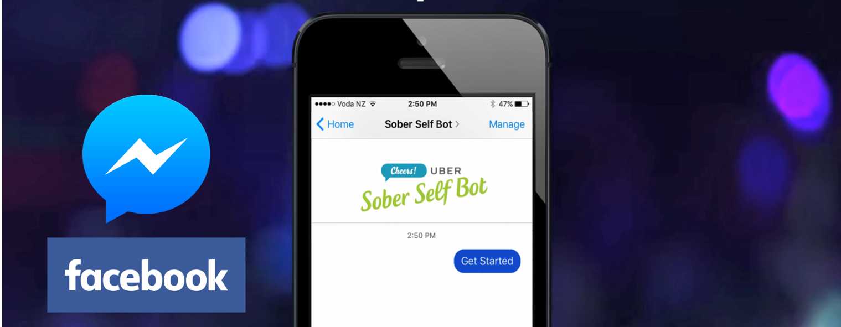
Sober Self Bot – what is it?
Facebook messenger “bot” for mobile phones
Talks the users’ language, and lets your “Sober self” help steer the behavior of your future “Social self”
Set a curfew when they plan on going home (5 pm - 2 am)
Personalise a reminder message (or let the bot create one)
The “sober self” messages the user to remind to head home - with a 25% Uber discount reward
User accepts, delays or declines their departure and the bot checks in with them the following morning

Slide 9
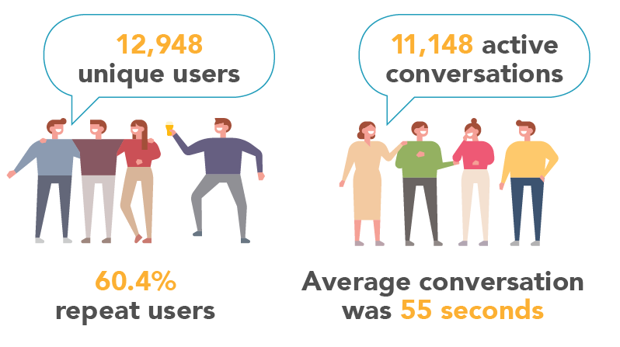
The Results – measured behaviour change

Slide 10
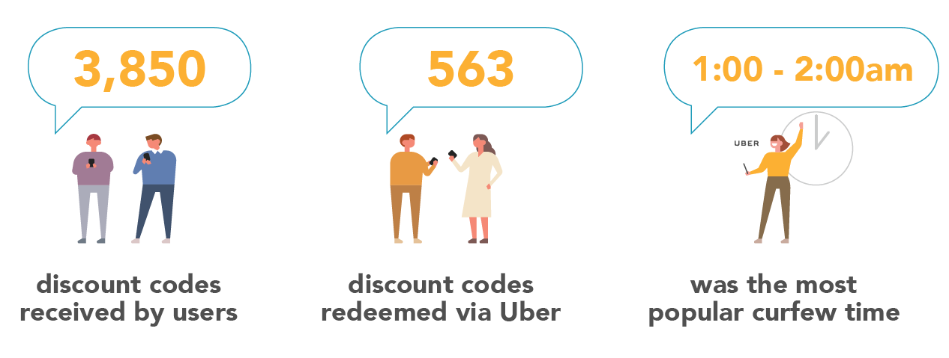
The Results – measured behaviour change

Slide 11
Next steps
Sober Self Bot – relaunch for summer 2018
Research baseline project 2018
  Drinking behaviours in NZ
  2084 surveys; weighted to match 2013 Census data for people aged 18+ (margin of error of +/- 2.19).
  Plus 36 qualitative interviews with pairs

Slide 12
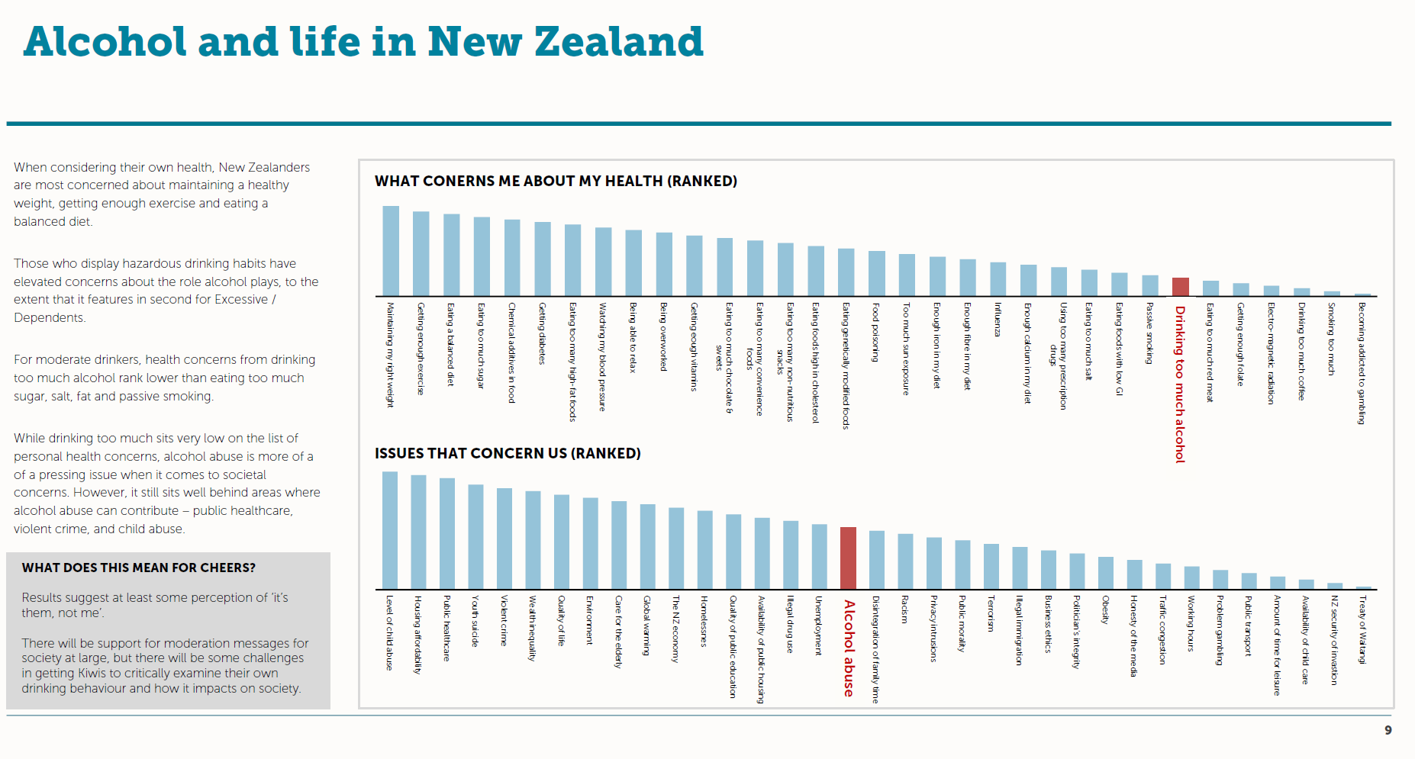
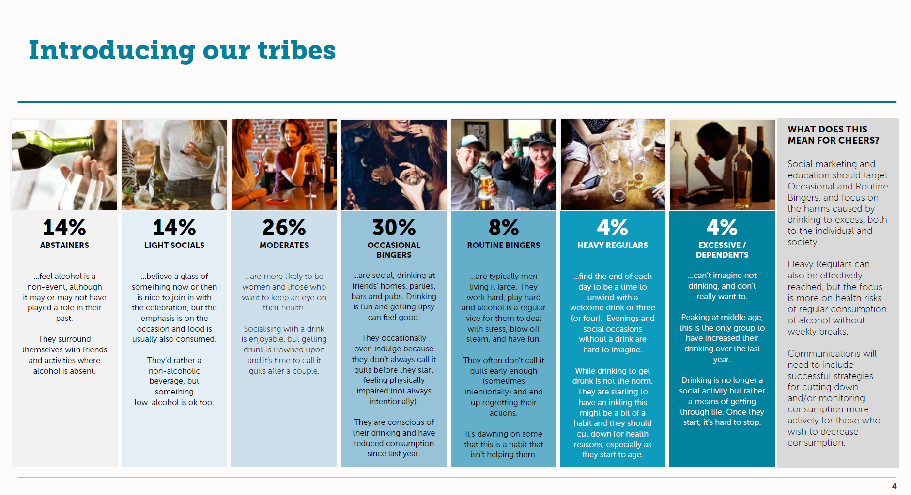
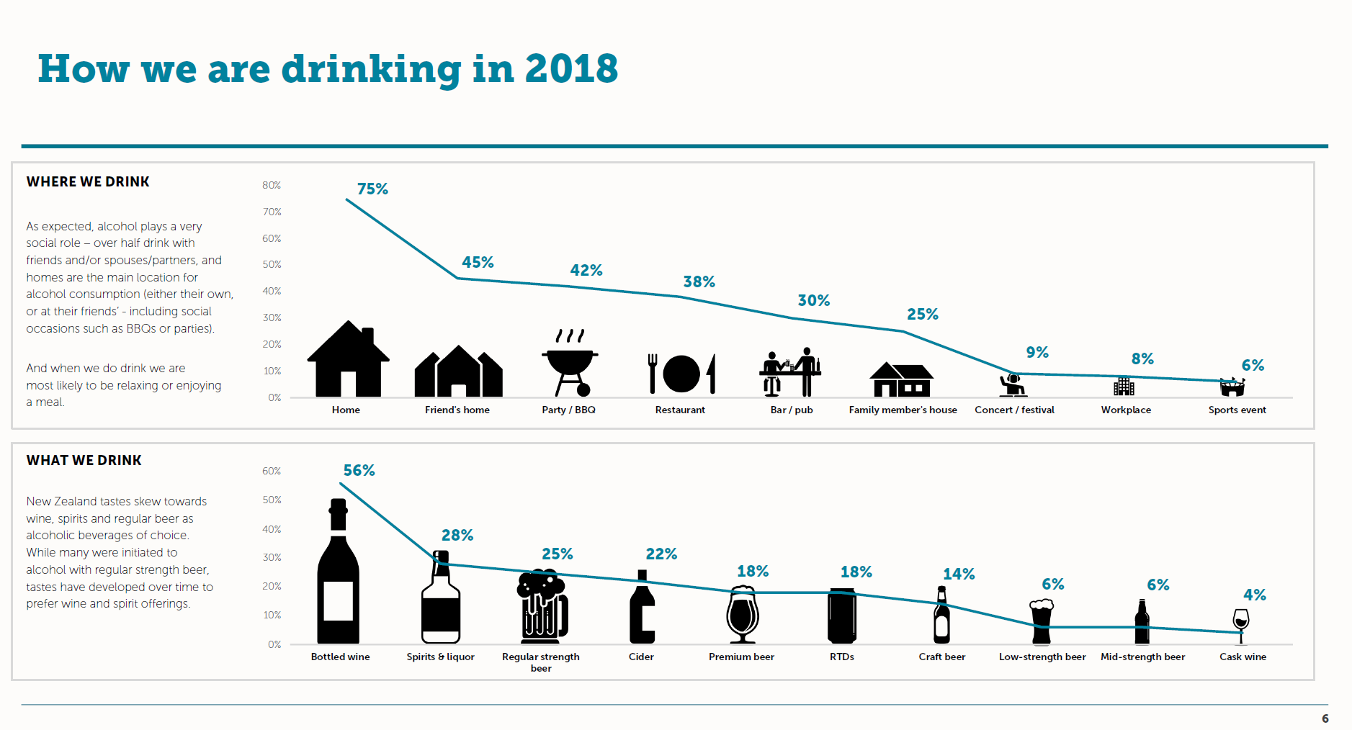
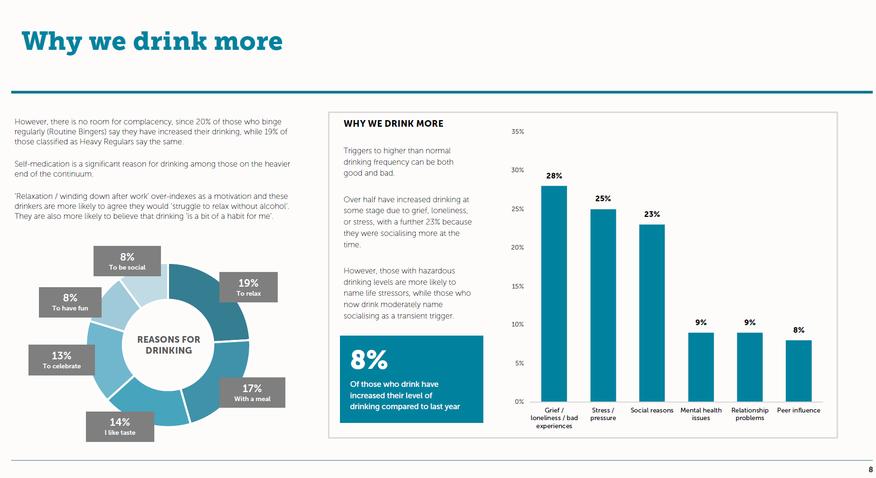
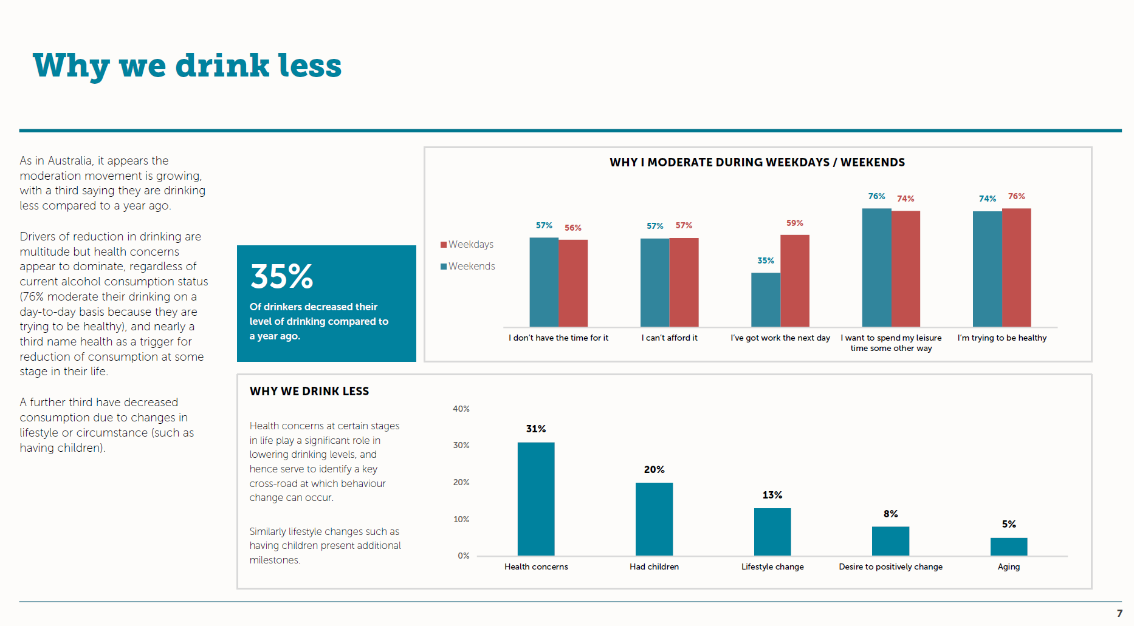
  Fascinating, detailed snapshot of why we drink,
  how, where, with whom, and
  how we feel about it

Slide 13
For more information:
Jeffrey Clarke, General Manager Advocacy, New Zealand Winegrowers - jeffrey@nzwine.com
Matt Claridge, Executive Director, The Tomorrow Project / Cheers!
matt@cheers.org.nz

