Slide 1
FIVS-Abridge Database Demonstration
Jacqueline LaPorte – FIVS-Abridge
APEC WRF November 2015 | Adelaide Australia
APEC Wine Regulatory Forum
Adelaide | Australia

Slide 2
Demonstration Outline
Overview of APEC user access.
How to access the APEC WRF Compendia on Export Certification, Food Safety and Labeling in FIVS-Abridge.
How to view individual economy regulations.
How to compare economy regulations.
How to view international agreements in FIVS-Abridge.
How to access additional resources in FIVS-Abridge.
How to search keywords in the FIVS-Abridge database.
How to update user account details.

Slide 3
Overview of APEC User Access
Three (3) user licenses per economy for use by government regulators.
Access available through December 2018 based on biannual updates provided by economy regulators.
New or edited data to be provided by January 15 and July 15 of each calendar year.
Additional details can be found in the WG on Compendia report.
WG on Compendia Co-Chairs: Mari Kirrane and Saul Cruz.

Slide 4
How to access the APEC WRF Compendia on Export Certification, Food Safety and Labeling
Select Source Documents from the Regulations menu.
Select the appropriate Topic and Market for your query.
Export Certification available under “Certification” topic.
Food Safety available under “Composition” and “Production” topics.
Labeling available under “Labeling” topic.

Slide 5
How to access the APEC WRF Compendia on Export Certification, Food Safety and Labeling
Video Demonstration available here.

Slide 6
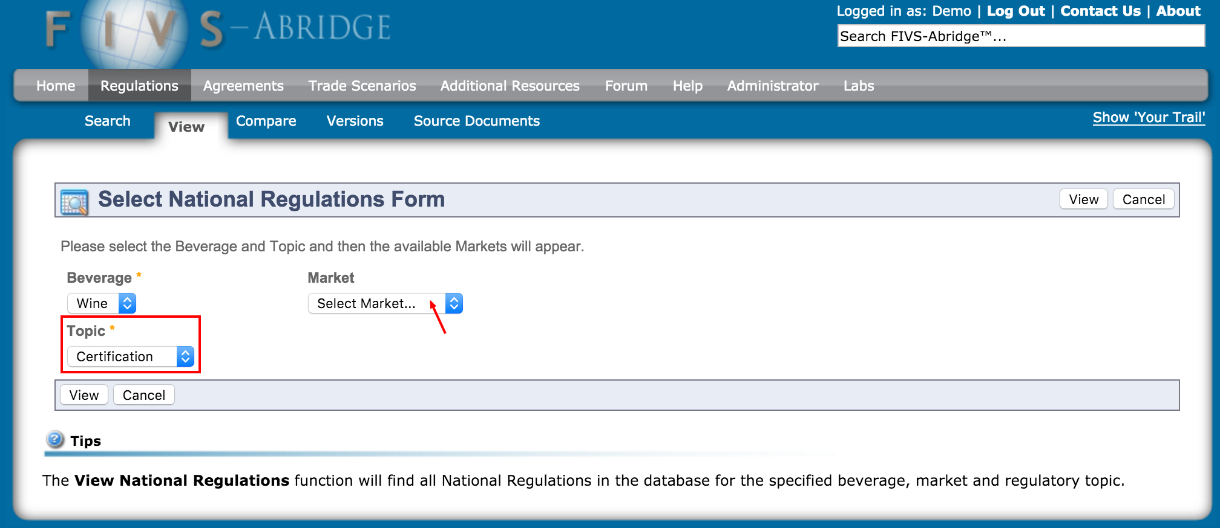
How to view individual economy regulations
Select View from the Regulations menu.
Select the appropriate Topic and Market for your query.
Video Demonstration available here.

Slide 7
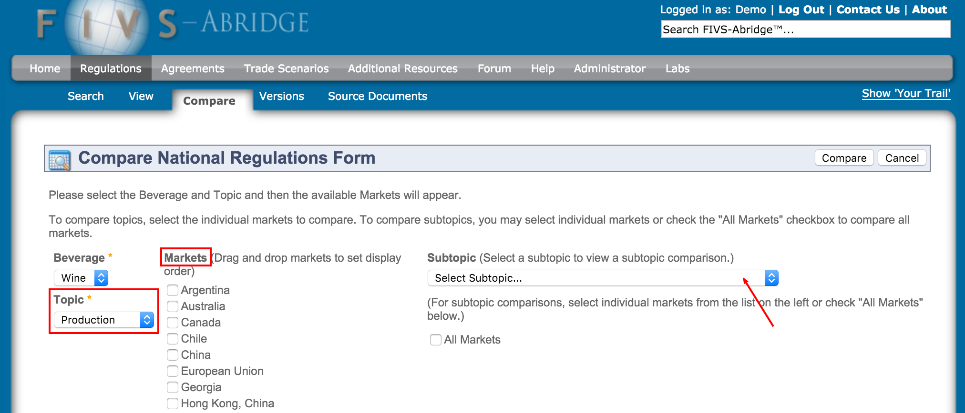
How to compare individual economy regulations
Select Compare from the Regulations menu.
Select the appropriate Topic and Markets for your query OR select the appropriate Topic and Subtopic.
Video Demonstration available here.

Slide 8
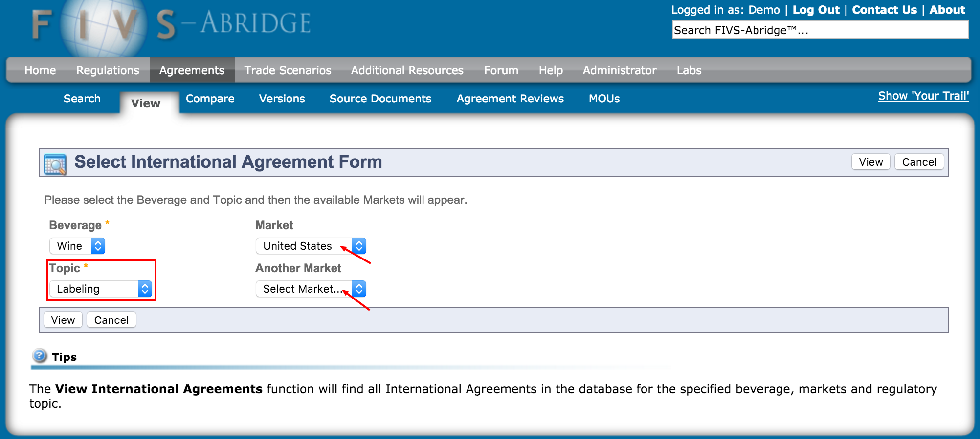
How to view international agreements
Select View from the Agreements menu.
Select the appropriate Topic and Markets for your query.
Video Demonstration available here.

Slide 9
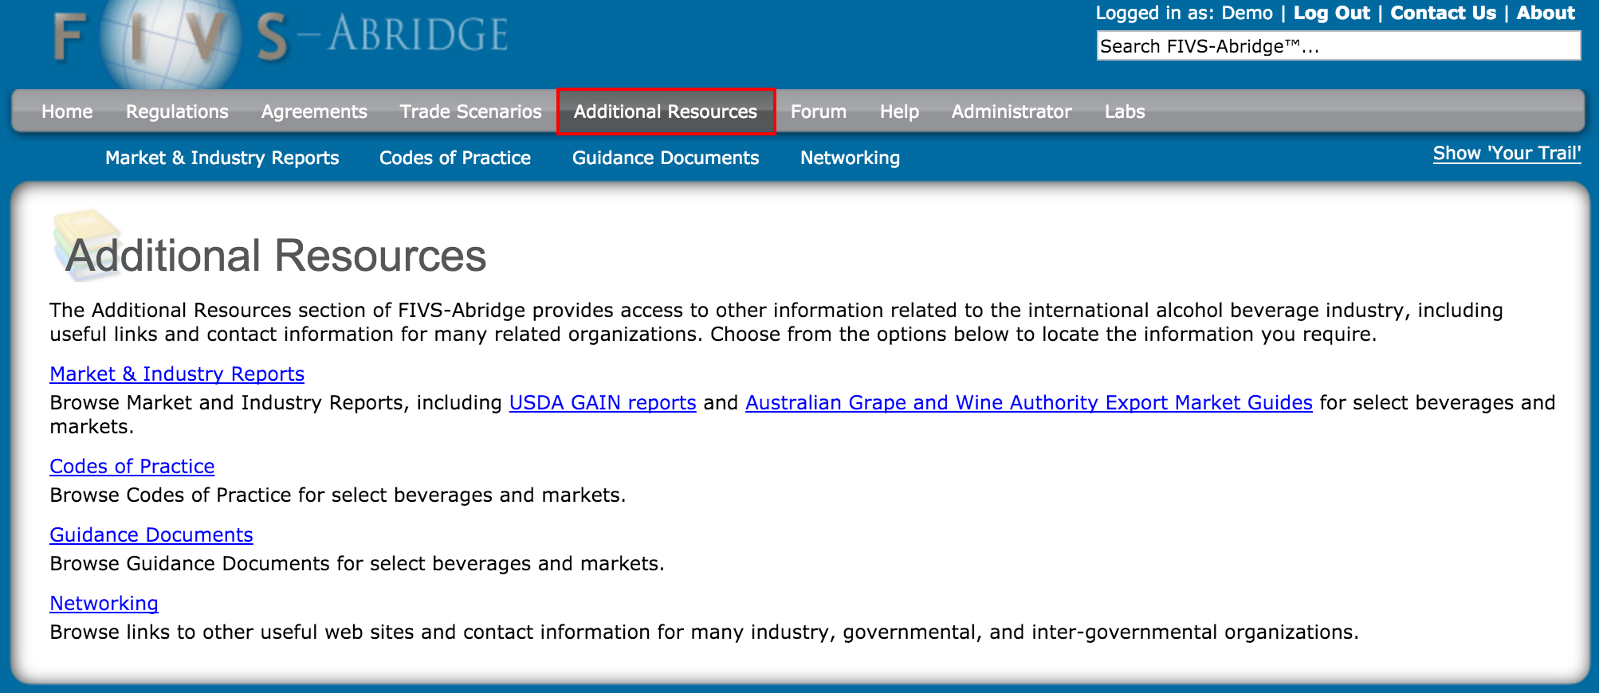
How to access additional resources
Select Additional Resources from main menu.
Select the Market & Industry Reports, Codes of Practice, Guidance Documents, or Networking.
Video Demonstration available here.

Slide 10
How to search keywords
Enter keyword(s) in search box located in upper right corner of site.
Filter results by topic, market, and/or location on the site. Select Compare subtopic to compare.
Video Demonstration available here.

Slide 11
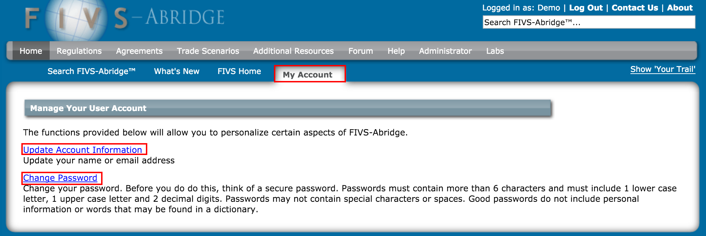
How to update user account details
Select My Account, then Update Account Information or Change Password
Video Demonstration available here.

Slide 12
Thank You!
Questions? Comments?
Please contact the WG Co-Chairs or the following FIVS-Abridge Staff:
Jacqueline LaPorte
Laurel Parker
Bennett Caplan

