Slide 1
China Wine Production and Consumption
By LI DE MEI
Beijing Agriculture College

Slide 2
Contents
1. Industry Statistics
2. Industry Current situation
3. Reasons behind the difficult situation
4. Buying behavior
5. Suggestion

Slide 3
1 Industry Statistic
volume '000 Tons

Slide 4
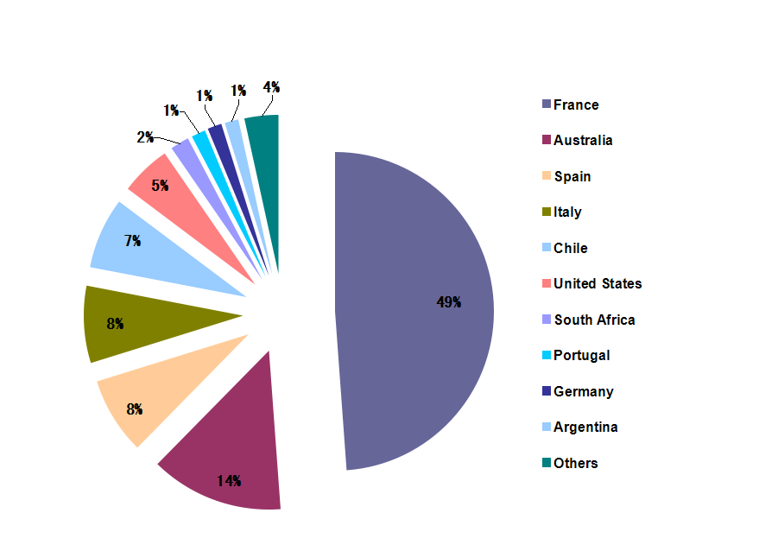
Proportion of imported wine by regions 2011 in volume

Slide 5
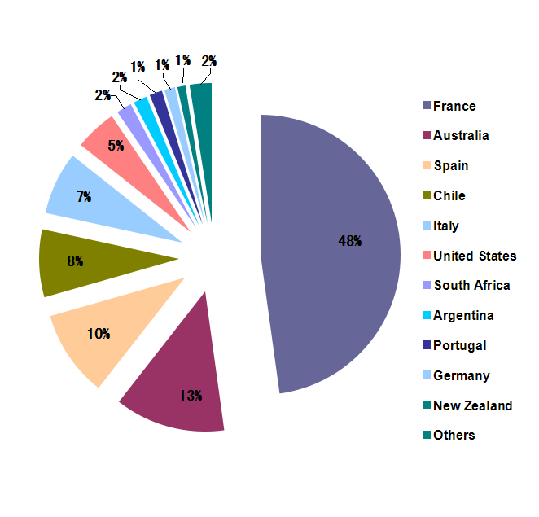
Proportion of imported wine by regions 2012 in volume

Slide 6
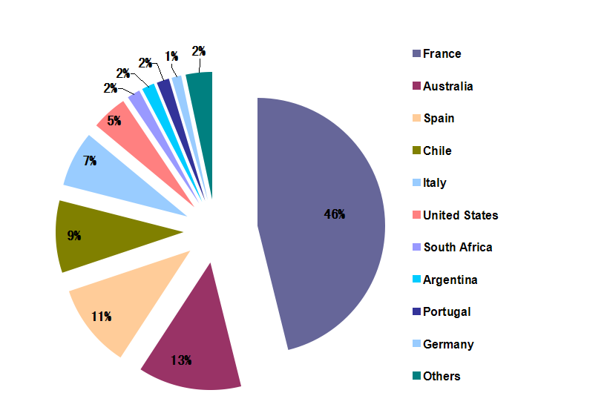
Proportion of imported wine by regions 2013 in volume

Slide 7
 | Economy | QUANTITY (L) | AMOUNTS (DOLLARS) | volume% | Price USD /Bottle
1 | France | 128,735,587 | 658,504,721 | 46.34 | 3.836
2 | Australia | 36,408,802 | 225,983,524 | 13.11 | 4.655
4/3 | Chile | 25,528,775 | 100,024,112 | 9.19 | 2.939
3/4 | Spain | 29,758,556 | 91,657,801 | 10.71 | 2.310
5 | Italy | 19,659,249 | 90,111,606 | 7.08 | 3.438
6 | United States | 12,697,990 | 73,563,958 | 4.57 | 4.345
8/7 | Argentina | 4,477,105 | 22,454,792 | 1.61 | 3.762
7/8 | South Africa | 4,592,477 | 22,294,873 | 1.65 | 3.641
11/9 | New Zealand | 1,910,200 | 19,834,972 | 0.69 | 7.788
10 | Germany | 3,441,175 | 18,892,546 | 1.24 | 4.118
9/11 | Portugal | 4,428,131 | 17,798,647 | 1.59 | 3.015
12 | Canada | 1,116,994 | 13,537,279 | 0.40 | 9.090
 |  | 277,786,619 | 1,377,197,079 |  | 3.718
Imported bottled wines 2013

Slide 8
2. Industry Current Situation
by the end of December the annual production of Chinese wines in 2013 was 1,178,300 kilolitres, a 14.59% decrease from 2012. Sales revenue was down by 8.52% to 40.82 billion RMB, making a profit of 4.38 billion RMB, a 20.06% decrease from the year before.
From the National Bureau of Statistics of China
The larger-scale companies were hit hardest. Across the 19 wineries owned by the top four winemaking companies in China, the production, sales volume and revenue are significantly down by 23.78%, 34.35% and 37.8% respectively.
From CADA

Slide 9
Wine Production in China
volume '000 Tons

Slide 10
Total Imported wine

Slide 11
Imported wines(≤2L) 2003- 2013

Slide 12
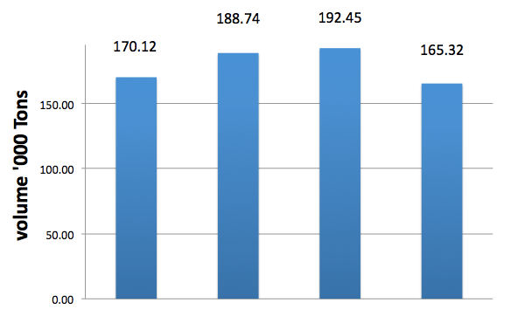
Total Imported wine
From Jan to Jun
2011 2012 2013 2014

Slide 13
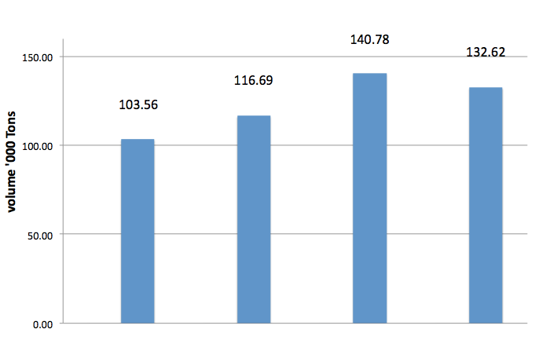
Imported Bottled wine
From Jan to Jun
Imported wine (≤2L)
2011 2012 2013 2014

Slide 14
3.Reasons behind the difficult situation
1) Consumers are willing to buy, but don’t know what to buy
2) Distributors are not all professionals
3) Overly replying on group purchase while overlooking consumer market
4) The methods used to promote wine are too linear, paying not enough attention to the special features of Chinese food culture

Slide 15
4. Buying behavior
How does a Chinese consumer choose wine
External factors are more attractive and effective
Price(retail price in $USD)
<20, majority,(domestic, new world, basic old
20-50, mixed, more old world
>50, majority on old world
Region/package
Variety/style(marked DRY RED WINE on label quite helpful)
Taste

Slide 16
Wine brand attributes preference of On-trade (Beijing Shanghai Guangzhou)
Factors with positive influence(ordered by their importence
Brand
Vintage/aged
Key person like it(manager, sommelier etc)
Profit
variety
award
region

Slide 17
Factors with negative influence
Discount
Match with menu
Not available on retail
Media promotion
Sponsor for printing menu
Who is the distributor
Gift to restaurant
Chief’s choice

Slide 18
Wine brand attributes preference of Off-trade
Factors with positive influence(ordered by their importence
Brand
Support from supplier
Profit
Retail price
Customer demand
Vintage/aged
Like the taste

Slide 19
Factors with negative influence
Variety
Awards
Region
AD
tasting
Media promotion
Who is the distributor
Producer support

Slide 20
A few thoughts about how to overcome these barriers
1) Analyzing Chinese wine consumers
Occasional consumers
Habitual consumers
2) Cooperation and competition
Beer or liquor VS wine
Local VS international
3) Address the specific features of Chinese food culture

Slide 21
4) A unified ‘Chinese palate’ doesn’t exist
5) The validity of consumer research
6) The rationality of wine price
7) Capture the new-generation of consumers
8) Misunderstandings about wine education

Slide 22
5.Suggestions
Register your own CHINESE name and trademark
Study local regulations (labeling etc.
by doing Administrative Recording with China CIQ.
Visit http://ire.eciq.cn/ then choose “the Filing Management System for Imported Food Exporters or Agents overseas” to log in, and fill in the forms accordingly.
You can ask for a bilingual manual from Chinese agent to guide you in filling this form. However, it is strongly recommended that you seek the help from your China consignee. Wrong information filled in may result in delay of your exporting shipment or even misleading record of your company in this system.

Slide 23
Obstacles to discover Chinese Market
1) Language
2) Communication
3) Competitor
4) Cuisine/food
……
DO NOT simply apply your succeeded experience in Europe or America

Slide 24
Encourage to do:
Work with media
To build good image of Economy/region
NZ: Pure, nature, safe food…
Tasting is very helpful for even beginners
Wine association should do more
Not encourage to do
Talk too much on history/technique
Too early to talk more on food & wine paring for majority consumer

