Slide 1
Development of Chinese Food & Wine Standard
Yutong HUANG – CNRIFFI
APEC WRF November 2015 | Adelaide Australia
APEC Wine Regulatory Forum
Adelaide | Australia

Slide 2
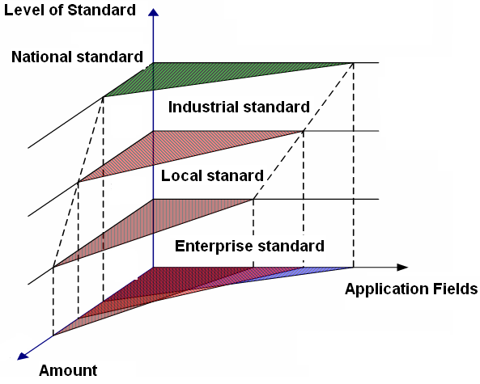
Classification of Standards
GB Standards
Industrial Standards
Local Standards
Enterprise Standards

Slide 3
Administration and Operational Mechanisms
Administration structure
Standardization Administration of the People’s Republic China (SAC), administration authority of State Council affiliated administration department, Province and municipality standardization, standardization unit of industries.
SAC supervise all GB standard, State Department affiliated administration department manage industrial standard, province and municipality standardization administration authority manage provincial standard, enterprise standard need be filed in administration authority of local government.

Slide 4
Operational Mechanisms
Mandatory standards are implemented by government administration departments, voluntary standards are adopted by enterprise voluntarily, and combined with product authentication system.
SAC deal with GB standard, ministries administration department for indutries standard, province and municipality standardization administration department and provincial standard, enterprise standards are revised by individual enterprise.

Slide 5
——The Administrative Structure
GB standards: SAC
Industry Standards: MOA, MIIT, MOC, MOE, State Administration of Grain
GB Technical Committee of Standardization in food industry: TCs: more than 30，SCs more than 150
Standardization institutions of food Industry:
more than 50

Slide 6
Food safety standards category
Fundamental Hygiene：containments，Pesticide Residues， Veterinary drug residue，Microbiology，Analysis，food labelling
Products standards：Product Specifications，MRLs
Technical Specifications：Hygienic specification 、control measures

Slide 7
Current framework of food quality standards
The main category
Grain and grain products
Oils and fats
Meat and meat products
Milk and milk products
Special dietary foods
Alcoholic beverages
Canned foods
Baked foods
seasoning
canndy
Food quality standards：
GB standards: more than 1700
Industry standards: more than 300

Slide 8
Procedure of Drafting Standard

Slide 9
Framework of food standard system
Quality Management
Market Circulation
Food Safety
Food Industry
Standard System
Agriculture
Hygiene Safety
Certification
Accreditation
Import& Export
Inspection & Quarantine

Slide 10
Framework of food standard system
Industrial
Standard System
Basic
Analysis
Package
Machinery and Equip.
Labeling
Raw materials
Food additives
Resource Utilization
Inspection method

Slide 11
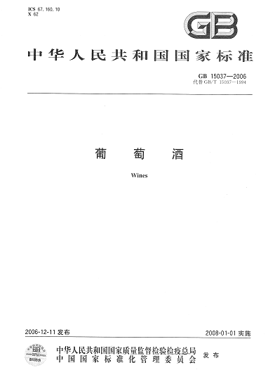
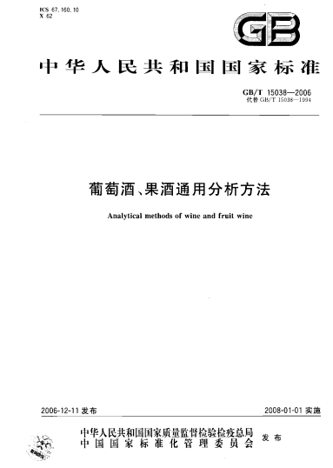

Slide 12
Templet of GB Standard
GB XXX—XX
GB 15037—2006 《wine》
GB/T XXX—XX
GB/T 10345—2007《Chinses spirits analysis method》
Year
Serial number
Standard code

Slide 13
Wines

Slide 14
Format of a GB Standard
Main Parts |  | Contents
Summarized part |  | Cover
 |  | Content
 |  | Preface
 |  | Introduction
Standard text | Common part | Name of Standard
 |  | Application Scope
 |  | Cited standard
 | Technical part | Definition and terms
 |  | Sign and abbreviations
 |  | Requirement
 |  | According to standards classification the content (sampling, Test method, Classification and nominating Sign, labeling, packing)
 |  | Appendix
Supplement part |  | Clue appendix
 |  | Foot note

Slide 15
Labeling requirements
Food Safety Law
GB 7718-2011 General Standard for The Labeling of Prepackaged foods
GB 10344-2005 General Standard for The Labeling of Prepackaged Alcoholic Beverage
Notes for filing of labeling

Slide 16
Inspections on hygienic and quality
GB 2757-2012 Distilled Liquor and Formulated Liquor
GB 2758-2012 Fermented Alcoholic Beverages and their Integrated Alcoholic Beverages
GB 15037-2006 Wine
GB 2760-2011 Standard for Uses of Food Additives

Slide 17
Other related GB standards:
GB/T 10781.1-2006 Strong Flavor Chinese Spirits
GB/T 10781.2-2006 Mild Flavor Chinese Spirits
GB/T 10781.3-2006 Rice Flavor Chinese Spirits
GB/T 16289-2007 Chi-flavor Chinese Spirits
GB/T 20821-2007 Chinese Spirits by Liquid Fermentation
GB/T 20823-2007 Te-flavor Chinese Spirits
GB/T 20824-2007 Zhima-flavor Chinese Spirits
GB/T 14867-2007 Feng-flavor Chinese Spirits
GB/T 20822-2007 Chinese Spirits Made from Tradition and Liquid Fermentation
GB/T 20825-2007 Laobaigan-flavor Chinese Spirits
GB/T 13662-2008 Chinese Rice Wine
GB/T 23547-2009 Nong jiang-flavor Chinese spirits
GB/T 23546-2009 Milk Wine
GB/T 25504-2010 Icewines
GB/T 26760-2011 Jiang-flavor Chinese Spirits
GB/T 26761-2011 Xiaoqu Traditional Chinese Spirits
GB/T 27586-2011 Vitis Amurensis Wines
GB/T 27588-2011 Lu Jiu
……

Slide 18
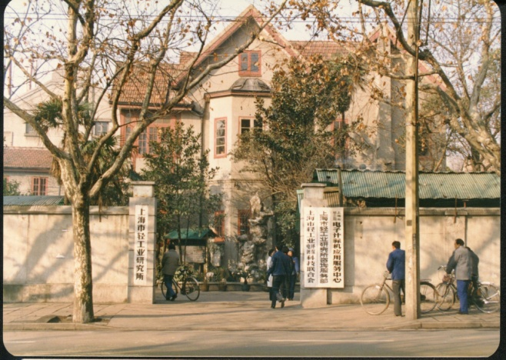
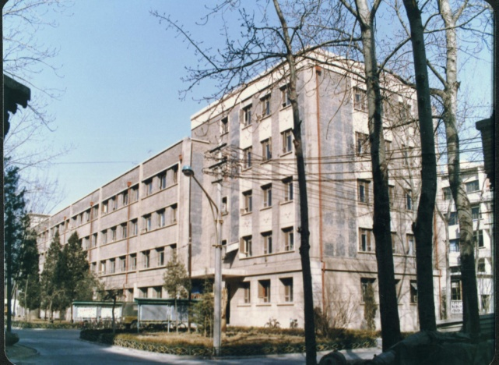
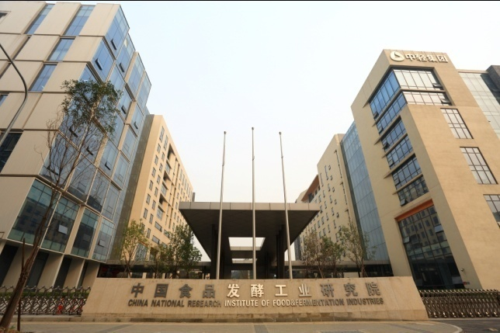
Began in 1930
Established in 1955
Re-name in 2002
A Research Laboratory of the Central Industrial Laboratory
Institute of Food and Fermentation Industry Sciences of Ministry of Light Industry
China National Research Institute of Food and Fermentation Industries (CNRIFFI)

Slide 19
GB Standardization Centre of Food ＆ Fermentation (SCFF)
Established in 1977;
the earliest and most authoritative institute specialized in research and formulation of food standards in China.
It has undertaken more than 600 standards refer to products, measure, basic, management and raw material etc.
National standards 330
Industrial standards 260
Military food Standards 20

Slide 20
GB Standardization Centre of Food ＆ Fermentation
Secretariat of GB Technical Committee on
Secretariat of GB Technical Committee on Chinese Spirits
A
B
G
C
SCFF
Secretariat of GB Technical subcommittee Industry Fermentation
Secretariat of GB Technical Committee on Special Foods
E
D
Secretariat of GB Technical subcommittee Canned Foods
Secretariat of GB Technical Committee on Soft Drinks

Slide 21
Thanks for your attention !
China National Research Institute of Food & Fermentation Industries

