Slide 1
Economy Roundtable: PR China
Ling Tian, Chen zhangting, Sun Yong

Slide 2
Imported Food Inspection Authorities
General Administration of Quality Supervision Inspection and Quarantine of the People’s Republic of China (AQSIQ) is responsible for the import food Inspection Scheme;
National Health and Family Planing Commission of the People’s Republic of China(NHFPC) determines food standards and advises AQSIQ on high risk products.

Slide 3
Risk Based Approach to Food Inspection
“Risk Food”
Dairy products
Nuts
Meat
Seafood
Vegetables
“Surveillance Food”
Everything else (including wine)

Slide 4
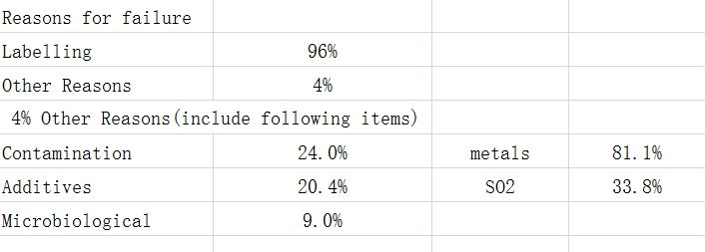
Failure rate

Slide 5
Are there any changes being planned for wine labelling and composition rules in your economy?
According to OIV concerning standards and the “Food safety law of PRChina” , GB15037-201X and GB15038-201X will be modified, but some contents of them are not sure;
Analyzing method of sulfur dioxide(SO2) was published, the new standard GB1886.213-2016, which will work Jan1,2016;
Analyzing method of artifical color was published, the new standard GB5009.35-2016, which will work Jan1,2016;

Slide 6
Are there any changes being planned for wine labelling and composition rules in your economy?
1. According to OIV concerning standards and the “Food safety law of PRChina” , GB15037-201X and GB15038-201X will be modified, but some contents of them are not sure;
2. Analyzing method of sulfur dioxide(SO2) was published, the new standard GB1886.213-2016, which will work Jan1,2016;

Slide 7
3. Analyzing method of artifical color was published, the new standard GB5009.35-2016, which will work Jan1,2016;
4. Analyzing method of ethanol was published, the new standard GB5009.25-2016, which will work Jan1,2016;

Slide 8
Is there a system in your economy for the approval of new winemaking additives? If so, which agency is responsible?
National Health and Family Planning Commission of PR China responsible for all of those new food additives (including alcohol beverages)

Slide 9
Electronic certificates
Up to now, no system accept or send electronic certificates;

Slide 10
Thanks for your attention !

