Slide 1
WRF 2016 ECONOMY ROUNDTABLE PHILIPPINES
Subtitle

Slide 2
CONDUCT OF LAB TESTING
No mandatory lab test by local labs, submission of Certificate of Analysis is sufficient for pre-market authorization
Third party labs (private and government) are accredited by Philippines FDA (http://www.fda.gov.ph/263-list-of-laboratories-recognized-by-the-fda/list-of-accredited-laboratories) to conduct tests if necessary
The government labs, including the Philippines FDA labs determines the standards

Slide 3
RANDOM SAMPLE COLLECTION AND TESTING
No random sample collection was done for the past twelve months due to absence of probable cause for public health risk
No complaints (consumer) samples submitted for testing during the period

Slide 4
CURRENT LABELLING REQUIREMENT
Percent alcohol (%)
Mandatory Nutrition Information on Food Products ( Department of Health Administrative Order No.2014-0030) exempts alcohol beverage
Inclusion of wine vintage in Certificate of Product Registration addressed as amendment of authorization

Slide 5
TECHNICAL WORKING GROUP FOR STANDARDS SETTING
Interagency technical committees comprise standard setting bodies
Department of Health/FDA – lead agency
Department of Agriculture (Animal, Plant, Agriculture and Fisheries Standards, Fertilizer and Pesticides Authority)
Department of Science and Technology (ITDI and FNRI)
Department of Trade (facilitates approval and publishing of standards compendia)

Slide 6
ELECTRONIC AUTHORIZATION
Electronic Registration (E-Reg)
Launched in June this year with Low Risk food products (including wine)
In August and September started receiving Medium and High Risk food
Mandatory online submission starting October
Electronic License to Operate (E-LTO) – currently on Test-run

Slide 7
ELECTRONIC AUTHORIZATION
Still limited to online submission of authorization application (web based)
Electronic review of documents (soft copies)
Online system approval / denial
Final authorization still on paper (security paper)

Slide 8
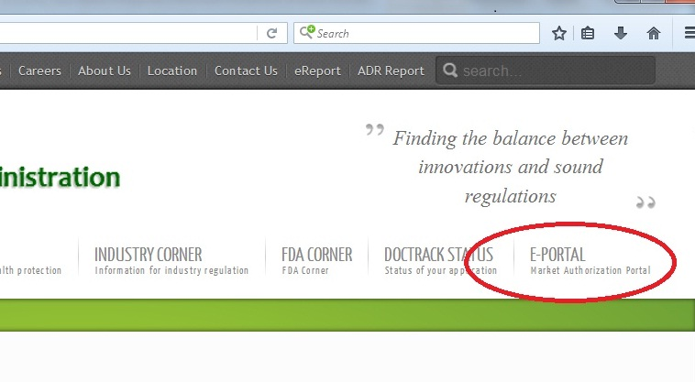
Philippines FDA E-Portal

