Slide 1
The Application of IRMS Methods for Detection of Wine Adulteration
Ling Tian–GuangDong CIQ , AQSIQ, P. R. China
APEC WRF November 2015 | Adelaide Australia
APEC Wine Regulatory Forum
Adelaide | Australia

Slide 2
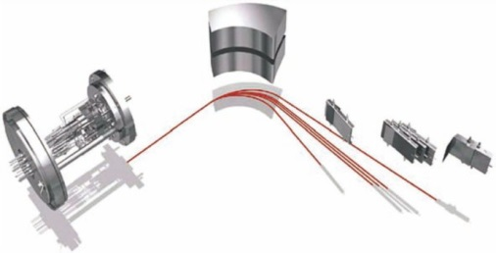
The Application of IRMS Methods for Detection of Adulteration of Wine
Background
Developed Methods
Databank
Cooperation

Slide 3
The Application of IRMS Methods for Detection of Adulteration of Wine
Background
Authentication of wine is the analysis process by which a wine is verified as being in compliance with legal regulations. Authentication is not only imperative for consumer protection with respect to an increased and globalized wine market. There is also a high interest of wine producers and traders to offer wines of high quality and reliable authenticity. Finally it is a political and economic objective of each producing country to market internationally well reputed wines.

Slide 4
The Application of IRMS Methods for Detection of Adulteration of Wine
Although quality awareness of wine producers is on a rather high level all over the world, there have been and still are incentives to produce wine by illegal practices. Furthermore, during the last decades, adulterations became more and more sophisticated, thus the development of even more powerful analytical methods for wine authentication has been an important concern in wine analytics. The recognition of stable isotopes as genuine markers of food was a milestone of improved food authentication.

Slide 5
The Application of IRMS Methods for Detection of Adulteration of Wine
Authentication of wine and other food products by SIR is based on the inter- and intra-molecular non-statistical distribution of the stable isotopes of the bio-elements carbon (¹³C/¹²C), hydrogen (²H/¹H), and oxygen (¹⁸O/¹⁶O). Figure shows the main general parameters which are influencing biotic and abiotic effects of fractionation of stable isotopes in grapes.

Slide 6
The Application of IRMS Methods for Detection of Adulteration of Wine
Biotic Fraction Effects
Mechanism of sugar photosynthesis
Grape Variety
Alcohol fermentation yeasts
²H/¹H
¹⁸O/¹⁶O
¹³C/¹²C
Abiotic Fraction Effects
Geographic origin, general climatic conditions
Temperature, rainfall during veraison
Date of harvest, oeonogical treatments

Slide 7
The Application of IRMS Methods for Detection of Adulteration of Wine
Developed two methods, cooperated with National Research Institute, Food and Fermentation Industries.
1. Methods for ¹⁸O/¹⁶O Isotope Ratio Determination of water in wine –Method using Isotopic equilibrium exchange reaction (Resolution OIV/OENO 353: 2009, MOD)
2. Determination of the Carbon Isotope Ratio ¹³C/¹²C of CO₂ in sparkling wines-Method using Isotope ratio mass Spectrometry (IRMS)

Slide 8
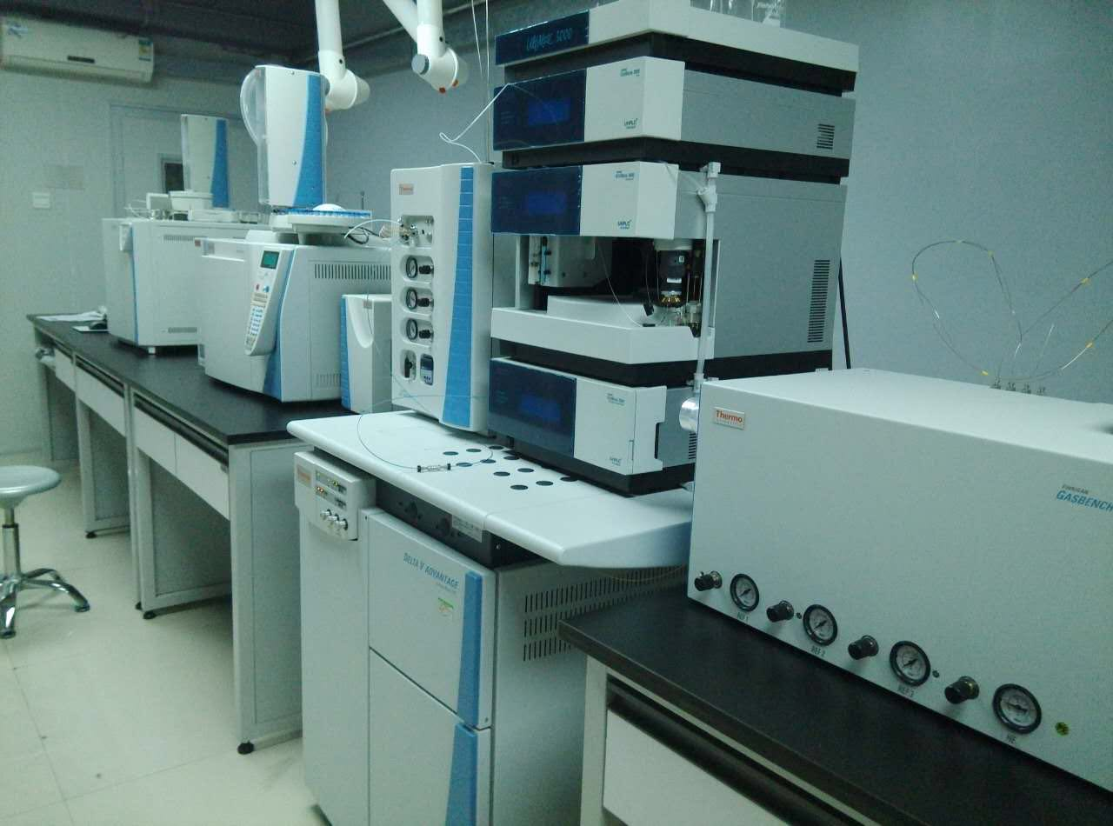
The Application of IRMS Methods for Detection of Adulteration of Wine

Slide 9
The Application of IRMS Methods for Detection of Adulteration of Wine
Databanks
Authenticity testing of wines by SIRA rely to a large extend on analytical data of a set of authentic reference samples.
The selection of suitable reference sample is also crucial. In a optimum situation, the reference samples coincide in terms of origin, and the (date of) vintage, with the wine to be analysed.

Slide 10
The Application of IRMS Methods for Detection of Adulteration of Wine
EU Wine Databank
In 1991, a decree for the establishment of an official wine databank (EU-Wine DB) at the Joint research center (JRC) in Italy was launched by the European Commission (EC). The EU-WineDB actually contain the isotopic results of authentic and respresentive samples from EU Member States (MS) with wine-growing regions since 1992.
APEC Wine Databank ? ?
Up to now, there is no databank which has been already launched. Necessary or not?
For APEC region, there are many high level or outstanding grape wines, just like famous winery, which are from Napa County, Barossa Valley , Ice wine from Ontario, and so on.

Slide 11
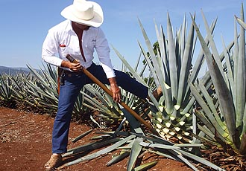
The Application of IRMS Methods for Detection of Adulteration of Wine
Cooperation with concerning institutes from Mexico
Research project (Supported by AQSIQ): Authentication of tequila by stable ratio analyses and elemental composition.
The key question:
The selection of reference tequila sample ?

Slide 12
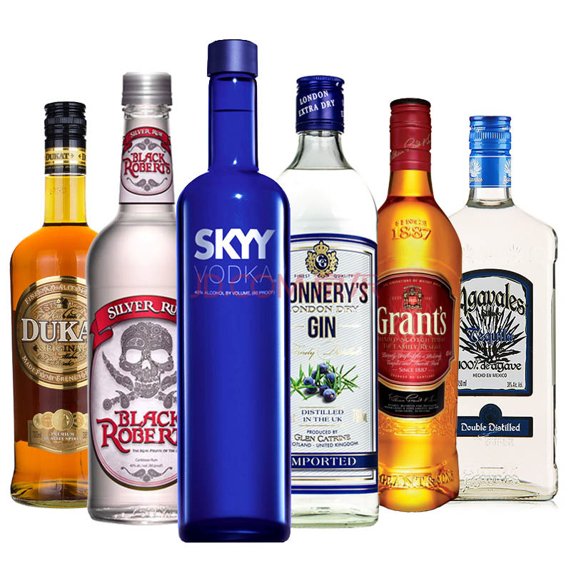
The Application of IRMS Methods for Detection of Adulteration of Wine
The concerning information of reference samples:
Latitude, longitude, distance from the sea (km), altitude, geology;
Temperature, relatively humidity and precipitation.

Slide 13
Thanks for your attention! tianling2008@yahoo.com 409232198@qq.com

