Slide 1


Guo Dehua
郭德华
Deputy Director, technical center for animal, plant and food inspection & quarantine
Shanghai Entry-Exit Inspection and Quarantine Bureau （SHCIQ）
上海出入境检验检疫局动植物与食品检验检疫技术中心 副主任
5 November 2013
The testing of import wine in China
进口葡萄酒的检测

Slide 2
Outline
目录
General situation of Shanghai entry-exit inspection and quarantine bureau
上海检验检疫局概况
The inspection standard of wines
葡萄酒检验标准
The recent research projects
最新研究成果

Slide 3



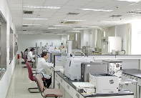
SHCIQ Major responsibilities
上海出入境检验检疫局主要职责
……
Sanitation supervision and inspection of import food.
进口食品卫生监督管理
Health quarantine and supervision of entry-exit passengers.
出入境人员卫生检疫及监督
Sanitary quarantine and treatment of entry-exit means of transport and goods.
运输工具及货运的卫生检疫及处理
Certification and accreditation of quality system.
质量体系的认证及认可
Inspection and supervision of import waste materials.
进口废物的检验及监督
Quarantine of entry and exit animals and plants.
进出口动物及植物的检疫
……

Slide 4
Organization Structure of Shanghai CIQ
组织框架
SHCIQ
14 functional divisions
14个职能部门
16 branches
16个分支局
5 technical support centers
5个技术中心

Slide 5
5 technical support centers
技术中心介绍
1. Technical Center for Animal, Plant and Food Inspection and Quarantine
动植物与食品检验检疫技术中心
2. Technical Center for Industrial Products and Raw Materials Inspection
工业品及原材料检验技术中心
3. Technical Center for Machinery and Electrical Appliances Inspection
机电产品检验技术中心
4. Shanghai Audit Center of China Quality Certification Center (CQC)
中国质量认证中心上海分中心
5. Shanghai International Travel Healthcare Center
上海国际旅行卫生保健中心

Slide 6
Responsibilities of Technical Center for Animal, Plant and Food Inspection and Quarantine
动植物与食品检验检疫技术中心职责
Laboratory inspection and quarantine of animals, plants, foods ,food contact materials, food additives, feeds and cosmetics imported and exported through Shanghai port;
上海口岸进出口动植物、食品、食品接触材料、食品添加剂、饲料和化妆品的实验室检验及检疫
Risk assessment on imported and exported animals, plants, foods and cosmetics during inspection and quarantine;
进出口动物、植物、食品和化妆品检验检疫的风险评估
Monitor on potential safety problems of imported and exported animals, plants, foods according to General Administration of Quality Supervision, Inspection and Quarantine（AQSIQ）;
进出口食品和动植物产品的国家安全卫生预警监测任务
Isolated quarantine and planting of imported animals and plants.
进出口动物及植物的隔离

Slide 7
Organization Structure of Technical Center for Animal, Plant and Food Inspection and Quarantine
动植物与食品检验检疫技术中心组织框架
Quarantine station for animals and plants
隔离场
Physical and chemical laboratory
理化室
Microbiological laboratory
微生物室
Animal quarantine and toxicology laboratory
动物检疫及毒理室
Plant quarantine and cereal inspection laboratory
植物检疫及粮谷室
Genetically modified organism detection and down & feather inspection laboratory
转基因及羽绒室
General Office
办公室
Liquor and cosmetics branch testing center
酒类及化妆品检测分中心
Technical Center
技术中心

Slide 8
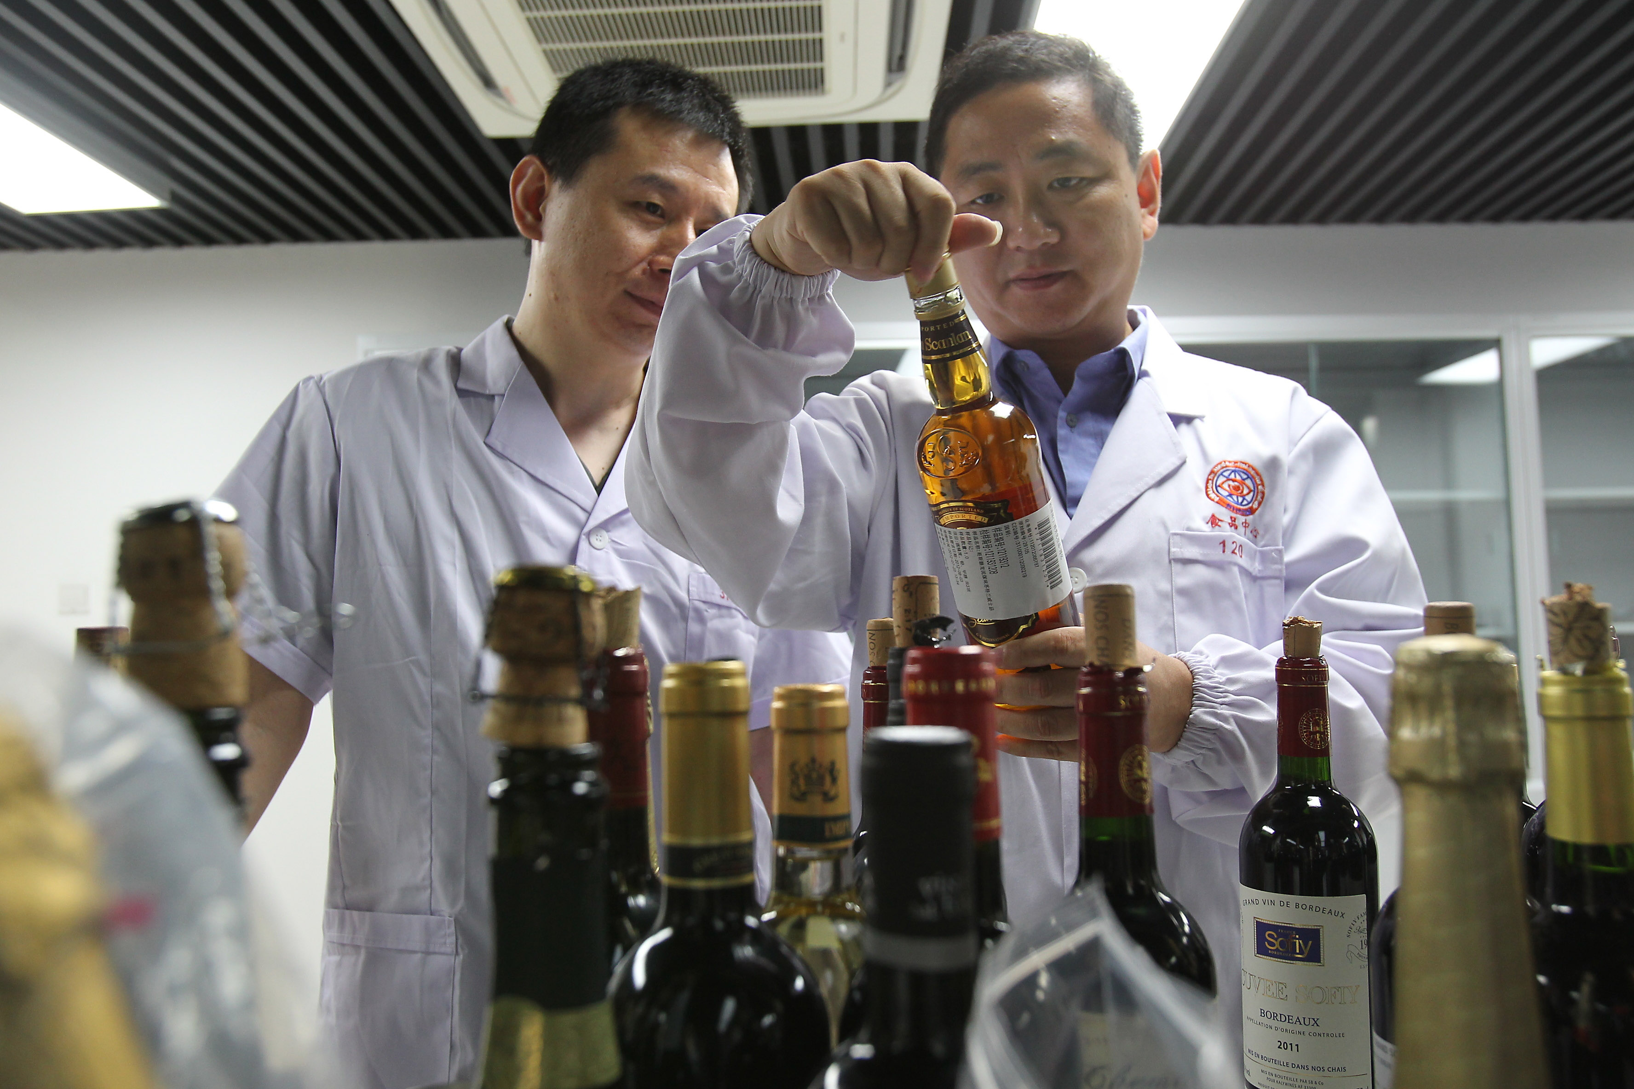
Professionals of Liquor and cosmetics branch testing center
酒类及化妆品检测分中心人员
32 dedicated and highly trained professionals work for this center, among whom there are
32名专业技术人员，其中：
  Professional title
    2 senior research scientists,
    4 senior professionals
    6 intermediate professionals,
2位研究员，4位高级技术人员和6位中级技术人员
  Education background
    3 doctors,
    3 masters
    17 bachelors.
学历为：3位博士，3位硕士和17名学士

Slide 9
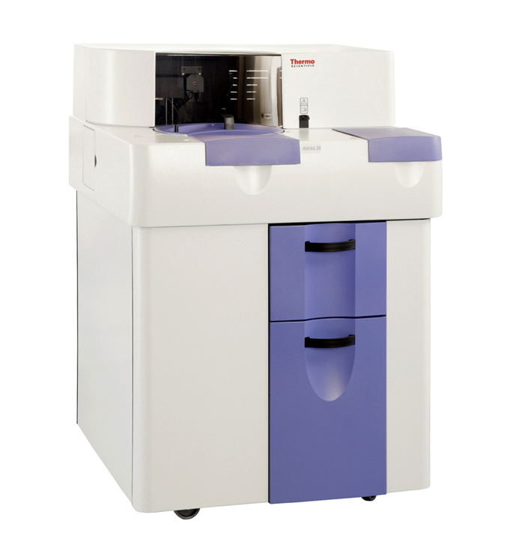
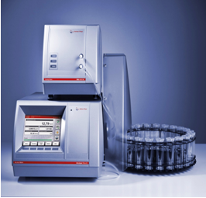
Instrument and Equipment of Liquor and cosmetics branch testing center
酒类及化妆品检测分中心设备
To meet the need of ensuring product quality and safety at Shanghai port, the testing center is equipped with many large-scale sophisticated instruments. The total amount of fixed assets has exceeded 3 million USD.
为满足上海口进出口酒类安全检测要求，分中心配置了超过3百万美元的仪器设备
  HPLC 3 sets/台; GC 2 sets/台; IC 1 sets/台; AAS 2 sets台;
  HPLC-MS/MS 1 set/台; HPLC-IT-TOF 1 set/台;
  ICP-MS 1 set/台;
  GC-MS 2 sets/台;
  Alcolyzer Plus Beer Me 1 set/台;
  Thermo Konelab Arena 1 set/台

Slide 10
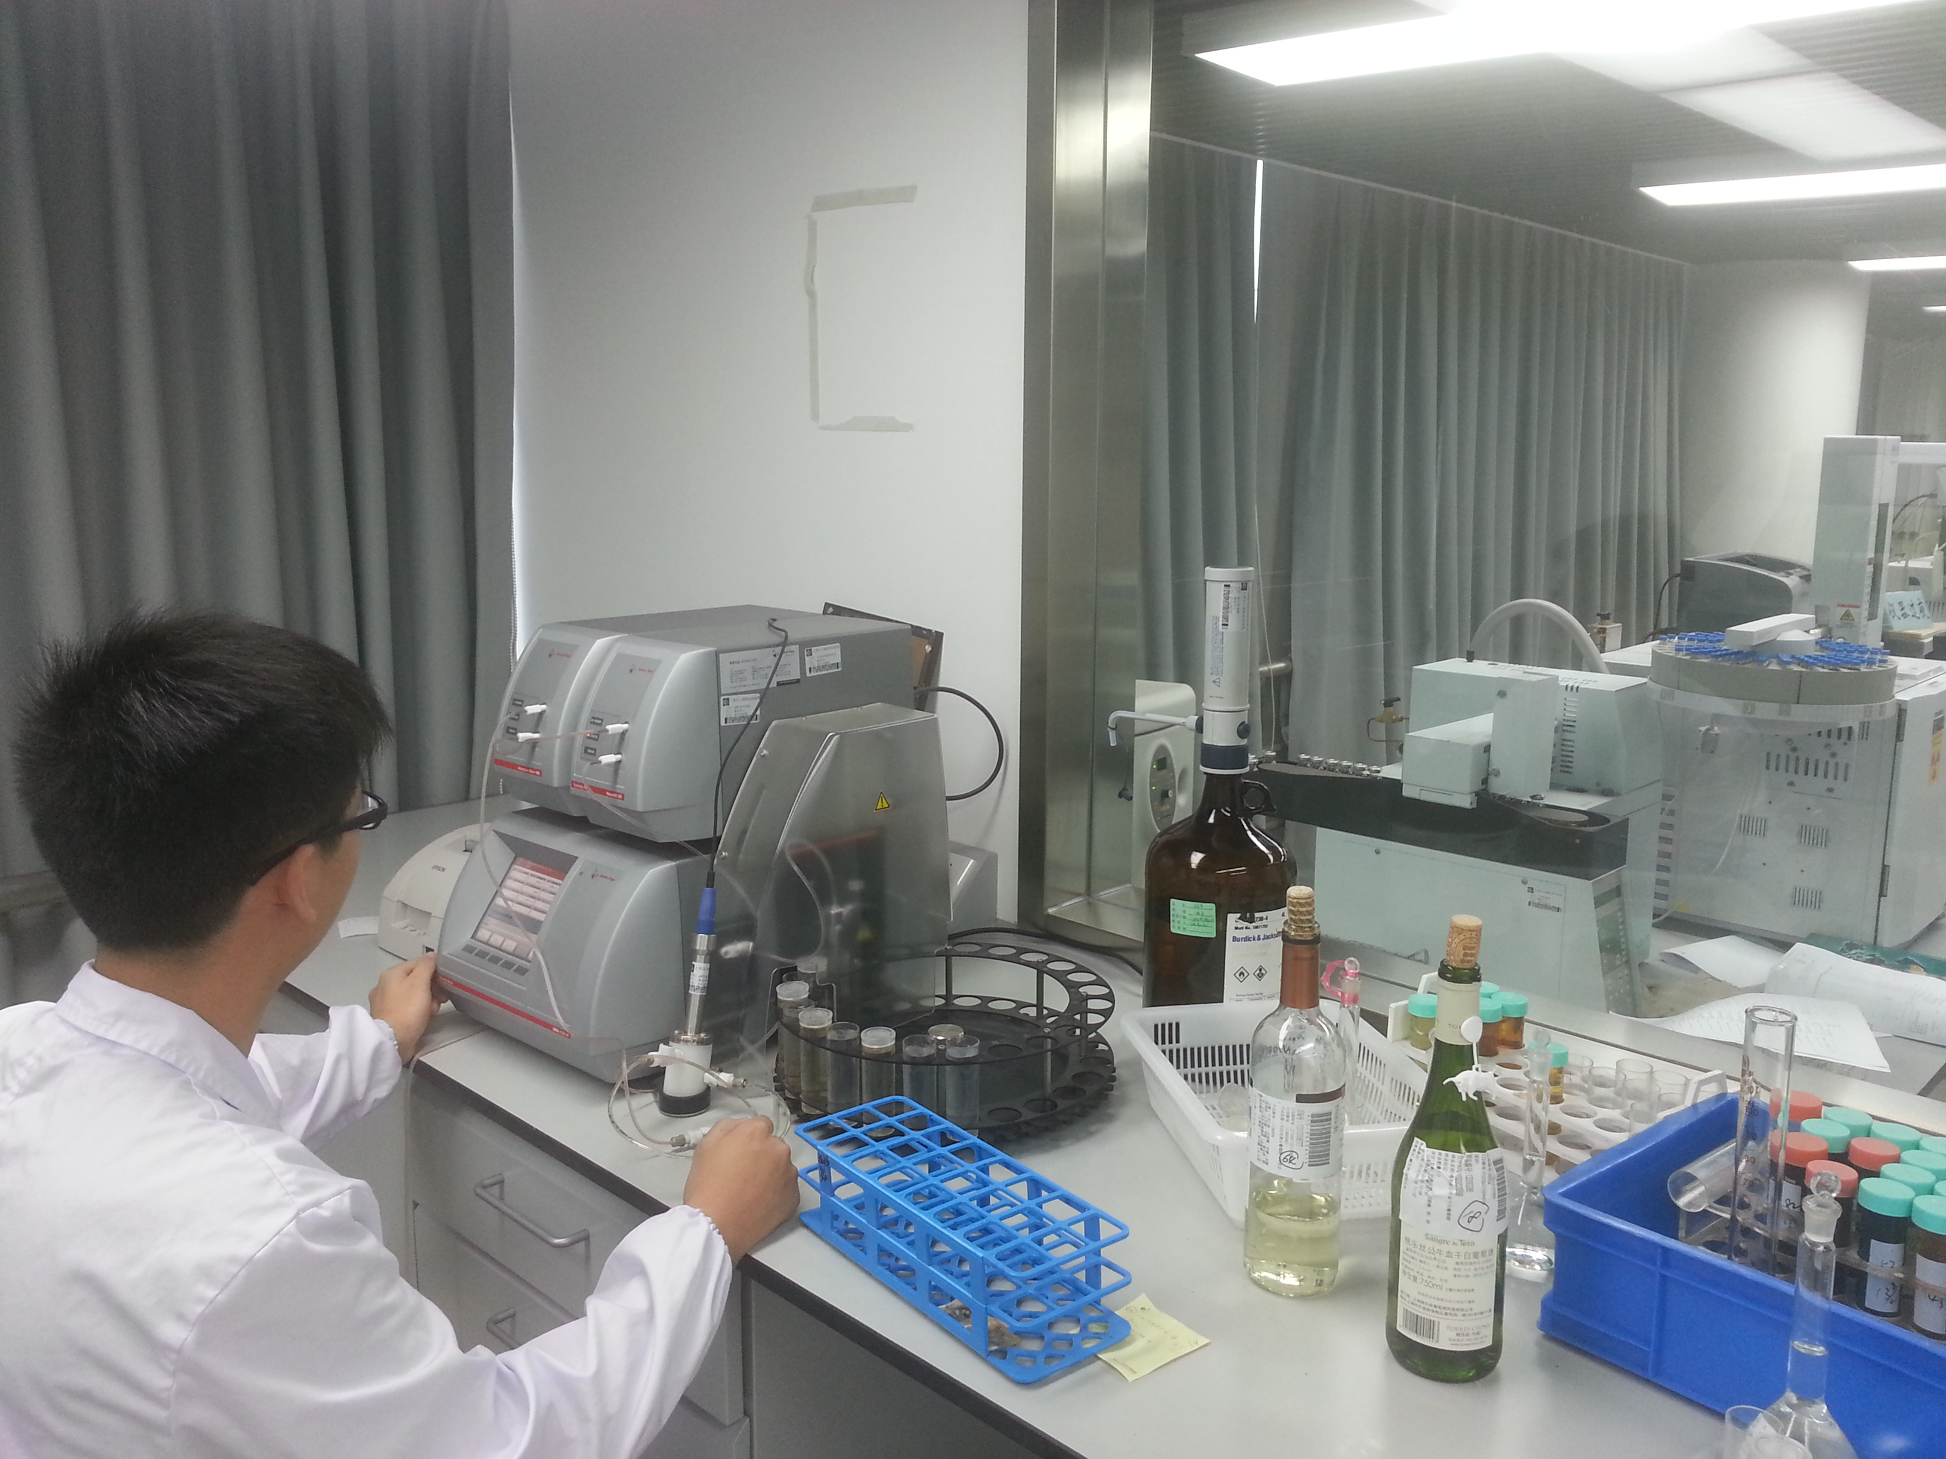
Infrastructure of Liquor and cosmetics branch testing center
酒类及化妆品检测分中心的面积及业务量
The center occupy an area of 2500 square meters, and the well-arranged and facilitated environment guarantees the quality of lab inspection work.
分中心场地面积2500平方米，具有良好的设施和环境，保证检验工作质量满足。
6,924 lots 9,833samples were determined and 35,179 results were reported last year.
去年完成6912批、9833个样品的检测，
出具35179个实验数据。

Slide 11
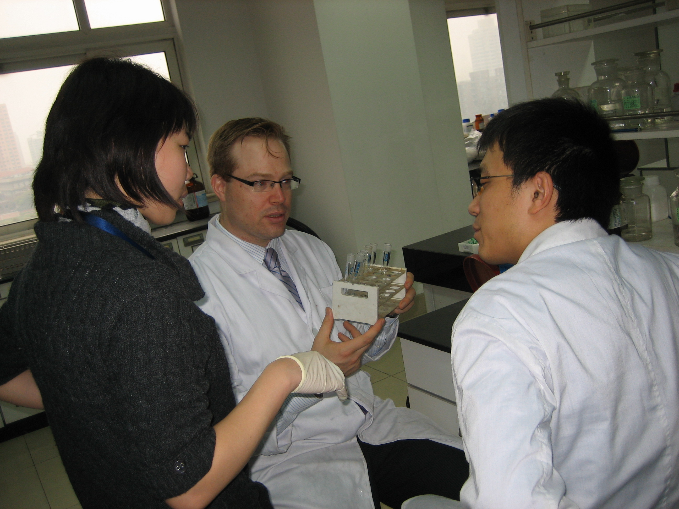
Quality management system of Liquor and cosmetics branch testing center
酒类及化妆品检测分中心的质量管理体系
Accreditation covering 36 test items on beverage wine and liquor products has been made by China National Accreditation Service for Conformity Assessment (CNAS).
饮料及酒类产品中的36个测试参数通过中国合格评定国家认可委员会（CNAS）的认可
Participate in many domestic and international
proficiency tests and collaborative experiments
every year and have attained satisfactory results.
(FAPAS,CNAS,LGC,TTB)
每年参加许多国内外能力验证和协同试验并取得
满意评价 (如：FAPAS,CNAS,LGC,TTB)）
Frequent technical exchanges with
delegations and expert teams from foreign
authorities such as TTB, CIVB, Pessac, etc.
经常与国外专业机构进行技术交流，如TTB, CIVB,
Pessac,等

Slide 12

Scope of Accreditation to ISO/IEC 17025:2005 of Liquor and cosmetics branch testing center
酒类及化妆品检测分中心认可的检测能力范围
Registration No/认可实验室编号. CNAS L1009
No. | Item/Parameter 项目/参数 | No. | Item/Parameter 项目/参数
1 | Alcoholicity 酒精度 | 9 | Fusel oil 杂醇油
2 | Total sugar 总糖 | 10 | Caffeine 咖啡因
3 | Dry extract 干浸出物 | 11 | Acesulfame K 安赛蜜
4 | Sulfur dioxide 二氧化硫 | 12 | Total acidity 总酸
5 | Volatile acids 挥发酸 | 13 | Formaldehyde 甲醛
6 | Iron 铁 | 14 | Ochratoxin A 赭曲霉毒素
7 | Copper 铜 | 15 | Citric Acid 柠檬酸
8 | Methanol 甲醇 | 16 | Phthalate esters 邻苯二甲酸酯类

Slide 13
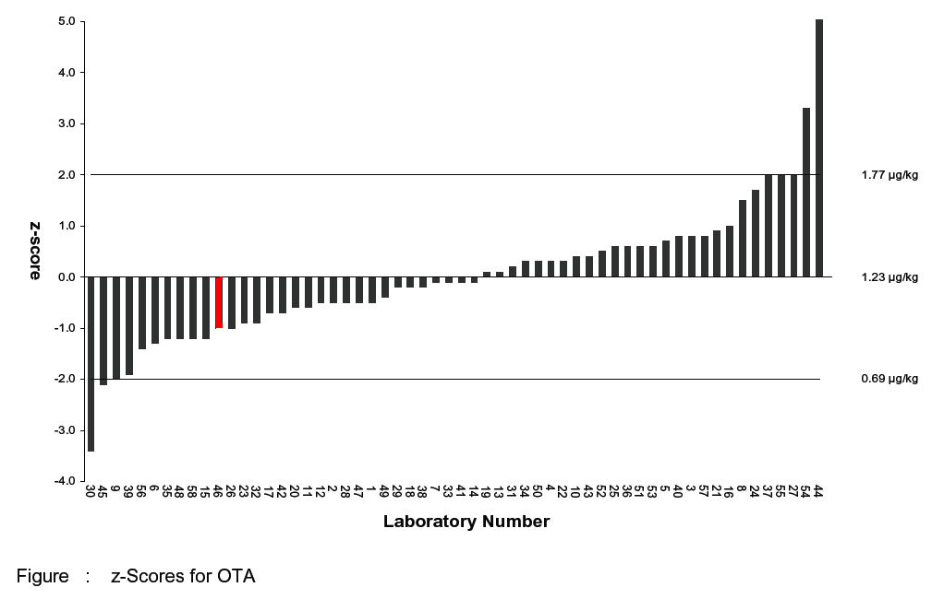

Ochratoxin A in wine proficiency testing（T1795）
In January 2011, participate in ochratoxin A in wine proficiency testing by FAPAS, the result is satisfactory. The test result of ochratoxin A is 0.95 µg/kg (the median is 1.23 µg/kg)
2011年1月，中心参加英国FAPAS组织的葡萄酒中赭曲霉毒素A的能力验证，测试结果为满意。测定值为0.95 µg/kg (中位值为1.23 µg/kg)

Slide 14
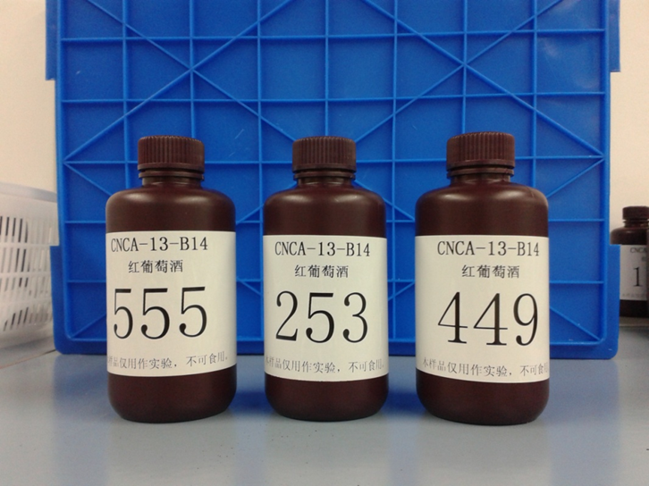
  Authority as Proficiency Testing Provider
  能力验证活动的提供者
2011
Awarded the State Key Testing Laboratory of Alcohol Qualification by AQSIQ
2012
Authorized to organize activities of the testing as a proficiency testing provider by Certification and Accreditation Administration（CNCA）
2013
PT of total sugar, sorbic acid, manganese contents in wine(CNCA-13-B14)
In April 2013 - complete validation plan, and sent the invitation to participants
A total of 113 laboratories for this PT in China
According to the design scheme of the preparation of samples: 2 level and 1 sample disturbance
质检总局批准为酒类检测国家重点实验室
国家认监委授权为能力验证活动提供者组织比对活动
2013年组织葡萄酒中总糖、山梨酸和锰含量的能力验证活动（CNCA-13-B14）
有113家实验室参加
分发两个测试样品和一个干扰样品

Slide 15
Outline
目录
General situation of Shanghai entry-exit inspection and quarantine bureau
上海检验检疫局概况
The inspection standard of wines
葡萄酒检验标准
The recent research projects
最新研究成果

Slide 16
National standards related to the wine
与葡萄酒有关的国家标准
GB 2758-2012 National standards for food safety “fermented alcoholic beverages and their integrated alcoholic beverages”
GB 2758-2012 食品安全国家标准“发酵酒及其配制酒”
  Pb/铅: 0.2 mg/kg
  sulfur dioxide/二氧化硫：0.25g/L, 0.4g/L(for sweet wines and fruit wines)
  sorbic acid/山梨酸：0.2g/kg
  D-isoascorbic acid (erythorbic acid)/D-异抗坏血酸: 0.15g/kg
  L（+）-tartaric acid/L(+)-酒石酸: 4.0g/L
  potassium permanganate(As mangaese)/高锰酸钾: 2mg/kg
  salmonella/沙门氏菌: 0/25 mL
  staphylococcus aureus/金黄色葡萄球菌 : 0/25 mL
Label should comply with the requirments of "General standard for the labeling of prepackaged foods" (GB 7718-2011) and GB 2758-2012 .
  标签应符合“预包装食品标签通则” （GB 7718-2011)和GB 2758-2012的要求

Slide 17
National standards related to the wine
与葡萄酒有关的国家标准
GB15037-2006 the National Standard “Wine”
GB 15037-2006 国家标准“葡萄酒”
  has taken effect since Jan.1,2008 as compulsory standard.
  作为强制标准与2008年1月1日实施
  The standard covers all processes from grape planting, wine production to its transportation. It gives more precise definition of wine and newly adds the sugar content classification.
  标准适用于葡萄种植，葡萄酒酿造及运输，并规定了葡萄酒的精确定义和根据总糖含量的分类
  About the industry common concerned issues of vintage wines, varietal wines, and original wines , the standard also gives definition. And the standard regulates the use of wine additives.
  关于行业共同关心的年份葡萄酒,品种葡萄酒和产地葡萄酒，标准给出了定义。标准同时对添加剂的使用进行了规定。
  Part of this standard defines the equivalent adopted the international organization for OIV regulations(2003 edition)
  标准的部分定义等效采用了OIV法规（2003版）

Slide 18
“Wine”(GB 15037-2006)
ITEM |  |  | SPECIFICATION
Alcoholicityª（20℃）（vol）/（%） |  |  | ≥7.0
Total sugar^{d}（As Glucose）/(g/L) | Still wines | Dry wines^{b} | ≤4.0
 |  | Semi-dry wines^{c} | 4.1~12.0
 |  | Semi-sweet wines | 12.1~45.0
 |  | Sweet wines | ≥45.1
 | Sparkling wines | Brut sparkling wines | ≤12.0（Tolerance、allowance is 3.0）
 |  | Extra-dry sparkling wines | 12.1~17.0（Tolerance、allowance is 3.0）
 |  | Dry sparkling wines | 17.1~32.0（Tolerance、allowance is 3.0）
 |  | Semi-dry sparkling wines | 32.1~50.0
 |  | Sweet sparkling wines | ≥50.1
Dry extract/（g/L） | White wines |  | ≥16.0
 | Rose wines |  | ≥17.0
 | Red wines |  | ≥18.0
Volatile acids（As acetic acid）/（g/L） |  |  | ≤1.2
Citric acid | dry、semi-dry、semi-sweet wines |  | ≤1.0
 | Sweet wines |  | ≤2.0

Slide 19
“Wine”(GB 15037-2006)
ITEM |  |  | SPECIFICATION
Carbon dioxide（20℃）/MPa | Semi-sparkling wines | ＜250mL/bottle | 0.05~0.29
 |  | ≥250mL/bottle | 0.05~0.34
 | Sparkling wines | ＜250mL/bottle | ≥0.30
 |  | ≥250mL/bottle | ≥0.35
Iron/（mg/L） |  |  | ≤8.0
Copper/（mg/L） |  |  | ≤1.0
Methanol/（mg/L） | White or Rose wine |  | ≤250
 | Red wine |  | ≤400
Benzoic acid or sodium benzoate（As benzoic acid）/（mg/L） |  |  | ≤50
Sorbic acid and sorbic acid sodium（As Sorbic acid ）/（mg/L） |  |  | ≤200
Notes： The total acid does not make the specification, only for the measured values(As tartrate, g/L). a alcohol with the field label and the measured values shall not exceed ±1.0% （%vol）. b when difference value between total sugar and total acid (As tartaric acid) is less than or equal to 2.0 g/L, total sugar can up to 9.0 g/L. c when difference value between total sugar and total acid (As tartaric acid) is less than or equal to 2.0 g/L, total sugar can up to 18.0 g/L。 d The specification of total sugar in semi-sparkling wines is the same of still wines.

Slide 20
Differences of inspection standards between China and OIV
中国与OIV组织在检验方法的区别
 | China | OIV
Total sugar definition 总糖定义 | Glucose + Fructose + under the condition of determination can be hydrolyzed to the reducing monosaccharide 葡萄糖+果糖及按测定条件可水解的还原糖 | Glucose + Fructose 葡萄糖+果糖
Determination of total sugars 总糖的测定 | Redox titration 氧化还原法 | Enzymatic analysis or HPLC 酶法或液相色谱法
Determination of total acid 总酸的测定 | endpoint of titration is pH 8.2 滴定终点为pH8.2 | endpoint of titration is pH 7.0 滴定终点为pH7.0

Slide 21
Outline
目录
General situation of Shanghai entry-exit inspection and quarantine bureau
上海检验检疫局概况
The inspection standard of wines
葡萄酒检验标准
The recent research projects
最新研究成果

Slide 22

Project 1: Investigation of heterocyclic aromatic amines contents in wine
项目1：葡萄酒中杂环胺含量的调查
Heterocyclic aromatic amine s(HAAs) which are produced during the cooking process can cause cancer and have a high mutation activity.
杂环胺在烹饪过程中产生，存在致癌和致突变可能性
HAAs has also been proved to exist in the wine, soy sauce, vinegar, atmospheric particulate matter, cigarette smoke, etc.
杂环胺也被发现在葡萄酒，酱油，醋，大气颗粒和烟气等中存在
International agency for research on cancer (IARC) in l993 as IQ “For humans is very suspicious carcinogens (grade 2 a)”；
国际癌症研究机构（IARC）于1993年将IQ归为“对人类来说是非常可疑致癌物（2a级）”
Trp-P-1, Trp-P-2,Glu-P-1, MeIQ, MeIQx, PhIP, AaC and Me AaC classified as “potential carcinogens (grade 2 b) ”.
Trp-P-1, Trp-P-2,Glu-P-1, MeIQ, MeIQx, PhIP, AaC and Me AaC 被归为“潜在的致癌物”（2b级）

Slide 23
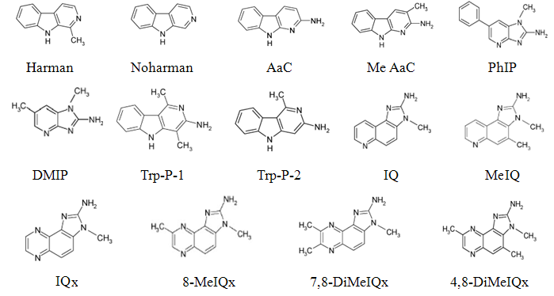
the name and structural formula of heterocyclic amines
杂环胺的名称及结构式

Slide 24
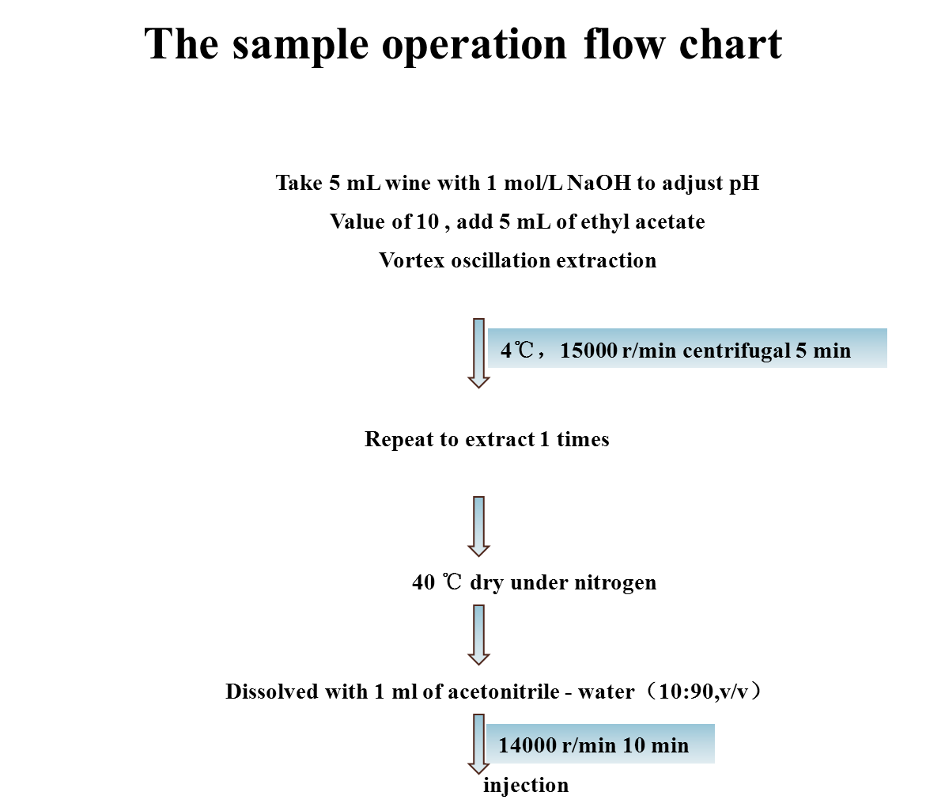

Slide 25
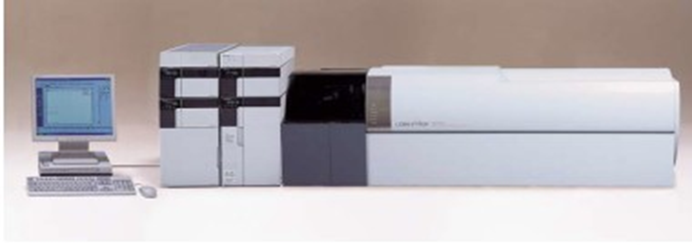
The instrument condition
仪器条件
Determinated by liquid chromatography-ion trap –time of flight tandem mass spectrometry
液相色谱-离子阱飞行时间串联质谱法
Use isotope internal standard
同位素内标定量
Phenomenex Kinetex 2.6μ C18 100A column（2.1 mm i.d.*100mm）
色谱柱:Phenomenex Kinetex 2.6μ C18
With a gradient elution of acetonitrile and 30 mM ammonium formate at a flow rate of 0.4mL/min
流动相：乙腈+甲酸胺
Detected under positive ESI
电离模式：ESI+
Time（min） | A Conc. | B Conc.
0.3 | 95% | 5%
4.2 | 70% | 30%
5.1 | 40% | 60%
6.8 | 40% | 60%
7.7 | 95% | 5%
9.9 | 95% | 5%

Slide 26
The contents of the HAAs in wines (μg/L)
葡萄酒中杂环胺的含量
wine No. | harman | Norharman | DMIP | Trp-P-1 | IQ | MeIQ | HAAs
A-1 | 1.47 | nd | 1.04 | nd | nd | nd | 2.51
-2 | 1.47 | 0.33 | 3.63 | nd | 1.19 | nd | 6.62
-3 | 1.26 | nd | 1.62 | nd | 0.33 | nd | 3.21
B-1 | 0.80 | 0.44 | 0.44 | nd | 0.93 | nd | 2.61
-2 | 1.16 | 0.48 | 4.62 | nd | 1.48 | nd | 7.74
-3 | 0.76 | 0.40 | 0.40 | nd | 0.64 | nd | 2.20
C-1 | 2.31 | 1.24 | 1.05 | 0.68 | 1.17 | nd | 6.45
-2 | 1.26 | 0.51 | 0.42 | nd | 0.97 | nd | 3.16
- 3 | 1.65 | 0.37 | 0.96 | nd | 0.72 | nd | 3.70
D-1 | 0.55 | 0.54 | 6.15 | nd | 1.76 | nd | 9.00
-2 | 7.13 | 0.80 | 1.81 | nd | 2.06 | nd | 11.8
-3 | 1.24 | 0.59 | 1.08 | nd | 1.04 | nd | 3.95
E-1 | 2.84 | 0.45 | 0.65 | nd | 1.07 | nd | 5.01
-2 | 3.63 | 0.60 | 9.98 | nd | 0.89 | 1.97 | 17.07
-3 | 1.92 | 0.42 | 1.79 | nd | 0.44 | nd | 4.57
F-1 | 2.28 | 0.34 | 0.8 | nd | nd | nd | 3.42
-2 | 1.24 | 0.33 | 0.35 | nd | nd | nd | 1.92
-3 | 2.12 | 0.50 | 0.76 | nd | 0.68 | nd | 4.06
G-1 | 0.45 | nd | 0.71 | nd | 0.33 | 0.90 | 2.39
-2 | 0.54 | nd | 0.64 | nd | 0.33 | nd | 1.51
-3 | 0.60 | nd | 0.73 | nd | 0.78 | nd | 2.11

Slide 27
Project 2: Pesticide residues in wine and the risk assessment
项目2：葡萄酒中农残及风险分析
Sample source：116 bottles of wine samples were tested
样品来源：116瓶葡萄酒样品
Screening object：organochlorine, organophosphorus, pyrethrins and a new generation of pesticides , 150 kinds of pesticides
筛查对象：有机氯、有机磷、菊酯类和新型农药等150种农药
Method: HPLC-MS/MS
方法： 液相色谱串联质谱法
Results of screening：Mainly include carbendazim, pyrimethani, cyprodinil, cyanazine, furalaxyl, metalaxyl, aldicarbsulfoxide, flutriafol , fenamidone and diethofencarb etc. 26 kinds of pesticide residues
筛查结果：主要有多菌灵、嘧霉胺、嘧菌环胺、草净津、呋霜灵、甲霜灵、涕灭威亚砜、粉唑醇、咪唑菌酮和乙霉威等26种农药残留
Evaluation object：Carbendazim, Pyrimethanil and Cyprodinil
评估对象：多菌灵、嘧霉胺和嘧菌环胺
Notes:
27

Slide 28
MRLs of the assessed pesticides in grapes
被评估的三种农药在葡萄中的限量
pesticide | EU | CAC | USA | CANADA | AUSTRALIA | JAPAN | CHINA
Carbendazim 多菌灵 | 5 mg/kg | 3 mg/kg | - | 5 mg/kg | 3 mg/kg | 3 mg/kg | 3 mg/kg
Pyrimethanil 嘧霉胺 | 5 mg/kg | 4 mg/kg | 5 mg/kg | 5 mg/kg | 5 mg/kg | 10 mg/kg | -
Cyprodinil 嘧菌环胺 | 5 mg/kg | 3 mg/Kg | 2 mg/kg | 2 mg/kg | 2 mg/kg | 2 mg/kg | -
Notes:
目前欧盟、CAC、澳大利亚、加拿大和日本对葡萄中多菌灵、嘧霉胺和嘧菌环胺的使用均提出限量要求。美国没有对葡萄中多菌灵的限量要求。中国规定在葡萄中多菌灵的限量为3 mg/kg，但对葡萄中嘧霉胺和嘧菌环胺的使用没有限量要求
28

Slide 29
Concentration distribution of Carbendazim, Pyrimethanil and Cyprodinil in wine (µg/L)
葡萄酒中多菌灵、嘧霉胺和嘧菌环胺浓度分布
Estimated intake | The detection rate | Minimum value | Maximum value | Average value | P50 | P90 | P95 | P97.5
Carbendazim | 54.31% | 0.005 | 210.24 | 14.04 | 4.70 | 104.04 | 181.60 | 183.10
Pyrimethanil | 57.76% | 0.005 | 225.50 | 6.59 | 3.20 | 25.00 | 87.60 | 91.30
Cyprodinil | 70.69% | 0.005 | 34.44 | 1.67 | 1.03 | 7.97 | 14.24 | 27.97
* Monte Carlo analysis are performed by Microsoft Excel plug in with @Risk5.7

Slide 30
Estimated exposure of Carbendazim, Pyrimethanil and Cyprodinil in wine (µg/kg·bw·d)
葡萄酒中多菌灵、嘧霉胺和嘧菌环胺暴露评估
Estimated exposure | Average value | P95 | P97.5
Carbendazim | 9.17×10⁻⁴ | 0.163 | 0.212
Pyrimethanil | 4.01×10⁻⁴ | 7.69×10⁻² | 0.105
Cyprodinil | 1.15×10⁻⁴ | 1.92×10⁻² | 2.58×10⁻²
* Monte Carlo analysis are performed by Microsoft Excel plug in with @Risk5.7
Notes:
30

Slide 31
Conclusion
结论
The P95 of exposure of Carbendazim in wine was 0.163 µg/kg b.w. per day, considering contribution of wine to the total pesticides exposure is different between male and female, up to 0.5L of wine per day for male and 0.3 L for female are of no safety concern.
多菌灵：以每天P95暴露量0.163 µg/kg计算，男性居民每天饮用葡萄酒不超过0.5L，女性居民每天饮用葡萄酒不超过0.3L不存在风险。
The P95 of exposure of Pyrimethanil in wine was 0.0769 µg/kg b.w. per day, up to 6.8 L of wine per day for male per day and 4.1 L for female are of no safety concern.
以P95暴露量0.0769 µg/kg计算，男性居民每天饮用葡萄酒不超过6.8L，女性居民每天饮用葡萄酒不超过4.1L不存在风险。
The P95 of exposure of Cyprodinil in wine was 0.0192 µg/kg b.w. per day, up to 6.3 L of wine per day for male and 3.8 L for female are of no safety concern.
嘧菌环胺：以P95暴露量0.0192 µg/kg计算，男性居民每天饮用葡萄酒不超过6.3L，女性居民每天饮用葡萄酒不超过3.8 L不存在风险。

Slide 32

Thank you for your attention

