Slide 1
Introducing FIVS
Greg Hodson
President, FIVS
9 October, 2018

Slide 2
FIVS – Who are we?

Slide 3
Who Are We?
FIVS is a global trade federation
Designed to serve all sectors of the alcohol beverage industry
Created in 1951, HQ in Paris
43 Full Members (Producers, Associations)
12 Affiliate Members (Research Institutions, Law Firms, Laboratories, Allied Associations)
1 Region (EU), plus 23 Countries

Slide 4
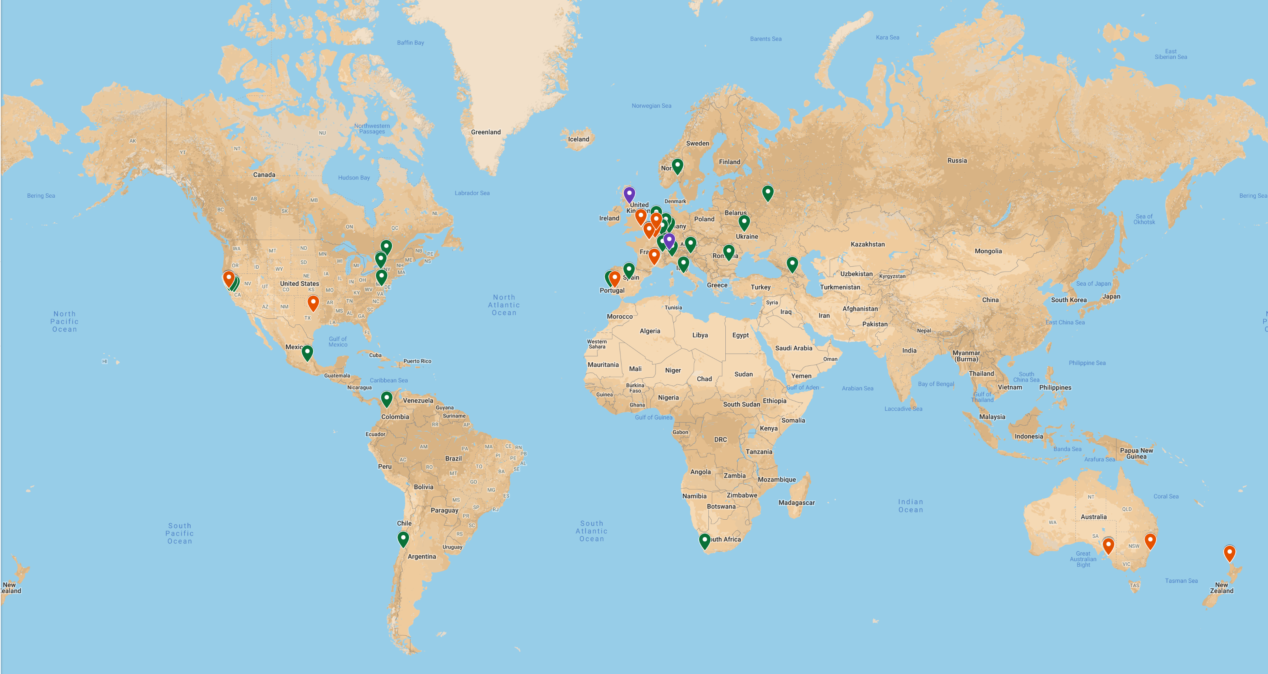
Membership Geography
55 Members, 24 regions/countries

Slide 5
Vision
A successful global alcohol beverage industry, operating on the principles of economic, social and environmental sustainability, focusing on consumer interests, and operating in a climate free from trade-distorting factors of all kinds.

Slide 6
Structure
Economic Sustainability
WG
Social Sustainability
WG
Environmental Sustainability
WG
Scientific & Technical Committee
“Triple Bottom Line” Alignment
What is FIVS for?
FIVS – For the overall Sustainability of the Global Industry

Slide 7
Observerships
Official observer to:
OIV (International Organisation of the Vine and Wine)
Codex Alimentarius Commission
WIPO (World Intellectual Property Organisation)

Slide 8
What Does FIVS Do?
(Overview – a closer look at current topics will follow this introduction.)

Slide 9
Economic Sustainability Working Group Highlights
Codex Committees (Labelling, Additives, Food Import and Export Inspection and Certification Systems)
Brexit
FIVS-Abridge

Slide 10
Social Sustainability Working Group Highlights
Refreshed our Code of Practice for Advertising and Marketing of Alcohol Beverages
FIVS-Assure launched on our new website to give guidance on programs to reduce harmful use of alcohol

Slide 11
Environmental Sustainability Working Group Highlights
Global Wine Producers’ Environmental Sustainability Principles
Social Sustainability Principles for Ethical Trading (jointly with Social Sustainability WG)
Water footprinting - a focus of activity

Slide 12
Scientific and Technical Committee
18 technical papers produced or refreshed
3 presented at OIV Congresses, published in proceedings:
Regulatory principles to enhance coherence and to facilitate trade in wine http://bit.ly/FIVSWineGRPs
Microbiologically, wine is a low food safety risk consumer product http://bit.ly/FIVSWineMicro
Methanol in Wine http://bit.ly/FIVSWineMeOH
As of 2017, many supplied to the International Wine Technical Summit to stimulate discussion
FIVS-APACE created and enhanced, made accessible to governments

Slide 13
Strategic Partnerships
Closer coordination and communication with “Wine in Moderation” to encourage responsible consumption of wine
University of Reims Wine and Law Program
Using FIVS-Abridge to stimulate better knowledge of wine regulations
Botanical Research Institute of Texas
Encouraging sustainable production of wine

Slide 14
Summary
FIVS works to enhance the overall sustainability of the alcohol beverage industry
It is able to speak with a consensus voice at meetings of intergovernmental bodies
It supplies detailed technical information on the characteristics of wine and encourage good regulatory practices
Public/Private initiatives (such as the APEC WRF the IWTS and the WWTG) have been particularly fruitful venues to explain wine and encourage good regulation around the world.

Slide 15
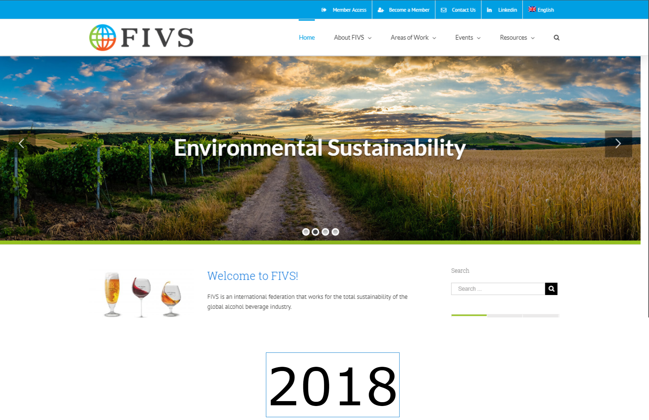
See fivs.org for More

Slide 16
Thank you!

