Slide 1

APEC Wine Regulatory Forum presentation on international issues
Report to the APEC Wine Regulatory Forum
Tony Battaglene (tony@wfa.org.au)
November 2015

Slide 2
There is a critical need for better regulatory coherence on wine trade in the APEC region.
Non-tariff barriers cost > $1 billion APEC Member Economies and businesses
Confusing network of international trade agreements, treaties, intergovernmental organisations and industry organisations.

Slide 3
Improved market access
Reducing barriers to trade allows businesses to save costs and concentrate on selling wine.
It also protects consumers.
Key barriers to access include:
  Certification requirements
  Labelling
  Oenological practices
  Maximum residue limits

Slide 4
Why do regulations differ?
All regulation must comply with international trading rules.
However, regulation may be set unilaterally to meet a countries public policy objectives; or as part of a broader regional/pluralateral arrangement; or according to international decisions.
Regulatory responses vary according to which mechanism is the prime driver.

Slide 5
International trade in wine is affected by a number of international institutions.
Any international institution of which APEC members economies are a member or of which our trading partners are a member mean that decision made in Rome, Geneva or Paris may dramatically impact on domestic regulatory policy.
In this presentation I will discuss several of the key institutions that will impact on APEC economies over the next 12 months.

Slide 6
WORLD TRADE ORGANISATION (WTO)
Establishes a number of agreements that govern world trading to prevent unilateral measures designed to impede trade by those countries seeking an unfair advantage
3 important agreements are:
Agreement on Technical Barriers to Trade (TBT)
Trade-Related Aspects of Intellectual Property Rights (TRIPS)
Sanitary and Phyto-Sanitary Agreement (SPS)

Slide 7
Signatories must ensure their regulation is compliant
TBT agreement ensures that regulations, standards, testing and certification procedures do not create unnecessary obstacles to trade.
SPS agreement provides rules on how governments can apply food safety and animal and plant health measures
TRIPS agreement has provisions relating to geographical indications including appellations of origin for wine and spirits

Slide 8
Notification provisions an important tool
Each time a government intends to introduce a regulation impacting on trade, it must notify WTO to allow other countries to respond to the regulations.
This provides an important tool to test compliance with WTO Agreements
However, many economies currently lack sufficient resources to respond to all notices effectively.

Slide 9
Recent issues notified to WTO
On 9 May 2014, Vietnam notified a revision of standards for specification, scope, application and limitation of food additives (SPS/VNM/54) with the revision entering into force in July 2014. Circular 8 of MOH was then passed and will come into force from 1 July 2015 replacing the original Circular 27.This revision effectively limits wine additives to those in the General Standard for Food Additives (GSFA) of the Codex Alimentarius Commission.
On April 15, 2015, the Alcohol Control Committee of Thailand announced the approval of the draft notification of Alcoholic Beverages Control, including the requirements for the labelling of alcohol beverages, which was effective from April 22, 2015.
On May, 20, 2015, the South African Department of Trade and Industry (DTI) published a government notice (No. 38808) inviting the public to comment on the National Liquor Policy.
On 28 July 2015 the Republic of Korea notified the World Trade Organisation (WTO) of proposed Amendments to the Standards and Specifications of Foods (G/SPS/N/KOR/511,).
On 1 June 2015, the Republic of Korea notified to the SPS Committee, The Enforcement Regulation of the Special Act on Imported Food Safety Control http://www.mfds.go.kr/index.do?mid=688&seq=27627 .

Slide 10
The system works!!!

Slide 11
INTERNATIONAL ORGANISATION OF WINE AND THE VINE (OIV)
Established in 2001 replacing the international Office of Wine and the Vine.
An intergovernmental organisation of a scientific and technical nature and performs work concerning vines, wine, wine-based beverages, table grapes, raisins and other vine based products.
45 member countries – account for 85% of world wine production, also includes consumer countries.
OIV is a good reference point for members when drafting regulations regarding oenological practices. Members are not obliged to adopt standards, but some, such as EU voluntarily do.

Slide 12
Qualifications
International Code of Oenological Practices is not an exhaustive list as some internationally accepted techniques are not permitted due to conflicts between OIV members laws.
Many OIV recommendations/resolutions are out-of-date and no longer relevant.
OIV is commencing a process of review.
OIV provides a good focus for exchange on wine issues, but is dominated by the European union member states.

Slide 13
Current OIV activities
OIV is reviewing its labelling standard.
OIV is reviewing all existing limits set in its resolutions.
OIV is developing resolutions to facilitate the trade, labelling and production of reduced alcohol wines and wine products.

Slide 14
WORLD WINE TRADE GROUP (WWTG)
Formed in 1998 as an informal plurilateral group with the objective of facilitating trade in wine by eliminating obstacles to trade
Includes Australia, New Zealand, Canada, South Africa, Chile, Argentina, Georgia and the United States
Has become a successful forum for industry and regulators to jointly discuss issues concerning global wine trade (e.g. sustainability and health labelling).

Slide 15
WWTG activities
WWTG has successfully negotiated formal treaties to harmonise wine labelling practices and oenological practices.
Developed and applied principles for good regulatory practices for wine.
Developed Agreements on regulatory cooperation and information exchange.
Is the premier world organisation with the objective of facilitating wine trade.

Slide 16
Current WWTG initiatives
Consideration of bilateral arrangements between WWTG as a group and non-WWTG members as a means of encouraging deeper engagement on regulatory issues.
Review and extend the principles of good regulatory practice.
Continue collaboration with APEC Wine Regulatory Forum.
Preparation of technical papers to inform debate on wine policy issues.

Slide 17
CODEX ALIMENTARIUS COMMISSION
Founded in 1962 to protect health, improve consumer protection and facilitate fair trade
Establishes int’l food standards, guidelines and recommendations
Codex is required to base its standards on sound scientific analysis and evidence
Codex’s health, food safety and commodity standards serve as references under WTO SPS and TBT Agreements and ensures Codex’s credibility and suitability for Australian conditions

Slide 18
CODEX ALIMENTARIUS COMMISSION
Codex standards are developed through a number of committees: Food Additives, Food Labelling, Methods of Analysis and Sampling, General Principles, Pesticide Residues, Food Import and Export Certification and Inspection Systems
Critical for the APECWRF to monitor and respond to developments(especially Food Additives and Food Labelling) to ensure public health, the rights of customers and barrier-free trade are not interfered with.

Slide 19
CCFA
Codex Committee on Food Additives is actively pursuing incorporation of wine additives in the General Standard for Food Additives (GSFA).
It is appropriate to update food category 14.2.3 Grape wines with additives actually used in the manufacture of wines, where the additives fulfil the criteria for justification for the use of additives
An eWg chaired by Australia and France is currently developing a paper on the use of good manufacturing practice (GMP) for wine additives.
Important for APECWRF to be aware of this issue which will be discussed in March 2016.

Slide 20
INTERNATIONAL ORGANISATION OF LEGAL METROLOGY
OIML – an intergovernmental treaty organisation est. in 1995 to promote global harmonisation of legal metrology procedures and comprising of Member States and Corresponding Members.
While OIML recommendations are not binding, decisions made in OIML will impact on APEC trade.
International consensus is achieved through technical committees and subcommittees.
TC6 – Pre Packaged Products is of most relevance to APEC wine sector and is poorly represented by APEC Member economies.

Slide 21
Current activities
OIML is reviewing:
  OIML R 79 Labelling Requirements for Prepackages (PDF 133KB)
  OIML R 87 Quantity of Product in Prepackages (PDF 345KB)

Slide 22
Other international developments
A number of economies (APEC and non-APEC) are reviewing their wine standards.
APEC WRF is a perfect sounding board of regulators with expertise in wine regulation to provide input and information to these economies.

Slide 23
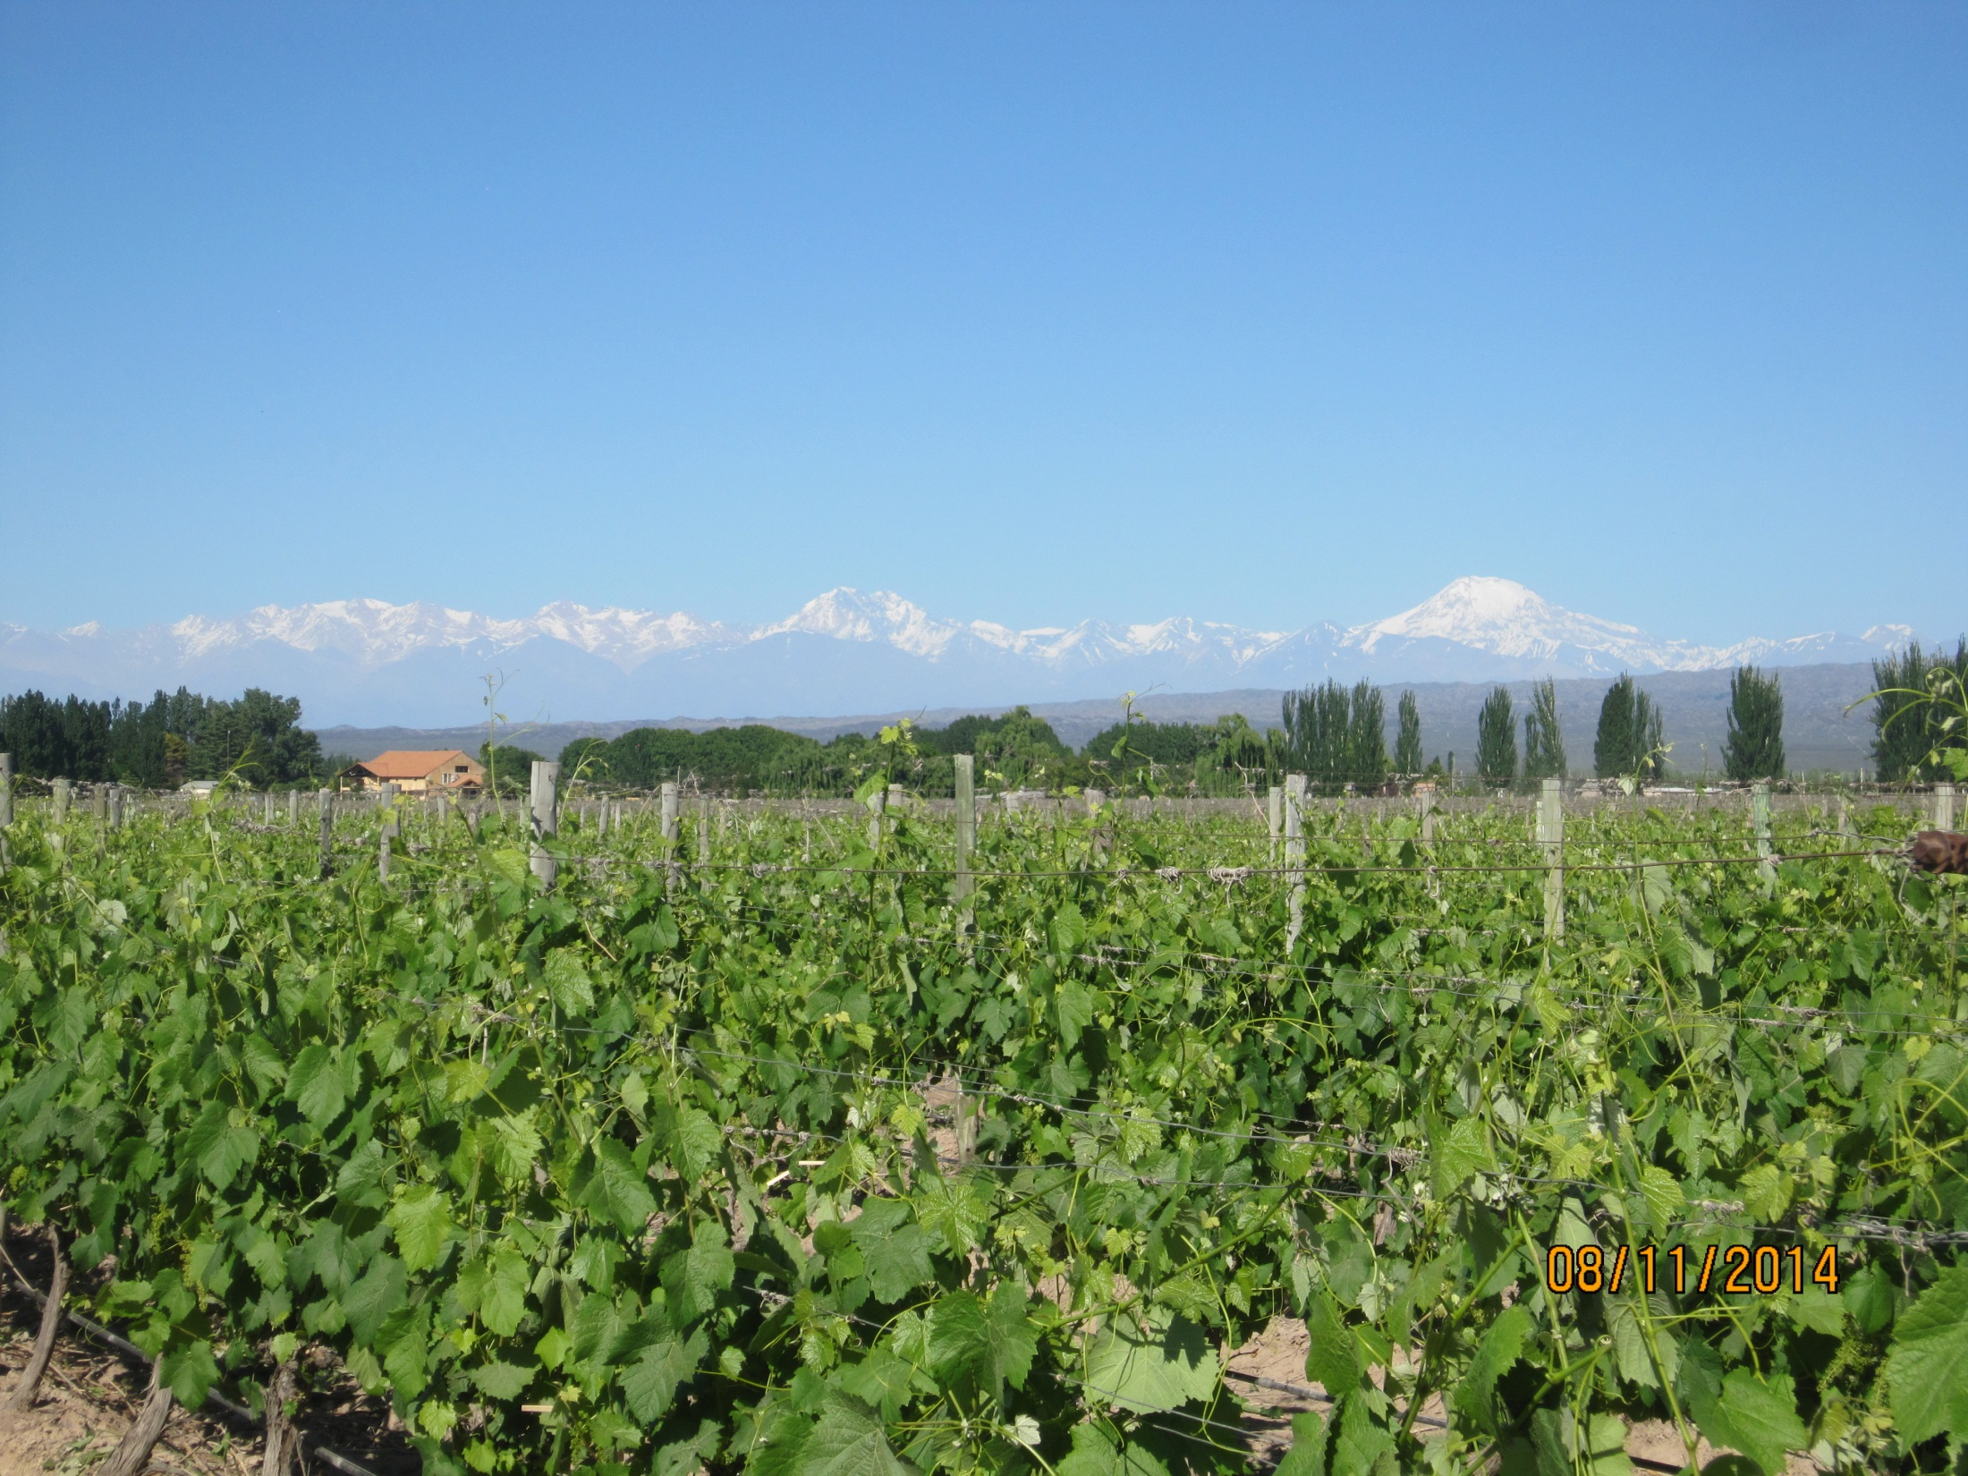
Conclusion
Many economies do not have the resources to maintain a close watch on relevant international organisations for wine trade.
APEC WRF contains expertise which can be utilised.
Current WRF activities will substantially improve efficiency in wine trade, reduce the cost to regulators and protect consumers once implemented.

