Slide 1
Panel Discussion on Compendia for Market Entry and Product Requirements David McCaleb U.S. Alcohol and Tobacco Tax and Trade Bureau

Slide 2
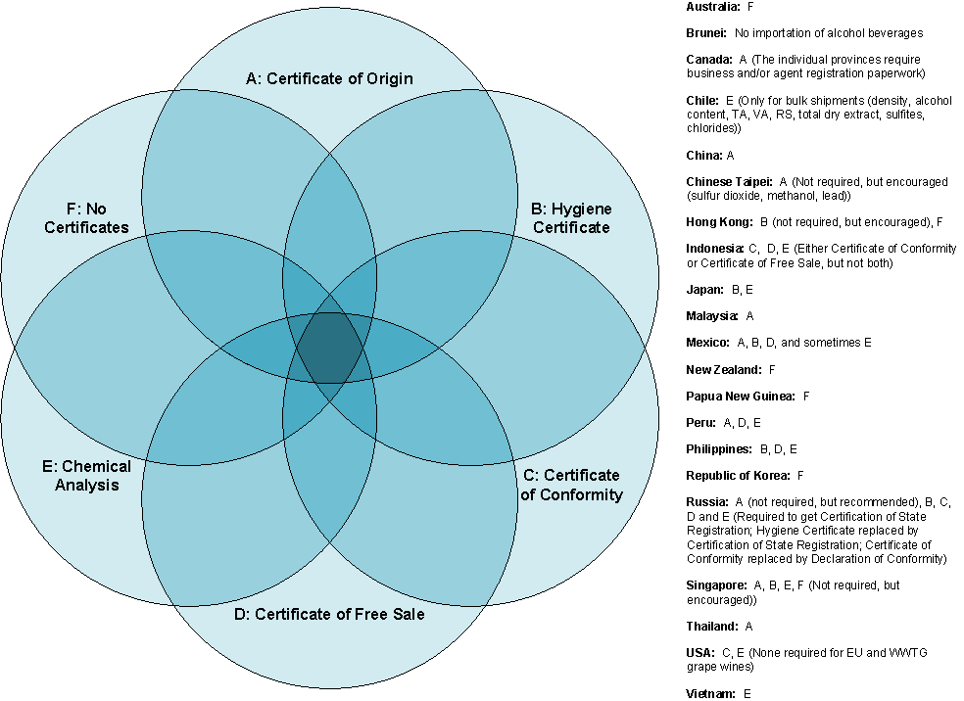
History of the Compendia
September 2011: Compendia of Certification Requirements

Slide 3
History of the Compendia
December 2011: Regulator Conference Call Agrees on Development of Labeling, Pesticide MRL, and Compositional Compendia
April 2012: Regulator Conference Call Agrees on Elements of Each Compendia
Labeling: Mandatory Labeling Information, Ingredient/Additive Labeling, Alcohol Content Tolerance, Allergen Labeling, Health Warning Statement, Requirements for Use of Vintage Year, Requirements for Use of Varietal, Requirements for Use of Appellation of Origin
Pesticide MRL: 300+ pesticides
Compositional: Alcohol Content, Tartaric Acid, Cyanides, Sulfites, Sorbates, Benzoates, Methanol, Copper, Iron, Lead, Ochratoxin A, Ethyl Carbamate, Histamine, Arsenic, Antimony, Boron, Cobalt, Cadmium, Fluorine, Mercury, Selenium, Silver, Tin, Zinc, Citric Acid, Ascorbic Acid, Erythorbic Acid, Sodium, Volatile Acidity, Malvidin Diglucoside

Slide 4
Current Status of the Compendia
April 2012-present: Data Collection
14 economies have submitted data for one or more of the compendia.
July 2013: FIVS Provides Missing Data for Several Economies.

Slide 5
Discussion Questions
Are the compendia useful? How will they be used, both within your economy and across APEC?
Are the current elements useful? Is there anything that should be added or removed?
Where should the compendia be located and how should they be distributed moving forward?
How should the compendia be updated moving forward?
What are our next steps for getting the most out of the compendia-building project?

