Slide 1
PROGRESS WITH THE FOOD SAFETY CO-OPERATION FORUM (fscf) MRL INITIATIVE
Steve J. Crossley
B.Sc., M.Sc., CChem FRSC., FIFST.
Manager - Scientific Strategy, International and Food Surveillance
Food Standards Australia New Zealand, Canberra, Australia

Slide 2

OVERVIEW
What is the Food Safety Cooperation Forum (FSCF)?
Background to MRL harmonisation work
Outcomes of the two MRL Workshops
Guideline for import MRL harmonisation
Next steps

Slide 3
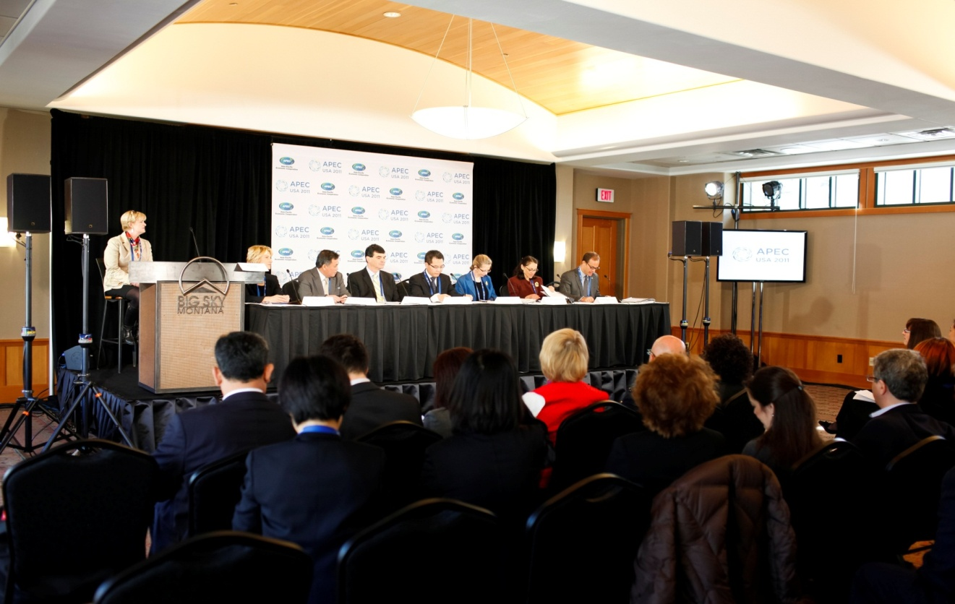
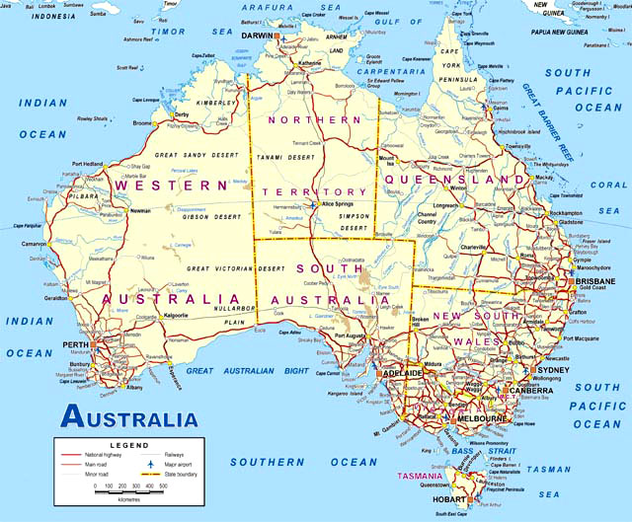
What is the FSCf?
Forum of Food Safety Regulators formed under the APEC Sub-Committee for Standards and Conformance (SCSC) in the Hunter Valley, Australia, April 2007 .
The APEC FSCF seeks to build food safety systems in the region that are consistent SPS & TBT agreements.

Slide 4
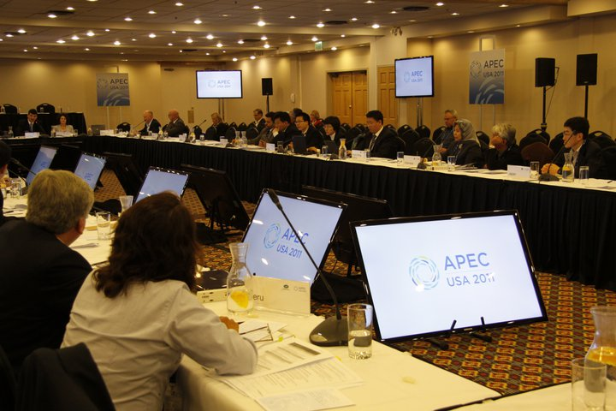
What is the FSCf? (continued)
APEC member economies agreed to work together to build robust food safety systems; to accelerate harmonisation with international standards to improve public health and facilitate trade, strengthen capacity building activities & information sharing.
The APEC FSCF is co-chaired by Australia (FSANZ) and China (AQSIQ).
Since the APEC FSCF was formed, food safety has been recognised as a high priority for APEC.

Slide 5

BACKGROUND TO THE MRL HARMONISATION WORK
  APEC Pesticide MRL Roadmap
  Development of a MRLs Roadmap document in June 2014, proposed initial 2 year timeframe
  Aligns with APEC Regulatory Cooperation Implementation Action Plan

Slide 6
  APEC Pesticide MRL Roadmap (continued)
  Aims for greater regulatory convergence of MRLs across APEC region, consistent with alignment to international standards
Developed a set of 4 broad principles for agreement and adoption to progress harmonisation of pesticide MRLs
Principles agreed at Beijing FSCF 2014

Slide 7
Broad principles
2
Adoption of Codex MRLs in domestic legislation and trade
3
Work sharing, or exchanging data to support the establishment of pesticide MRLs by member economies, in cases where there is no domestic equivalent for a member economy
1
Participation in the development of MRLs in Codex Alimentarius (Codex) via the Codex Committee on Pesticide Residues (CCPR)
4
Develop unilateral “recognition”, or “import tolerances” where practical and appropriate, in domestic regulation of specific pesticide/commodity MRLs of trading partners on a case-by-case basis.
Notes:
In relation to broad principles # 1 and #2 above, the Codex Committee on Pesticide Residues (CCPR) is responsible for establishing Codex MRLs for pesticide residues in specific food items or in groups of food and in animal feed, providing a list of international standards for pesticide residues in foods. However, there are times when national MRLs for certain pesticide/commodity combinations are in place prior to the adoption of corresponding MRLs by Codex. In these circumstances, the relevant government or chemical manufacturer may submit supporting data to Codex for development of an international standard. In other situations, national competent authorities may establish MRLs independently for the same pesticide/commodity combination, using different data sets due to different good agricultural practice (GAP) and/or methodologies or appropriate levels of protection. This may result in divergent national regulatory standards and create barriers to trade.
It is noted that many countries apply Codex MRLs for imported food, particularly when no national MRLs have been established. In some countries, automatic recognition of Codex MRLs is an agreed policy, while in other countries, specific Codex MRLs are either adopted as national MRLs provided there are no national dietary intake concerns (e.g. European Commission) or can be used as the basis for setting import tolerances”.
For those countries that are not able to apply Codex MRLs (either by automatic recognition or specific adoption), such as Australia, USA, Canada, Taiwan, mechanisms (and data requirements) exist to allow the establishment of specific “import tolerances” to facilitate trade.
The key issue to consider in the promotion of harmonization of pesticide MRLs between exporting and importing countries in the APEC region, is whether APEC economies can be encouraged to “recognize” the MRL set by Codex (provided a suitable MRL exists in Codex). Alternatively, APEC economies could “recognize” the exporting economy’s MRL “import tolerance”, where there is no domestic equivalent MRL in the importing APEC economy, and where this lack of an MRL applying to the imported food results in a barrier to trade. For this to occur, it would be necessary to demonstrate via risk assessment that the dietary exposure assessment (both acute and chronic) indicates no safety issue for the importing economy. An economy’s decision to “recognize” or develop an “import tolerance” for another economies’ MRL should also be based on the condition that the use in the exporting economy is consistent with that economy’s GAP; and is safe under the dietary exposure conditions of the importing country.
In relation to the broad principle # 3 above, it is noted that regulatory cooperation through recognition or convergence of pesticide MRLs can also be advanced through data sharing and information exchange programs, which may assist in facilitating trade in safe food between APEC member economies, and where appropriate, reduce the burden of member economies in carrying out independent field trials and data generation in support of the establishment of new pesticide MRLs.
With regards to broad principle #4, more work has been completed to try to reduce confusion in relation to the meaning of the use of the terms “recognition” and “import tolerance” (see below).

Slide 8

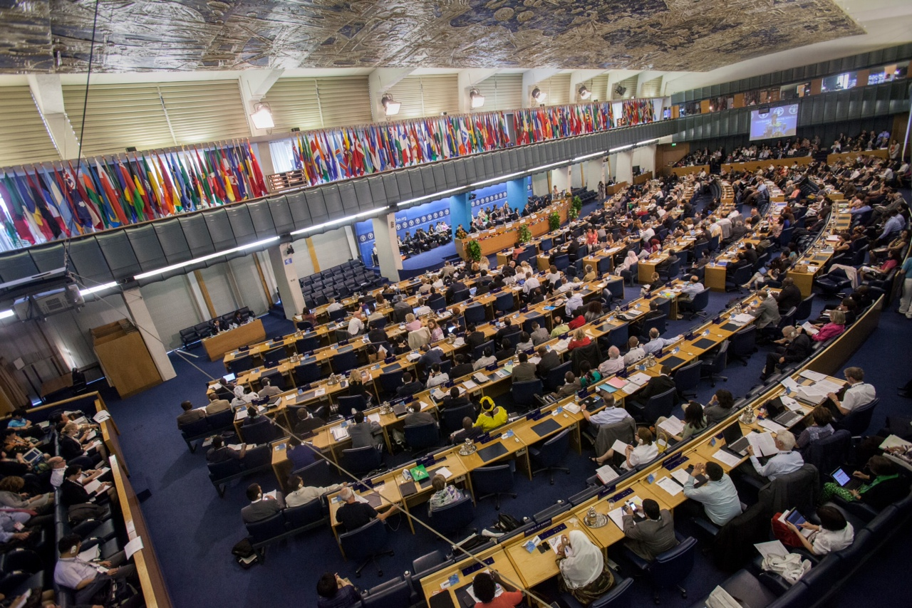

Slide 9


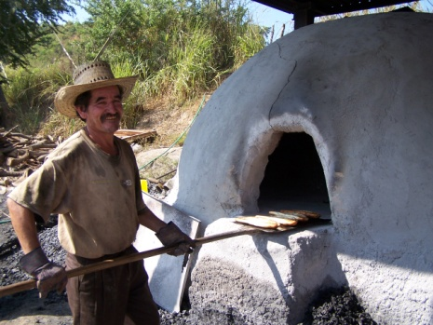


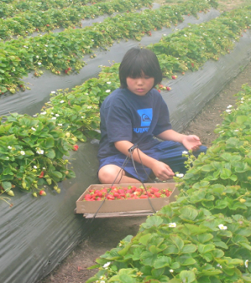

THE SCIENTIFIC BASIS OF CODEX
International Risk Assessment Bodies
Request
Scientific Advice
JMPR
Joint Meeting on Pesticide Residues
JECFA
Joint Expert Committee on Food Additives
JEMNU
Joint Expert Meeting
on Nutrition
JEMRA
Joint Expert Meeting on Microbiological
Risk Assessment
Ad Hoc
Expert Meetings
Scientific Advice
CODEX Committees
Output
CODEX ALIMENTARIUS COMMISSION
International Food Standards
Consumer Protection
& Food Trade
http://www.fao.org/food/food-safety-quality/scientific-advice/en/
http://www.who.int/foodsafety/en/

Slide 10

Harmonising import MRLs
  Two years project funded by Australia (2015-16)
  Pilot project on harmonisation of wine/wine grape MRLs
  Second pilot project on tropical fruit (mango) MRLs
  Facilitating work through development of Guideline on harmonisation of MRLs for imported foods in APEC member economies
  The outcomes of this project are being fed into the broader APEC FSCF Regulatory Cooperation work.

Slide 11
linkages
Complements work being undertaken by APEC Wine Regulatory Forum
Links to work of the World Wine Trade Group
Builds on the consistent international standard development framework for pesticides promoted by Codex Alimentarius Commission
• Complements objectives of APEC FSCF Partnership Training Institute Network (PTIN)
Notes:
This project continues the work of the APEC FSCF in advancing the APEC Regulatory Cooperation Plan in the area of food safety by furthering its goal of promoting alignment of APEC members’ food regulatory standards to relevant international standards wherever possible and consistent with WTO obligations.
The project complements the work being undertaken by the APEC Wine Regulatory Forum on Export Certificates and the Pilot project on pesticide MRLs in wine and wine grapes and mangoes.
It also has linkages to the work of the FSCF’s MRLs working group and the World Wine Trade Group in streamlining the interpretation of ‘recognition’ and ‘import tolerance’ among APEC member economies.
This project will build on the consistent international standard development framework for pesticides promoted by Codex Alimentarius Commission.
This project also compliments the work of the FSCF’s Partnership Training Institute Network (PTIN).

Slide 12
Outcomes of 1st expert workshop, SYDNEY - april 2015
Within APEC economies:
  Identified trade barriers and impacts when different MRLs for pesticide/food commodities
  Identified key factors and/or impediments around harmonising MRLs within economies
  Agreed on principles, definitions, processes and minimum data for guideline on harmonisation of MRLs
  Agreed on benefits, components and structure of a guideline
  Prepared and consulted on draft guideline document

Slide 13
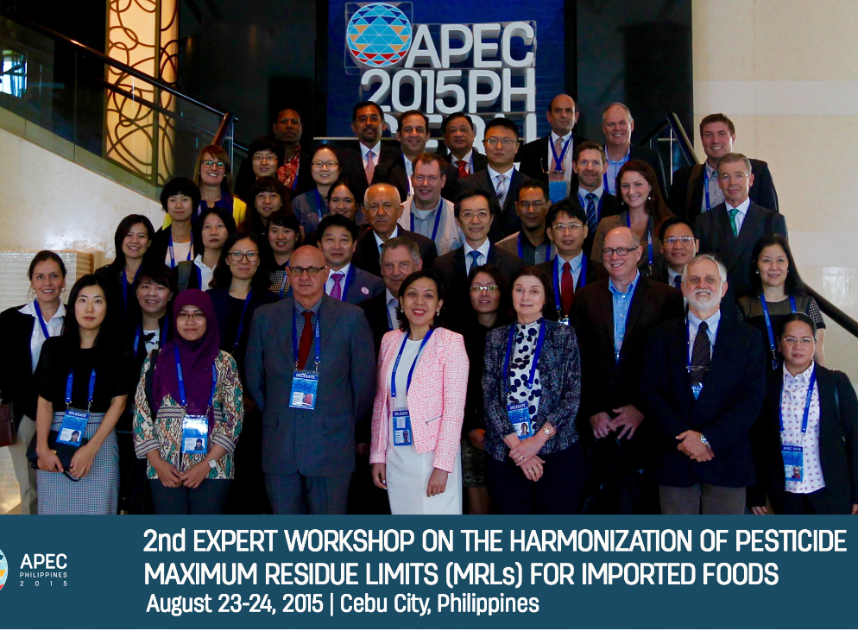

Slide 14
Outcomes of 2nd expert workshop, CEBU - august 2015
Agreed on report from 1st expert workshop
Reviewed and agreed on a draft guideline for harmonisation of import MRLs within APEC economies
  Utilised data and work undertaken for wine/wine grapes
  Compiled data for mangoes as part of process
  Case studies around key commodities and options for how MRLs could be harmonised
Recommended next steps to finalise and facilitate implementation of guideline across APEC economies

Slide 15
Summary of Member Economy Policies & Processes for Import MRLs (examples)
 | Automatically recognise Codex as import tolerances | Default Level Numerical, LoQ, LoD | Adopt/recognise Codex or import tolerances by bilateral negotiation | Data requirements for adoption | Support CCPR | Support APEC Guidance | Request to pass through Competent Authority? Yes/No
Australia | No | LoQ | Yes | Yes – Import data, MRLs, STMRs, DEA, GAP | Yes | Yes | No
Canada | No | 0.1mg/kg | Yes | Yes – GAP, DEA, MRLs, STMRs | Yes | Yes | No
Chile | No | No | (for confirmation) | Yes – GAP, DEA | Yes | Yes | Yes
PRC | No | No | Yes | Yes – GAP, residue chemistry, MRL, STMR, DEA | Yes | Yes | Yes
Indonesia | No | LOQ | Yes | Yes-GAP, MRLs, DEA, STMRs, DEA | Yes | Yes | Yes

Slide 16
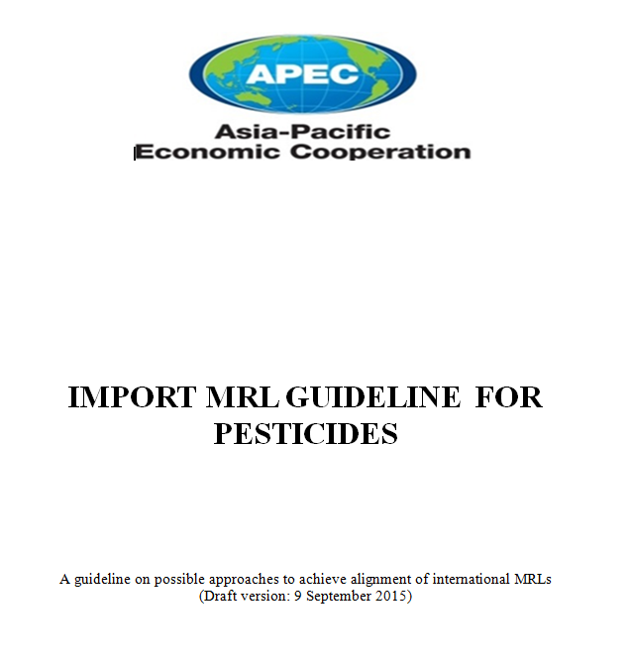
GUIDELINES FOR IMPORT MRL HARMONISATION
“Framework within which science-based standards can be developed and applied uniformly and transparently across APEC economies”

Slide 17
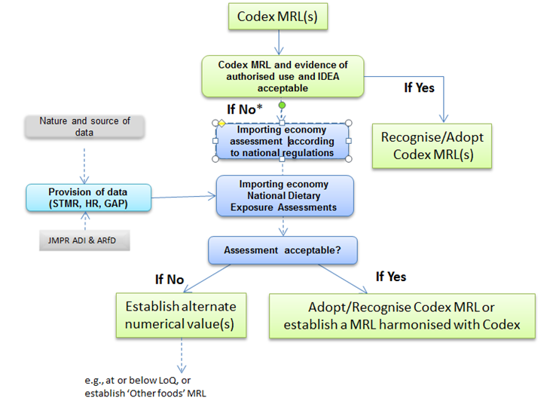
Outline of indicative import MRL assessment process

Slide 18
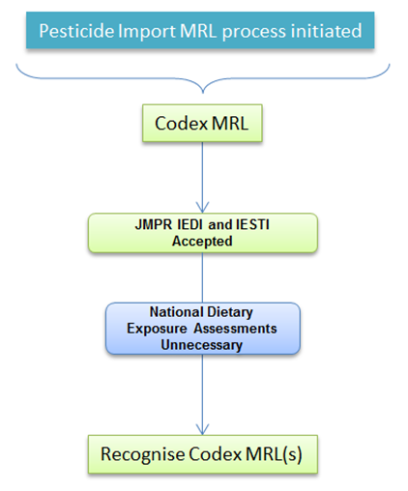
SCENARIO 1 – existing codex mrl without dietary exposure assessement (dea)

Slide 19
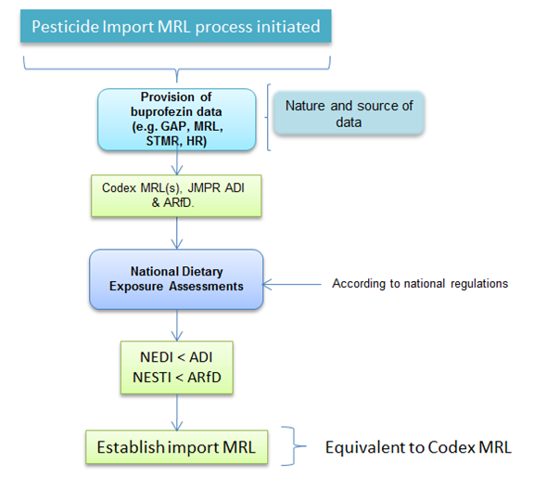
SCENARIO 2 - existing codex mrl with dea

Slide 20
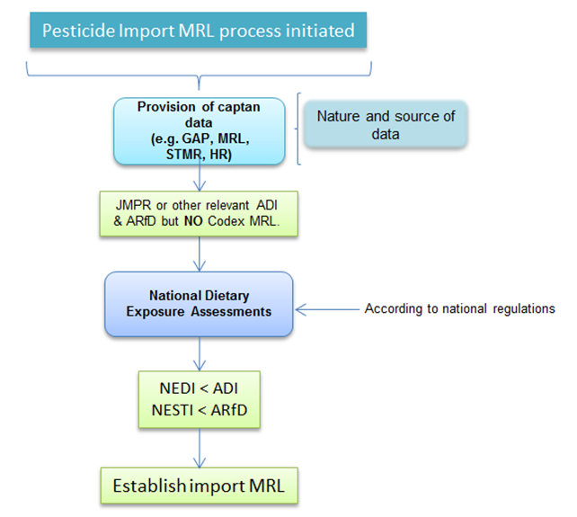
SCENARIO 3 – no codex mrl

Slide 21
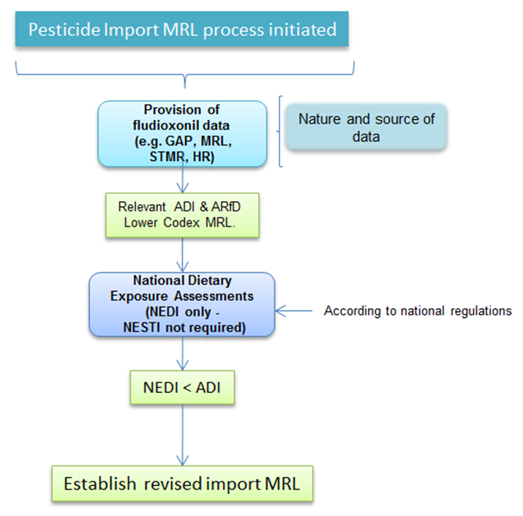
Scenario 4 – import mrl sought is higher than the codex mrl

Slide 22
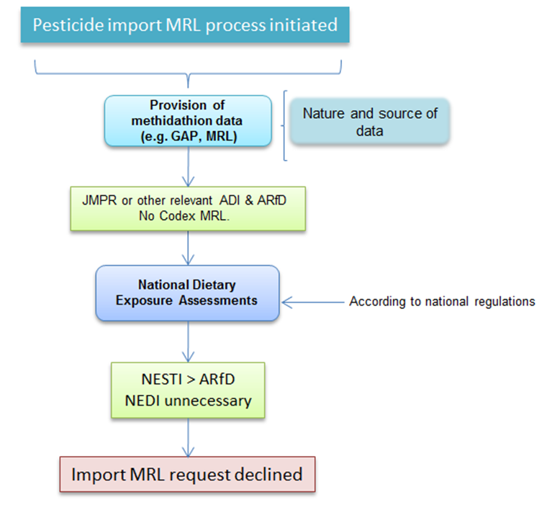
Scenario 5 – with jmpr assessment but no codex mrl

Slide 23
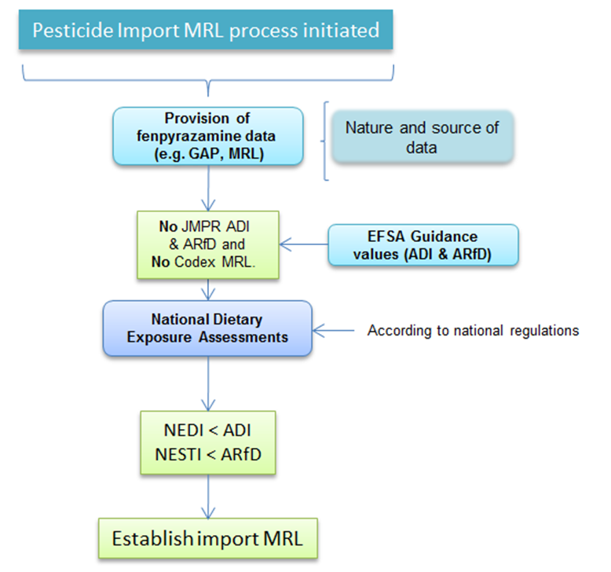
Scenario 6 – no jmpr assessment and no codex mrl

Slide 24
Common features of all scenarios
Notification of intention to submit a request to relevant importing economy agency
Proposal submission
Science-based assessment
Decision on import MRL
Notification of applicant economy & WTO

Slide 25
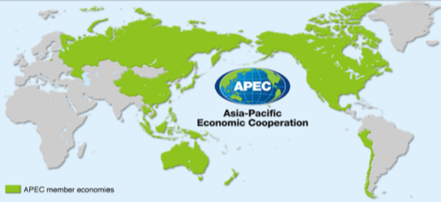
Next steps
Finalisation of the Guidelines – out for comment
Completion of the evaluation process
Agreement from all APEC economies out of the session, via the FSCF Steering Committee
Continuing Collaboration with the APEC Wine Regulatory Forum
New funding investigations

Slide 26

IMPLEMENTATION (UNDER CONSIDERATION)
Technical capacity building eg. DEA workshop
Translation of the Guidelines?
Further work on pilot commodities (ie. wine & wine grapes, mango)
Identify other import MRL priorities
Road test with economies
  Impediments
  Legislative issues
  Information requirements

Slide 27



Any Questions or comments?
Thanks to many including:
Lisa Tengdahl, Paul Brent, Kevin Broderick, Scott Crerar, Marion Healy.

