Slide 1
Consolidated Wine Export Certificate for U.S. Wine Exported to China
Fan Ni
Alcohol and Tobacco Tax and Trade Bureau
U.S. Department of the Treasury

Slide 2
In FY 2012, TTB issued 4,470 export certificates for shipments to APEC economies.
In FY 2012, of the 4,470 export certificates for APEC economies, 3,614 (80.9%) were processed for China.
Certificates for each shipment may include Certificate of Free Sale, Certificate of Authenticity, Certificate of Health, Certificate of Sanitation and Certificate of Origin.

Slide 3
Certificates for APEC Economies

Slide 4
Cooperation Between TTB and AQSIQ
TTB signed a memorandum of understanding (MOU) with China’s General Administration of Quality Supervision, Inspection and Quarantine (AQSIQ) in December 2007.
TTB and AQSIQ started to negotiate the consolidated wine export certificate in the first quarter of 2012.
In June 2013, AQSIQ and TTB agreed on the content of the consolidated wine export certificate for US wine exported to China after 18 months negotiation.

Slide 5
An Initial Version of the Certificate

Slide 6
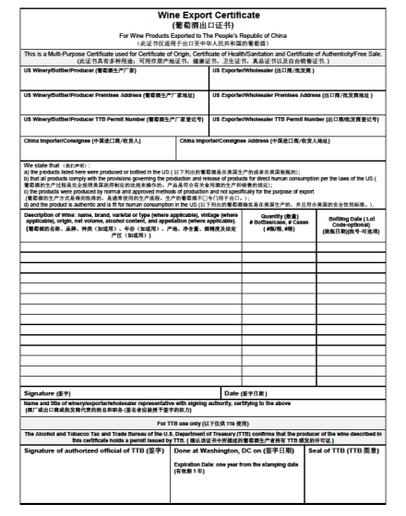
The Final Version of the Certificate

Slide 7
Description of Wine
Grade of Wine
Age of Wine
Appellation
Geographic Indication
Name
Brand
Varietal or type
Vintage
Origin
Net volume
Alcohol content
Notes:
At one point, following (11 items) were listed under the section of description of wine

Slide 8
Description of Wine
“May include” was used.
Name
Brand
Varietal or type
Vintage
Origin
Net volume
Alcohol content
Appellation
Notes:
Then, “May include” was used to add some flexibility to describe the wine exported. Since we noticed that some wine may not have information on varietal and vintage, such as vintage blends and varietal blends.

Slide 9
Description of Wine
Name
Brand
Varietal or type (where applicable)
Vintage (where applicable)
Origin
Net volume
Alcohol content
Appellation (where applicable)
Notes:
Finally it was Accepted by both parties.

Slide 10
Other Items Have Been Discussed
Bottling Date
Quantity of the wine exported
Transportation information
Additive information
“For AQSIQ” stamp
Transition period
Notes:
Finally it was Accepted by both parties.

Slide 11
What We Have Learned
Be patient and keep engaged.
Recognize there are two different regulatory systems.
Take feasibility assessment on any new proposals which were provided from your negotiating counterpart.
Take pragmatic approach.
Giving a meaningful counter proposal.
Team work.

Slide 12
e-information Exchange Platform
An email address, ITDChinaCertificates@TTB.gov has been established to receive any inquiries regarding the export certificate.

Slide 13
Questions?

