Slide 1
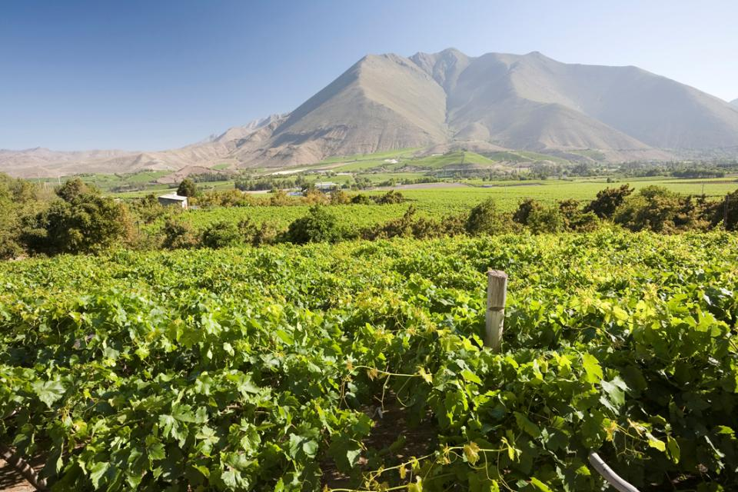
CLIMATE CHANGE: A BIG CHALLENGE
1

Slide 2
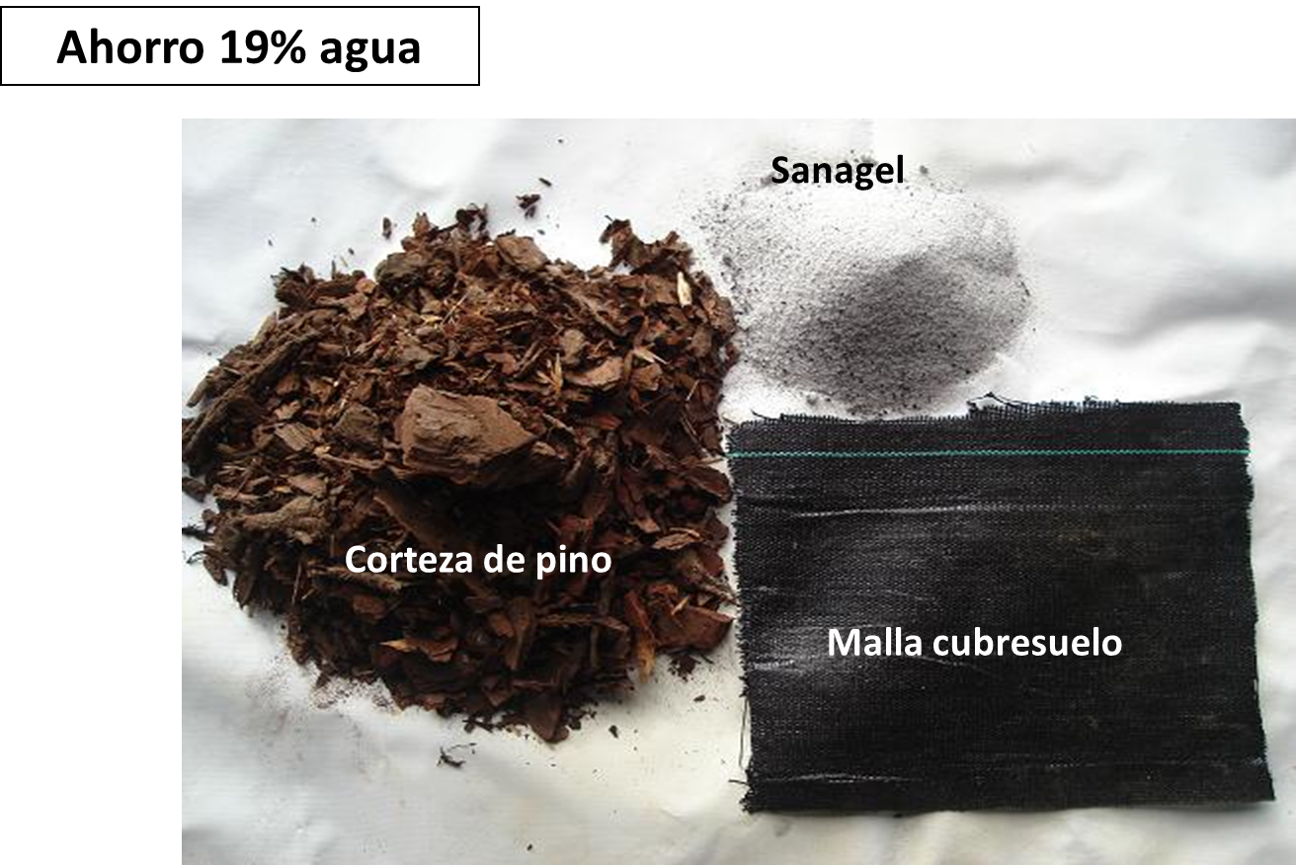
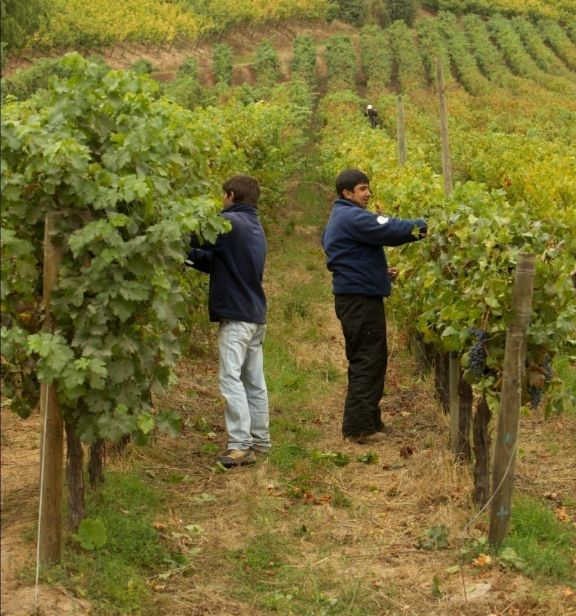
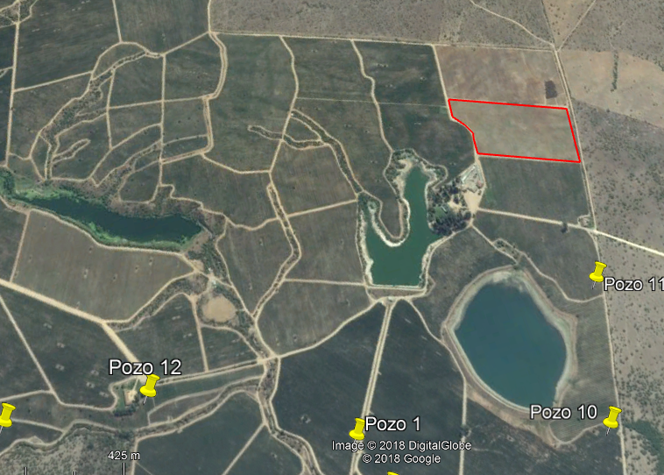
Adaptation to Climate Change Viña Montes
Mulch for reducing evaportranspiration
Drought tolerant roostocks
Saving Water 13%

Slide 3
Cultural practices
Changes
Water resources and irrigation
Quality
Energy
Public Policies
Pest and diseases
Risk Evaluations
Norms and Regulations

Slide 4
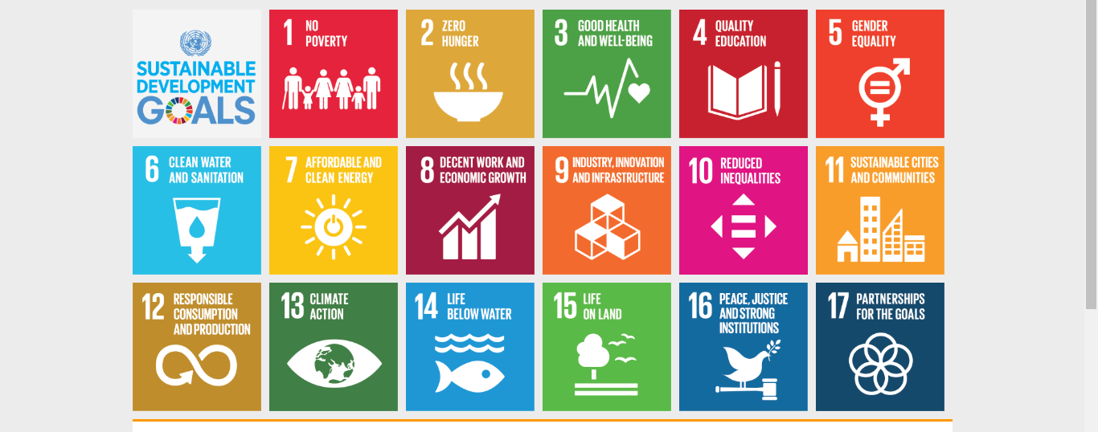
Environmental Sustainability Programmes
17. Strengthen the means of implementation and revitalize the global partnership for sustainable development

