Slide 1
From Social Aspects To Social Sustainability
❍ 3 Bottom Line Plan
❍ High Level of Danger
❍ FIVS/WIM MoU
❍ EU Trade Associations Initiative =
Wine In Moderation

Slide 2


FOR A
SUSTAINABLE
WINE CULTURE
THAT INSPIRES HEALTHY LIFESTYLES & WELL-BEING

Slide 3


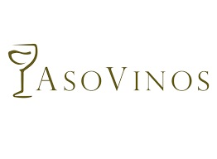


16 countries in Europe & South America with structured programmes
Activities delivered in more than 30 countries around the world
Notes:
So how do we actually do this ?
Well, Wine in Moderation is organised around three main missions.
As you can see here:
We aim to organise action – this means we gather the sector around one common programme
We empower professionals – so we give them the know-how and the tools to further inform the consumer
And last but not least, we encourage moderation and responsibility towards….the consumers
If you think about what we said before and how the programme is adaptable to the needs and expectations of the different countries, this means that it is actually our members and supporters that implement the programme in their respective markets. They will decide where they will put their focus and how they will actually manage to encourage the moderate and responsible consumption of wine among their consumers and visitors.

Slide 4
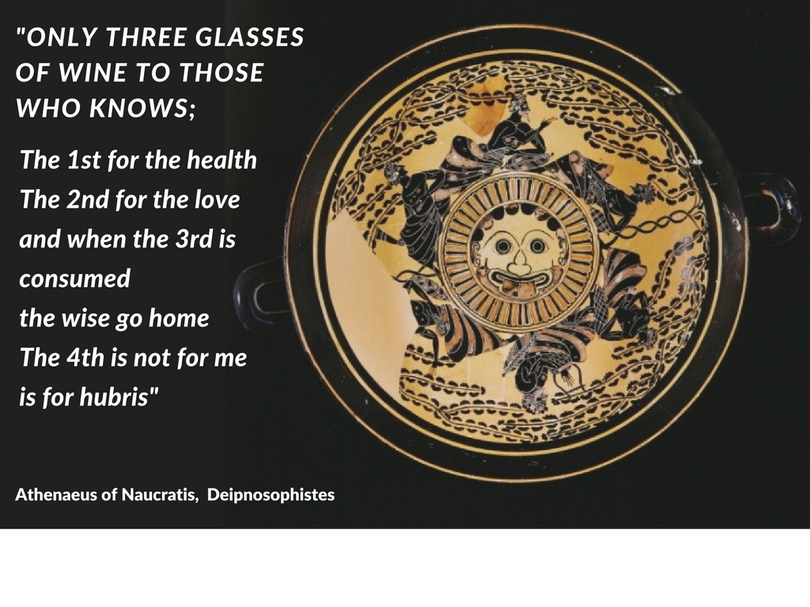



Slide 5

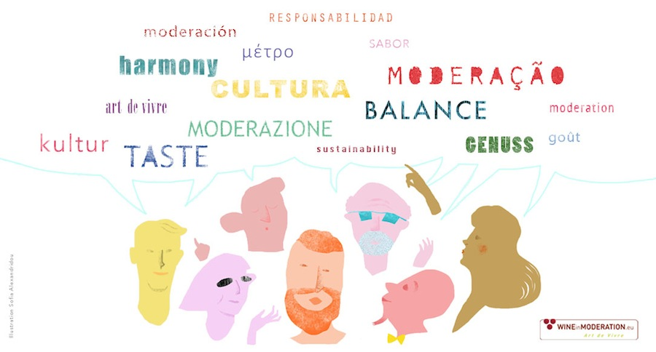
Wine in Moderation = Art de Vivre
A message that speaks to everyone
Notes:
But in the end, the message is one:
…

Slide 6


Slide 7

Enjoy wine to its fullest
Understand the wine you drink: knowing where its unique character comes from, makes drinking all the more pleasurable.
Drink slowly: take the time to savour the wine’s distinctive taste.
Accompany wine with good food: alongside a glass of water.
Appreciate wine with good
company, friends and family.
Be sensible, avoid excess

Slide 8
IN CERTAIN SITUATIONS AND AMONG PARTICULAR POPULATION GROUPS, ALCOHOLIC BEVERAGES SHOULD BE AVOIDED
Wine consumption requires maturity: underage individuals should not drink.
Pregnant women should avoid consumption of alcoholic beverages.
Avoid drinking if you drive
Always consult your doctor
for your drinking pattern & health

Slide 10

Wine in Moderation
in action

Slide 11

A Corporate Social Responsibility (CSR) action can be considered as WiM Action if :
It is developed by an actor that has joined the programme and has been authorised the use of the WIM TM
It carries the WiM logo/message and/or has a reference to the Wine in Moderation
It follows the principles, values of the Wine in Moderation programme and it is in line with the Wine in Moderation National Action Plan
It adheres to the Wine Communication Standards principles

Slide 12
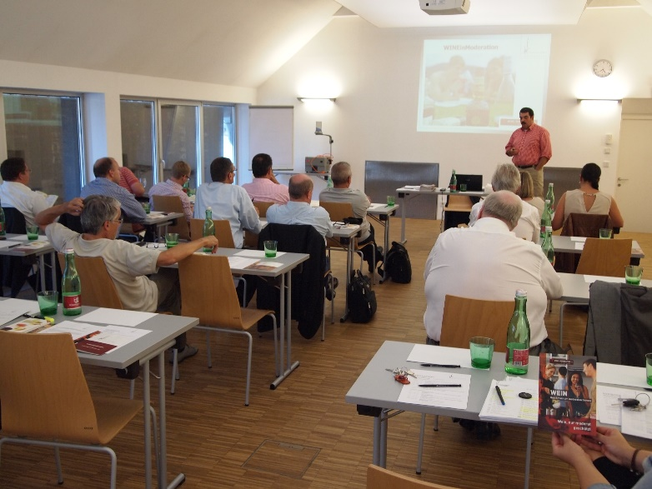
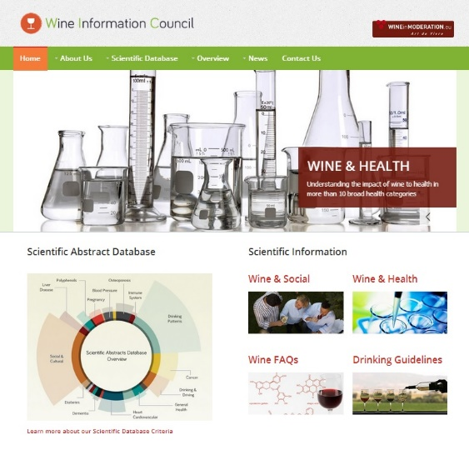
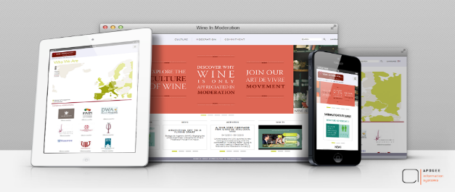
Empowering professionals. How ?
Train all your employees about wine in moderation and responsible business practices
Keep your employees updated with the Wine in Moderation programme and the latest scientific evidence by disseminating the Wine in Moderation and the Wine Information Council Website & newsletter.

Slide 14

RESPONSIBLE COMMERCIAL COMMUNICATION. HOW?
Include the Wine in Moderation logo or a message of responsible consumption on your communication and promotion materials.
Align all communication with the Wine Communication Standards (WCS) principles.
Use the Wine in Moderation logo on the back labels of your products

Slide 16
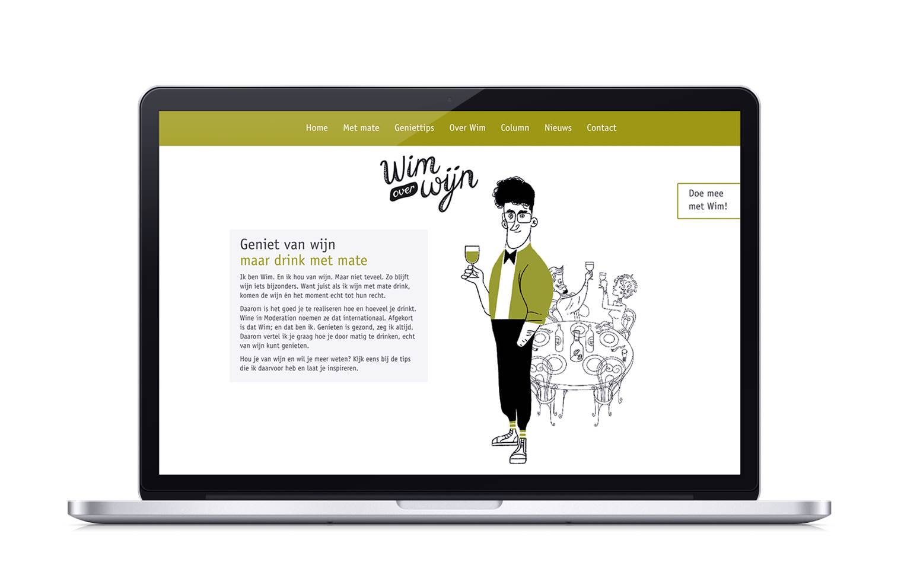
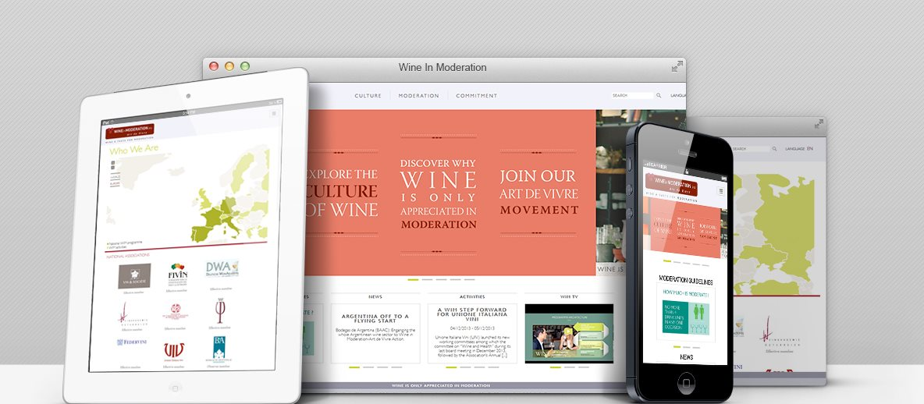
ENCOURAGING MODERATION & RESPONSIBILITY
Art de Vivre Campaigns
Inspired by the culinary and cultural heritage of wine, promote moderation and responsibility in wine drinking as a cultural and social norm.
Consumer Information
Make available evidence-based information, to help consumers make responsible choices compatible with a healthy lifestyle.

Slide 18











WiM Collective Actions

Slide 19

Notes:
And “Wine in Moderation is part of the solution to encourage a sustainable wine tourism experience”

