Slide 1
AGWA’s Approach to Risk Assessment
Rachel Triggs – Australian Grape & Wine Authority
APEC WRF November 2015 | Adelaide Australia
APEC Wine Regulatory Forum
Adelaide | Australia

Slide 2
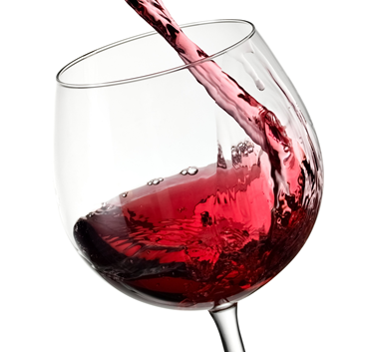
Wine is a Food
Australia New Zealand Food Standards Code
www.foodstandards.gov.au

Slide 3
Wine is a Low Risk Food
Because
Microbiological: The wine environment does not support the growth of pathogenic bacteria
Physical: Foreign items, ie, glass, minimal risk due to filtration and quality control systems
Chemical: Most additives approved for use in winemaking are natural derivatives of grapes and risk is controlled by quality management systems

Slide 4
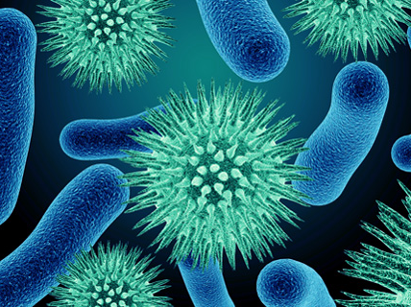
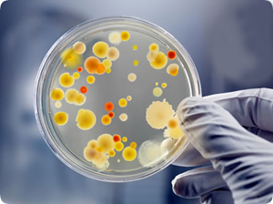
Microbiological Testing
‘Wine is the most healthful and hygienic of beverages…’
(Louis Pasteur)
‘No human pathogens can flourish in wine environment.’
(Sugita-Konishi et al, Japanese Society for Bioscience, Biotechnology and Biochemistry, 65(4) 954-957 2001)

Slide 5
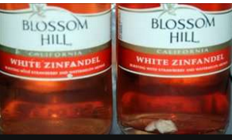
Physical Contamination
Isolated examples
HACCP (Hazard Analysis by Critical Control Points)

Slide 6
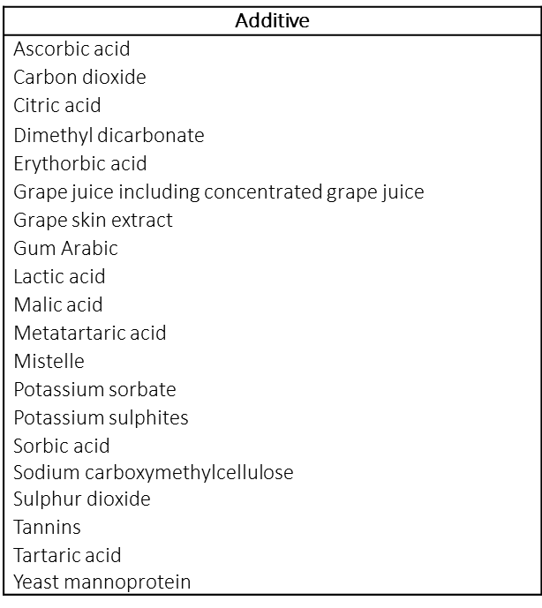
Australian Wine Production
Standard 4.5.1 : Additives for Australian Use

Slide 7
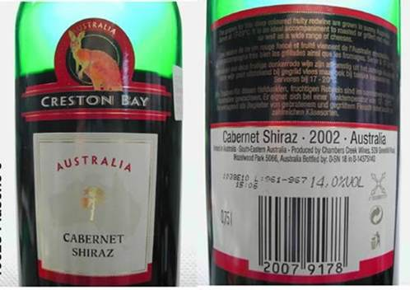
Case Study : Risk of Harming Consumers
Product Recall
Lidl supermarkets, EU 2002
Extremely high level of sulphur dioxide in small proportion of the batch
Australian wine, bottled in Germany, poor quality control procedures
Notes:
“Australian wine can kill” 108,000 litres exported in bulk to Germany. SO2 OK

Slide 8
Risk Management
Establish limits
Monitor control
Establish corrective action procedures
Verify effectiveness
Notes:
Standard HACCP protocol. Note the failure in the German example to perform the last step. Limit needs to be the lowest of those applying in each of the international markets in which the wine might be sold. Hence the need for reliable information of the specification that applies in each of those markets.

Slide 9
Wine Production Systems
Hazard Analysis by Critical Control Points
Summary of Hazards Required to be Controlled
Material | Hazard | Control
Sulphur dioxide | Respiratory problem in susceptible consumers | Accurate measurement of additions, and final concentration
DMDC | Methanol | Control dosage
Milk, Eggs | Affect on susceptible individuals | Warning labels
Glass pieces | Ingestion by consumers | Bottling procedures
Agri-Chemical Residues | Exceeds maximum residue limit | Spray diaries

Slide 10
Three Categories of Winemaking Risk
Risk of harming consumers
Risk of misleading or deceiving consumers
Risk to wine ‘quality’
Notes:
As regulators we are not concerned about the last of these categories. Because the context in which I am using the word here is “grade” or “excellence”- a subjective determination beyond the competence of regulators. The control of the wine production process, however, is largely focussed on this category as the wine producer attempts to achieve the optimal result from the available raw material, the grapes.

Slide 11
Wine Fraud

Slide 12
Fraud Risk Management
WINE PRODUCTION
WHITE WINES
RED WINES
Traceability
Records throughout winemaking process
Australia conducts 400 annual audits of these records
In 2010 one Australian company fined nearly $500,000
Role for import inspection systems?
Grapes
Grapes
Crushing
Crushing
Pressing
Fermentation
Clarification
Pressing
Fermentation
Complete Fermentation
Clarification
Finishing
Aging
Blending
Fining Filtration
Bottling
Notes:
Probe not available.. Limited. Countries reputations rely on the history of abuse and how it is dealt with in the country of origin. Most New World countries have robust regimes, and a history of effective response to isolated instances of non-compliance. The same has not always been true in Europe with the result that consumers have lost confidence in the truthfulness of certain labels. Think about role for import inspection-counterfeiting-certainly an issue for enforcement authorities in the country where counterfiet wine is being marketed- bow much evidence is there that counterfeit wine is crossing national borders?

Slide 13
Export Controls
Licence to Export
Product Registration
Shipment Permit

Slide 14
AGWA Auditing Principles
Risk management principles underpin the schedule. These principles involving assessing:
the magnitude of the risk; and
the likelihood of it occurring.
Audit coverage is designed to include:
a wide spread of regions
minimum 400 field audits
30% of national crush
one of the four largest wine producers; five of the top 20
80 non-producers and contract bottling facilities
audits during vintage fruit receival

Slide 15
AGWA Auditing Principles
Audit agenda:
Larger entities, with electronic systems in place, are less likely to be non-compliant, but highly damaging if breaches detected.
Contract processors present a higher risk as inherent problems could be spread across multiple brands.
Non-producers present unique risks, particularly with customer supplied labels.
Entities exhibiting previous non-conformance will be subject to additional scrutiny.
Unless identified as high risk, individual product audits will be restricted to no more than three per occasion.
Wineries with evidence of satisfactory internal audits will be subject to lower levels of inspection.

Slide 16
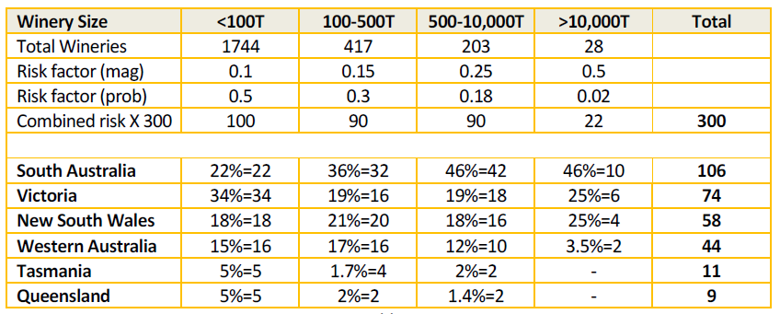
AGWA Auditing Principles
Risk-based principles audit agenda:
Notes:
Source: Regulatory Services Quality Manual (published on Wine Australia website)

Slide 17
AGWA Sample Program
Samples are collected to determine compliance with the Food Standards Code and for potential wine contamination issues.
Parameters are reviewed annually and include, for example, phosphorus acid; 2,4-D, plasticiers, histamine, ethyl carbamate, ochratoxin, heavy metals, agri-chemicals.
Producers with systems controlling agricultural chemical residues in finished wine, ie, spray diary regime, internal residue testing, will form the basis for determining the number of samples collected at each audit.

Slide 18
Risk : Conclusion
Inspection and Testing is not the best way to ensure food safety
Food safety is assured through the implementation of quality management systems

Slide 19
Thank you

