Slide 1
Risk Management Principles & Practice:
Facilitating Regulatory Reform
Jonathan Breach
Head of Quality & Regulatory Affairs
November 2015
Notes:
1

Slide 2
Wine companies trading internationally are entrenched in a risk management culture out of necessity .
Food production risks, legal compliance risks and supply chain integrity risks documented previously in APEC forums.

Slide 3
There is still a gap in the language and characterisation of risk between commercial entities and regulatory agencies.
This is in part a difference in “Risk Appetite” and is reflected in regulatory mechanisms on the spectrum points of Self Regulation, Co-Regulation and Statutory Regulation.

Slide 4
If we are not speaking the same language of risk management:
within industry
to regulators
between trade partners
what unnecessary market entry barriers do we make for ourselves?

Slide 5
Three areas of focus:
What international frameworks of risk should we be using?
Continuous review of risk management regulation and/or controls used commercially & legislatively.
Evidence based regulation to address risk.

Slide 6
Quality & Food Safety Risks:
Well characterised for wine production activities
Some markets exhibit lack transparency on assumptions, assessment characterisation and justifications arising in legislative controls for:
Product classification – wine,wine-based product,
Additives & Processing Aids – use & limits
Production techniques- dealcoholisation
Critical quality control parameters - microbiology

Slide 7
Codex “Working Principles for Risk Analysis for Food Safety For Application By Governments (2007)”
Ensure protection of human health
Applicable to national food control & food trade
Application of risk analysis should be integral part of a national food safety system
Risk management in a national system to be supported by functioning food control system

Slide 8
Industry experience:
Possible protectionism presented as SPS concern
Requirements placed upon traded product not applied to domestically produced product
Lack of transparency and scientific justification of risk or regulatory control.
Over-regulation because industry self-regulation not accepted.
Utilisation of other government agencies to conduct market surveillance using different rules to those agreed and accepted by food control agencies.

Slide 9
“Precaution Principle” – transparent risk analysis of scientific uncertainty and variability; and assumptions for such.
Enshrined in WTO Agreement on SPS.
Risk of Over-regulation / defacto Prevention Principle with an ill-defined assumption of consumer harm risk.
Excuse is often “provides regulatory certainty”

Slide 10
Risk Assessment – 4 Steps
Hazard Identification
– what may cause harm?
Hazard Characterisation
– mechanisms by which harm may occur?
Exposure Assessment
– magnitude, frequency, duration, uncertainties?
Risk Characterisation
– probability of harm?
Should take into account relevant production, storage and transportation practices.

Slide 11
ISO 31000:2009 – Risk Management : Principles and Guidelines
Internationally accepted standard for risk management
Consistent with Codex Alimentarius Working Principles for Risk Analysis
Same principles utilised by commercial entities under Quality Management Systems

Slide 12
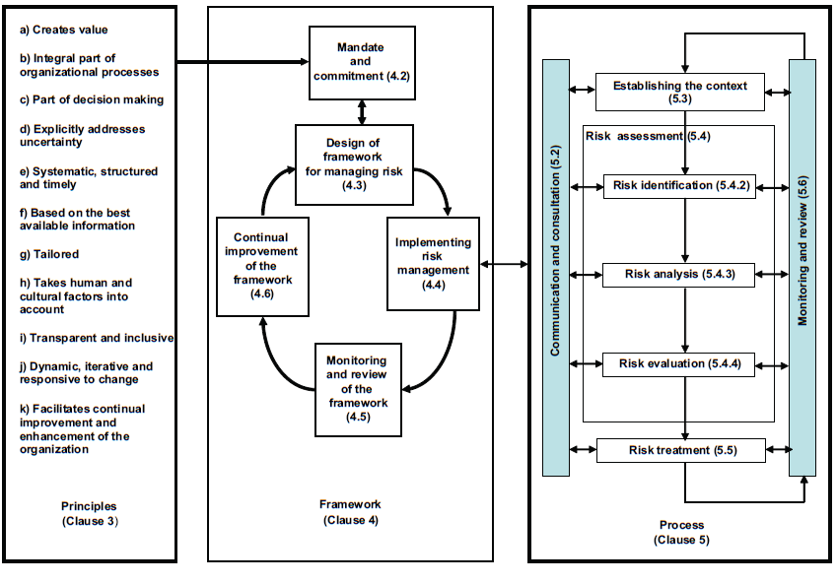

Slide 13
Industry Role in Risk Management
- Creating value/part of decision making (ISO31000)
- Effective communication and consultation with all interested parties should be ensured throughout the risk analysis (Codex)
BUT
Concern on move towards the exclusion of industry on certain regulatory challenges (WHO)

Slide 14
Risk Management Within Supply Chain
Third party accreditations:
HACCP
BRC, IFS
Stand alone: Aldi,Woolworths, Tesco – some of which stronger than ‘industry standard’
Quality focus : but growing importance on environmental and labour standards
Opportunities for lighter touch regulations in some areas commensurate to level of accreditation?

Slide 15
Continuous Improvement of Risk Management Framework
Fundamental action under ISO 31000
Recalibration of risk management controls
Should be applicable to regulatory instruments

Slide 16
Wine Australia Sensory Panel – Example of Government Regulatory Reform
Passing a tasting panel was a previous condition of export for Australian wine.
Identification of wine faults:
oxidation, contamination, clarity & condition
“protecting Australia’s reputation”
Requirement removed as condition of export – resources put into auditing instead.

Slide 17
WFA-WISA Supplier Raw Material Checklist (Industry Self-Regulation)
Identified risk: small to medium winemakers less resourced to provide high scrutiny to additives/processing aids.
Created an industry standard Suppliers Checklist
Ensure every winery receives:
- C of A’s; SDS, QMS accreditation certificates of manufacturer, GMO allergen statements
- Signed declarations on conformance Purity, Identity, TSE Risk, Traceabiltiy
Creates an audit trail for producers
Provides assurance to customers and government partners
http://www.wfa.org.au/assets/codes-and-guidelines/WFA-WISA-PID-v1.pdf

Slide 18
Trans Pacific Partnership Agreement Chapter 25 Regulatory Coherence
“Good Regulatory Practice” – planning, designing, issuing, implementing and reviewing regulatory measures.
Regulatory Impact Assessments:
- assess the need for a regulatory proposal
- examine feasible alternatives, costs & benefits and distributive impacts
- explain the grounds for selection (including in terms of risk management)
-rely on best reasonably obtainable information

Slide 19
Trans Pacific Partnership Agreement Chapter 25 Regulatory Coherence
Timely review of existing regulatory measures.
12 month notice of new regulations.
Agencies to consider regulatory measures in other jurisdictions when designing new regulatory instruments.

Slide 20
Very similar to…
COAG Principles of Best Practice Regulation
The Council of Australian Governments (COAG) has agreed that all governments will ensure that regulatory processes in their jurisdiction are consistent with the following principles:
establishing a case for action;
a range of options must be considered, including self-regulatory, co-regulatory and non-regulatory approaches, and cost/benefit;
adopting the option that generates the greatest net benefit for the community;
legislation should not restrict competition unless:
the benefits of the restrictions to the community as a whole outweigh the costs, and
the objectives of the regulation can only be achieved by restricting competition

Slide 21
providing effective guidance in order to ensure that the policy intent and expected compliance requirements are clear;
ensuring that regulation remains relevant and effective over time;
consulting effectively with affected key stakeholders at all stages; and
government action should be effective and proportional to the issue being addressed.
Evidence Based approach to regulation
i.e. Consumer Focussed Labelling (words to the effect)

Slide 22
First steps – Tsiblisi Statement
World Wine Trade Group Tbilisi Statement on Analytical Methodology and Regulatory Limits (Sept 2014)
First three principles
Avoiding unnecessary analyses. Governments should establish regulatory limits that are based on risk, thereby avoiding unnecessary analysis.
Relevant standards. In addition to considering relevant standards from international standards setting bodies, in the context of a country's WTO obligations, governments should also consider work done by WWTG participants when establishing new regulatory limits.
Regulatory cooperation. Governments should seek cooperation in approaches to regulatory limits where it is feasible to do so and where there is no scientific or other legitimate justification for national or regional differences.

Slide 23
A convergence of risk management regulation is underway amongst certain economies
Risk-averse regulation still exists in other economies
Clear need for common understanding of the language, assessment, review and communication of risk to internationally accepted principles
Key mechanism for further reduction in technical barriers.

Slide 24
Thank You

