Slide 1
The Microbiological Safety of Wine
Greg Hodson, PhD – Wine Institute Technical Advisory Committee Chair
Sara Azevedo- Wine Institute
APEC WRF November 2015 | Adelaide Australia
APEC Wine Regulatory Forum
Adelaide | Australia

Slide 2
Overview
Background on “Wine is a low risk food”
Wine Characteristics
Wine Acidity
Wine Alcohol Content & Polyphenols
Wine Sulphite Content
The Hurdle Concept
Food Safety Risk Management Principles
Resulting Regulatory Framework
Conclusions

Slide 3
Background
“Wine is a low-risk food” – claimed at every APEC WRF meeting.
Meaning – low risk from a microbiological food safety perspective.
APEC WRF should move forward on a sound scientific basis.
Where is the science to support this claim?

Slide 4
Wine Characteristics: Acidity
Two important facts:
Wine is a high acid (and therefore low pH) food.
High acid foods present a hostile environment for microorganisms.

Slide 5
Wine Characteristics: Acidity
An Academic Viewpoint:
Finished wine pH can be between 3.3 and 3.8, depending on the tannin content.
-Washington State University, Research Extension (http://bit.ly/1NWIesI)

Slide 6
Wine Characteristics: Acidity
A Trade Press Viewpoint:
White wines: …..Typical pH ranges between 3.1 and 3.5. Usually, higher acidity and lower pH levels are seen in the same wine, so a tart wine would have an acidity of about .65 and a pH of 3.3. A soft wine would have a lower acidity, say .44, and a pH that’s higher, say 3.7.
Red wines: The numbers here are often higher. A tart red wine would have an acid level of about .75 percent with a pH of 3.45; a soft red wine would have a lower acid of, say, .50 and a pH of 3.8.
- On Wine, Dan Berger, Napa Valley Register (http://bit.ly/1RUFLgP)

Slide 7
Wine Characteristics: Acidity
An analytical instrument manufacturer view point:
Typical pH levels in wine range from 2.9 to 3.9.
- Measuring pH in wine and juice, Water Analysis Instruments, Thermo Fisher Scientific (http://bit.ly/1OGUBJq)

Slide 8
Wine Characteristics: Acidity
Wide Consensus (many other sources could be quoted):
The pH of wine is typically between 2.9 and 3.9

Slide 9
pH: How low can pathogens grow?
Pathogens | Min. pH
Bacillus Cereus | 4.3
Campylobacter Jejuni | 4.9
Clostridium Botulinum (A, proteolytic B&F) | 4.6
Clostridium Botulinum (E, non-proteolytic B&F) | 5.0
Clostridium Perfringens | 5.0
Pathogenic E.Coli | 4.0
Listeria Monocytogenes | 4.4
Salmonella spp. | 3.7
Shigella spp. | 4.8
Staphylococcus Aureus (growth) | 4.0
Staphylococcus Aureus (toxin formation) | 4.0
Vibrio Cholerae | 5.0
Vibrio Parahaemolyticus | 4.8
Vibrio vulnificus | 5.0
Yersinia Enterocolitica | 4.2
Fish and Fishery Products Hazards and Control Guidance, U.S. Food and Drug Administration, 4: 420 (http://bit.ly/1M8xCjL)

Slide 10
Wine Characteristics: Acidity
So simply on the basis of its inherent acidity, almost no pathogens will survive in wine.
But some literature suggests that the polyphenolic chemicals present in wine act synergistically to enhance its overall antimicrobial character.

Slide 11
Studies on Anti-Microbial Effects of High Acidity (low pH) and Polyphenols in Wine
“…food-borne bacteria were killed in both red and white wine within thirty minutes,”
Department of Human and Environmental Sciences at the Ochanomizu University, Japan (http://1.usa.gov/1NWJYCb)
“…consumption of wine during a meal may lower the risk of toxi-infection caused by certain pathogens,”
- Escola Superior de Biotecnologia, Universidade Católica Portuguesa,Portugal (http://bit.ly/1QYoPp4)
“[red wine has] significant anti-norovirus effects on foodborne viruses,” - Researchers, South Korea (http://bit.ly/1GXlmBl)

Slide 12
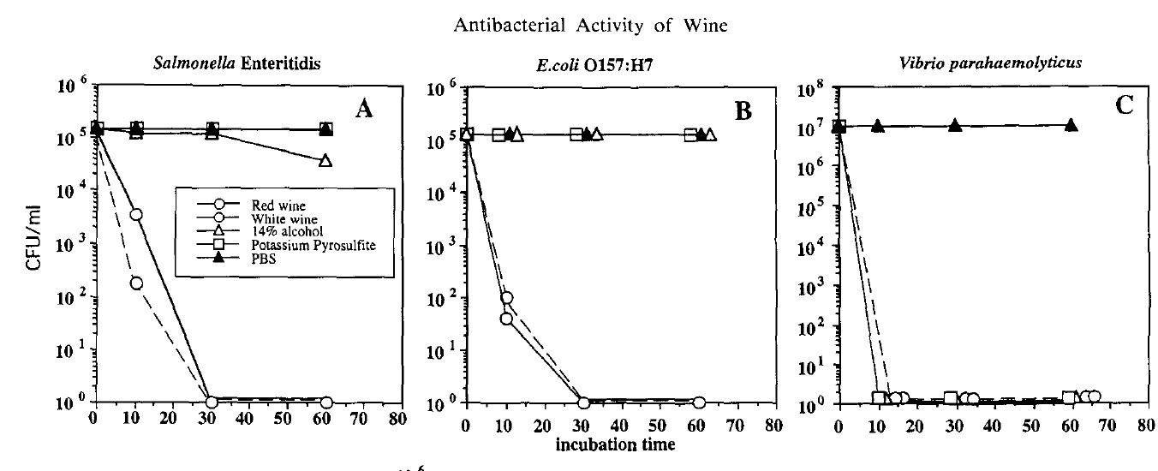
Studies on Anti-Microbial Effects of High Acid (low pH) and Polyphenols in Wine
All three studies concluded that high acidity (low pH) and polyphenolic compounds contributed significantly to wine’s antimicrobial properties.

Slide 13
Wine Characteristics: Alcohol
However, there are many more anti-microbial factors at work in wine- like alcohol.
Alcohol in foods creates a hostile environment for microorganisms.
By regulation around the world, wine most often contains over 7% by volume of ethanol (alcohol).

Slide 14
Wine Characteristics: Alcohol
World Wine Trade Group (WWTG):
“Wine” is a beverage ……containing not less than 7% and not more than 24% alcohol by volume.
International Organisation of Vine and Wine (OIV):
[Wine’s]… acquired alcoholic strength should not be less than 8.5% vol. Nevertheless, …..the total minimum alcoholic strength can be reduced to 7% vol. by special legislation of the region in question.

Slide 15
Wine Characteristics: Alcohol
Ethanol at higher concentrations (70-80%) is used sanitation products like hand sanitizers.
Nevertheless, at lower concentrations, ethanol does have the ability to inhibit and kill pathogenic microorganisms.
“The general mode of action for inactivation of microorganisms by alcohols is by denaturation of proteins, with the primary site of action being the cell (plasma) membrane.... Moulds and actinomyceles are most susceptible to alcohols and are inhibited at 4% (v/v) whereas most bacteria can still grow at this concentration. Application of 5.5 % (v/v) shows a bacteriostatic effect on E. coli, but in order to kill this microorganism concentrations of22.2 %or higher are necessary.”
Understanding Pathogen Behaviour Virulence, Stress Response and Resistance (pg. 489-490), Edited by Mansel Griffiths (http://bit.ly/1OV2Ccg)

Slide 16
Wine Characteristics: Alcohol
On the basis of this information it is clear that the alcohol content in wine alone will exert a bacteriostatic effect on microorganisms.
But yet again, there are more anti-microbial factors at work in wine- like sulphites.

Slide 17
Wine Characteristics: Sulphites
Sulphur dioxide (SO₂) & sulphites (INS 220-228):
Sulfur dioxide is a broad-spectrum antimicrobial agent that has an inhibitory affect on a wide variety of microorganisms.
For white wines, a level of 0.8 ppm molecular SO2 will slow down the growth of yeast and will prevent the growth of most other microbes.
Depending on the wine pH, 11-125 ppm of free SO2 will give 0.8 ppm molecular SO2 in the wine.
SULFUR DIOXIDE. The science behind this anti-microbial, anti-oxidant wine additive, Pat Henderson, Practical Winery & Vineyard http://www.practicalwinery.com/janfeb09/page2.htm

Slide 18
Hurdle Concept
The concept of combining several factors to preserve foods has been called the hurdle effect, where each factor is a hurdle that microorganisms must overcome in order to survive.
Hurdle technology is the deliberate combining of factors to create an environment in food where microbiological safety is ensured.

Slide 19
Hurdle Concept
”The Hurdle Concept.” H. Alakomi, E. Skytta, I. Helander & R. Ahvenainen. VT Biotechnology Espoo. In: Minimal Processing Technologies in the Food Industries (2002) pp 175-195 ed. T. Ohlsson, N. Bengtsson

Slide 20
Hurdle Concept
Wine quite naturally contains as many as six hurdles, many of which on their own make the growth of pathogens almost impossible.
Collectively, it is certain that pathogenic micro-organisms cannot survive in wine.

Slide 21
Hurdle Concept: Wine
“Alcohol is an effective antimicrobial at levels as low as 2.5%”
- Applied and Environmental Microbiology (http://1.usa.gov/1PJzYvf)
“When different combinations of ethanol, organic acids, and acidity were tested against the pathogens, it was found that a composition of 0.15% malic acid, 0.6% tartaric acid, 15% ethanol, and pH 3.0 has a strong bactericidal effect”.
- Microbial Safety of Minimally Processed Foods (http://bit.ly/1Lqjfds)
“The wines tested had strong antibacterial activity against the 4 pathogens, S. Typhimurium, E. coli O157:H7, L. monocytogenes, and S. aureus”
- Journal of Food Science (http://bit.ly/1LPFpY9)

Slide 22
Food Safety Risk Management Principles
Wine is an acidic, alcoholic, polyphenol and sulphite containing product. It has high organic acid content and low redox potential. Therefore it has strong anti-microbial properties.
It is a consumer product with low microbiological food safety risk.
It should be regulated accordingly.

Slide 23
Food Safety Risk Management Principles
The Food and Agriculture Organization (FAO) and the World Health Organization (WHO) developed generic framework for risk management with the goal to:
“…protect public health by controlling risks as effectively as possible through the selection and implementation of appropriate measures.”
(http://www.fao.org/3/a-w4982e.pdf ))

Slide 24
Resulting Regulatory Framework
Given what we have seen concerning the antimicrobial properties of wine, governments have regulated wine accordingly by classifying it as a low risk food.

Slide 25
Low Risk Food: E.U.
European Food Safety Authority’s (EFSA) decision tree proposes a categorization of risk based on food composition and impact on pathogens. Wine is clearly low-risk according to this model.
- Scientific Opinion on the development of a risk ranking framework on biological hazards (2012). European Food Safety Authority, (http://www.efsa.europa.eu/sites/default/files/scientific_output/files/main_documents/2724.pdf )

Slide 26
Low Risk Food: Philippines
Republic of the Philippines FDA
“…hereby implements an electronic registration (E-registration) system initially applicable for raw materials or ingredients and low risk pre-packaged process food products in order to streamline the application and evaluation process without compromising public health and consumer safety…”
Wine (including still, sparkling and fortified grape wine) is included as a low risk food in Annex A
(http://bit.ly/1jBGLeL)

Slide 27
Time/Temperature Control for Safety (TCS) Foods: U.S.A.
Foods with a pH below 4.2 (not heat treated or heat treated but not packaged) are “non-TCS Foods” (not needing time and temperature treatment to control growth of pathogens and/or spores where applicable).
Food Code 2013. Recommendations of the United States Public Health Service. Food and Drug Administration. Table B, Page 339. http://1.usa.gov/UyyRFj*
Wine has a pH below 4.0 and is packaged, so would not be expected to support the growth of pathogens and spores.
* While “non-TCS foods” are not automatically “low risk foods”, this approach still confirms that wine will not support the growth of vegetative pathogenic micro-organisms and spores of pathogenic micro-organisms.

Slide 28
Conclusion
Wine is a polyphenolic, high acid and alcohol containing product with anti-microbial properties.
=
It is a consumer product with low microbiological food safety risk.
=
It should be regulated accordingly, and this is recognized by many economies around the world.

