Slide 1
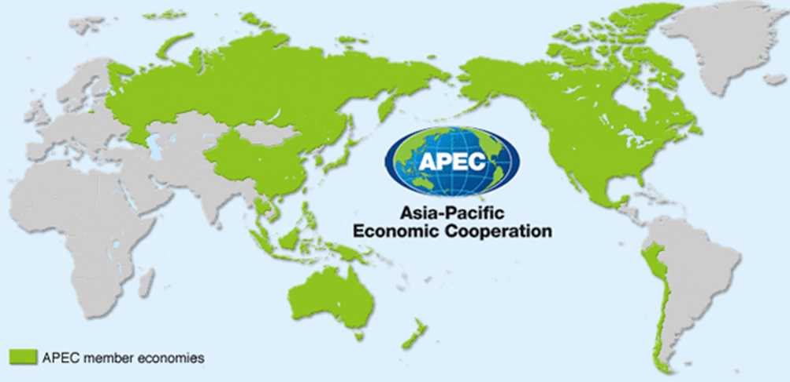
STUDY ON EXPORT CERTIFICATES IN APEC ECONOMIES
APEC WRF Working Group on Export Certificates

Slide 2
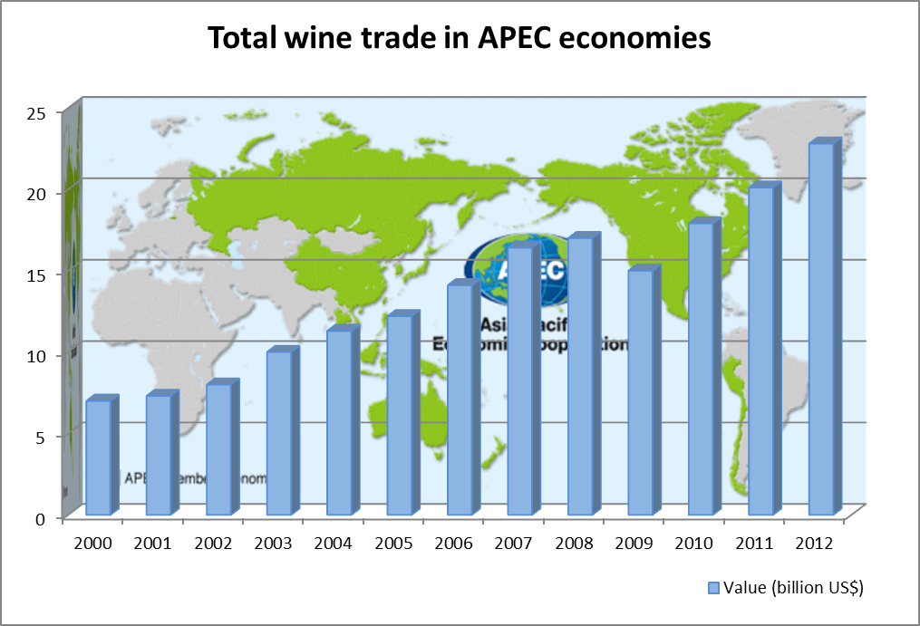
Background
- The wine trade in the APEC region has grown dramatically in importance for both exporting and importing member economies.
- The value of APEC wine trade more than tripled, increasing from US$7 billion in 2000 to US$25 billion in 2013.

Slide 3
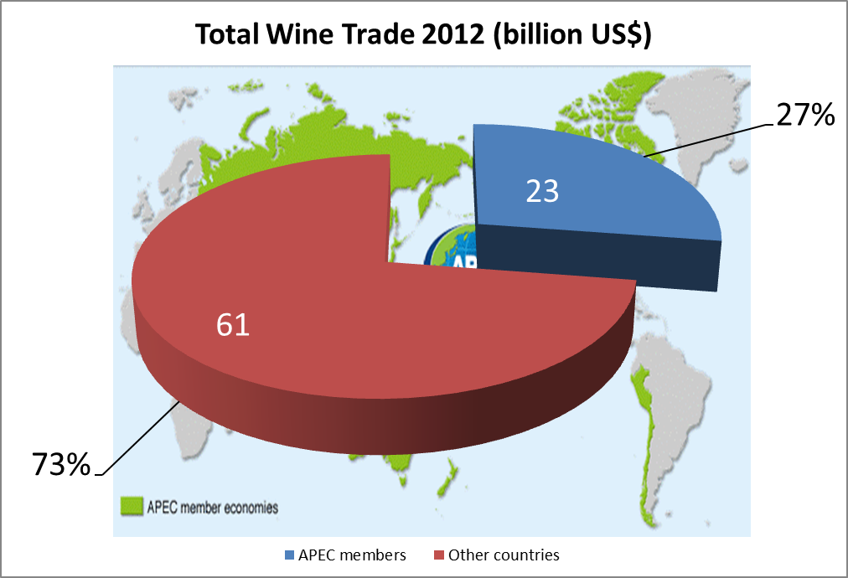
Background
- APEC made up 27% of the US$84 billion total value of global wine trade.
- Wine consumption in the 21 APEC countries has more than doubled from 1990 to 2013 and wine production has flourished in many of those countries.

Slide 4
Introduction
This study was carried out by the WG on Export Certificates as a key outcome of the November 2013 APEC Wine Regulatory Forum (WRF) meeting in Washington D.C.
A 6 questions survey, related with export certificates, was sent to 21 APEC economies, in order to gather information that could help to find common element inside the export/import process.
The Working Group on Export Certificates was requested to study the information received, generate a generic profile of the export documents required by APEC economies, and indicate the feasibility of elimination, consolidation, and electronic submission of certificates within APEC.
A key point, is to increase in knowledge and engagement among APEC economies, that will allow the parties to reevaluate the need for having export certificates to the point of eliminating at least some of the certificates, or reducing the burden on government and industry through consolidation, electronic certifications, self-certification and mutual acceptance-like agreements.

Slide 5
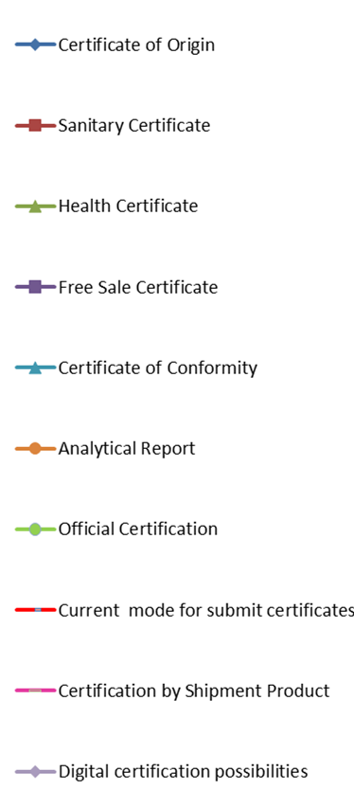
Chart - Study on Export Certification

Slide 6
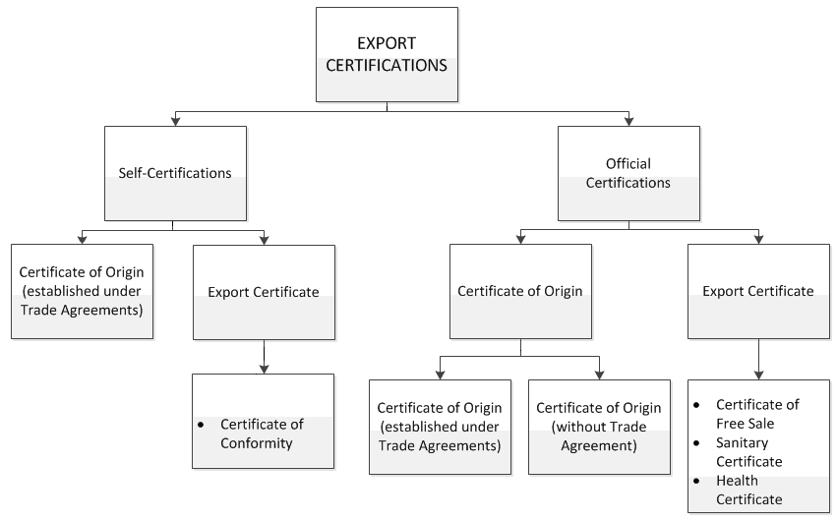
Types of Export Certificates

Slide 7
Self-Certification
Self-certification is one type of certification of origin, often made only under the protection of some trade agreements, in which the exporter, importer or producer himself declares that the exported goods comply with the rules of origin set out in the respective trade agreement, which allows them to benefit from a specific tariff preference.
The exporter or producer himself becomes responsible for issuing export documents.
Must to comply with all regulatory and legal requirements established by the law in the country of origin.
The exporter or producer is subject to control and supervision by the responsible official agency in the country of origin.

Slide 8
Self-Certification
The exporter or producer is subject to control and supervision by the responsible official agency in the country of origin.
Specific types of certificates may be requested by the importing party (Retail Market) for quality assurance and product conformity.
This types of certificates are not directly issued by an official body in the country of origin and can be issued directly by the exporter or producer (under a robust licensing system) without requiring official certification.
Certificate of Conformity: certifies the compliance of production and trade with the requirements of the country of origin. The certificate may contain information about analytical reports and/or production lot identification that allows for the product to be traded in the country of origin.

Slide 9
Official Certification
Official certificates are those issued by a competent government body, that are in charge of the control and supervision of compliance with the rules governing production, elaboration and trade of wines.
This organization is the guarantor of the exported product, and certifies that the product is exported in compliance with the rules and regulations of the country of origin or provides laboratory results so that the economy that receives the certificate can determine if the product is in compliance.
Certificates of Origin
Export Certificates

Slide 10
Certificate of Origin
A "Certificate of Origin" certifies the economy of origin of the products destined for export, in accordance with the Rules of Origin set out under the respective trade agreements, in which this type of certification is essential in order for the exported product to benefit from a tariff preference, that reduces or exempts it from taxation when entering the country of destination. Thus, the Certificate of Origin corresponds to Customs matters.
The Certificate of Origin corresponds to Customs matters.
Could be established under Trade Agreement.
Could be requested without Trade Agreement by the importing party.

Slide 11
Export Certificates
Export certificates are documents issued from one government agency to another government agency, in which it is possible to certify various conditions, characteristics and compliance with rules and regulations associated with the exported product, which guarantee the fulfillment of the requirements of the official authorities in the importing party, allowing for customs clearance and marketing of the product in the country of destination.
This type of certificates are not used to benefit from a tariff preference or exemption.
Required by government agencies in the importing party.
Used to substantiate labeling or marketing claims.

Slide 12
Export Certificates
Customs clearance.
Registration validation.
Import licensing.
Sanitary registration for free sale.
Confirming sanitary conditions.
Substantiating labeling or marketing claims.
Guaranteeing the safety of the products.

Slide 13
Types of export certificates used by APEC economies
Certificate of Free Sale: Certifies the condition of the product in the country of origin, in relation to compliance with rules and regulations that allow for their production, trade and consumption in the country of origin. These certificates also attest to the safety of the product and its suitability for human consumption, which makes it suitable for consumption and sale in the country of destination: "If people drink a wine in the place where it is produced, this wine is also acceptable for consumption in the place where it is imported.“

Slide 14
Sanitary Certificate (“Sanitary and Purity Certificate”): Certifies the sanitary condition of the product and/or its suitability for human consumption in the country of origin.
Health Certificate: Certifies the sanitary condition of the product and regulatory compliance for production and trade in the country of origin. This addresses the safety of the product for human consumption.
Analysis Reports: to verify compliance with regulations relating to pre-determined physicochemical parameters and/or labeling requirements.

Slide 15
Recommendation
To establish a framework for reducing export certification requirements and burdens through a variety of different options that do not impose obligations on economies that currently do not require certification, such as:
1. Consolidation of certain certificates thru a model certificate
2. Self-certification
3. A pilot project on e-certification, and/or,
4. The development of mutual acceptance types of agreements between one or more economies.

Slide 16
Conclusion
Despite some of the differences that exist among our wine regulatory regimes when it comes to export certification, the WRF Working Group on Export Certificates will facilitate the process for APEC economies to become more familiar with each other’s systems and help identify mechanisms for economies to consider in reducing unnecessary burdens caused by export certificates. The recommendations provided in this study are intended to bring about action that will help achieve the goals of the WRF’s multi-year effort to assist economies in “implementing specific, measurable good regulatory practices” in the area of wine trade, which contributes to APEC’s goal to “further enhance economic growth and prosperity for the region and to strengthen the Asian-Pacific community.”

Slide 17
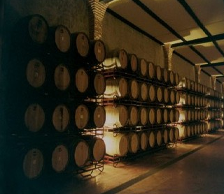
Thank you for your attention

