Slide 1
WELCOME TO APEC VIET NAM 2017

Slide 2
Events
The Informal Senior Officials' Meeting (ISOM) and the Seminar on the priorities on APEC 2017 will be held on December, 2016;
The First Senior Officials' Meeting (SOM1) and Related Meetings will be held from February to March, 2017;
The Second Senior Officials' Meeting (SOM2) and Related Meetings will be held on May, 2017;
The Third Senior Officials' Meeting (SOM3) and Related Meetings will be held on August, 2017;
The APEC CEO Summit and the Economic Leaders' Meeting will be held on the second week of November, 2017.

Slide 3
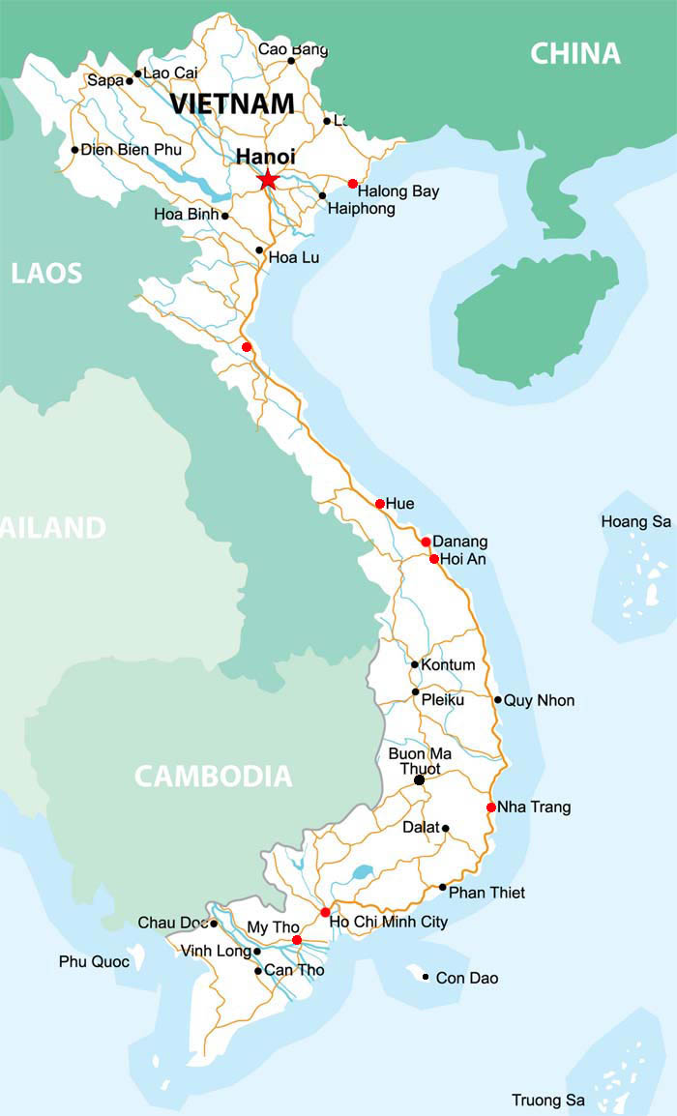

Slide 4
Welcome to Viet Nam

