Slide 1
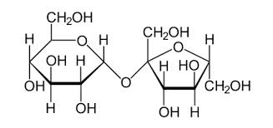
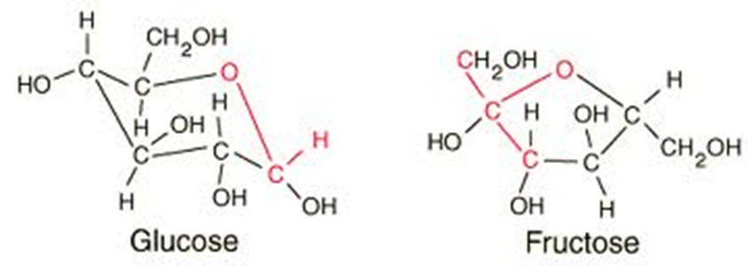
Testing Sugar in Wine
Greg Hodson & Steve Tallman
September 12, 2014
Sucrose

Slide 2
Agenda
Sugars in wine – background
Be careful what you are testing for!
Be careful how you are testing for it!
Be careful of regulatory consequences!
Possible Next Steps

Slide 3
Sugars in Wine
Sugars accumulate in the grapes as they ripen.
* Fructose is about twice as sweet as Glucose
Sugar | Typical Sugar Proportions in Wine(%)
Glucose | 47.6
Fructose | 47.6
Sucrose | 3.1
Pentoses | 1.1
Pectins | 0.6

Slide 4
Sugars in Wine (cont’d)
Reducing Sugars:
Includes any sugar with an aldehyde group (e.g. glucose + fructose)
Sucrose is not a reducing sugar
Residual Sugar:
All fermentable sugars.
Includes glucose, fructose, sucrose & pentoses
Non-fermentable carbohydrates:
Includes polysaccharides, pectins, tannins, pigments, organic acids
Extract (non-volatiles of wine):
Includes sugars, fixed acids, organic salts

Slide 5
Be careful what you are testing for!
Some reference methods test for Reducing Sugars only:
Lane-Eynon Method – Copper reduction
Thin Layer Chromatography (TLC)
Segmented Flow Analysis
Enzymatic (Glucose + Fructose)
Colorimetric determination based upon optical density
Most commonly used, low cost, rapid, accurate

Slide 6
Be careful what you are testing for!
2) Some reference methods test for Residual Sugar:
HPLC/RI (Glucose + Fructose + Sucrose)

Slide 7
Be careful what you are testing for!
3) Some techniques are secondary methods - must be calibrated against results from reference method:
Fourier Transformed Infrared (FTIR)
Fast, reliable, commonly used
But:
Dependent on calibration for accuracy
Dependent on which reference method is used to calibrate
Calibration must be done in house and not “borrowed”
Determinations must fall within the range of the calibration

Slide 8
Different Methods = Different Results
Wine Varietal | Reducing Sugar -Enzymatic Glucose+Fructose (g/L) | Residual Sugar – HPLC/RI Glucose+Fructose+Sucrose (g/L) | Difference* (g/L)
Chardonnay | 8 | 8 | 0.0
Sparkling wine | 82 | 82 | 0.0
Cabernet | 4.5 | 5.0 | 0.5
White Zin | 39 | 40 | 1.0
Pinot Noir | 13 | 14 | 1.0
Generic red | 11 | 12 | 1.0
Chardonnay | 16 | 17 | 1.0
Merlot | 12 | 13 | 1.0
* Average Difference = 0.8 g/L

Slide 9
Be careful how you are testing for it! Ideally:
Perform Method Validation (every lab)
Determine Uncertainty of Measure
Ensure calibration by performing linearity checks
Conduct ongoing preventative maintenance
Participate in proficiency testing
Provide adequate staff training
Ensure system suitability through lab control samples (LCS)
Perform LCS control charting – trend analysis

Slide 10
Be careful how you are testing for it!
REDUCING SUGAR | Merlot |  |  | Zinfandel
HPLC | 5.800 | 0.000 | -0.037 | 6.700 | 0.000 | -0.089 | 1 of 3
Enzymatic | 5.852 | 0.417 | 0.016 | 6.850 | 0.476 | 0.061 | 36 of 42
Segmented Flow | 6.115 | 0.403 | 0.278 | 7.238 | 0.371 | 0.448 | 2 of 2
FITR | 5.200 | 0.000 | -0.637 | 6.000 | 0.000 | -0.789 | 1 of 2
Grand Means | 5.837 | 0.467 |  | 6.789 | 0.596 |  | 48 of 56
Method of Analysis | Group Mean | Btwn Lab SD | Diff from Grand Mean | Group Mean | Btwn Lab SD | Diff from Grand Mean | Labs Included
RESIDUAL SUGAR | Merlot |  |  | Zinfandel
Cu Reduction | 8.076 | 0.909 | 0.584 | 9.322 | 1.054 | 0.586 | 10 of 11
Segmented Flow | 8.500 | 1.414 | 1.008 | 9.725 | 1.874 | 0.990 | 2 of 2
FTIR | 6.672 | 1.150 | -0.820 | 7.991 | 1.398 | -0.745 | 6 of 6
Other | 6.025 | 0.177 | -1.467 | 7.051 | 0.354 | -1.686 | 2 of 2
Grand Means | 7.492 | 1.254 |  | 8.736 | 1.411 |  | 20 of 21
Proficiency Test Data show that:
Reducing Sugar methods tend to perform better than the Residual Sugar methods
The Enzymatic method tends to perform better than the other Reducing Sugar methods

Slide 11
Be careful of regulatory consequences!
Sometimes sugar-related labeling is required:
Sweetness descriptors for wine by sugar content¹
Dry: Contains a max of 4 g/L sugar content²
Demi-sec: >4 g/L - 12 g/L sugar content³
Semi-sweet: >12 - 45 g/L sugar content
Sweet: >45 g/L sugar content
¹ OIV (18/73, Eco 3/03)
² Or 9 g/L when the level of acidity of TA ≤ 2 g/L less that the sugar content.
³ Or 18 g/L when the content of TA is ≤ 2 g/L less that the sugar content.

Slide 12
Be careful of regulatory consequences!
If there is a labeling requirement that is based on sugar content and wines are to be tested for label compliance based on sugar analysis
Then:
Labels correctly prepared with well-calibrated and performed analyses may be non-compliant when tested by poorly performing labs/methods (and vice-versa)
Labels that are correctly prepared with results from one well-performing method may be non-compliant when the wine is tested with another one

Slide 13
Possible Next Steps
Determine the methods used for sugar analysis of wine in the APEC economies
Determine if labeling requirements are applied based on sugar analysis
Assess scope for confusion based on different methods of analysis
Explore possibility for proficiency testing of sugar methodologies among APEC economies

Slide 14
Thank You!
Questions?

