Slide 1
Heavy Metal in Wine
State Key Testing Laboratory of Wine and Alcohol Beverage
Ling TIAN , Ph.D.
September 11, 2014

Slide 2
Content
View of the Key Lab;
Heavy Metal in Wine;
In future/advices.

Slide 3
View of the Lab
Our Histroy
The wine testing laboratory was established and operated in 2010 in Huangpu, Guangdong Entry-Exit Inspection and Quarantine Bureau (CIQ).
The lab was approved to be state key wine testing laboratory in 2011, by General Administration of Quality Supervision, Inspection and Quarantine of the People’s Republic of China (AQSIQ).

Slide 4
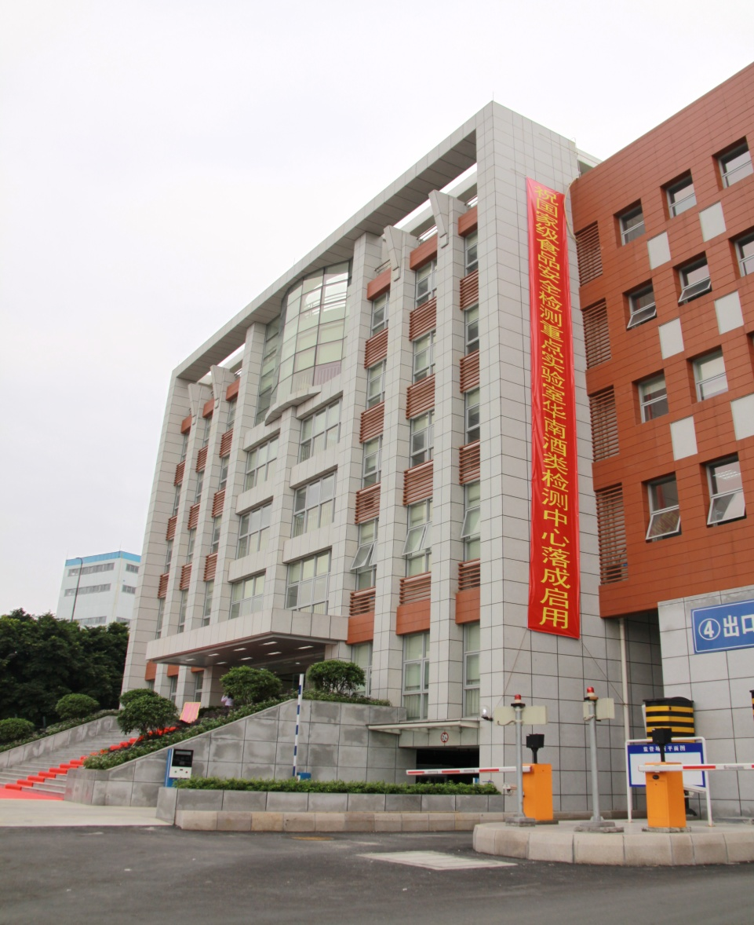
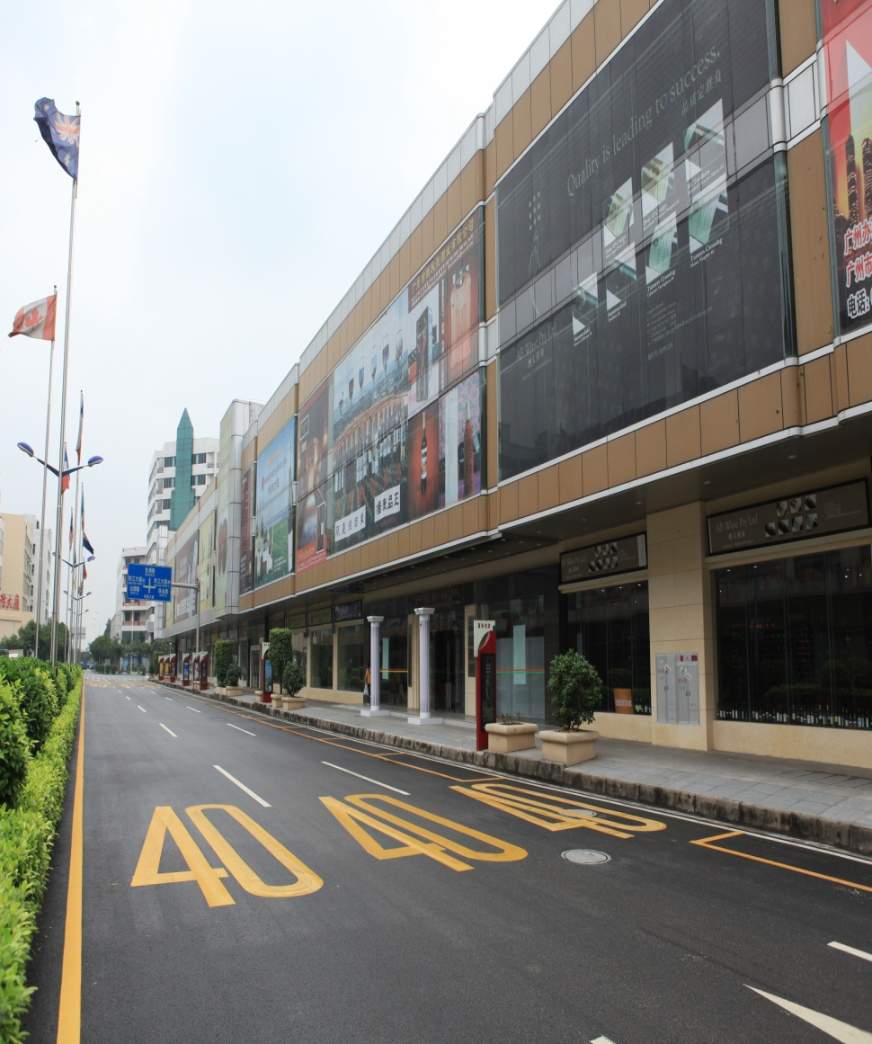
Our Building

Slide 5
Accreditation
State Key testing Laboratory of wine and Alcohol Beverage (Guangdong) is accredited by CNAS-CL01 (China National Accreditation Service for Conformity Assessment, CNAS), which is equal to (ISO/IEC17025:2005).
Our current Scope of Accreditation for the lab’s facility covers all methods which is concerning China’s standard of grape wine.

Slide 6
Technical Platform of the Lab
Instrumental platform
Wet Chemistry
IRMS
(Flash EA, Gas Bench, GC-Isolink, LC-ISOlink)
GC/GC-MS
Inorganic tools (ICP/ICP-MS/AES)
Microbiology
LC/ LC-MS

Slide 7
Technical Platform of the Lab
Wet chemistry: alcohol, dry extract, sugar, acid, etc.
GC/GC-MS: Plasticizer, Pesticides, aroma compounds, etc.
LC/LC-MS: Mycotoxin, biogenic amines, amino acids, food addictives, polyphenols, etc.

Slide 8
Technical Platform of the Lab
IRMS(Flash EA, Gas Bench, etc.): Authenticity/determination the isotope ratio of ¹⁸O/¹⁶O, ¹³C/¹²C, ²H/¹H, etc.
Inorganic tools (ICP/ICP-MS) : Mineral elements(Cu、 Fe、 Pb、 Zn, etc.);
Microbiological methods: Bacteria and Pathogens (Total bacterial count, Coliforms, Salmonella, Shigella, Staphylococcus aureus, etc. );

Slide 9
Heavy Metal in Wine/ Background
Along with P.R.China’s recent and fast economic development, the Chinese wine sector experiences substantial changes.
From 2003 to 2013, wine production increased from 343.2 to 1382.1ML(Million liter) (302%), also sharp increasing of wine imports (including bottled wine, bulk wine and sparkling wine) from 41.2 ML to 376.8ML.

Slide 10
Heavy Metal in Wine/ Background

Slide 11
Heavy Metal in Wine/ Background
Meanwhile, the consumption volume of alcoholic beverages greatly increased in China: China has replaced France and became the No.1 of wine consumption economy in 2013.

Slide 12
Heavy Metal in Wine/ Background
Concerning too much the Food safety issues happened, also the wine’s safety also aroused too much interest.
Metal content also is one of the risk factors, although the trace elements are essential for humans, many of them (e.g., Cu, Bi, Sn, As, Pb) have unknown biological function and are toxic, because they accumulated in the human organism.
In fact, at slightly higher levels than when found in living beings, they can have toxic effects.

Slide 13
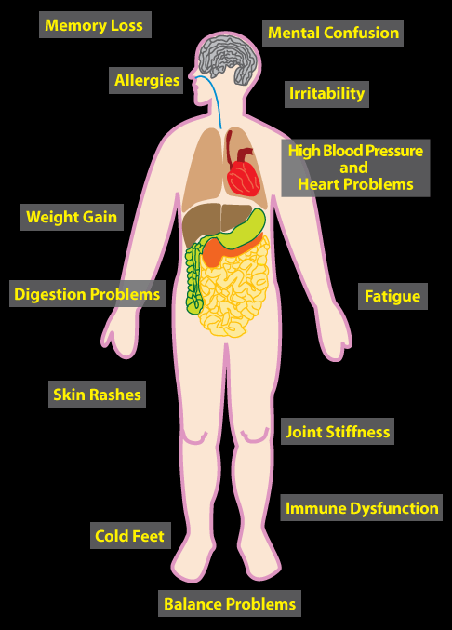
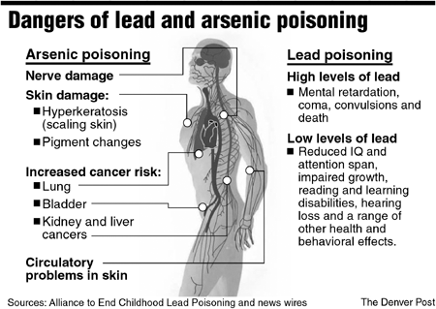
Heavy Metal Poisoning

Slide 14
Heavy Metal in Wine/ Background
Source:
1). The primary natural metal content of wines is determined by many factors, such as the type of soil, the variety of grape, the weather conditions, the pollution, and viticultural practices.
2). The secondary mineral contamination is derived from the use of pesticides and fertilizers or acquired during winemaking.

Slide 15
Limit Standards
No. | Metal (Chinese Standard) | Chinese standards | Metal (OIV Standard) | OIV Standard
1 | Copper (Cu) | ≤1.0mg/L | Arsenic (As) | ≤0.2mg/L
2 | Iron (Fe) | ≤8.0mg/L | Cadmium (Cd) | ≤0.01mg/L
3 | Lead (Pb) | ≤0.2mg/L | Copper (Cu ) | ≤1.0mg/L
4 | Manganese (Mn) | ≤2.0mg/L | Lead (Pb) | ≤0.15 mg/L
5 |  |  | Zinc (Zn) | ≤5mg/L

Slide 16
Testing Methods
No. | Metal (Chinese Standard) | Chinese standards | Metal (OIV Standard) | OIV Standard
1 | Copper (Cu) | GB15038-2006 | Arsenic (As) | OIV-MA-AS323-01A/B(AAS)/C(Colorimetry)
2 | Iron (Fe) | GB15038-2006 | Cadmium (Cd) | OIV-MA-AS322-10
3 | Lead (Pb) | GB5009.12-2010 | Copper (Cu ) | OIV-MA-AS322-06
4 | Manganese (Mn) | GB/T 5009.90-2003 | Lead (Pb) | OIV-MA-AS322-12
5 |  |  | Zinc (Zn) | OIV-MA-AS322-08

Slide 17
Case1-Heavy Metal In Wine
Sample: 94 bottles of wine from different economies/area;
Methods: Chinese testing Standard and ICP-AES;
Metal: Copper (Cu), Iron (Fe), Lead (Pb),Manganese (Mn), Arsenic (As), Cadmium(Cd), Zinc (Zn).

Slide 18
Case1-Metal In Wine
Result:
Metal | Copper (Cu) | Iron (Fe) | Lead (Pb) | Manganese (Mn) | Arsenic (As) | Cadmium (Cd) | Zinc (Zn)
Over Standard | 0% | 2.13% | 0% | 13.83% | 0% | 0% | 0%

Slide 19
In Future/advices
Based on the metal’s toxic effects and its resource, we need to track the metal of wine, also make sure the results’s reliability. There are two advices:
1). Ring tests;
2). Research project: Heavy Metal In Wine;

Slide 20
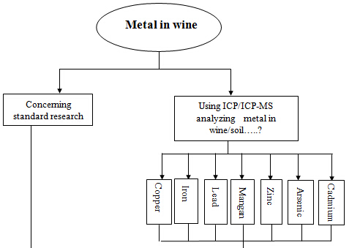
Heavy Metal In Wine

Slide 21
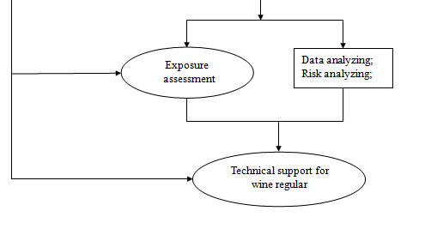
Heavy Metal In Wine

Slide 22
Thanks for your attention!

