Slide 1


Chinese Taipei’s Perspectives on the Maximum Residue
Limits, MRLs – the Case of Hop
National Treasury Administration
Ministry of Finance

Slide 2

Outlines
The Hop Project
Cooperation among Agencies
Developing MRLs
Conclusions

Slide 3
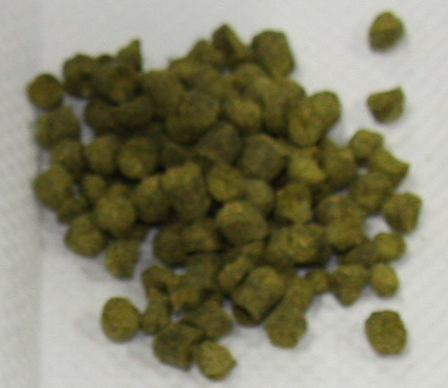
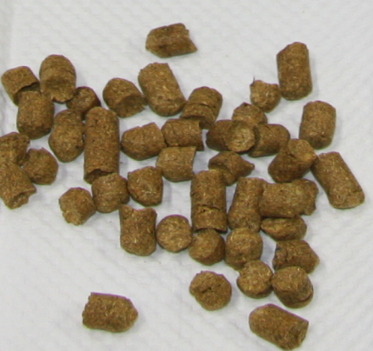
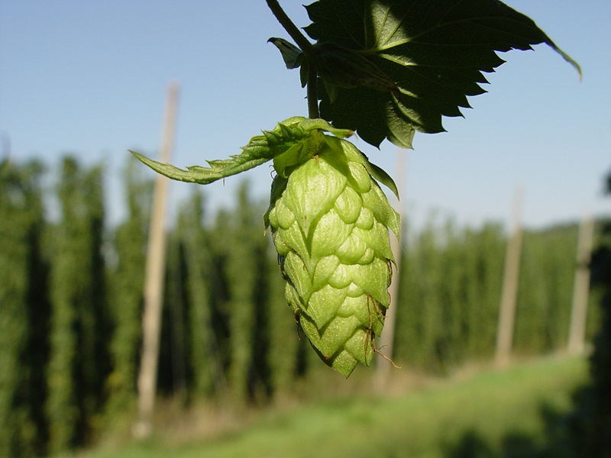
The Hop Project
Hop flower
Source: Wikipedia
Photos: Pellets of dried hop of different origins

Slide 4


Cooperation among Agencies
Customs Administration
Local Governments
Testing
Laboratory
Council of Agriculture
National Treasury Administration
Ministry of Health & Welfare

Slide 5
Developing MRLs Suggestions
Pesticides Residues Testing
Primary Sampling
Primary Results Analysis
Sec. Results Analysis
Sec. Sampling
Formulation
CODEX & other Standards or Limits
Health & Consumption Information
Suggestions

Slide 6
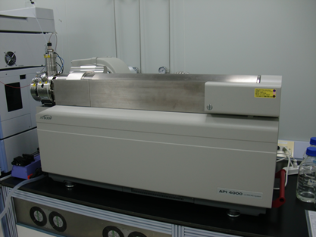
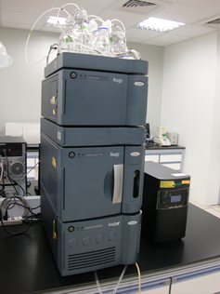
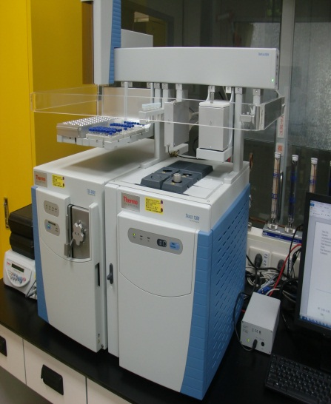
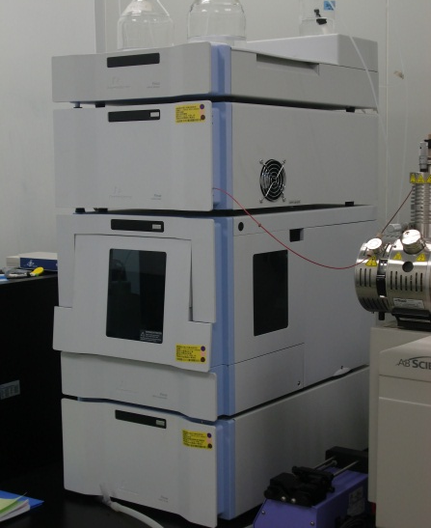

Instruments Used
The samples were firstly prepared by following the QuEChERS (Quick, Easy, Cheap, Effective, Rugged, and Safe) approach, and then brought to the liquid chromatograph/tandem mass spectrometer, or gas chromatograph/tandem mass spectrometer, depending on the properties of pesticide.

Slide 7
Number of Needed MRLs
Summing up the number of possible pesticides reasonably exist in the hop (as A)
Number of MRLs needed to be set up
Deleting the pesticides already permitted (as B) with lowest limits domestically
Subtracting the pesticides (as C) not permitted or adopted domestically
Removing pesticides (as D) of not being requested to set or of being put into combined calculation with other pesticides
Deleting pesticides (as E) with their maximum permissible intake already exceeding 100% domestically
N = A – B – C – D – E

Slide 8
Among Found Residues & MRLs
Pesticide Name | Highest conc. ( ppm) | CODEX ( in ppm) | Economy P1 (ppm) | Economy P2 (ppm) | Economy C (ppm)
Acetamiprid | 1.53 | - | 0.1 | 0.01 | -
Azoxystrobin | 1.00 | 30 | 30 | 20 | 30
Boscalid | 15.31 | 60 | 60 | 35 | 35
Carbendazim | 0.08 | - | 0.1 | - | 0.1
Dicofol | 1.08 | 50 | 50 | 65 | 50
Dimethomorph | 4.23 | 80 | 50 | 60 | 80
Dithiocarbamates | 4.20 | 30 | 25 | - | 30
Fenpyroximate | 0.35 | 10 | 10 | 10 | 15
Flonicamid | 0.11 | - | 2 | 7 | 5
Hexythiazox | 0.90 | 3 | 20 | 2 | 30
Propamocarb HCl | 1.08 | - | 0.2 | - | -
Propargite | 1.69 | 100 | 100 | 100 | 100
Pyraclostrobin | 0.88 | 15 | 10 | 23 | 15
Quinoxyfen | 0.42 | 1 | 0.5 | 3 | 1
Trifloxystrobin | 9.50 | 40 | 30 | 11 | 40

Slide 9
Possible Non-compliant Cases
Unit: in ppm

Slide 10
Conclusions
Applying the MRLs developed by CODEX
Having regulatory cooperation through recognition of pesticides used on wine
Developing all needed MRLs on one’s own is costly

Slide 11



T
Thank You for Your Attention

