Slide 1


APEC WRF WG
- Technical Issues under Consideration at the Codex Committee on Food Additives (CCFA)
Dr Eric Wilkes
Australian Wine Research Institute

Slide 2
Organic acids in wine
The main organic acids found in wine are:
  Tartaric
  Malic
  Lactic
  Succinic
  Acetic
  Citric
The proportion of each are largely driven by environmental factors.
Notes:
The six main organic acids found in wine are all present in varying amounts naturally.
There is a vast range of other acids also found which can contribute to the overall sensory experience, but they are present is proportionally insignificant amounts compared to the main six.
Tartaric, malic and citric are present in grapes while acetic, lactic and succinic are products of primary and secondary fermentation processes.
The naturally occurring proportions of each of these acids is largely driven by environmental and genetic factors and has a significant impact on the final sensory and varietal profile of the product.

Slide 3
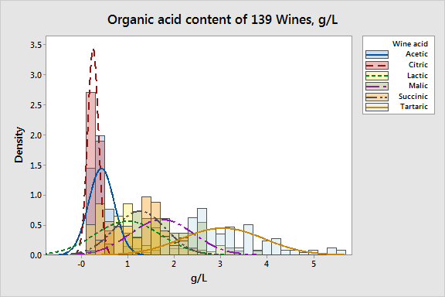
A complex story
The organic acids found in wine have a direct and significant role in the taste, balance, colour and stability of a wine, and represent an integral aspect of the wine style.
Notes:
During the vinification process we see significant changes in the levels of organic acids.
The final levels of each are driven by the initial quantities present, the grape variety, the wine style desired and the various vinification process and yeast used.

Slide 4
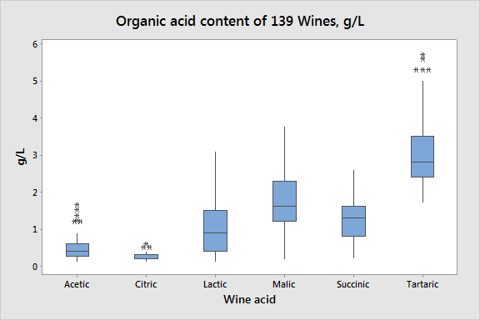
No simple relationship
The variation in organic acid content between wines is significant and represents a complex interplay between environmental and stylistic issues.
Importantly, all these naturally occurring species pose no health related issues at quantities found in wine.
Notes:
The variation in organic acid content between wines is significant and represents a complex interplay between environmental and stylistic issues.
Importantly, all these naturally occurring species pose no health related issues at quantities found in wine.

Slide 5
An integral winemaking tool
Climate, vineyard and variety are the main drivers of the naturally high variation in acid content.
Warmer climates can lead to significantly less acid available in grapes¹.
Acid adjustments are a traditional and widely accepted tool used to meet sensory, stylistic and stability goals.
Acid additions are made to meet a sensory profile (GMP) rather than to meet arbitrary limits.
Introduction of arbitrary limits on such naturally variable components would impose a significant impost on the ability of some economies to make wines that meet their traditional and consumer expectations.
1 Ribereau-Gayon et.al., Handbook of enology , volume 1
Notes:
Acid additions are made to a sensory profile (GMP) rather than to meet arbitrary levels
The respiratory loss of malic acid is more pronounced in warmer climates. When all the malic acid is used up in the grape, it is considered “over-ripe” or senescent. Winemakers must compensate for this loss by adding extraneous acid at the winery in a process known as acidification. J. Robinson (ed) “The Oxford Companion to Wine” Third Edition pg 421–422 Oxford University Press 2006

Slide 6
Manganese in wine
Manganese is a naturally occurring element ubiquitous throughout the environment.
In wine its possible sources include soil and water, some vineyard sprays and fertilizers, and to a lesser extent some wine processing aids, equipment and cleaning products.
Manganese salts, also a possible source of manganese, are not permitted wine additives in most economies.
Winemaking processes do not tend to reduce its levels at any processing stage.
At the levels found in wine, manganese does not pose any human health risk, and is indeed an essential element for health.
Notes:
Underlying geology plays a major part in the bioavailability.
Not only is it not a permitted additive in most parts of the world, there is simply no reason to add it or it salts at an stage of the vinification process.
Not only do vinification processes not reduce the presence of Mn, in the case of red wines it releases extra Mn during the breakdown of the skins.

Slide 7
Significant variability
8.0
5
7.0
4
6.0
5.0
Mn concentration (mg/L)
3
Mn (mg/L)
4.0
3.0
2
2.0
1
1.0
0.0
0
Africa
Europe
Oceania
S-America
60
40
20
0
20
40
60
Region
Australian red wines
International red wines
The range of Mn levels found in wines around the world is significant.
However, the differences between regions is not statistically significant with distributions being similar.
Notes:
This first study reviewed levels over 600 wines from around the world.
The second study focused on 200 wines from Australia in comparison to 200 international wines.

Slide 8
Short-term environmental impacts appear significant
Vintage-to-vintage variation is significant.
This would appear to be linked to changes in climatic conditions and their impact on the bioavailability of Mn in soil.
Notes:
From a survey of nearly 2000 samples of finished wine.
Interestingly 2011 was a significantly wet year when we would have expected a greater use of fungicide sprays.

Slide 9
Impact of fungicide sprays
Some studies found a link between the use of Mn-containing fungicides and Mn content in wine².
However, a recent study at the AWRI found no clear link to between the number of spray applications and final concentration in wine.
2 Pera, L. la Dugo, G. Rando, R. Bella, G. di Maisano, R. Salvo, F. Statistical study of the influence of fungicide treatments ( mancozeb, zoxamide and copper oxychloride) on heavy metal concentrations in Sicilian red wine.. Food Additives and Contaminants 25 3 : 302-313 ; 2008.
Notes:
Grapes were sourced from 22 vineyards which had documented number of Mn-based fungicide applications. This fruit was then fermented under controlled conditions and no correlation was found.
A number of other vineyards that had no applications at all, had levels of Mn above 2.0 mg/L
The differences between this study and earlier ones is probably related to the impacts of local environmental conditions such as rain events during ripening.

Slide 10
Mn - a difficult to control natural component
The main drivers of manganese concentration appear to be local soil bioavailability and environmental conditions.
Vineyard practices may be able to modulate but not eliminate manganese levels.
The vinification process is not adding to the levels already found in grapes.
Given the natural variation found in the sources it is difficult, if not impossible, for wine producers to ensure that they will meet an arbitrary limit not based on the observed natural variation in wines.
Furthermore, such limits do not reflect any health or quality concerns and impose an unreasonable impost on economies.

