Slide 1
APEC Wine Regulation Forum, September 11-12, 2014, Beijing
Operation of Codex Committee on Pesticide Residues
Xiongwu QIAO
Codex Committee on Pesticide Residues,
Shanxi Academy of Agricultural Sciences, PR China
CODEX MRLs (CXLs) International Food Standards on Pesticide Residues

Slide 2

Codex Alimentarius Commission
An intergovernmental organization to find a consensus on the Codex Alimentarius
Multiple partners characteristic(contact points, ministries, Codex Secretariat, FAO, WHO, NGOs, etc.) in a common project to: Develop and maintain a collection of international food standards (the Codex Alimentarius)
Aimed to protect the health of consumers, and ensure fair international trade in food
CODEX MRLs (CXLs) International Food Standards on Pesticide Residues

Slide 3
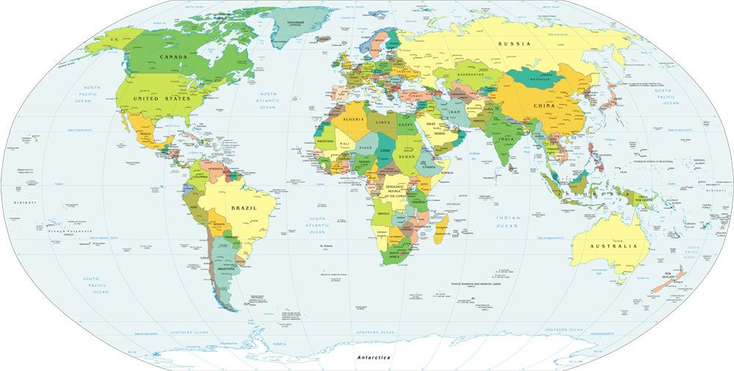
186 member economies/organizations, and 224 observers(NGOs, IGOs & UN)
50+1
2
17
23
33
48
12
CODEX MRLs (CXLs) International Food Standards on Pesticide Residues

Slide 4
Codex Alimentarius Commission
Secretariat
Executive Committee
General Subject Committees
Commodity Committees
Ad-hoc intergovernmental task forces
General Principles (France)
Food Labelling
(Canada)
active
Active (none)
Sugars
(Colombia)
Processed Fruits and Vegetables (United States)
dissolved
Fish and Fishery Products (Norway)
Antimicrobial Resistance (Republic of Korea)
Animal Feeding (Denmark)
Import and Export Inspection and Certification Systems (Australia)
Fresh Fruits and Vegetables (Mexico)
Fats and Oils
(Malaysia)
Spices and Culinary Herbs (India)
Fruit Juices (Brazil)
Foods derived from Biotechnology (Japan)
Aditivos Alimentarios (China)
Processing and Handling of Quick Frozen Foods (Thailand)
Food Additives (China)
Pesticide Residues
(China)
Contaminantes de los Alimentos (Países Bajos)
Contaminants in Foods (Netherlands)
adjourned sine die
FAO/WHO Coordinating Committees
Higiene de los Alimentos
(Estados Unidos)
Food Hygiene
(United States)
Residues of Veterinary Drugs in Foods
(United States)
Cereals, Pulses and Legumes (United States)
Meat Hygiene
(New Zealand)
Africa
(Ghana)
Latin America and the Caribbean (Mexico)
Methods of Analysis and Sampling (Hungary)
Nutrition and Foods for Special Dietary Uses (Germany)
Natural Mineral Waters
(Switzerland)
Vegetable Proteins
(Canada)
Asia
(Indonesia)
North America and South West Pacific
(Tonga)
Milk and Milk Products (New Zealand)
Cocoa Products and Chocolate (Switzerland)
Europe
(Poland)
Near East (Tunisia)
CODEX MRLs (CXLs) International Food Standards on Pesticide Residues

Slide 5
Committee
Commission
(adoption)
Discussion
paper
Committee
Executive Committee
(critical review)
Project
document
S 1
Proposed draft standard
S2
elaboration
S3
consultation
S4
negotiation
Endorsement by
general committees
S 5
Draft standard
S6
consultation
S7
negotiation
S 8
Codex procedure
for Standard Setting
(8-steps procedure)
Codex
standard
CODEX MRLs (CXLs) International Food Standards on Pesticide Residues

Slide 6
Following the 8-steps procedure, CODEX MRLs (CXLs) are international food safety standards on pesticide residues in food or feed, those are adopted by CCPR before approved by CAC based on 2 basic principles.
1. Science:
Sound scientific analysis and evidence, in order to ensure the quality of the standards. Since 1995 Risk Analysis Principles has been introduced.
For establishment of Codex maximum residue limit (MRL = CXL), CCPR uses the risk assessment mechanism conducted by Joint Meeting on Pesticide Residues(JMPR ), as FAO/WHO scientific advice.
CODEX MRLs (CXLs) International Food Standards on Pesticide Residues

Slide 7
The CXLs are decisions based on good agricultural practice (GAP), while at the same time considering the pesticide toxicity and exposure (dietary intake) with a possibly accurate uncertainty.
2. Concensus:
As a subsidiary committee of CAC, CCPR tries making every effort to reach agreement on the adoption or amendment of standards by consensus.
CODEX MRLs (CXLs) International Food Standards on Pesticide Residues

Slide 8
Member participation of CCPR sessions
CCPR Sessions (year) | members | observers | Delegates
39th(2007) | 53 | 7 | 199
40th(2008) | 59 | 8 | 227
41st(2009) | 73 | 10 | 246
42nd(2010) | 50 | 7 | 193
43rd (2011) | 58 | 7 | 189
44th (2012) | 69 | 6 | 253
45th (2013) | 59 | 7 | 244
46th (2014) | 60 | 10 | 240
CODEX MRLs (CXLs) International Food Standards on Pesticide Residues

Slide 9
Products of CCPR:
---- ca. 3500 CXLs, for ca. 245 pesticides.
---- Risk analysis policy:
Risk analysis Principles applied by CCPR,
Periodic review of the Codex CXLs,
Prioritization of CCPR works.
---- Other related documents:
Codex classification of foods and animal feeds
CODEX MRLs (CXLs) International Food Standards on Pesticide Residues

Slide 10
CCPR recommendation of CXLs (2006-2014)
CCPR sessions (year) | CCPR’s recommendation
 | Step 8 | Step 5/8 | Step 5 | revokation
38th(2006) | 284 | 207 | 5 | 174
39th(2007) | 4 | 183 | 7 | 124
40th(2008) | 18 | 261 | 17 | 92
41st(2009) | 13 | 228 | 29 | 114
42nd(2010) | 6 | 211 | 52 | 95
43rd (2011) | 35 | 282 | 22 | 125
44th (2012) | 20 | 251 | 23 | 59
45th (2013) | 36 | 331 | 0 | 146
46th (2014) | 1 | 345 | 0 | 105
CODEX MRLs (CXLs) International Food Standards on Pesticide Residues

Slide 11
Challenges to CCPR:
Speed and Quantity of CXLs
Ca.1000 active ingredients of pesticides are registered world wide. Codex has elaborated CXLs only for ¼ of them with ca. 3500 MRLs. These Couldn’t obviously meet the demand of international trade in food, especially for developing economies.
CODEX MRLs (CXLs) International Food Standards on Pesticide Residues

Slide 12
Challenges to CCPR:
2. How scientific the process could be?
The CXL recommendation is based on science, i.e. data from GAP & Dietary exposure for risk assessment. But the data support is far from satisfactory. Some key words about this issues : GAP, cGAP, Data set size, GEMS/Food consumption cluster diets, long & short term dietary exposure assessment, estimation & uncertainty, commodity grouping, etc.
CODEX MRLs (CXLs) International Food Standards on Pesticide Residues

Slide 13
Challenges to CCPR:
3. Difficulties on the way to reach a concensus
As a intergovernmental forum, CCPR makes decision on a concensus basis. But there is no absolute unanimity. This is reasonably reflecting the interest differentiation of parties of CCPR. Some key words related : Data sharing, level of protection (industrialized/developing, import/export economies), prioritization, national policy of pesticide use, etc..
CODEX MRLs (CXLs) International Food Standards on Pesticide Residues

Slide 14
Looking forward
Revision of the risk analysis principles
Risk analysis principles applied by CCPR is the basic policy document for risk manager (CCPR) and for risk assessor (JMPR) as well. Key of the revision is changing of the periodic review policy, and rules of prioritization of CCPR/JMPR works.
2. GAP data evaluation
Residue data set must be big enough, in order to get a acceptable estimation of real residues in foods. At the same time, an appropriate estimation method is necessary for the accurate exposure assessment.
CODEX MRLs (CXLs) International Food Standards on Pesticide Residues

Slide 15
Looking forward
3. Refining of the dietary data
Refining and updating of GEMS/Food consumption cluster diets based on national nutrition survey. There are only 13 groups, for example, Cluster G for Afghanistan, Bangladesh, Cambodia, China, India, Indonesia, Laos, Malaysia, Mongolia, Myanmar, Nepal, Pakistan, Sri Lanka, Thailand, Viet Nam. There must be a false assumption that 15 eocnomies are cooking using one menu.
Large portion data are needed for short term dietary exposure assessment. There are now only data submitted from fewer economies.
CODEX MRLs (CXLs) International Food Standards on Pesticide Residues

Slide 16
Looking forward
4. Capacity building for developing economies
FAO, WHO and some UN members strived to do more to help developing economies to establish their own food safety system, pesticide registration and marketing system, but there is still a long way to go for a more effective participation of developing economies.
5. Capacity building of JMPR
Lacking on qualified experts and financial support, The scientific advisory body of CCPR was overloaded, what was a significant limit factor for CCPR works. Enhanced international and domestic involvement is expected.
CODEX MRLs (CXLs) International Food Standards on Pesticide Residues

Slide 17
Thanks for your attention
International Standards on Pesticide Residues in Food:
Codex achievements and challenges

