Slide 1
APEC WRF Compendia
On Certification, Labeling, Safety, and Pesticide Maximum Residue Limits (MRLs)

Slide 2
Working Group Recommendations
Subsequent to the completion of the Survey of Existing Wine Regulation Databases, the Compendia Working Group has, after consultations with the APEC Secretariat, issued the following recommendations:
In order to emphasize transparency, issue a selective tender (e.g., Request for Proposal) in which different organizations, including those which manage the databases discussed, may submit proposals for incorporating and maintaining the Compendia information collected in their databases for access by all APEC WRF participants.

Slide 3
Recommendations (continued)
Given the budgetary limits in place for this project, the selection process will give priority consideration to existing database systems, as this will allow for the maximization of limited resources and facilitate the sharing of information within the shortest amount of time possible.
The main goal will be to ensure that the database(s) chosen to co-locate or house the Compendia information are searchable, user-friendly, and can be updated periodically.
As an interim step, the Compendia Working Group has post the completed Compendia on the APEC WRF website, for immediate access and review by APEC economies.

Slide 4
Thoughts?

Slide 5
Current status

Slide 6
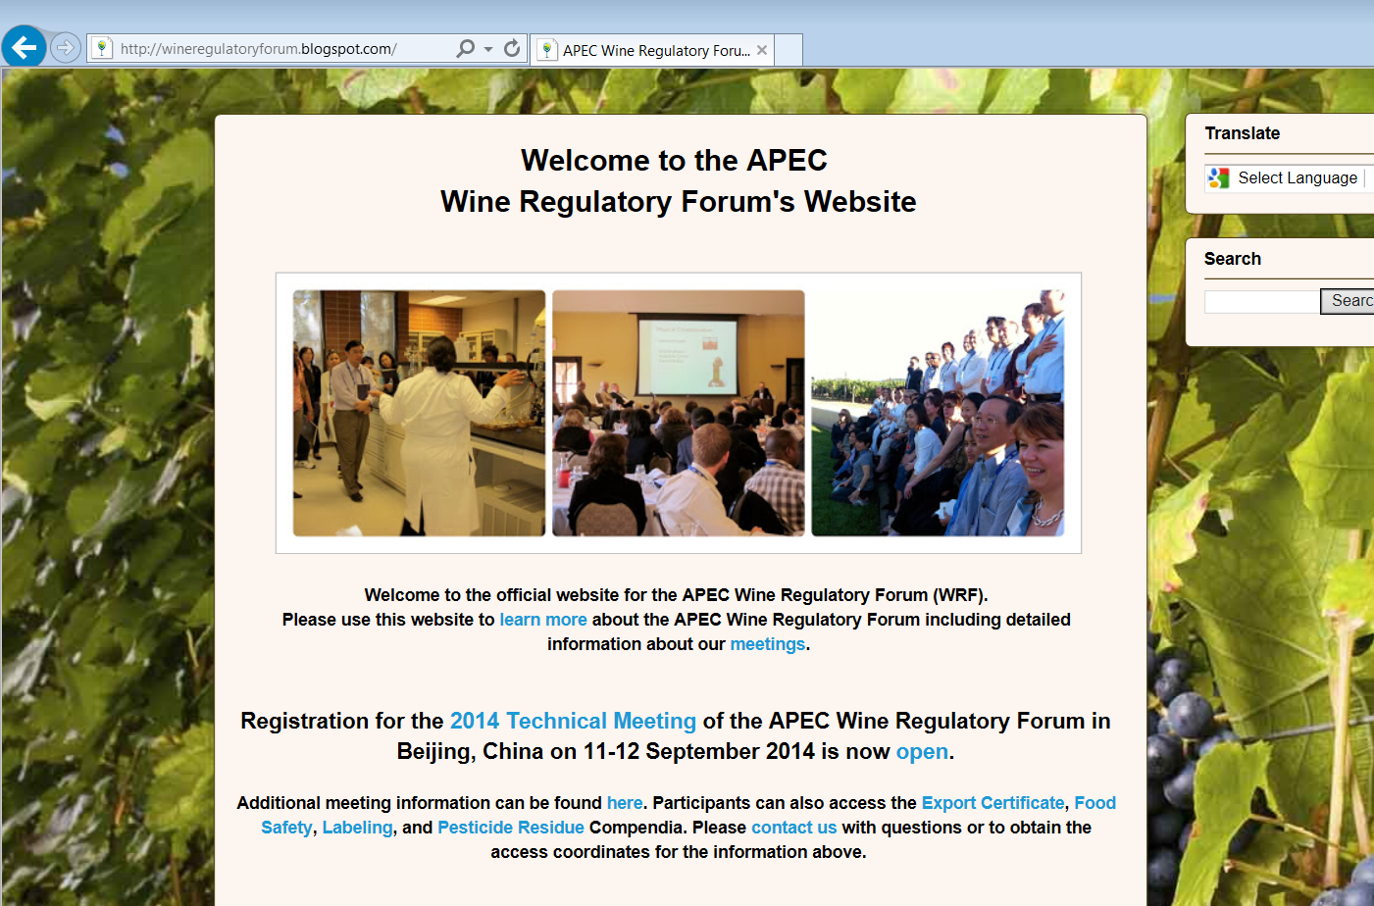

Slide 7
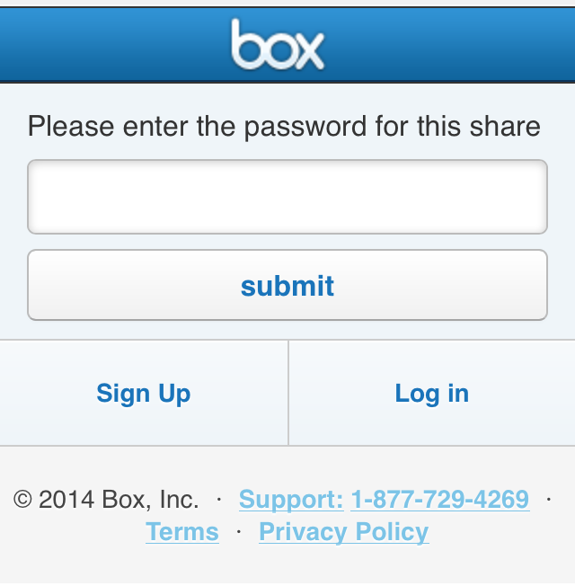
Enter password
This information was provided by email to APEC participants. New users may request access to log-in information by contacting the APEC project overseers.

Slide 8
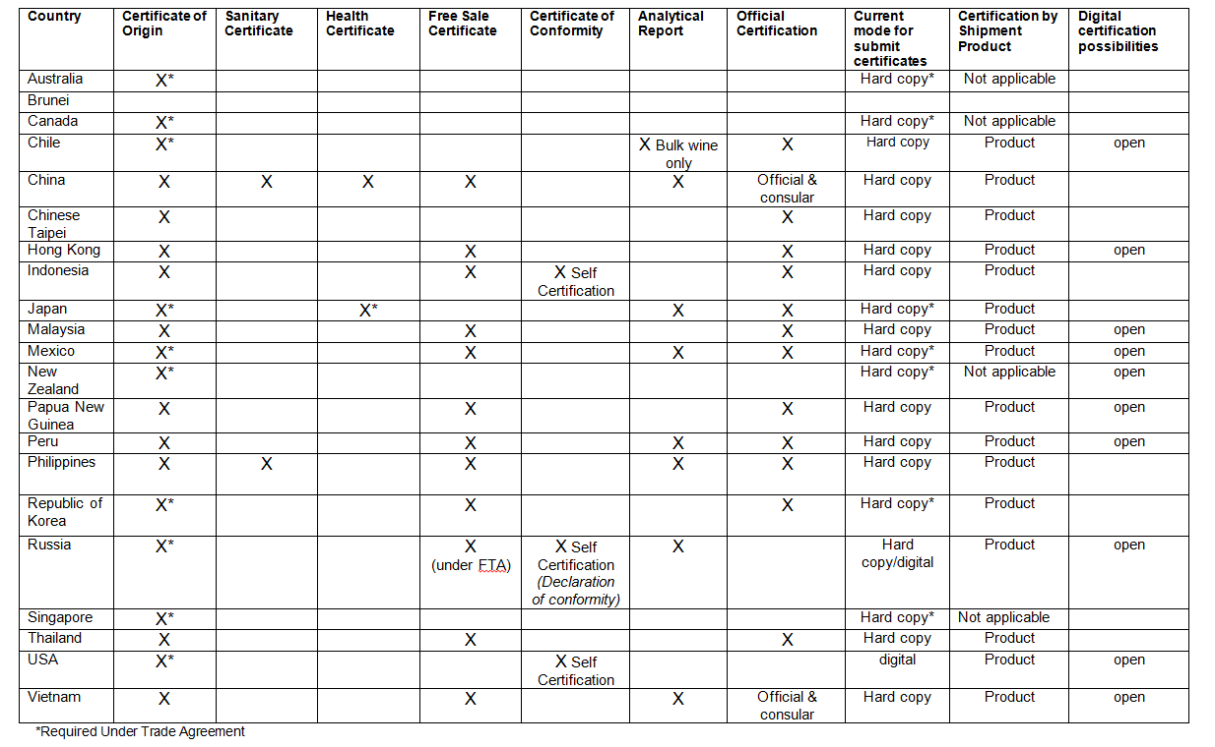
Compendium on Export Certification

Slide 9
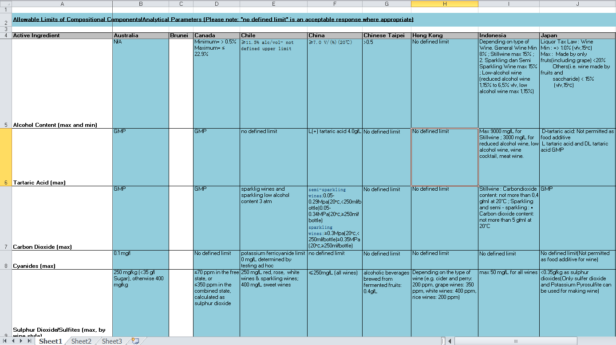
Food Safety Compendium

Slide 10
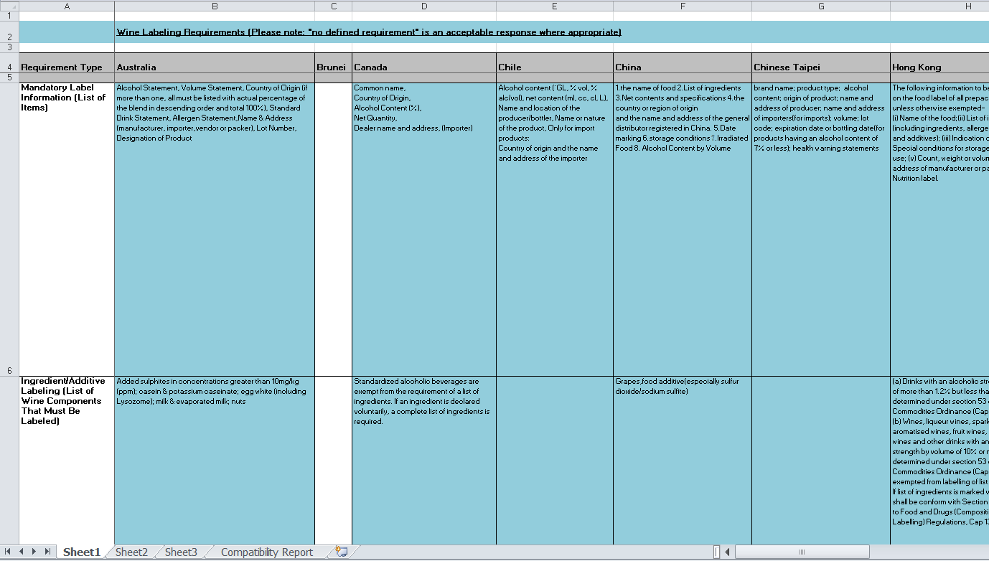
Labeling Compendium

Slide 11
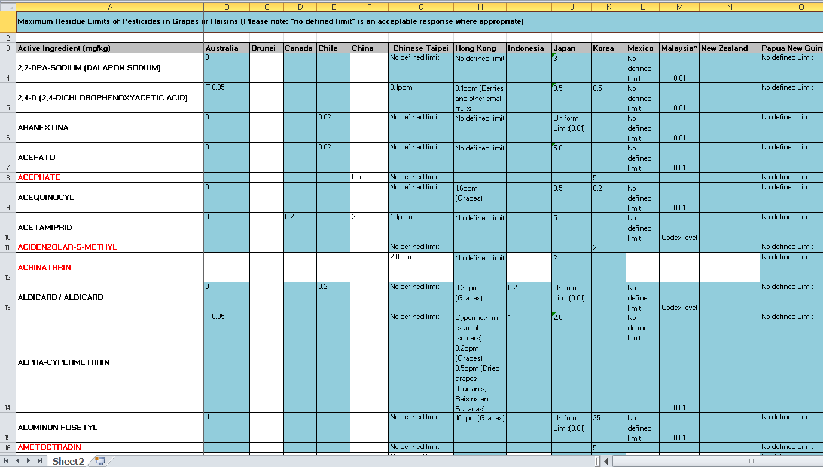
Compendium on Pesticide MRLs

Slide 12
Thank you!

