Slide 1
Working Group on Compendia: Survey of Existing Wine Regulation Databases
Greg Hodson
12 September 2014

Slide 2
Purpose and Approach
Determine if any existing wine regulation databases might supplement the APEC Wine Regulatory Forum (WRF) Compendia.
Understand how information is organized in them.
Determine they might serve as permanent repositories for the Compendia data with little or no modification.

Slide 3
Compendia Areas
Food Safety
Wine production regulations (additives, processing aids and processing techniques)
Wine composition regulations
Labeling
Pesticide Residues

Slide 4
Evaluation Criteria Used
Products/Services were assessed on 4 criteria:
Information Scope
Presentation
Coverage
Accessibility

Slide 5
Food Safety
Several online services provide information on regulations regarding production and composition of grape wine:
FIVS-Abridge
AWRI
TTB
Bryant Christie International
NETVS
Ship Compliant
This survey did not investigate other paid services (such as Decernis at http://www.decernis.com) which are not directly related to wine but to food safety issues in general.

Slide 6
Report Outcomes
FIVS Abridge and the AWRI products seemed to have the greatest potential to play some role in relation the work of the APEC WRF.
These products will be covered here but see the full report for a consideration of the other tools.

Slide 7
FIVS-Abridge: Description
Commercial product, found online here: http://www.fivs-abridge.com.
Produced and operated in conjunction with the international alcohol beverage trade association, FIVS.
Has been available for about 7 years.

Slide 8
FIVS-Abridge: Information Scope
Currently dedicated to information on grape wine regulations.
Contains (inter alia): wine composition and wine production (i.e. additives, processing aids and production techniques).
Continuously updated (daily) as new information becomes available.

Slide 9
FIVS-Abridge Presentation
Dropdown boxes and check box selections enables rapid, side-by-side comparisons of regulations and agreements of different economies in relation to wine, as well as the ability to examine the full text of a regulation when necessary.

Slide 10
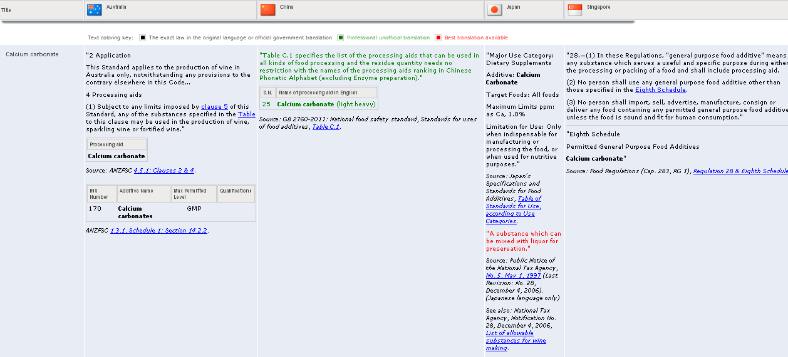
FIVS-Abridge Information Scope (Cont’d)
Presents regulations side by side in a tabular format (including multi-lateral and bilateral treaty documents)
Constructed with the goal of facilitating trade by expediting progress in harmonization provisions among economies where there is no scientific justification for the national differences that exist.
Production information includes: additives, processing aids and processing techniques.
Contains export guides by Australia Grape and Wine Authority for 36 markets (including 16 of the 21 APEC economies).
Constructs “trade scenarios”
Multi-lingual interface with regulations predominantly available in English and French.
Text provided in: official versions, professional but unofficial translations, or best translations available (color-coded to identify authority).
Provides links to extracts and/or complete regulations.

Slide 11
FIVS-Abridge: Information Scope
Presents regulations, multi-lateral and bilateral treaty documents
Side by side comparison of essential elements
Additionally, includes Wine Australia Export Guides for 36 markets (including 16 APEC economies).
Constructs “trade scenarios”
Extracts and/or complete regulations.

Slide 12
FIVS-Abridge: Coverage & Accessibility
Economy | Composition | Production
Australia
Canada
Chile
China
Hong Kong, China
Japan
New Zealand
Russia
Singapore
South Korea
USA
Markets covered by the product continue to grow. Current APEC economy coverage is shown.
Currently available by paid subscription, due to the costs implicit in developing and maintaining a resource of this nature.

Slide 13
Australian Wine Research Institute (AWRI): Description
2 databases for grape wine:
The Compositional limits database. Frequently updated: http://www.awri.com.au/industry_support/regulatory_assistance/export_requirements/
The Production processes database (additives and processing aids, but not processing techniques). Less frequently updated: http://www.awri.com.au/industry_support/regulatory_assistance/additives/

Slide 14
Australian Wine Research Institute (AWRI) Presentation
Queries are launched using drop-down boxes interface but the results pertain only to the single market of inquiry.
No access to source documents is provided and no side-by-side comparisons of the rules from different economies.
Designed for users within Australia, databases only take account of the agreements that Australia has entered into with other parties.

Slide 15
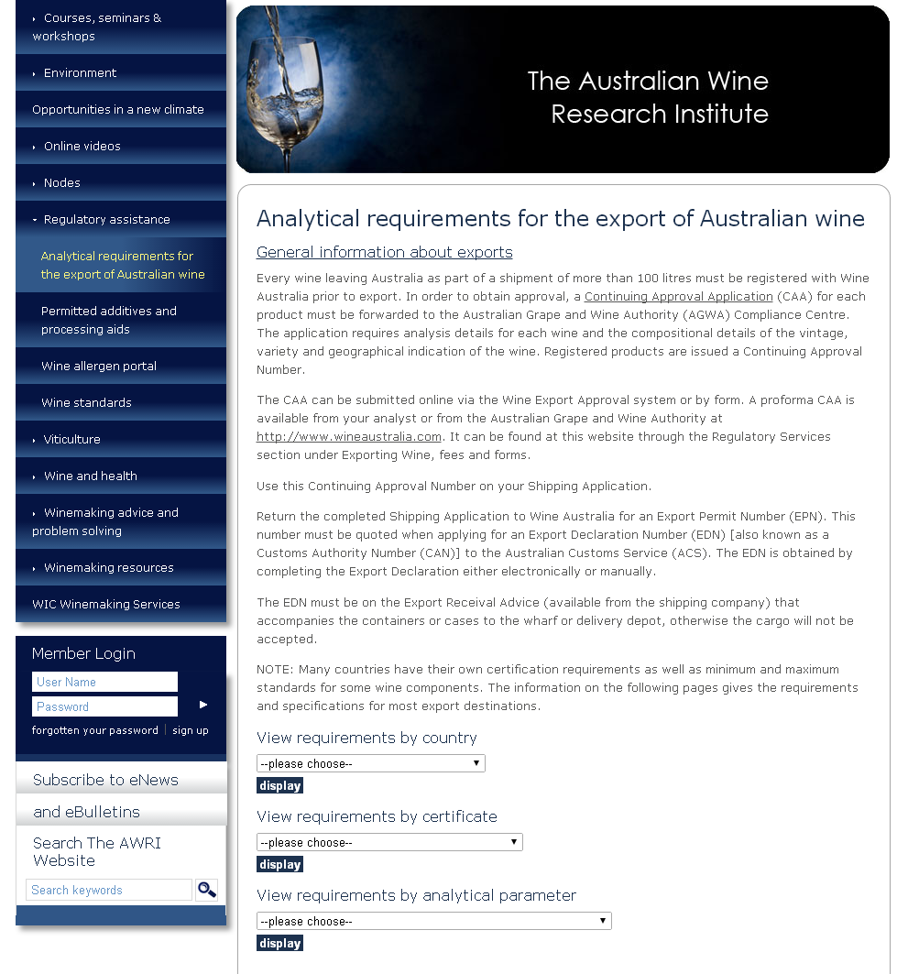
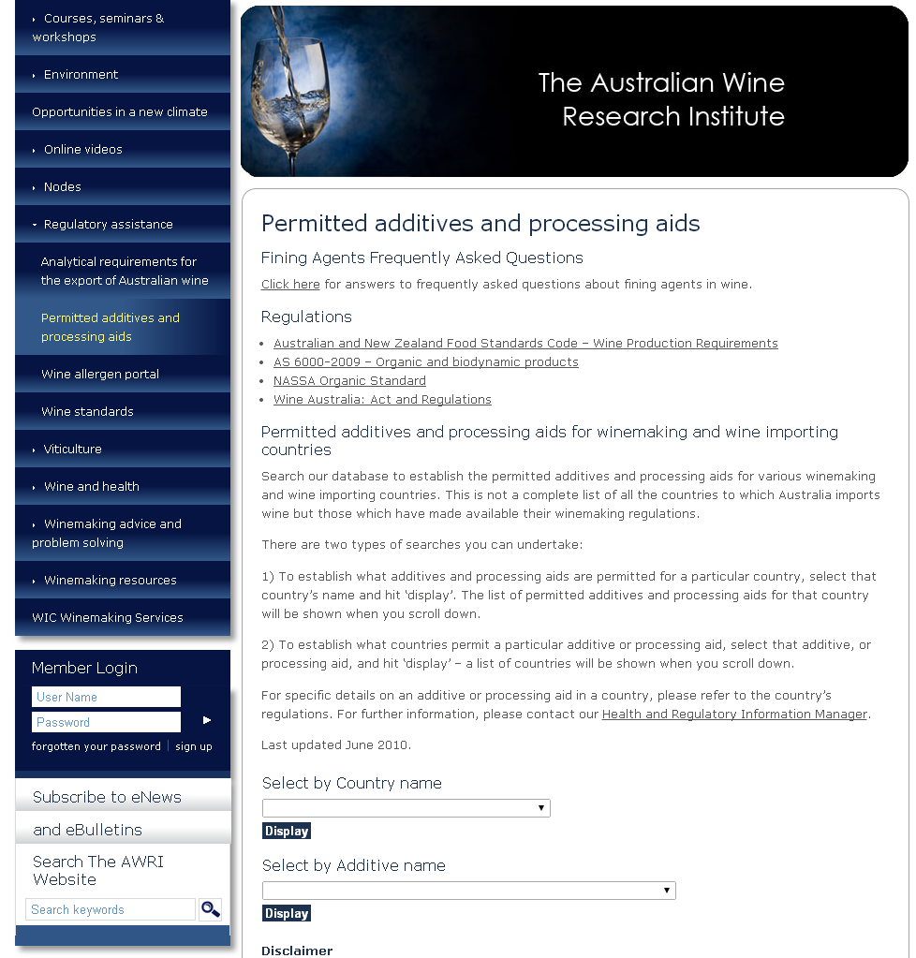
Australian Wine Research Institute (AWRI) Description
A Wine Research Institute based in Adelaide, Australia.
Funded by the Australian industry with a proportion of matching dollars from the government
Offers a two databases for wine: composition limits and additives/processing aid usage limits (permitted processing techniques does not seem to be included).
The Compositional limits database may be found online here: http://www.awri.com.au/industry_support/regulatory_assistance/export_requirements/
The Production processes database (additives and processing aids, but not processing techniques) may be found online here: http://www.awri.com.au/industry_support/regulatory_assistance/additives/

Slide 16
AWRI: Presentation
No access to source documents
No side-by-side comparisons of the rules from different economies.
Designed for users within Australia; only takes account of agreements Australia has entered into with other parties.

Slide 17
AWRI Coverage & Accessibility
Economy | Composition | Production
Australia
Canada | (Ontario/ Quebec)
Chile
China
Hong Kong, China
Indonesia
Japan
Korea
Malaysia
New Zealand
Papua New Guinea
Philippines
Russia
Singapore
Chinese Taipei
Thailand
USA
Viet Nam
Current APEC economy coverage shown.
Databases freely available.
Composition database contains information for 18 of the 21 APEC economies.
Production database contains information for only 6-8 of the 21 APEC economies.
No information on processing techniques.

Slide 18
Labeling
Two online services provide information on labeling:
FIVS-Abridge
TTB
FIVS Abridge seemed to have the greatest potential to play some role in relation the work of the APEC WRF. See the full report for more information on the TTB resource.

Slide 19
FIVS-Abridge: Scope
Provisions from different economies may be compared side by side.
The information available includes the following:
Mandatory Elements: Alcohol Statement, Allergen Labeling, Expiry Date Labeling, Blends, Country of Origin, Legibility and type size, Lot number, misleading claims, Name and address of responsible parties, Product name or description, Standard drink, Volume statement, Warning or advisory statements.
Voluntary Elements: Brand name, Geographical indications/Appellations of origin, Health claims, Medals and awards, Traditional expressions or terms of quality, Grape variety indications (single, dual, multiple), Vintage year, Label approval

Slide 20
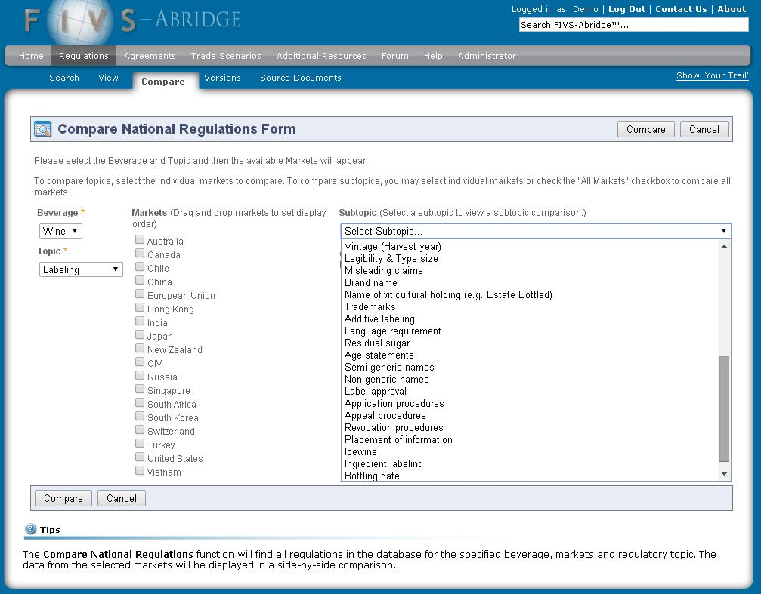
FIVS-Abridge Scope
The wine labeling requirements are quite comprehensive.
Provisions from different economies may be compared side by side.
The information available includes the following:
Mandatory Elements: Alcohol Statement, Allergen Labeling, Expiry Date Labeling, Blends, Country of Origin, Legibility and type size, Lot number, misleading claims, Name and address of responsible parties, Product name or description, Standard drink, Volume statement, Warning or advisory statements.
Voluntary Elements: Brand name, Geographical indications/Appellations of origin, Health claims, Medals and awards, Traditional expressions or terms of quality, Grape variety indications (single, dual, multiple), Vintage year, Label approval

Slide 21
FIVS-Abridge: Coverage
FIVS-Abridge currently contains information on wine labeling requirements for 12 APEC economies:
Australia; Canada; Chile; China; Hong Kong, China; Japan; New Zealand; Russia; Singapore; Korea; United States; Viet Nam

Slide 22
Food Safety & Labeling Summary
 | FIVS-Abridge | AWRI | TTB | Bryant-Christie | NETVS | Ship Compliant
Composition Data | 10 | 18 | Some coverage (up to 16) | No | Unknown
Production Data | 11 | 6 | Some Coverage (up to 16) | Yes (additives), No (processing aids)- 15 | Unknown
Processing Technique Data | ~11 |  |  |  | Unknown
Labeling? | 12 |  | Some Coverage (up to 16) |  | Unknown | Some
Source Document Access? |  |  | Some |  | Unknown | Some
International Scope?
Grape Wine
Fruit and Rice wines |  |  |  |  | Unknown
Ability to compare economies | Yes |  |  |  | Unknown
Frequent updating | Yes | Yes(composition), No (production)
Freely accessible |  |  |  | Unknown
(Numbers refer to APEC Economies)

Slide 23
Food Safety and Labeling - Conclusions
FIVS-Abridge seems well suited to play a role relating to the APEC WRF Compendia, assuming issues of accessibility to the database can be resolved. Its structure should be able to contain fruit and rice wine data also.
The two AWRI databases are useful additional resources in this area.

Slide 24
Pesticides
A separate set of databases is dedicated to pesticide MRLs.
In some cases, these are produced by the same organizations studied previously:
Bryant Christie International
AWRI
Codex Alimentarius
EU Commission Pesticide MRL.
The Bryant Christie product seems to be most promising. The others are covered in more detail in the report.

Slide 25
Bryant Christie Chemical Residues Database: Description
Bryant Christie International maintains the USDA-FAS supported database of pesticide and veterinary drug MRLs which can be found online here: http://www.mrldatabase.com.

Slide 26
Bryant Christie Chemical Residues Database: Scope
Comprehensive tool (from a US perspective) which can be queried to identify which pesticides are permitted on which crops and what the applicable MRL is.
Comparative information for same substance in different crops/markets returned.
Relevant Codex Alimentarius MRLs included.

Slide 27
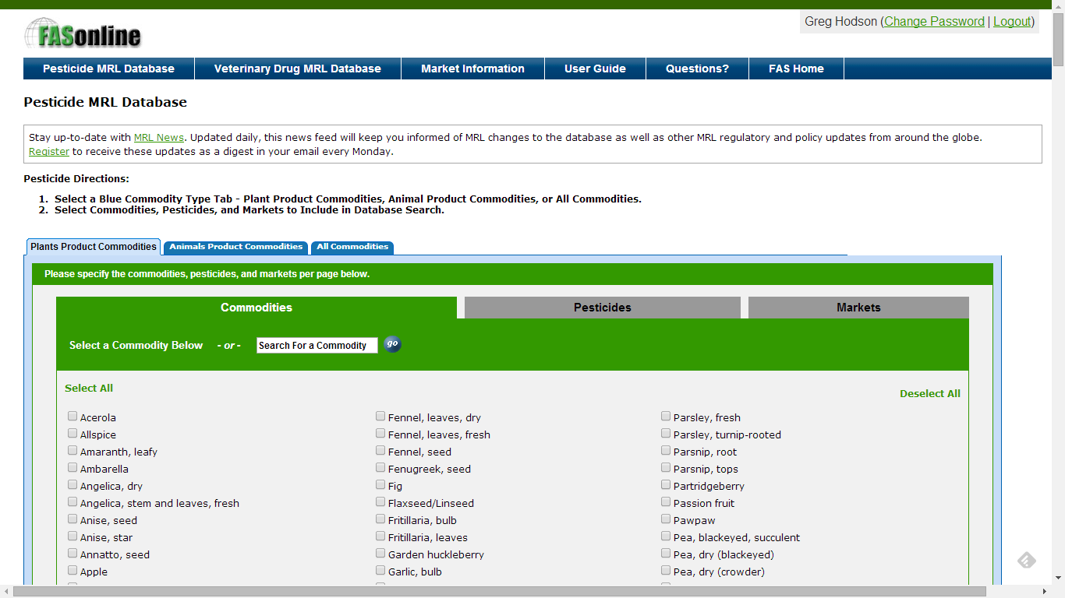

Slide 28
Bryant Christie Chemical Residues Database: Coverage & Accessibility
Comprehensive: MRLs for about 352 different pesticides on around 635 crops
20 APEC economies included:
Australia; Brunei; Canada; Chile; China: Hong Kong, China; Indonesia; Japan; Korea; Malaysia; Mexico; New Zealand; Peru; Philippines; Russia; Singapore; Chinese Taipei; Thailand; United States; Viet Nam
Freely available.

Slide 29
Pesticide Databases: Summary
 | Bryant Christie | AWRI | Codex | EU
# of APEC economies covered | 20 | 17 | 0 | 0
Source Document Access?
International Scope? | Yes (US perspective) | Yes (Australian perspective)
Grape Wine
Fruit and Rice wines
Ability to compare economies
Frequent updating |  |  | n/a
Freely accessible

Slide 30
Pesticide Databases - Conclusions
The most suitable product would appear to be that maintained by Bryant-Christie International but supported by the USDA, assuming that it could be expanded so contents are not restricted to a US-only perspective.

Slide 31
Overall Conclusions
No single database contains information on all the areas covered by the APEC Compendia, or could realistically serve as a repository for all the information.
Some existing tools look promising as means to complement the existing compendia and/or to serve as repositories for them going forward.
Grape wine regulation databases should be able to host information for fruit and/or rice wines.
It is more efficient to attempt to work with existing products than to build new ones.

Slide 32
Recommendations
Discussions with the relevant parties may be conducted with a view to co-locating the APEC WRF compendia within appropriate database system(s) as identified in this review:
FIVS-Abridge = Food Safety and Labeling
Certification also?
Bryant-Christie International = Pesticide MRLs

Slide 33
Questions?

